Slide 1
Shipment_Analysis
For Various States Of USA

Slide 2
Team Members:
Akshay Shedge
Pallavi Bidwe
Rutuja Gadge
Shagufta Jahan
Akshay Choudhary
Dhaval Raval
S Sathishkumar
Mentor: Ms. Neha

Slide 3
What is the Business Problem?
An International E-Commerce company (Electronic goods) wants to use some of the most advanced machine learning techniques to analyse their customers with respect to their services and some important customer success matrix.
Objective
As a Data Scientist, they want you to build a model to predict if the shipments are or will reach on time or not.
For this, they want you to use Logit/Probabilistic technique with the most accurate model.

Slide 4
Project Architecture / Project Flow
EDA
Business Objectives
Data Collection
Model evaluation & feedback
Deployment
Final Presentation
Model Building

Slide 5
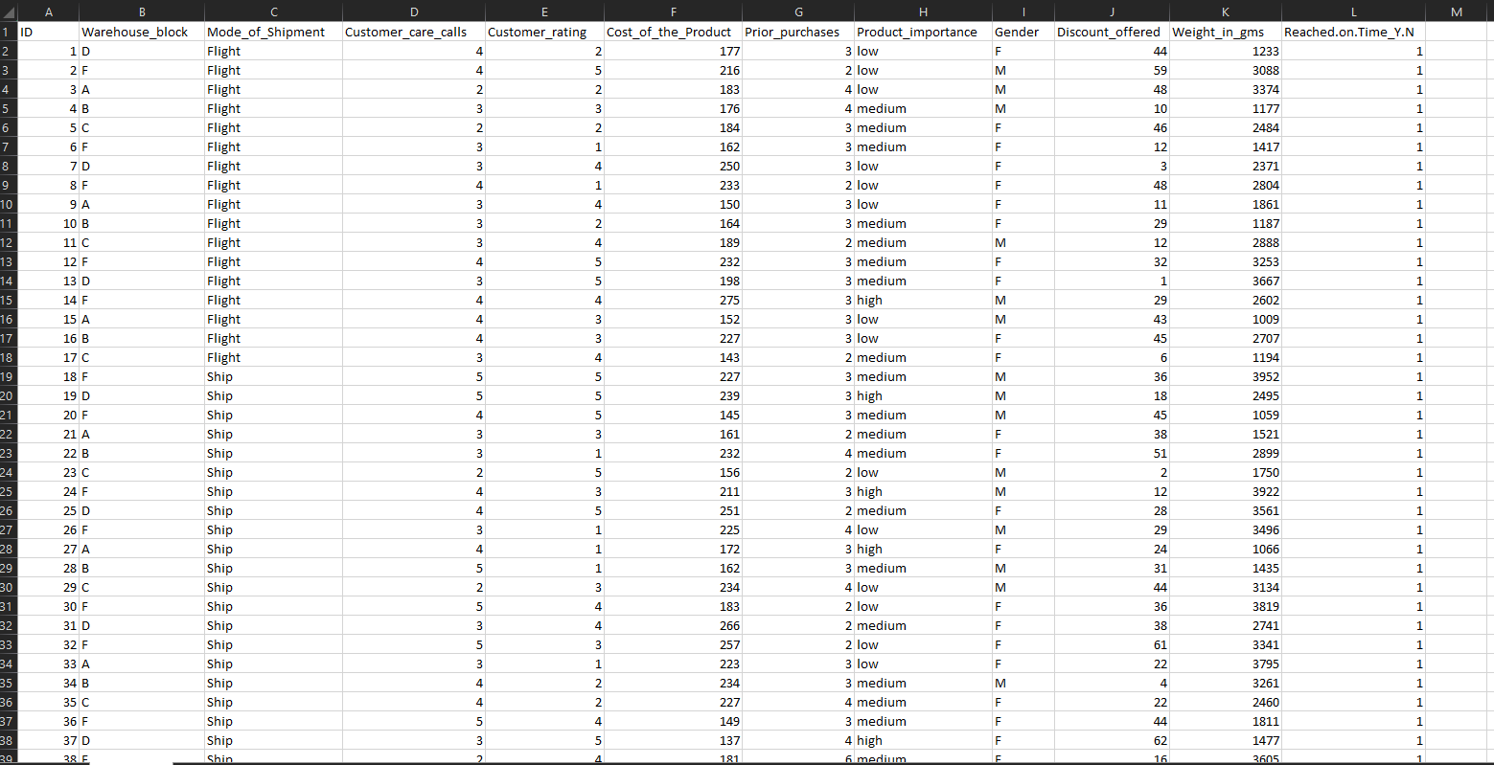
Dataset Overview

Slide 6
Dataset’s Some Column Details
● ID – Id number of the customer
● Warehouse_block - The company has a big warehouse which is divided
in various blocks such as A,B,C,D and so on.
● Mode_of_Shipment - The company ships the products by different modes
of transport such as ship, air and road
● Customer_care_calls - This variable indicates the number of calls made for
enquiry of the shipment.(Sometimes customers make too many calls,
hence the company wants to know that are these customers unknowingly
favoured.
● Customer_rating - The company has rated every customer on various
parameters, 1 being the lowest (Worst), 5 being highest (Best)
● Cost_of_the_Product - It is the cost of the product in USD

Slide 7
● Prior_purchases - This variable indicates the number of prior purchases
● Product_importance - The company has categorised the products in the
range of high, medium and low based on various parameters
● Gender - Male or female
● Discount_offered - It is the percentage of discount offered on that
specific product.
● Weight_in_gms - It is the weight in grams
● Reached.on.Time_Y.N - It is the Y variable, where 1 Indicates that the
product has NOT reached on time and 0 indicates it has reached on
time

Slide 8
Company’s Expectation:
The company operates in various states of USA, but the customer data is only specific to one state in the USA.
The warehouse is located on the eastern part whereas, the state to which
shipments are delivered is at the western part of USA.
As a Data Scientist, they want you to build a model to predict if the shipments are or will reach on time or not.
For this, they want you to use various Logit/Probabilistic techniques
with the most accurate model.

Slide 9
Suggested Models(from Company) for Comparing Accuracy:
1. Logistic Regression
2. Support Vector Machines
3. Random Forest
4. XgBoost or any other boosting technique.

Slide 10
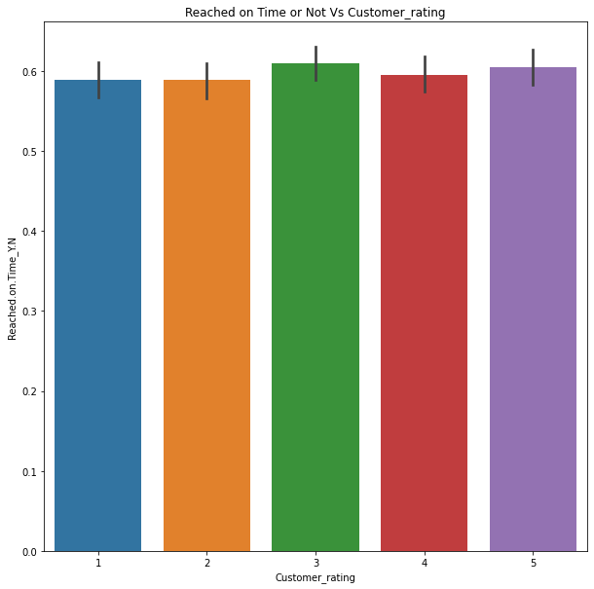
Exploratory Data Analysis (EDA)
Customer_rating vs Reached on.Time_Y.N

Slide 11
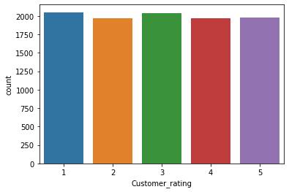
Customer_rating Total Counts

Slide 12
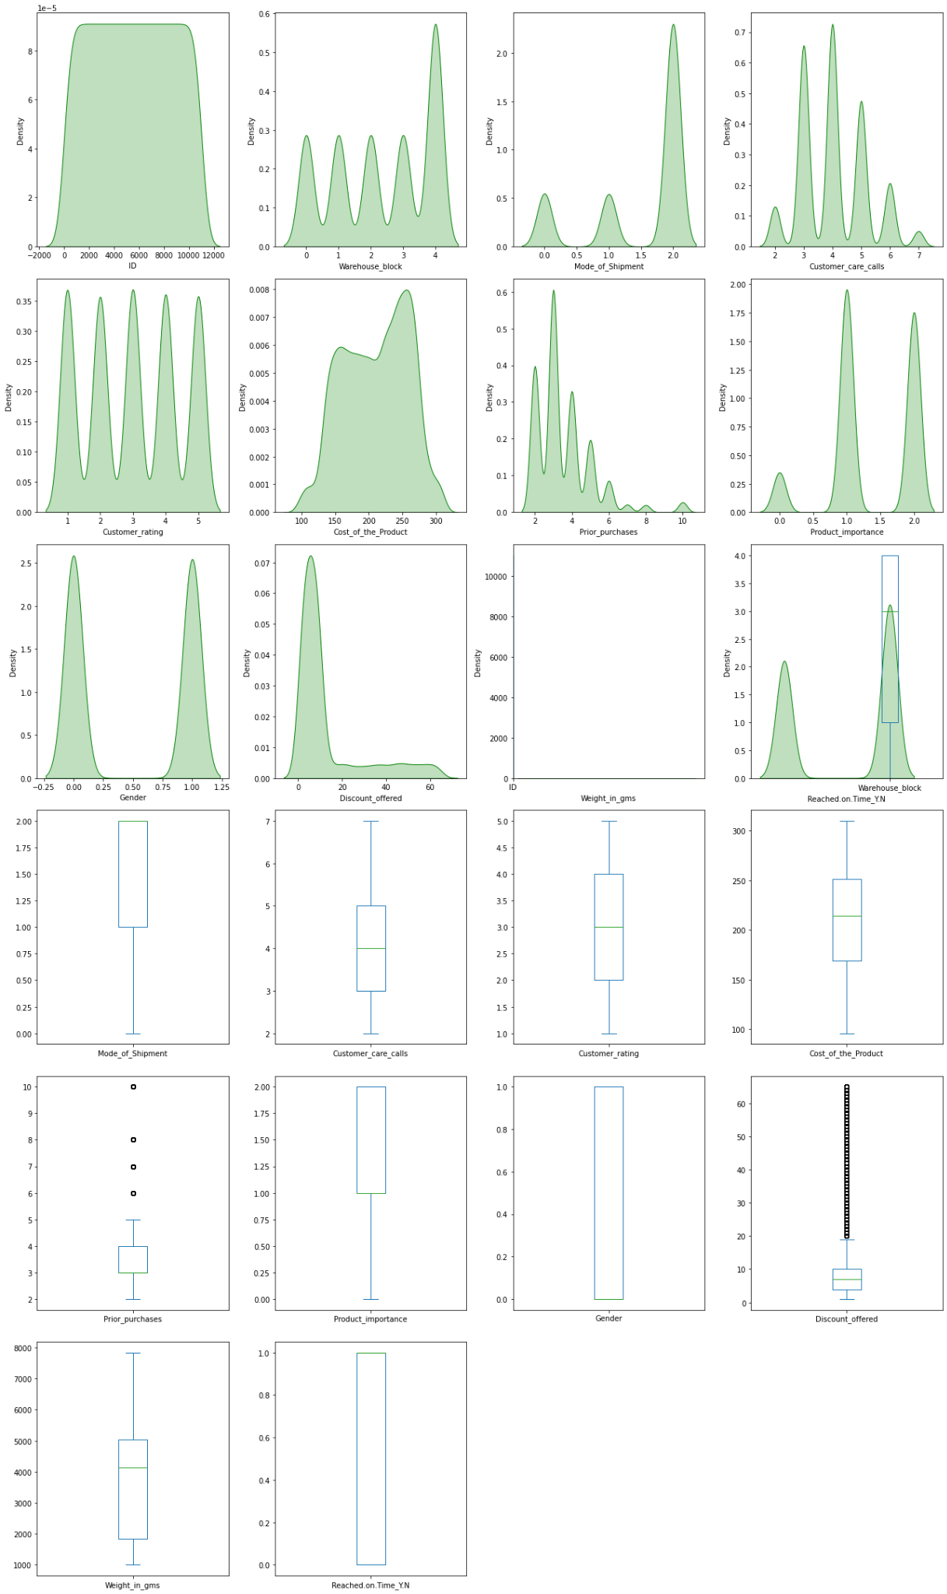
Outliers

Slide 13
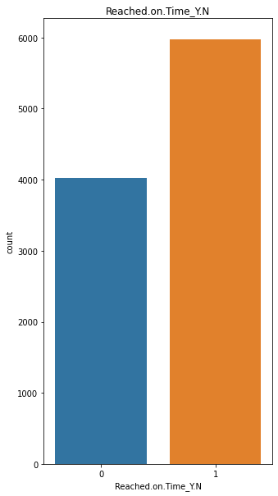
Reached.on.Time_Y.N

Slide 14
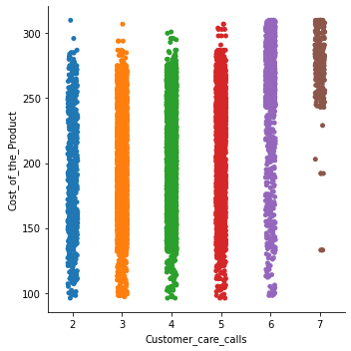
Customer_care_calls vs Cost_of_Product

Slide 15
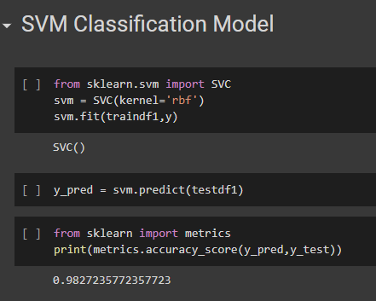
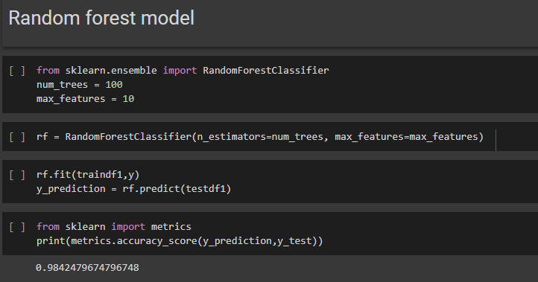
Model Building
Our Model is based on Classification System and have used several models to get
better accuracy for the deployment session.

Slide 16
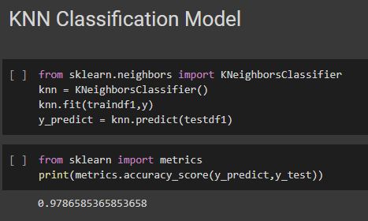
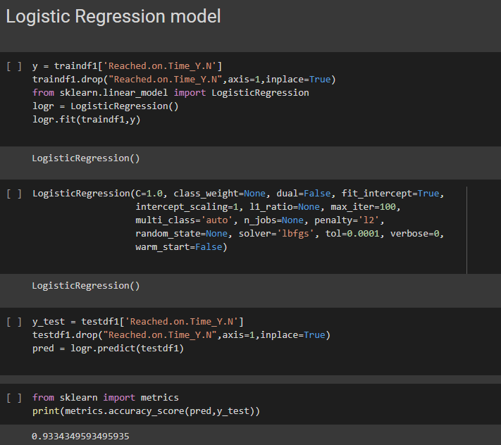

Slide 17
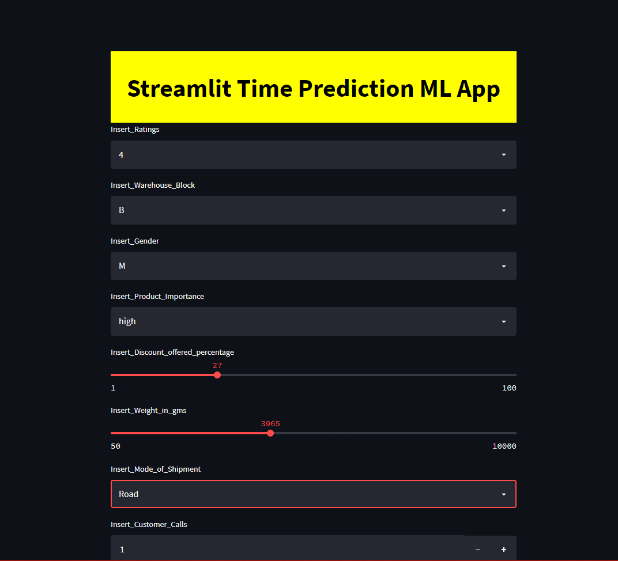
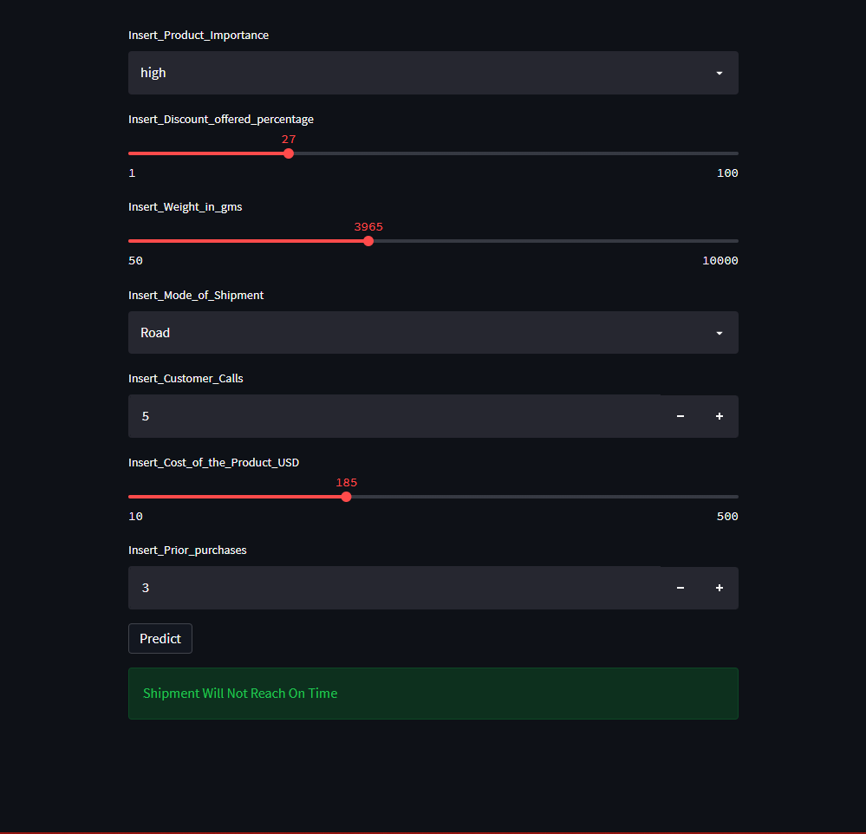
Model Deployment using Streamlit

Slide 18

Model Deployment using Streamlit Video
Deployment is done
using Streamlit.

Slide 19
Thank You!

