Slide 1
Re-selling_Price_ Prediction
For Used European Cars

Slide 2
Team Members:
Akshay Choudhary
Akshay Shedge
Pallavi Bidwe
Rutuja Gadge
Shagufta Jahan
Dhaval Raval
S Sathishkumar
Mentor: Ms. Neha

Slide 3
What is the Business Problem?
Objective
An online used car re-selling company needs to evaluate the used car condition, & accordingly predict the re-selling price of the car.
The task is of evaluating the data collected about the used cars sold in the past, & based on that make predictions for the price of the cars sold in the future. As the first phase we need to develop the proof of concept to make the client understand how effective the feature could be.

Slide 4
Project Architecture / Project Flow
EDA
Business Objectives
Data Collection
Model evaluation & feedback
Deployment
Final Presentation
Model Building

Slide 5
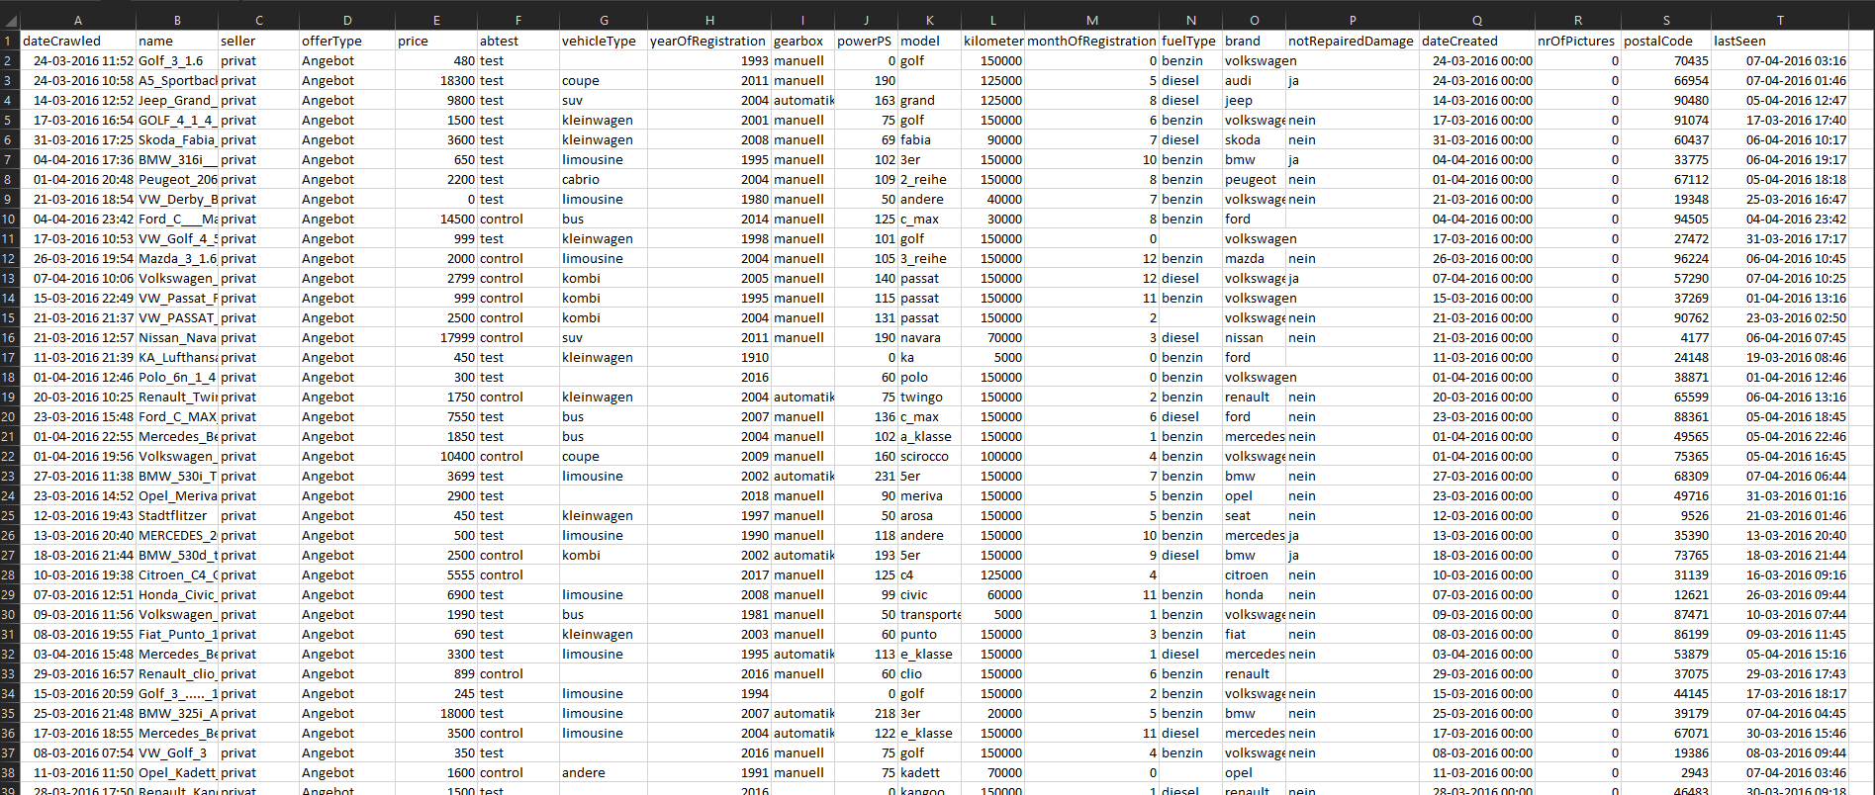
Dataset Overview

Slide 6
Dataset was extraction was done through kaggle.com .
There are around 3.8L rows and 22 columns (Before EDA).
Column names are:
'dateCrawled', 'name', 'seller', 'offerType', 'price', 'abtest', 'vehicleType', 'gearbox', 'powerPS', 'model', 'kilometer', 'monthOfRegistration', 'fuelType', 'brand', 'notRepairedDamage', 'dateCreated', 'nrOfPictures', 'postalCode', 'lastSeen', 'Car_age'.

Slide 7
Dataset’s Some Column Details
Name:- Indicates the full name of the car
Price :- This column indicates the current price of the second hand car
Abtest:- This column indicates that similar variant of the car being used to determine the experience of the user
VehicleType:- This column indicates the type of car whether it is limousine , a suv , bus etc.
Year of registration:- Indicates the year in which the car was registered
Gearbox:- Indicates whether the car has an manual gearbox or automatic
Powerps:- indicates the power of the vehicle which is the metric measure of horsepower
Model:- indicates the model of the brand
Kilometer:- indicates how long the car has been driven
Fueltype:- indicates the type of fuel whether diesel or petrol(benzin)
Brand:- indicates the brand of the vehicle

Slide 8
Exploratory Data Analysis (EDA)

Slide 9
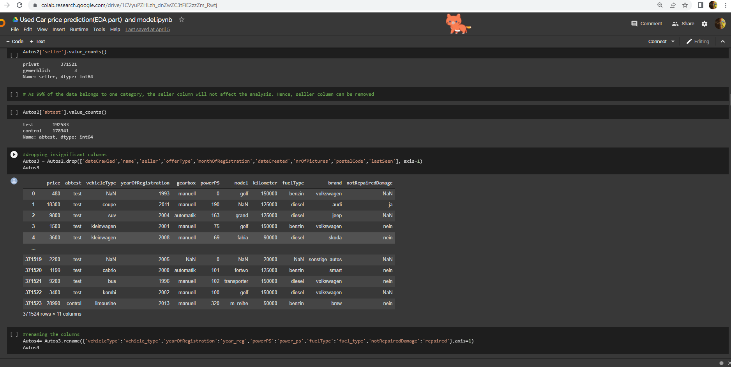
Deleting unnecessary columns

Slide 10
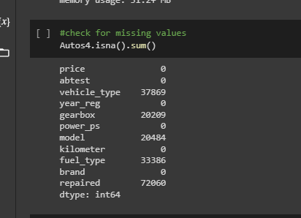
Checking for Nan Values

Slide 11
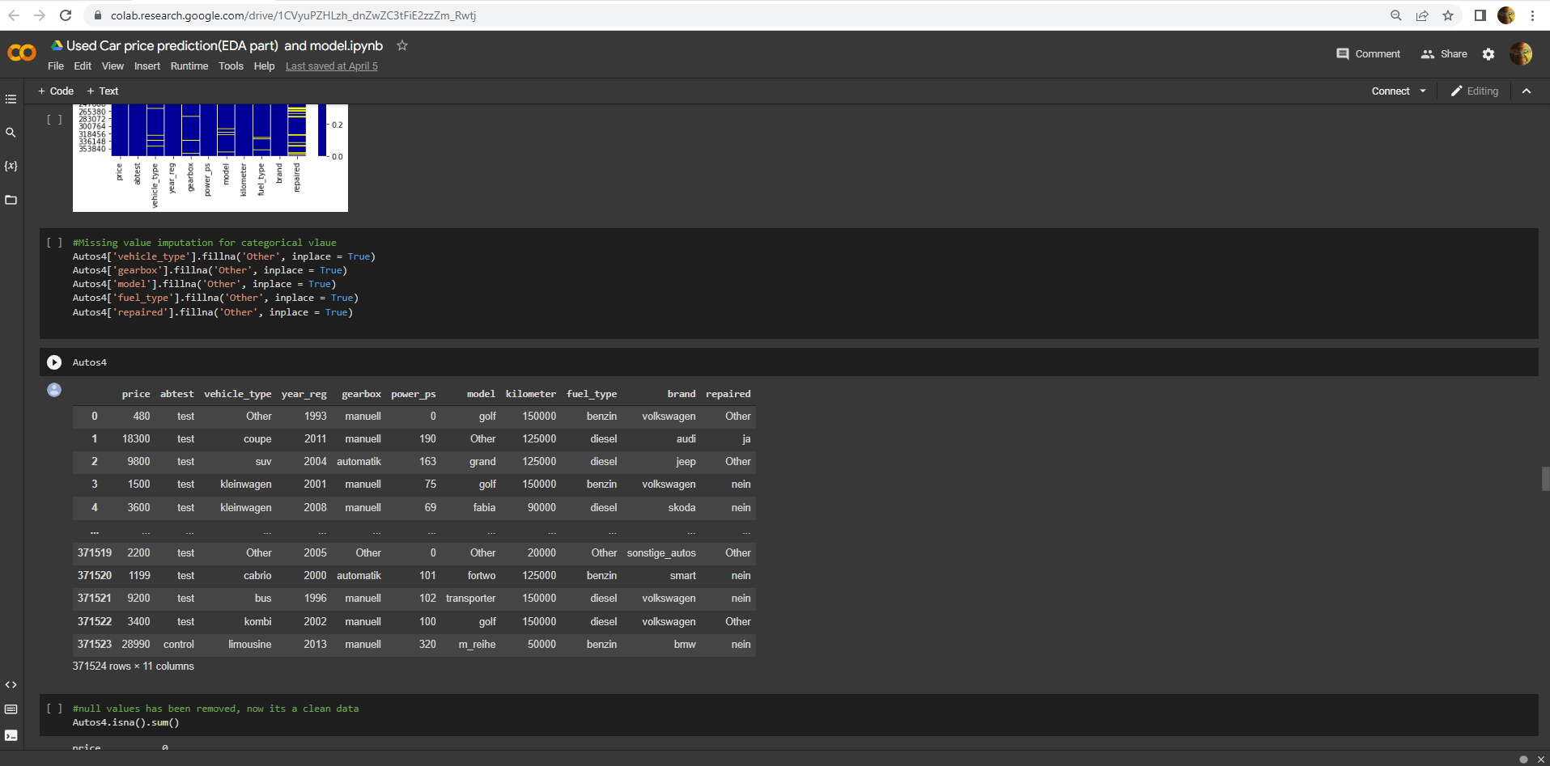
Replacing nan Values
We have replaced nan values with others

Slide 12
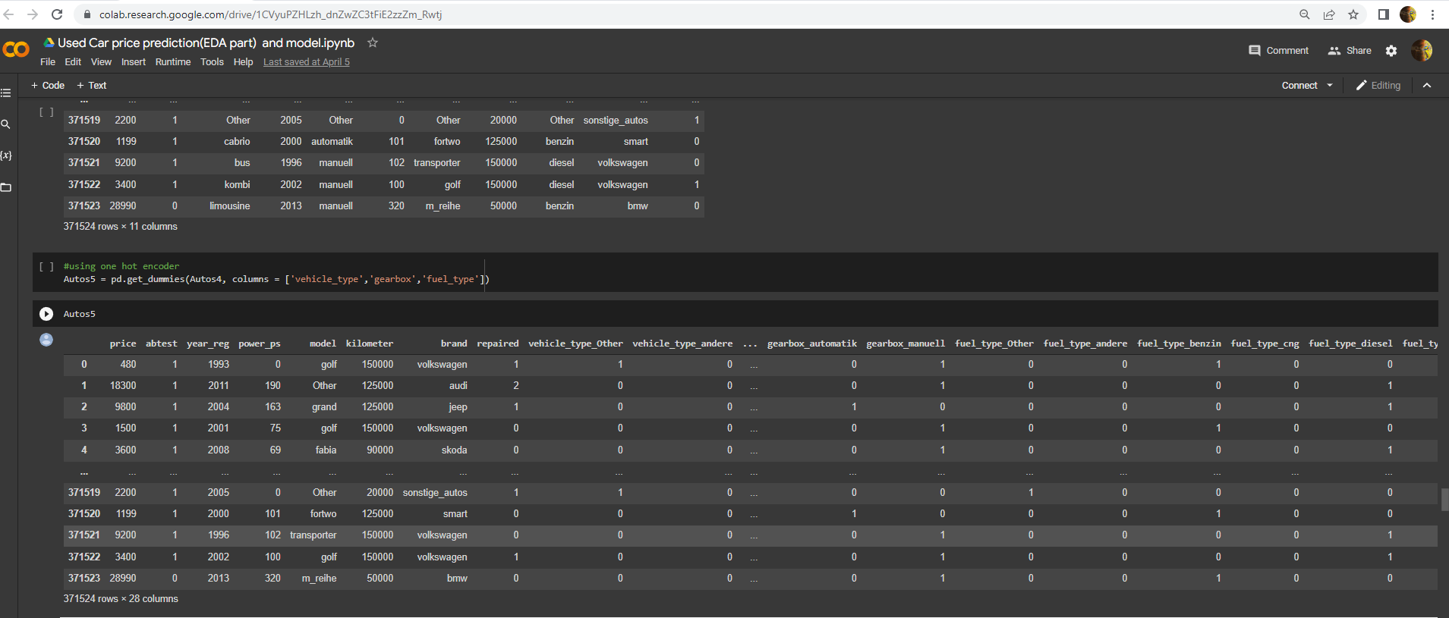
Creating dummy variables

Slide 13
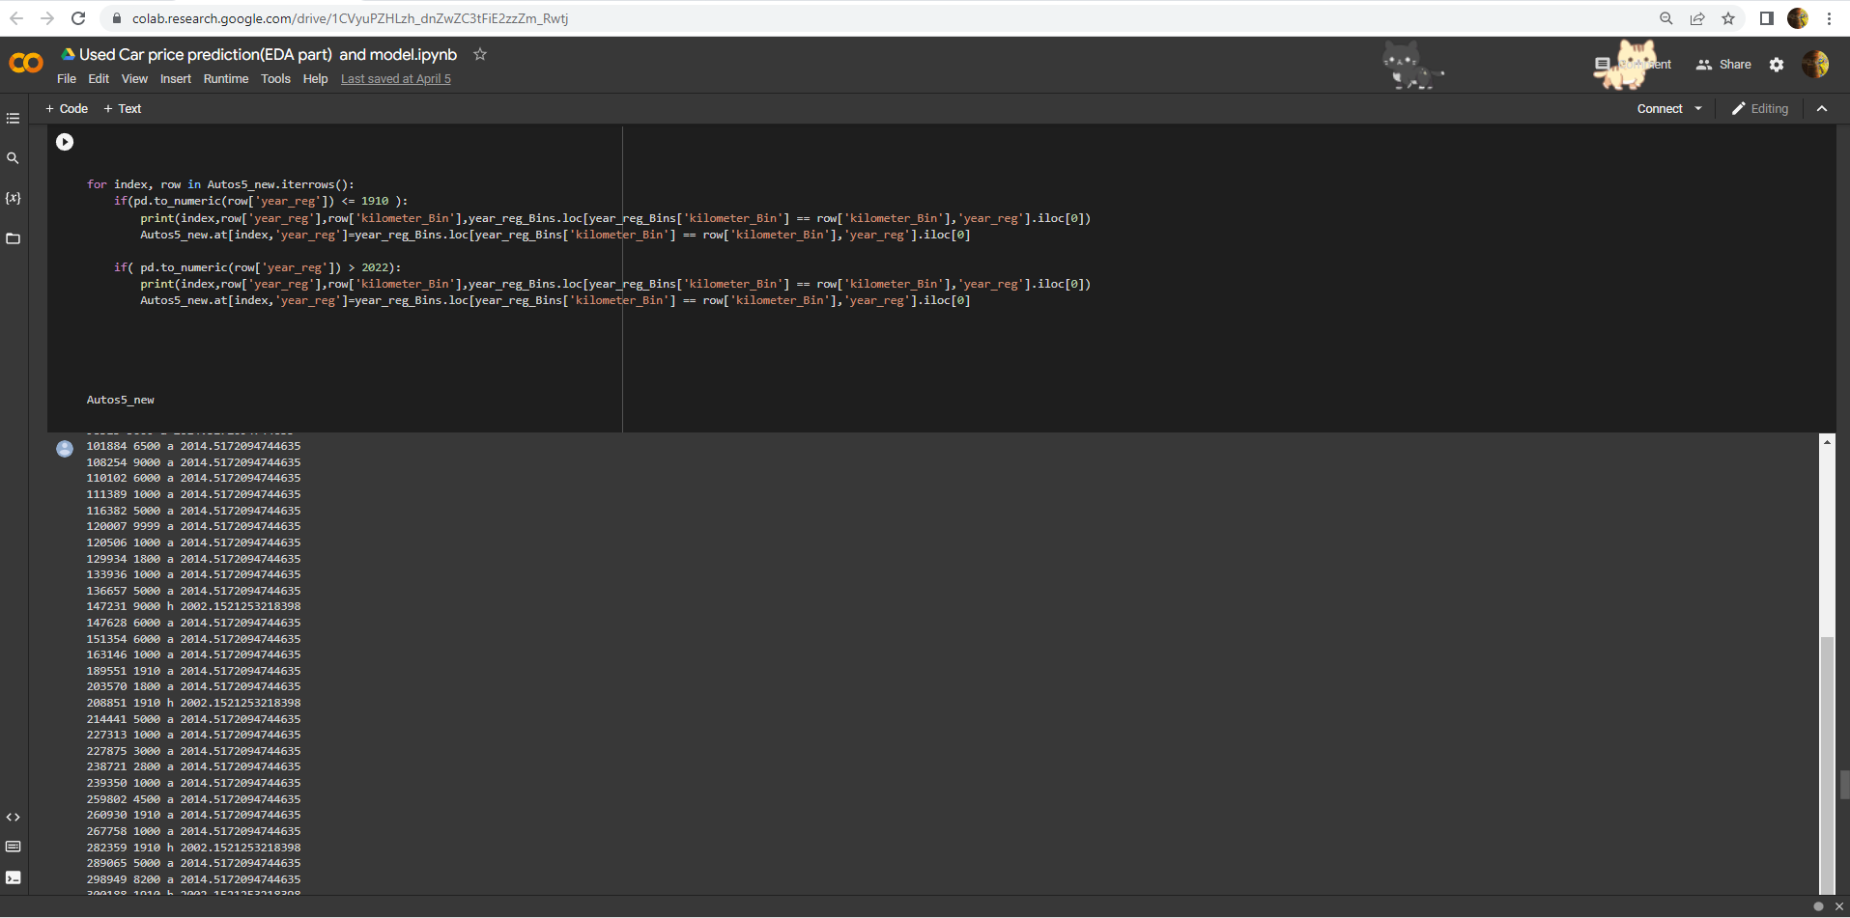
Missing Value imputation of date using kilometer

Slide 14
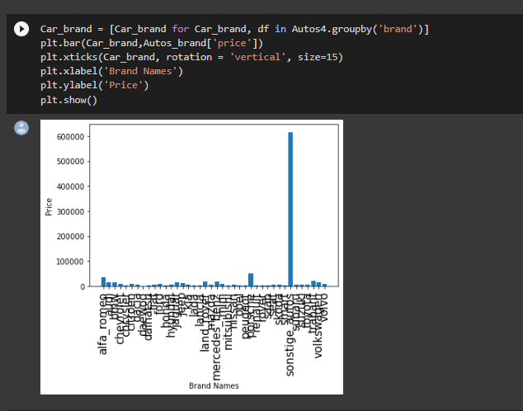
Data Visualisation
The data indicates the price variance of all brands of car

Slide 15
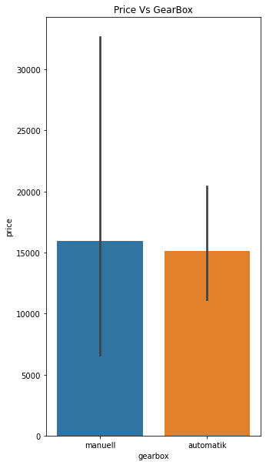
Boxplot for Price Vs GearBox

Slide 16
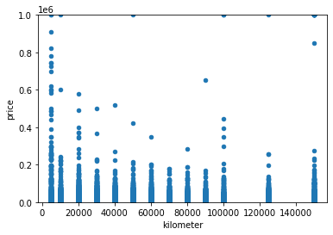
Scatter plot for Price according to Kilometer

Slide 17
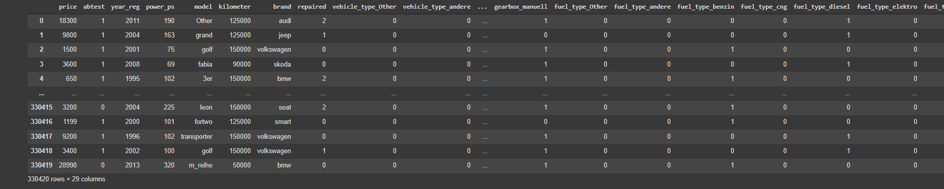
Dataset After Eda

Slide 18
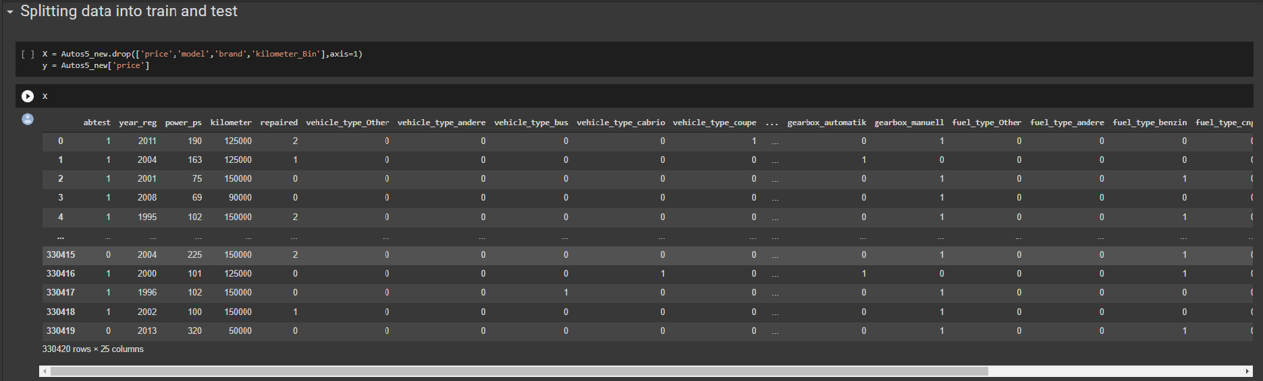
Training and test Data
Evaluating X and y variable before the split

Slide 19
Model selection and accuracy

Slide 20
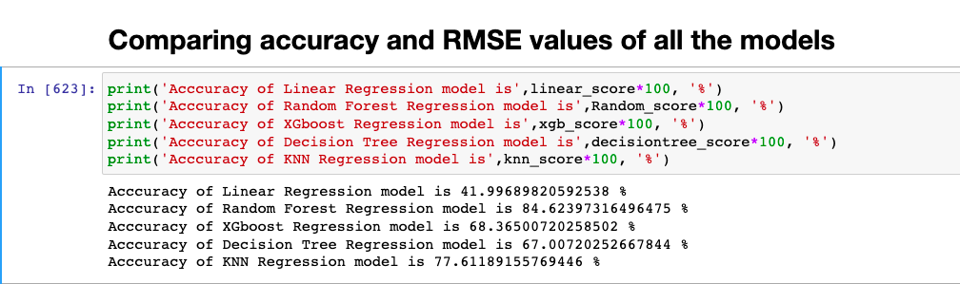
Comparing values of different Models

Slide 21
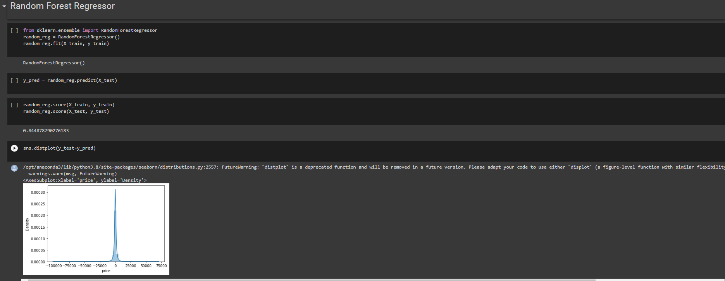
Random forests model model code

Slide 22
Model Deployment

Slide 23
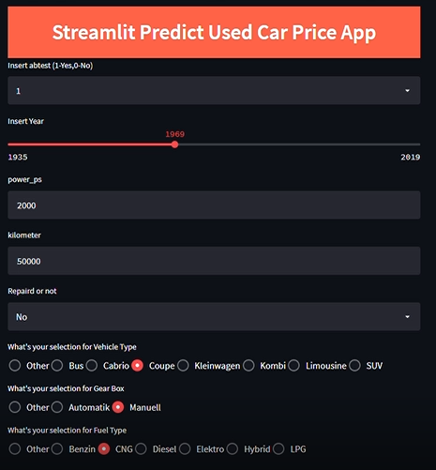
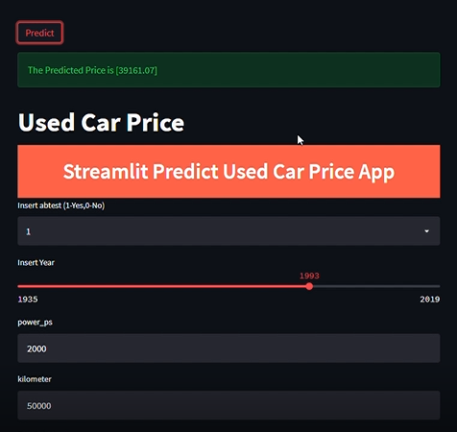
Model Deployment using Streamlit

