Slide 1
Data Visualization

Slide 2
Number of NULL values of different
AUSTRALIA 198
EURO AREA 198
NEW ZEALAND 198
UNITED KINGDOM 198
BRAZIL 198
CANADA 198
CHINA 197
HONG KONG 198
INDIA 199
KOREA 198
MEXICO 198
SOUTH AFRICA 198
SINGAPORE 198
DENMARK 198
JAPAN 198
MALAYSIA 198
NORWAY 198
SWEDEN 198
SRI LANKA 198
SWITZERLAND 198
TAIWAN 201

Slide 3
We have the exchange rates of the following countries
AUSTRALIA
EURO AREA
NEW ZEALAND
UNITED KINGDOM
BRAZIL
CANADA
CHINA
HONG KONG
INDIA
KOREA
MEXICO
SOUTH AFRICA
SINGAPORE
DENMARK
JAPAN
MALAYSIA
NORWAY
SWEDEN
SRI LANKA
SWITZERLAND
TAIWAN

Slide 4
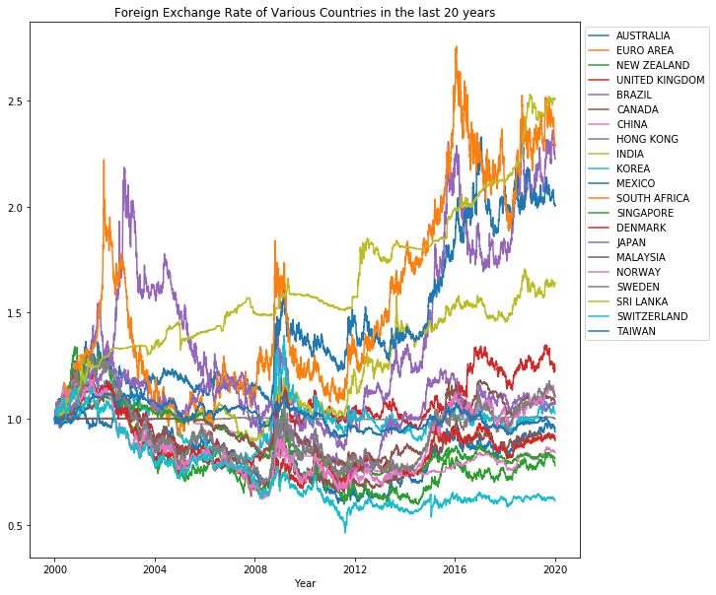
Foreign Exchange Rates
For all the given
Countries w.r.t USD from
2000 to 2019

Slide 5
From 2000 To 2009

Slide 6
14 countries' currencies have shown appreciation. They are:
7 countries' currencies have shown depreciation.
They are:
AUSTRALIA
EURO AREA
NEW ZEALAND
BRAZIL
CANADA
CHINA
SINGAPORE
DENMARK
JAPAN
MALAYSIA
NORWAY
SWEDEN
SWITZERLAND
TAIWAN
UNITED KINGDOM
HONG KONG
INDIA
KOREA
MEXICO
SOUTH AFRICA
SRI LANKA

Slide 7
From 2010 To 2019

Slide 8
18 countries' currencies have shown depreciation. They are:
AUSTRALIA
EURO AREA
NEW ZEALAND
UNITED KINGDOM
BRAZIL
CANADA
CHINA
HONG KONG
INDIA
KOREA
MEXICO
SOUTH AFRICA
DENMARK
JAPAN
MALAYSIA
NORWAY
SWEDEN
SRI LANKA
3 countries' currencies have shown appreciation. They are:
SINGAPORE
SWITZERLAND
TAIWAN

Slide 9
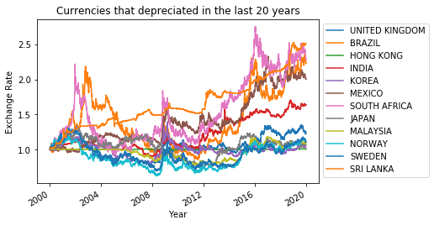
Overall
12 countries' currencies have shown depreciation. They are:
UNITED KINGDOM
BRAZIL
HONG KONG
INDIA
KOREA
MEXICO
SOUTH AFRICA
JAPAN
MALAYSIA
NORWAY
SWEDEN
SRI LANKA

Slide 10
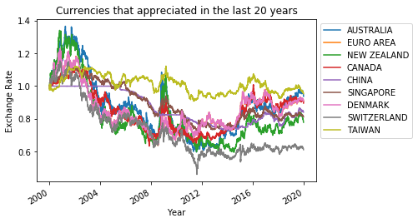
Overall
9 countries' currencies have shown appreciation. They are:
AUSTRALIA
EURO AREA
NEW ZEALAND
CANADA
CHINA
SINGAPORE
DENMARK
SWITZERLAND
TAIWAN

Slide 11
Overall
11 regions which appreciated then depriciated:
AUSTRALIA
EURO AREA
NEW ZEALAND
BRAZIL
CANADA
CHINA
DENMARK
JAPAN
MALAYSIA
NORWAY
SWEDEN
0 regions depriciated then appreciated:
7 regions depreciated continuously:
UNITED KINGDOM
HONG KONG
INDIA
KOREA
MEXICO
SOUTH AFRICA
SRI LANKA
3 regions appreciated continously:
SINGAPORE
SWITZERLAND
TAIWAN

Slide 12
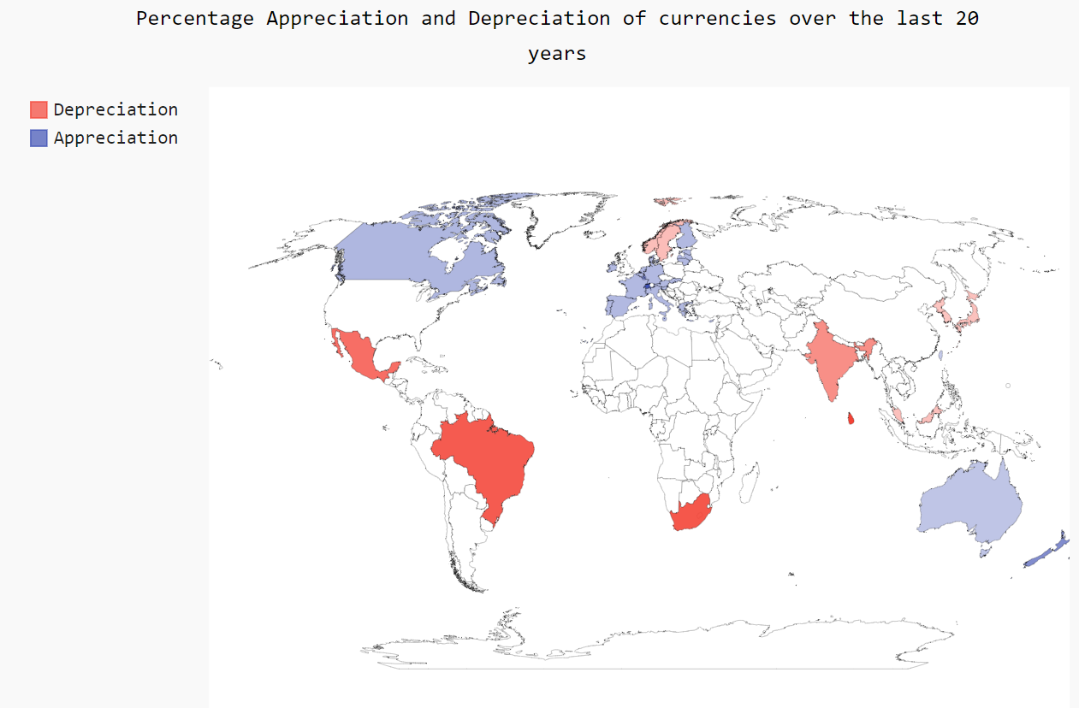

Slide 13
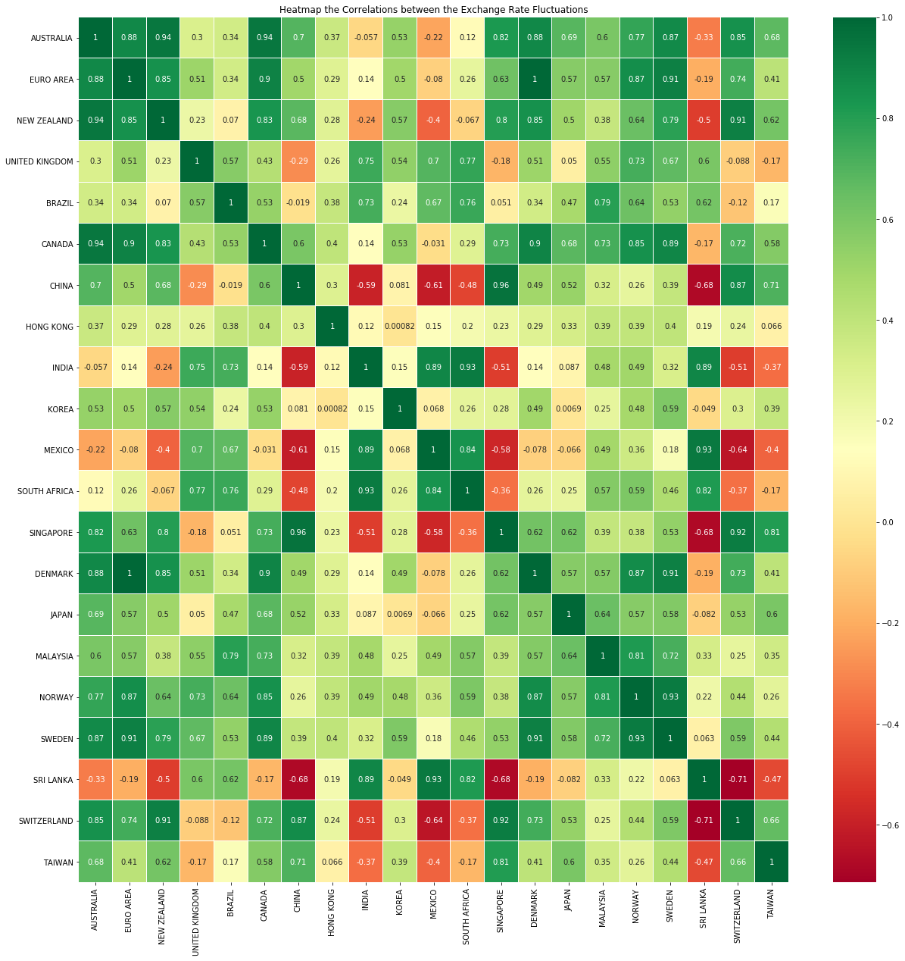
Pearson correlations among the given currencies

Slide 14
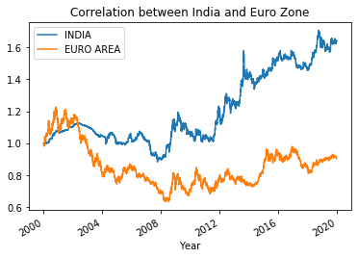
Similarly, relations between any two currencies can be drawn

Slide 15
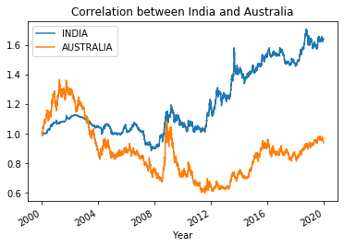
Similarly, relations between any two currencies can be drawn

Slide 16
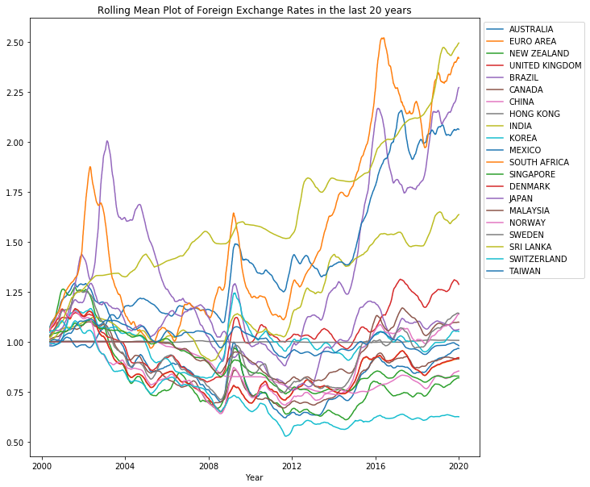

Slide 17
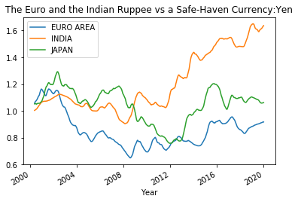

Slide 18
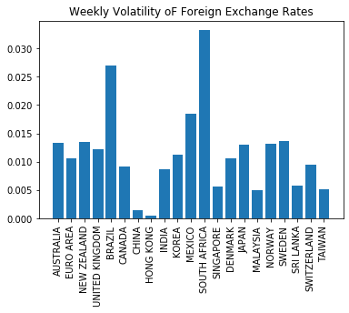

Slide 19
