Slide 1
Operating Theme Park
Team Name: CodesMent
Team Members: Harsh Ajay
Laxit Khanpara
Ruttvik Padhara
Dhaval Bavda
Aagam Shah
Name of the mentor: N Narshimha Pillai
06 August 2024

Slide 2
The Problem Statement
Running a theme park is complicated and requires careful management to make sure visitors have a great time. This project is important because it helps improve how the park operates and serves guests, making their experience enjoyable and stress-free.
Solving this problem is tough because it involves handling many services and a lot of visitors while keeping everything smooth and secure.
We addressed these challenges by creating an easy-to-use interface with React, providing clear instructions, and gathering feedback from real users to make improvements. Using advanced technology helped us build a reliable and efficient system for managing the park.
About the project
Notes:
Notes:
In this session we look back at MPI Modules 4-6 and explore the concepts in more detail through the lens of some of the readings
Let’s get started

Slide 3
Objectives
Objectives
Deliver a high-quality website
Meet all functional requirements
Efficient Operations
Sustainable Benefits
Increased visitor satisfaction
Improved operational efficiency
Enhanced Park management capabilities
Improved Customer Engagement
Establish a Strong Online Presence
Economic Growth
Objectives

Slide 4
Deliverables
Product: A high-quality, user-friendly website for the theme park built on the MERN stack (MongoDB, Express.js, React.js, Node.js)​
Publication: Detailed documentation outlining the development process, challenges faced, and solutions implemented.
Service: Online ticket purchasing, ride information and feedbacks, food menu management , Event Management, Park’s Feedback.
Outcome:
Improved operational efficiency by streamlining ticket sales and visitor management​
Greater visibility and online presence for the theme park
Deliverables

Slide 5
Our Work:
Provides a fully integrated platform where visitors can purchase tickets, access ride information, and avail special offers all in one place. The website also includes features for feedback and review
Optimized for high performance and reliability, ensuring smooth operation even under heavy traffic. Security measures are robust, protecting user data and transactions.
Other Work:
Often limited to basic ticket sales and static information pages without interactive or personalized features.
May struggle with performance issues during peak times and often lacks comprehensive security protocols.
Background
Notes:
Notes:
In this tutorial we will work through each of the three resources allocated as 30min exercises.
Working in groups with the provided guiding questions you will collate your thoughts and reflections from reading the paper and organize these thoughts in the light of the module’s perspective.
So, for the first module you will take the orientation that the module discusses and contemplate the learnings and meanings identified within the reading from this orientation
Once every group has had a chance to discuss and capture their thoughts, we will share these in short presentations to examine the depth and diversity of views from within the group.

Slide 6
Project Research and Initiation
Project Research
Target Audience Identification
Consumer Behaviour Analysis
Stakeholder Identification
Work breakdown structure and task allocation among team members
Project Research
Project Management
Design UI/UX and Frontend
Backend Development
Deployment
Project Research and Initiation
Notes:
Notes:
Take each of the questions shown on the slide and answer them individually.
Discuss with your peers your thoughts. Are there consensus positions within the group?
If there are multiple viewpoints or different aspects of the work that are interesting, challenging, or “aha moments” for people please consider why the importance of these attributes may be different for different people

Slide 7
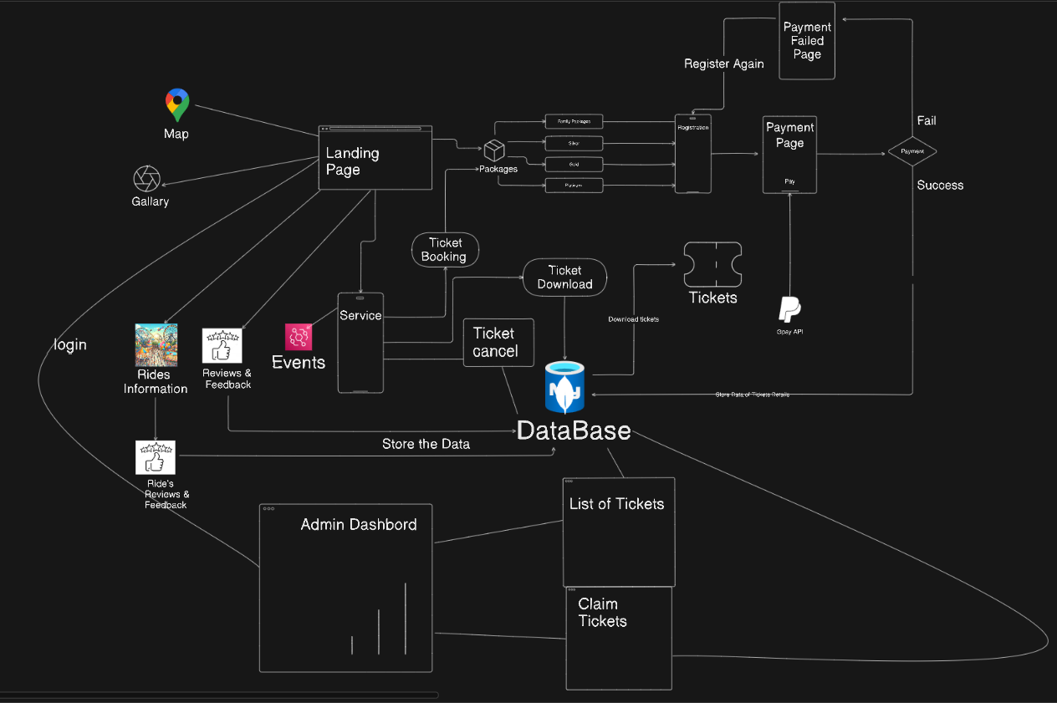
System Diagram
Project Development Cycle

Slide 8
Project Development Cycle: Technologies Used
MERN Stack (Our Chosen Technology)
Pros: MERN stack is a complete development environment that offers flexibility, scalability, and a large community of developers who can help.
Cons: It requires knowledge of multiple technologies, and new developers might need time to learn it
LAMP Stack (Linux, Apache, MySQL, PHP)
Pros: LAMP stack is a well-established way to build websites, and many developers are familiar with PHP.
Cons: It might not be as scalable as Node.js, and PHP can have security issues if not used carefully.
Python Django
Pros: Django is a popular web framework for building dynamic websites and web applications with Python.
Cons: Django might not be able to handle high-traffic websites as efficiently as other technologies, which could be a concern for a theme park website that expects a large number of visitors.
Project Development Cycle

Slide 9
Project Development Cycle: Project Execution
1. Project Management
Planning and Coordination
Risk Management
2. Design UI/UX and Frontend Development
UI/UX Design
Frontend Development Using REACT
3.Backend Development
Ticket Booking System
Food Menu Integration
Rides and Packages Related Information System
Upcoming Events
4.Deployment
Testing and Assurance
Launching
Project Development Cycle

Slide 10
Project Development Cycle:
Risks
Downtime due to server failures, network issues, or software bugs can result in service interruptions.
Challenges
Loss of revenue, customer dissatisfaction, operational delays.
Development problems, suboptimal performance.
Mitigation
Ensure proper version compatibility and testing, Follow best practices for integration.
Project Development Cycle

Slide 11
Project Development Cycle: Change management
1. Parking System (Removed)
2. Ride Count System (Removed)
3. Map Integration (Removed)
Reason for Change: Due to time constraints and a shift in project priorities, it was decided to defer these implementation to a future phase.
Impact on Project:
Time: The removal allowed the team to focus on other features.
Effort: The team's workload was optimized, reducing complexity and allowing for better quality in other deliverables.
Project Development Cycle

Slide 12
Project Development Cycle: Testing
Unit Testing: Conducting unit tests to verify the functionality of individual components.
Integration Testing: Performing integration tests to ensure that different parts of the system work together as expected.
End-to-End Testing: Carrying out end-to-end tests to validate the entire user journey from start to finish.
Project Development Cycle

Slide 13
Project Development Cycle: Future Work
Expansion of the Ecosystem: Integrating third-party services, such as food ordering, merchandise shops, or partnerships with local businesses, to create a comprehensive ecosystem.
Adding of Features: Parking System, Ride Count System, Map Integration.
Project Development Cycle

Slide 14
Project Development Cycle: Conclusions and Summary
The development of the theme park management system was a complex yet rewarding project that aimed to enhance the user experience and operational efficiency of the park. Throughout the project, various modules were designed and implemented, including frontend and backend development, integration of payment gateways, and user interaction features such as ride feedback and ticket booking systems.
Live Link: https://themeparkcodesment.netlify.app/
Backend Api: https://waterpark.onrender.com
Repository URL: https://github.com/laxitkhanpara/WaterPark
Project Development Cycle

Slide 15
Project Development Cycle: Lessons learnt
Impact
Educational Impact
Social Impact
Learnings from Project Development
Technical Skills
Project Management
Collaboration and Soft-Skills
Problem-Solving
Project Reflection

