Slide 1
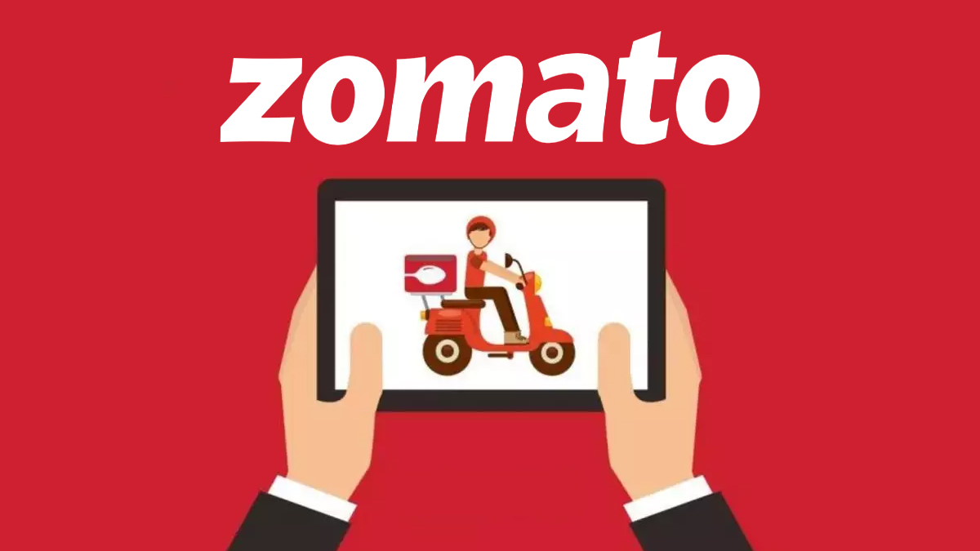
DETAILED ANALYSIS ABOUT BUSINESS MODEL OF ZOMATO

Slide 2
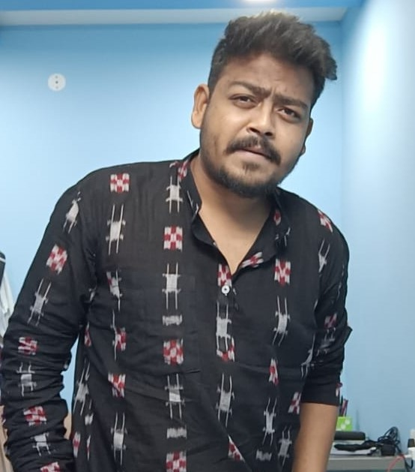

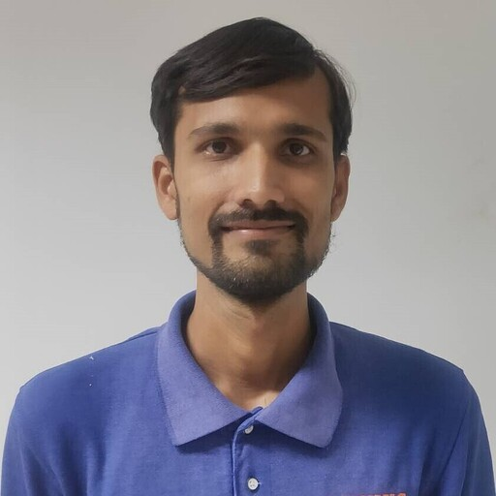

MEET OUR TEAM
PRITAM JAL
RAGAVENDRAN
DHAVAL HARNESHA
VARANASI JAGDEESH

Slide 3
Objectives
To Analyse Business model
To Analyse Revenue model
Describe Key competitor
4P analysis
Porters analysis
To Identify Cause & Effect analysis
Growth Opportunities in current scenario

Slide 4
About Zomato
Zomato was started in the year 2008 with initial name “Foodiebay”. It was launched in the year 2010, it is a platform that connects customers, Restaurants and Delivery Partners.
Customers use this platform to get varies services from restaurants such as food delivery and table reservation.
This entire process and the work flow works through an Application which makes it easy for the users to choose food from a wide variety of options.
Zomato launched Hyperpure in the year 2019 which is a B2B platform that allows restaurants to buy Fresh Spices and Fresh Chickens.
It servers worldwide with the help of 5000+ employees.
Market strategy for Zomato includes a combination of digital marketing channels such as search ads, third-party ads, in-app ads, SEO strategy, social media marketing and even bill boards or newspaper advertising.

Slide 5
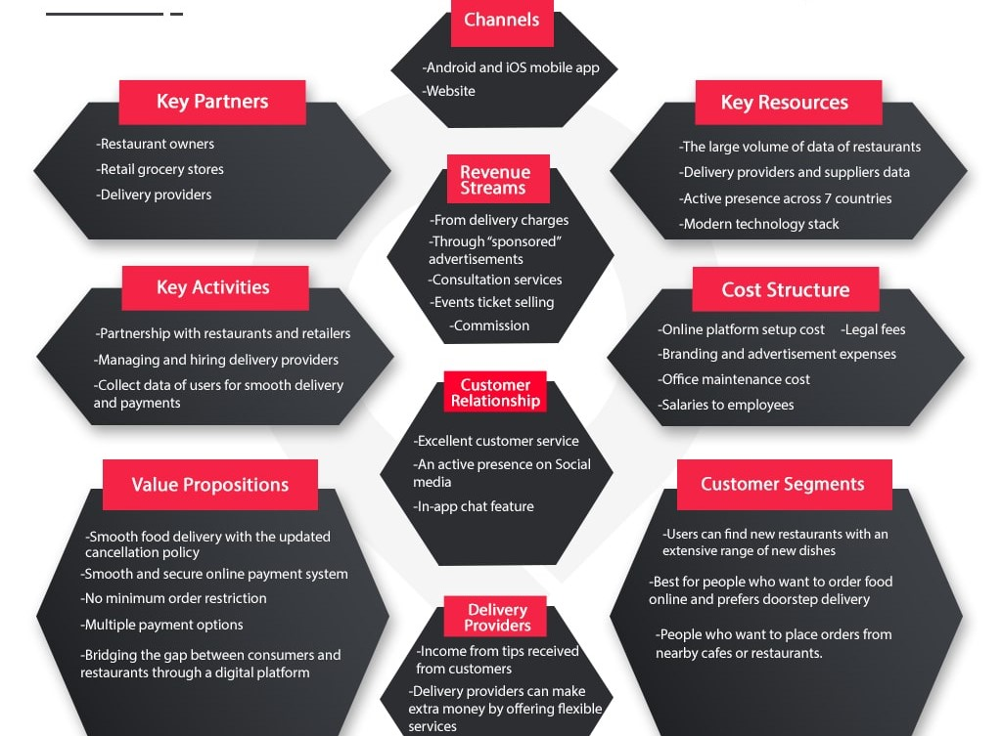
Business model

Slide 6
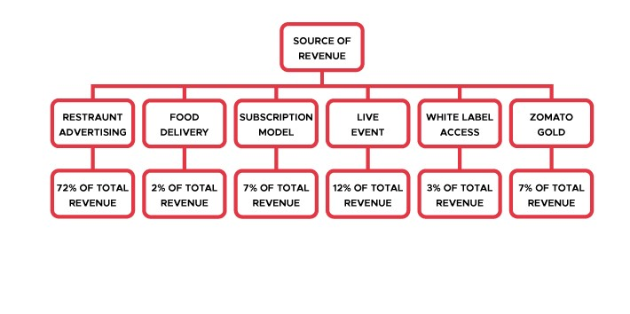
Revenue Model

Slide 7
Financial model
Year | Revenue (In Crores) | Profit/Loss (in Crores) | Total Assets (In Crores)
FY 2011 | 0 | -1.09
FY 2012 | 2 | -7.6
FY 2013 | 12 | -10
FY 2014 | 36 | -37
FY 2015 | 96.7 | -136
FY 2016 | 185 | -492
FY 2017 | 332.3 | -389
FY 2018 | 466 | -103.68 | 1374
FY 2019 | 1313 | -965.23 | 3413
FY 2020 | 2605 | -2367.16 | 2900
FY 2021 | 1994 | -812.82 | 8704
FY 2022 | 4192 | -1209 | 17327

Slide 8
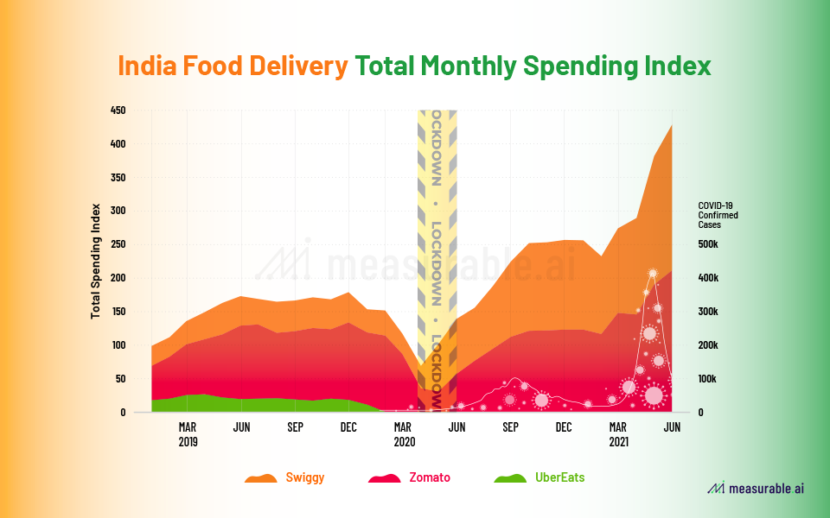
About Market
About competitors:-

Slide 9
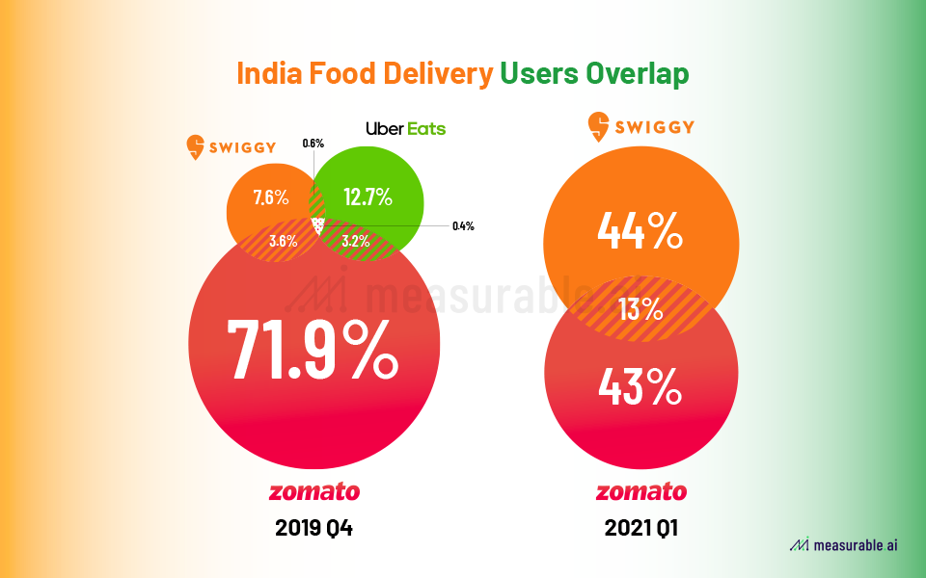
Zomato App’s Contribution in Indian Market:-

Slide 10
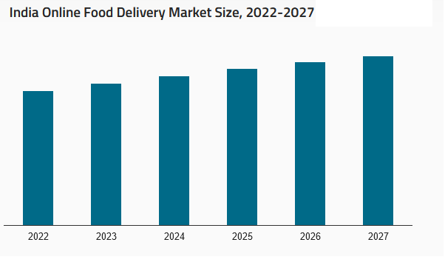
The India online food delivery market is expected to exhibit a CAGR of 28.9% during 2022-2027

Slide 11
Porters analysis of Zomato
Intensity of market Rivalry
Few competitors
As per CAGR - 28.9% in future
Barriers to Entry
Less potential
Strong brand name
Supplier Power
More suppliers
Switching cost were less
Buyer Power
Customer conversion rate
Offers and deals
Good customer service
Delivering TAT
Substitutes
Less substitutes

Slide 12
4P’s of Zomato
Product Near By location restaurant food (GPS Location). Application features. Customer review systems. Quality food. Delivery time less. | Place Available in 23 countries like India, Canada, UAE, UK etc.. Every month 90 M user visit site. In India almost cover urban area. But in some rural area’s faces difficulties.
Promotion Restaurant itself. Broadcasting. Delivery boy T-shirt & Bag. Application works on AI. | Price Provide offer & discount. Do not take any charge form supplier. Reasonable delivery charges. Provide competitive price. Additional offer for VIP customers.

Slide 13
Failure Cause and Effect Analysis
New competitor in market
Enter in new market segments
Feedback System
Media reputation damage
Chance of Leakage customer’s data
Rural area services limited
Price comparison
Natural Factor

Slide 14
Growth opportunities in Current Scenarios
Customer Acquisition:-
“Menu mania” is the First Acquisition on July 2014.
Entry to New market:-
September 2014, Poland based Restaurant search service.
December 2014, Italian based Restaurant search service.
New venture in same Bussiness line:-
September 2018, Bangalore based food e-market place “Tongue stun food” - $18 million.
December 2018, in lucknow “Tech eagle innovations” Works on drones.
New Product Opportunities:-
21 January 2020, Zomato Aquired “Uber Eats”.
24 June 2022, Zomato Acquired “ Grofers”.

Slide 15
Findings
100% depends on digital systems
Depends on Restaurants availability
Unavailability in some rural areas
User friendly application
Satisfactory customer feedback system & return policy of orders
Consumes more than 50% online food market system

Slide 16
Conclusion
According to current trends, Zomato's Digital Marketing Strategy will have to keep advancing. They need to find fresh ways to draw more interest in their customers. They are doing a stellar job right now. If they continue to work hard on it, they will reap more profit. Zomato needs to be more dynamic in compete with other online food service providers by timely making changes according to customer needs.

Slide 17
Learning
Team Work
Time Management
Improve Business analysis skills

Slide 18
Thank You

