Slide 1
Improved Pruning for Convolutional Neural Network
Dhaval Parmar
MTech (AI)
Sr. No. : 16689

Slide 2
Problem Statement
Convolutional Neural Network performing well in various task like segmentation, object detection etc.
Computation and memory requirement is high
Difficult to use big model with CNN on end devices
Han et al. proposed Deep compression model to reduce parameter without significantly affecting model performance
In 2017, Hao li et al. proposed technique for pruning filters for efficient convolution network
Trained VGG-16 network on CIFAR 10 data set.
Studied redundant filters in layers and pruned network accordingly
Further pruned network using proposed similarity measure
Notes:
Discuss related work in brief

Slide 3
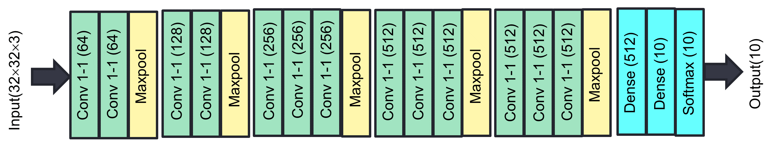
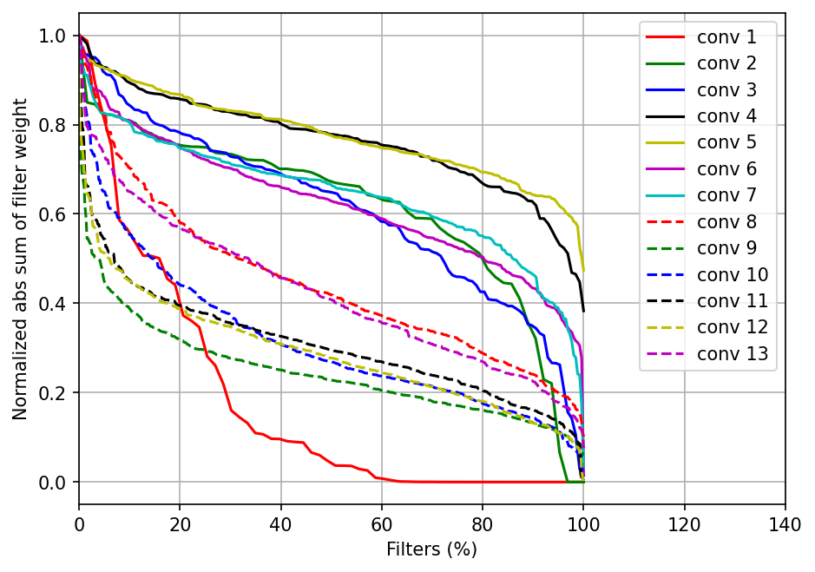
Proposed Approach
VGG-16 network has most of the convolution layer
Model trained on CIFAR-10 has distribution of sum of absolute value of filter weight as shown in graph
Filter having low sum represent sparse weight and does not transfer much information
Conv-1 and conv-8 to 13 has considerable percentage of redundant filters
We can prune different number of minimum sum filter depending upon redundancy in layer
Pruned and trained model still may have filter with similar weight
We can use cosine similarity measure with threshold value to prune network
Notes:
Discuss the project and your approach

Slide 4
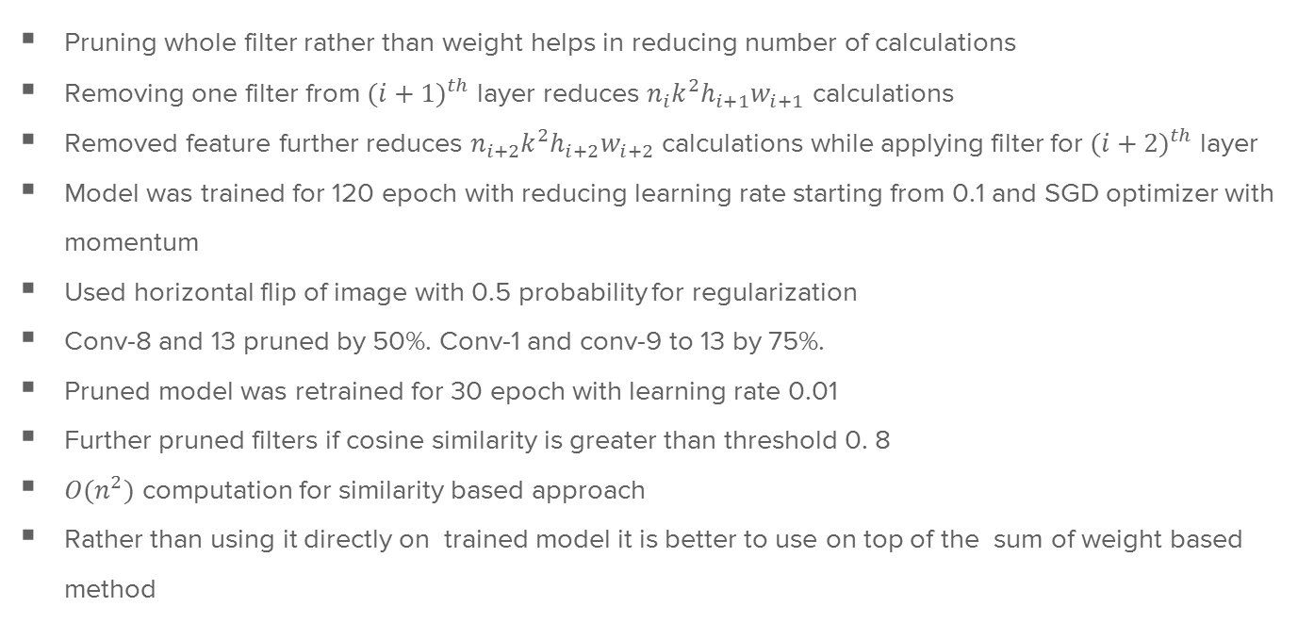
Technical Details
Pruning whole filter rather than weight helps in reducing number of calculations
Removing one filter from ${(i+1)}^{th}$ layer reduces $n_{i}k^{2}h_{i+1}w_{i+1}$ calculations
Removed feature further reduces $n_{i+2}k^{2}h_{i+2}w_{i+2}$ calculations while applying filter for ${(i+2)}^{th}$ layer
Model was trained for 120 epoch with reducing learning rate starting from 0.1 and SGD optimizer with momentum
Used horizontal flip of image with 0.5 probability for regularization
Conv-8 and 13 pruned by 50%. Conv-1 and conv-9 to 13 by 75%.
Pruned model was retrained for 30 epoch with learning rate 0.01
Further pruned filters if cosine similarity is greater than threshold 0. 8
$O(n^{2})$ computation for similarity based approach
Rather than using it directly on trained model it is better to use on top of the sum of weight based method
Notes:
Discuss your novel ideas and implementation

Slide 5
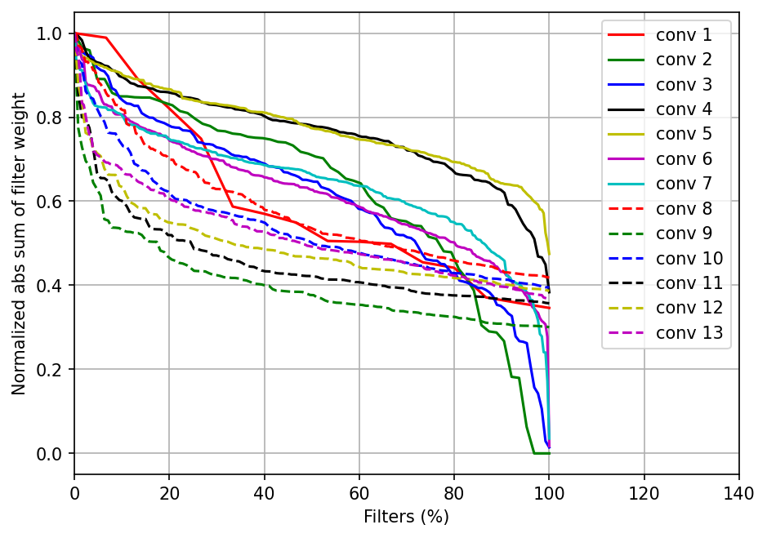
Results & Conclusion
Weight distribution after pruning is better
Even after pruning 76.84% parameter model accuracy is comparable
Pruned model trained from scratch is not be able achieve this accuracy
Further parameter can be pruned up to 82.02% using cosine similarity without affecting accuracy
 | Accuracy | Parameters | % Pruned
Trained | 92.30 | 149919946 | -
Pruned (Scratch) | 91.25 | 3471530 | 76.84
Pruned | 92.37 | 3471530 | 76.84
Pruned (Cosine) | 92.42 | 2694357 | 82.02
Notes:
Discuss Results and highlight improvements over baseline

Slide 6
Contributions (Novelty)
Trained VGG-16 network on CIFAR-10 data set using Pytorch
Studied model to decided percentage of filters to prune
Pruned model and retrained it
Trained pruned model from scratch
Further reduced parameter using proposed cosine similarity based approach
Notes:
Discuss your novel ideas and implementation

