Slide 1
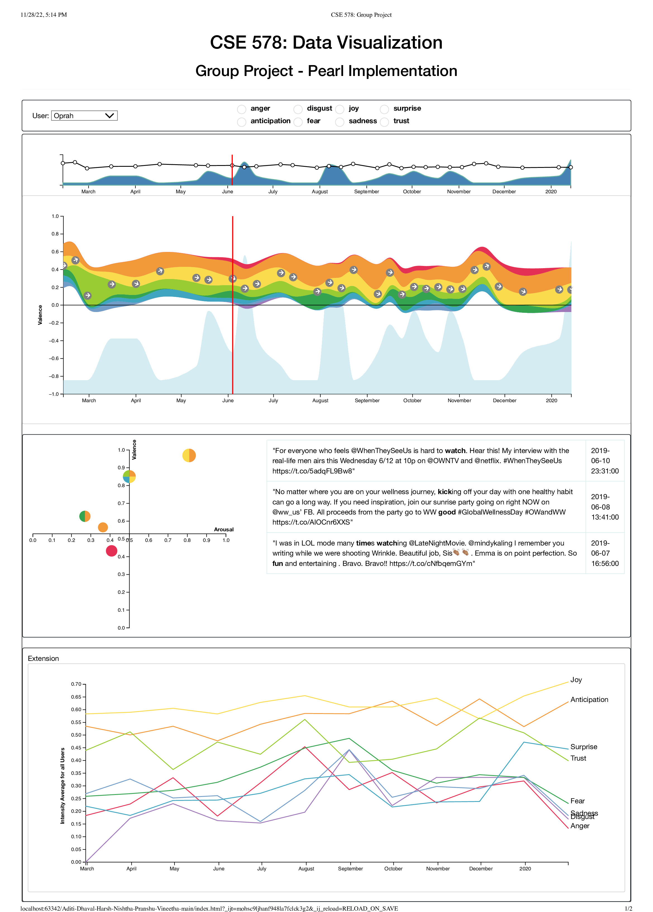
PEARL: An Interactive Visual Analytic Tool for Understanding Personal Emotion Style Derived from Social Media
Introduction
Humans are emotional beings, and we feel different types of emotions from time to time which can be easily detected while interacting with people face to face but it is hard to detect emotions through text.
In real life, people interact with each other psychically and in social life through means of social platforms using mediums like text, pictures, etc.
The project implements all the visualizations mentioned in the paper along with interactions and added a visualization for showing the average emotions of the users through multiple time intervals. and periods.
System Description
There are multiple visualization extensions implemented for the dataset and the analysis done.
Time Series Graph
Valence Emotion Visualization
Tweets-Word Visualization
Valence-Arousal Visualization
Tweets Display Visualization
Average Emotion Visualization
The graphs present visualize various aspects of the data with the help of interactions that link all the graphs.
Color differentiation is used for all the graphs for each of the emotion classes.
Datasets:
The dataset used for the same includes tweet text data associated with multiple events and personalities.
It also contains the values of the dominance, arousal, and valence with respect to each emotion expressed by the set of words in the tweet sentences.
Results:
It depicts the overall emotions to an advertisement of all users with respect to a time frame.
For the users who choose not to share their data can view the generalized advertisements presented to the audience as per the most common emotion displayed by users in the previous time frame.
Researching scientists can know the general trends of users’ emotions and can use it to include in their studies, whereas politicians can use it for advertising campaigns.
By selecting the date range from where the disasters occurred, one can get the generalized emotion of users.
Aditi Shashank Joshi
ajoshi64@asu.edu
Harsh Jigneshkumar Patel
hpatel66@asu.edu
Pranshu Pandey
ppande19@asu.edu
Dhaval Maheshbhai Patodiya
dpatodiy@asu.edu
Nishtha Bhimte
nbhimte@asu.edu
Vineetha Pattapagalu
vpattapa@asu.edu

