Slide 1

To-Do List App using Flutter
RNS INSTITUTE OF TECHNOLOGY
BENGALURU - 98
DEPARTMENT OF INFORMATION SCIENCE & ENGINEERING
Presentation on Internship
Dhaval Shrei
USN: 1RN18IS038
ENMAZ Engineering Services Pvt. Ltd.
Internal Guide
Mr. T S Bhagavath Singh
Associate Prof, Dept of ISE, RNSIT
External Guide
Mr. Akshay D R
Co-Founder & CEO, Enmaz Engineering Services Pvt. Ltd., Bangalore

Slide 2
AGENDA
Abstract
About the Company
Introduction
Literature survey
Requirements
System Design
Implementation
Results
Testing
Conclusion and Future Enhancements
References
Q & A

Slide 3
ABSTRACT
The goal of this app is to help us manage all our tasks at one place so that we are able to manage our daily routines more efficiently.
We will have a better sense of the estimated time we’ll need to spend on our tasks and will be able to manage our routine according to the various tasks at hand.
Users will be able to add tasks to their todo lists simply and quickly and delete particular lists when needed.

Slide 4
ABOUT THE COMPANY
Enmaz Engineering Pvt. Ltd is a Service based company founded in the year 2019.
It specializes in
Embedded H/W Development
Embedded Firmware Development
Cloud support
Big Data Analysis and Reporting
Dashboard UX/UI design and development
Model Analysis.

Slide 5
INTRODUCTION
Social media and other easily accessible online distractions make it hard for us to stay focused on our tasks and make it difficult for us to do our work efficiently.
. It’s more important for us to prioritize tasks and work on those that are most important and have all the tasks at one place.
Such an app is helpful in planning our daily schedules. We can add more tasks at any time and delete a task that is completed

Slide 6
LITERATURE SURVEY
TaskDo: A Daily Task Recommender System: a research paper by Dr. Mohammad Amin Kuhail, Assistant Professor, Nikhil Sai Santosh Gurram, Graduate Student, School of Computing and Engineering, University of Missouri – Kansas City
Many individuals like working professionals, students, and house makers often find lack of time and time management as problems for successful task accomplishment.
This problem has driven us to contribute a task recommender system which suggests a specific type of tasks to users based on their history of tasks and various factors at that specific time.

Slide 7
REQUIREMENTS
Hardware Requirements
CPU: Pentium processor and above
RAM: 4 GB
HDD: 40 GB
Software Requirements
Operating System: Windows 8 and above
Editor: Visual Studio Code
IDE: VS Code
Front-end Language: Dart
Minimum Android Version : Froyo (API Level 8)

Slide 8
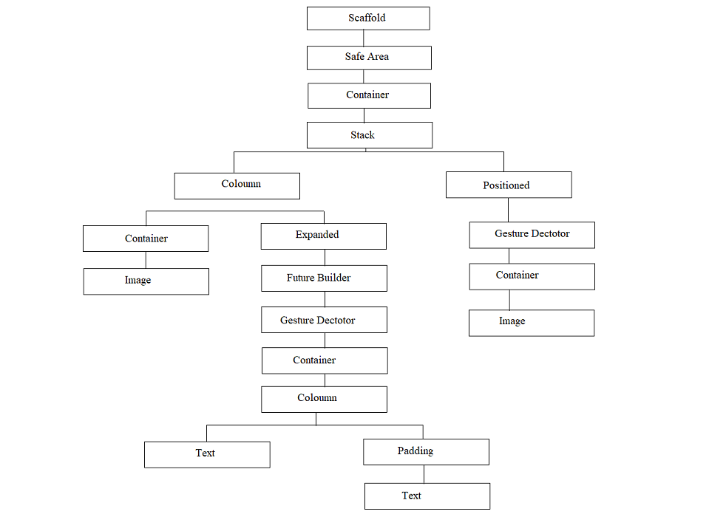
SYSTEM DESIGN
Widget Tree for Home page

Slide 9
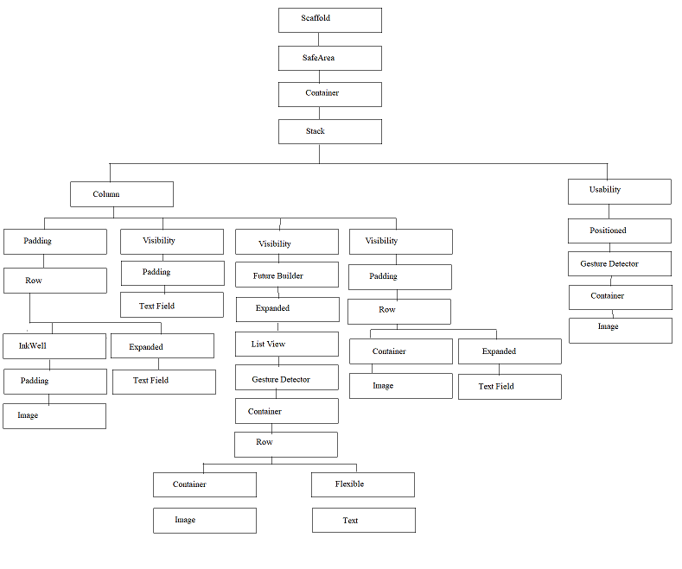
Widget Tree for
TO-DO list page

Slide 10
IMPLEMENTATION/CODING
main.dart
import 'package:flutter/material.dart';
import 'package:google_fonts/google_fonts.dart';
import 'package:what_todo/screens/homepage.dart';
void main() {
runApp(MyApp());
}
class MyApp extends StatelessWidget {
@override
Widget build(BuildContext context) {
return MaterialApp(
debugShowCheckedModeBanner: false,
theme: ThemeData(
textTheme: GoogleFonts.nunitoSansTextTheme(
Theme.of(context).textTheme,
),
),
home: Homepage(),
);
}
}

Slide 11
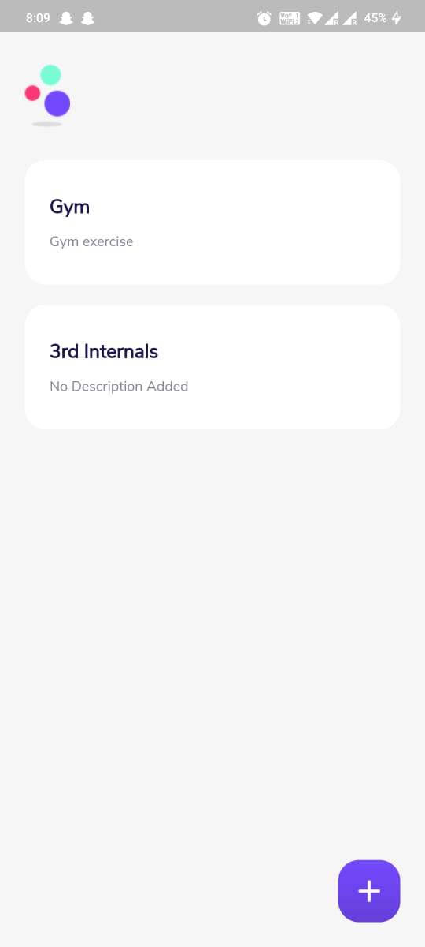
RESULTS
Home Page

Slide 12
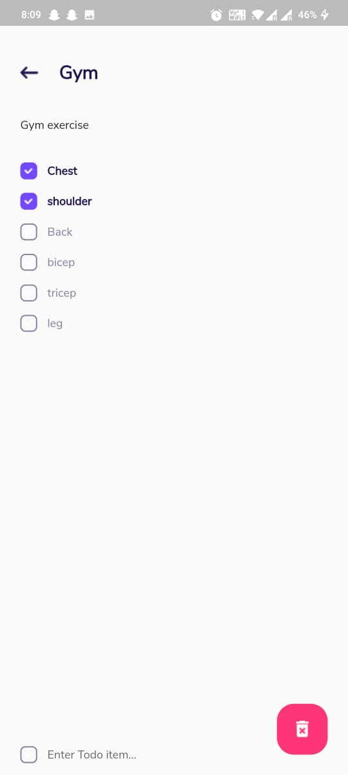
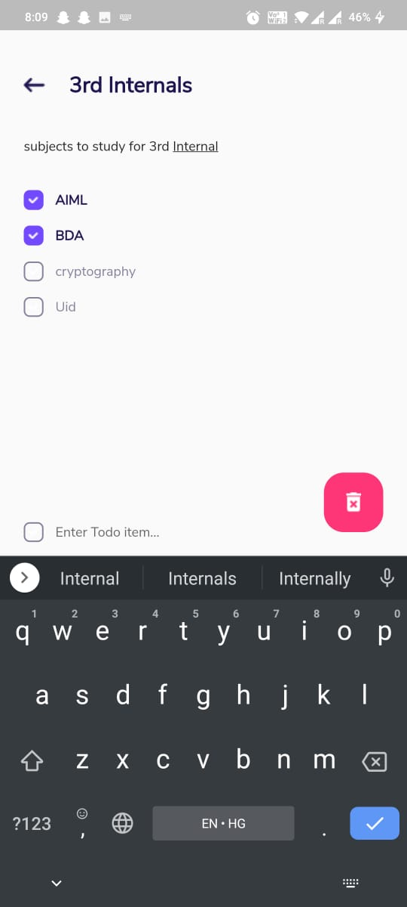
Display To-Do lists

Slide 13
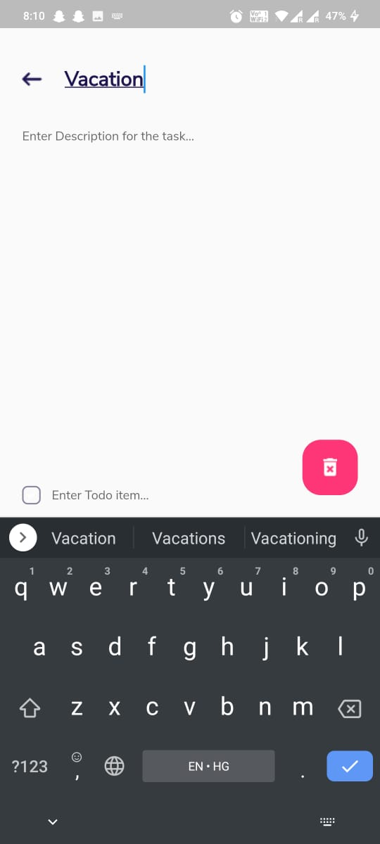
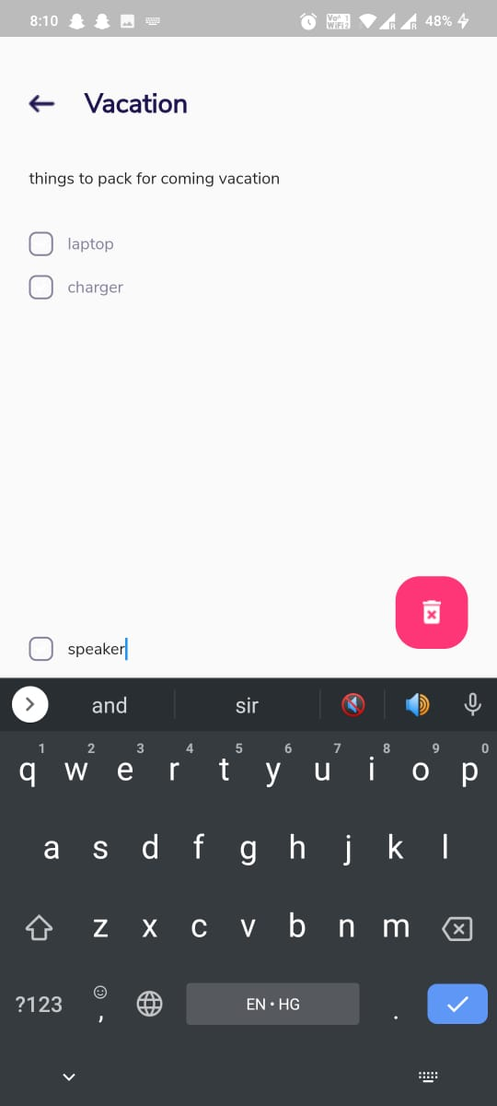
Creating a new list
VIII Semester, Department of ISE, RNSIT
2021 - 2022
13

Slide 14
TESTING
Testing is a process of executing a program with the interest of finding an error. Levels Of Testing
Unit Testing
Integration Testing
Validation Testing
Output Testing
User Acceptance Testing

Slide 15
CONCLUSIONS
This application is beneficial for the users who want to manage all their tasks at a single place.
It is helpful in planning our daily schedules. We can add more tasks at any time and delete a task that is completed
It helps to maintain our day-to-day tasks or list everything that we have to do wherein different tasks are divided into various categories.

Slide 16
FUTURE ENHANCEMENTS
We can add the functionality to track the time we spend working on the to-do items so that we have a better sense of the estimated time we’ll need to spend on our tasks.
We can further generate a report showing where we spend our time on tasks at the end of each day.
We can add the ability to prioritize tasks via deadline.

Slide 17
REFERENCES
[1] https://flutter.dev/
[2] https://developers.google.com/learn/pathways/intro-to-flutter
[3] Beginning Flutter: A Hands On Guide to App Development by Marco L
Napoli
[4] https://stackoverflow.com/

Slide 18
QUESTION AND ANSWERS

Slide 19
THANK YOU

