Slide 1
Prepared By Malar Jothi S, Dhavasree S, Karthika S

Slide 2

Concepts
Maven Basics
Spring MVC Basics
JQuery Basics

Slide 3
MAVEN

Slide 4
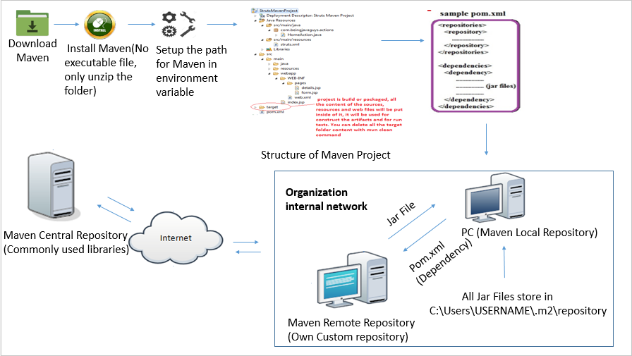
MAVEN DIAGRAM

Slide 5
PLUGINS IN MAVEN
PLUGIN
Use:
Create jar files and war files
Compile code, unit test code
Create project documentation
Many Plugin available in Maven

Slide 6
PLUGINS IN MAVEN
PLUGIN
Some of the Plugin in maven are
Maven Compiler Plugin
- Special Plugin
- No need to define it inside pom.xml
- Downloaded and executed when maven needs it
Maven compiler plugin has two goals defined:
Compile: Compile the classes under src/main/java
test-compile: Compile the classes under src/test/java

Slide 7
PLUGINS IN MAVEN
PLUGIN
Maven Clean Plugin
- Remove files generated at build-time in a project's directory
Maven-antrun-plugin:
provided maven bydefault
Use to do for specific command or task or script

Slide 8
Advantage
Creates default project structure
All dependencies downloaded automatically
Save time
Reusable and maintainable
Easier to comprehend

Slide 9
Spring MVC

Slide 10
Spring mvc lifecycle
Handler Mappings
Request
2
1
Controller
Browser
Request
Dispatcher Servlet
Controller
Service
3
Request
4
Model and view
6
Response
6
View name
Response
Model
DAO
view
View Resolver
View
5
Database

Slide 11
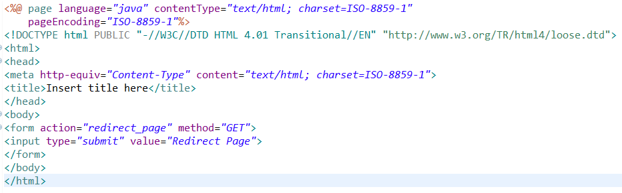
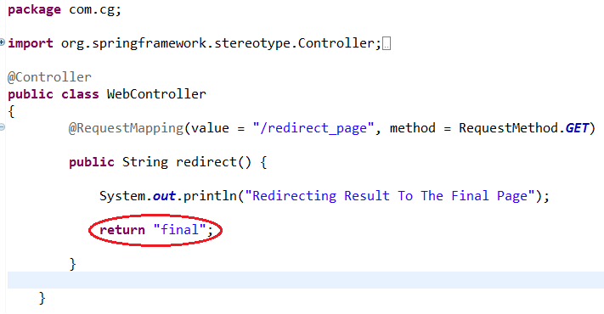
Spring MVC send redirect
JSP to controller to JSP redirection

Slide 12
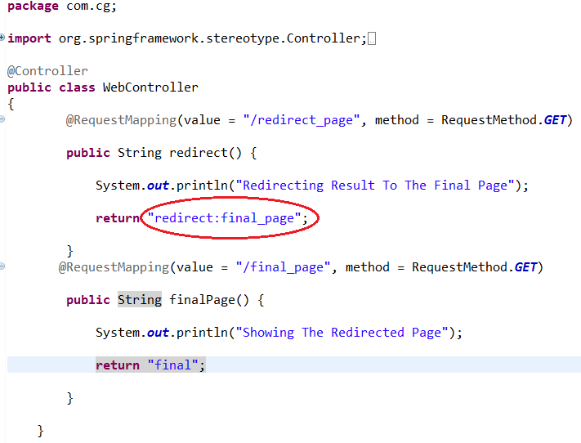
Controller to Controller redirection

Slide 13
JQuery

Slide 14
Benefits of JQuery
JQuery is a single page application because it loads only required part and display the response within same page.
A framework which makes event handling, animating, and Ajax interactions simpler and faster.
It is supported by all major web browsers.
More plugins available.

Slide 15
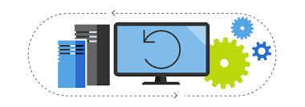
Block Diagram
request
Jsp Page
Response
(index.jsp)
On hitting button
Browser
response
Document is ready
($())
Selector function
JQuery library rendered on client side
Server Class(.class)
JSP Translator
Tomcat server
generate
Source code(.java)
(index_jsp.java)
(index_jsp.class)

Slide 16
JQuery Submodules
1.Document ready event
$(document).ready(function(){});
JQuery has a ready element that checks the document and wait until the document is ready to be manipulated.
2.Selector
$(selector).action()
It allow you to select and manipulate HTML element(s).
e g: $(document).ready(function(){
$(“#button").click(function(){
$("#test").hide();});});
When a user clicks on a button, the element with id="test" will be hidden

Slide 17
3.Jquery Events
$(button).click(function(){});
Trigger a function to the click event of selected element.
The four events in jQuery are mouse, keyboard, form and document events.
e g: $(document).ready(function(){
$("p").dblclick(function(){
$(“#table”).hide();});});
When a user double clicks on a element p, the element with id="table" will be hidden

Slide 18
4.Jquery Traversing
Traversing is used to find html elements based on their relation to other elements.
1.Filtering – It allow you to select a specific element based on its position in a group of elements.
The methods in filtering are first(), last() and eq()
5.Jquery AJAX
AJAX is about loading data in the background and display it on the webpage, without reloading the whole page.

