Slide 1


Slide 2
A place where speech
is free
This is Dhawal Menaria and here is my class XII computer
science project on social forum .
Lets dive in it

Slide 3


Social Forum Application
A Forum is a community where people can engage in conversations and exchange ideas, opinions, and suggestions.

Slide 4

Splash
Screen

Slide 5

Progress
Bar

Slide 6

Welcome
Screen

Slide 7

Login
Page

Slide 8

Register
Page

Slide 9
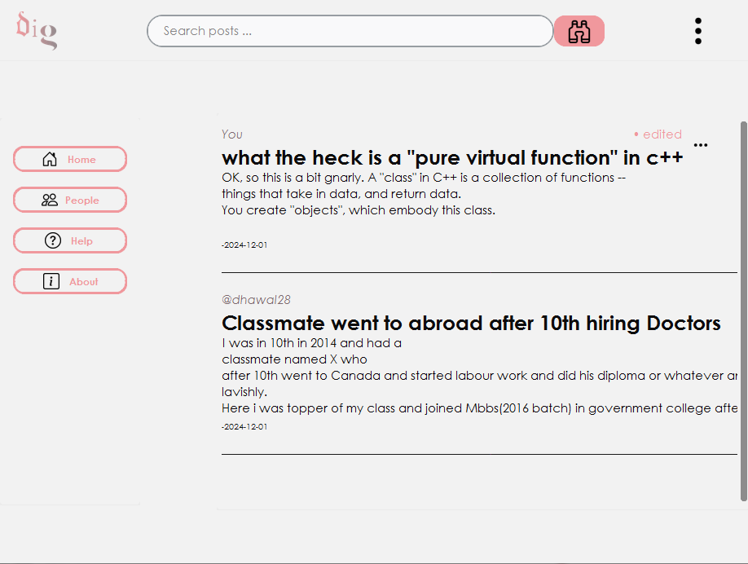




Menu
Profile
Home
Page
Create Post
Logout

Slide 10
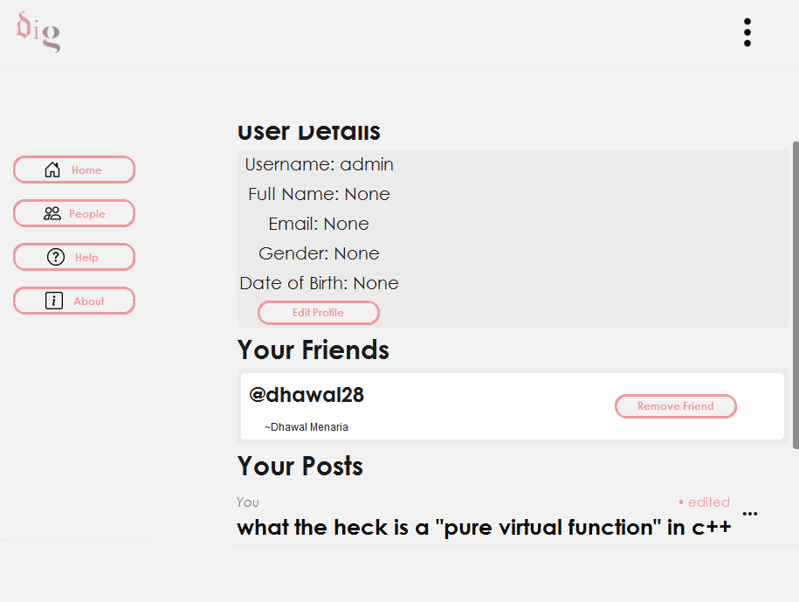
Profile page

Slide 11
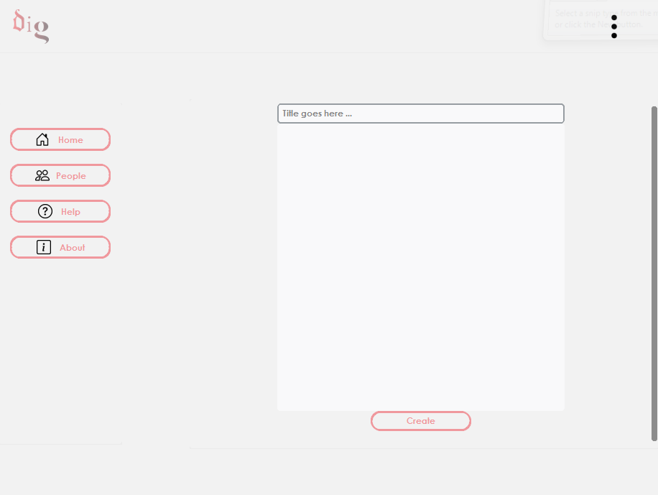
Create Post page

Slide 12
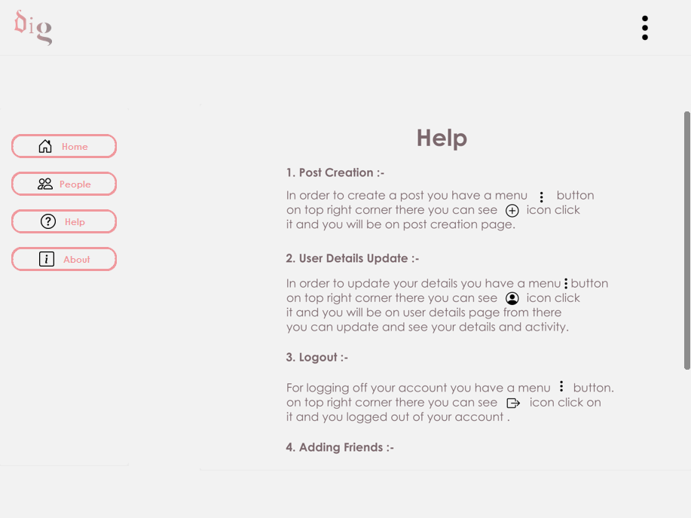
Help
Page

Slide 13
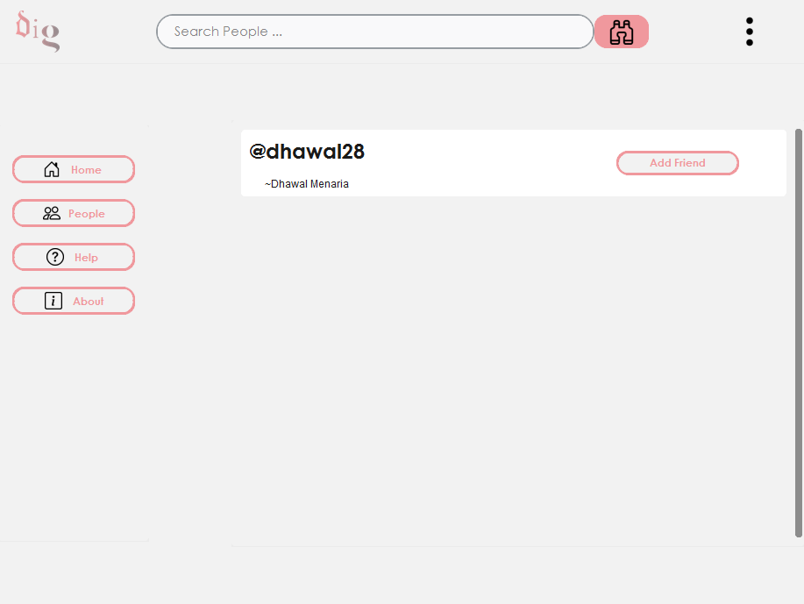
People
Page

Slide 14
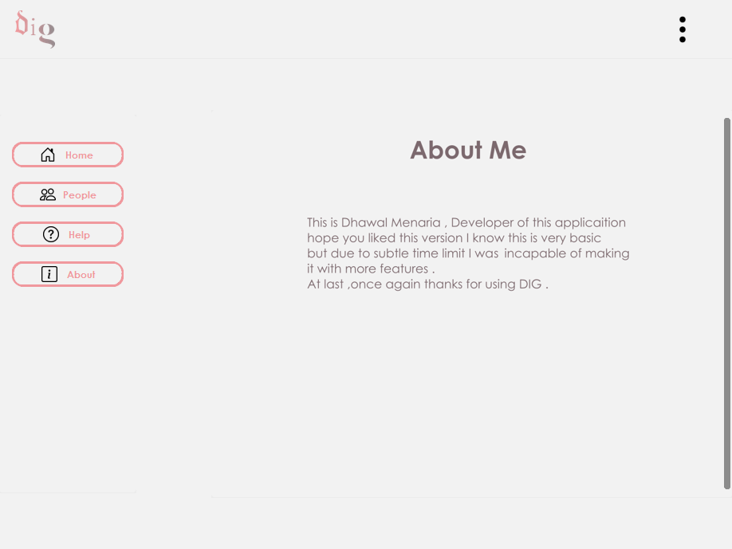
About
Page

Slide 15



