Slide 1
CS344 : Introduction to Artificial Intelligence
Pushpak Bhattacharyya
CSE Dept.,
IIT Bombay
Lecture 19- Probabilistic Planning

Slide 2
Example : Blocks World
STRIPS : A planning system – Has rules with precondition deletion list and addition list
Robot hand
A
Robot hand
C
B
A
B
C
START
GOAL
on(B, table)
on(A, table)
on(C, A)
hand empty
clear(C)
clear(B)
on(C, table)
on(B, C)
on(A, B)
hand empty
clear(A)

Slide 3
Rules
R1 : pickup(x)
Precondition & Deletion List : handempty, on(x,table), clear(x)
Add List : holding(x)
R2 : putdown(x)
Precondition & Deletion List : holding(x)
Add List : handempty, on(x,table), clear(x)

Slide 4
Rules
R3 : stack(x,y)
Precondition & Deletion List :holding(x), clear(y) Add List : on(x,y), clear(x), handempty
R4 : unstack(x,y)
Precondition & Deletion List : on(x,y), clear(x),handempty
Add List : holding(x), clear(y)

Slide 5
Plan for the block world problem
For the given problem, Start → Goal can be achieved by the following sequence :
  Unstack(C,A)
  Putdown(C)
  Pickup(B)
  Stack(B,C)
  Pickup(A)
  Stack(A,B)
Execution of a plan: achieved through a data structure called Triangular Table.

Slide 6
Why Probability?
(discussion based on the book “Automated Planning” by Dana Nau)

Slide 7

Motivation
c
a
b
In many situations, actions may have
more than one possible outcome
  Action failures
    e.g., gripper drops its load
  Exogenous events
    e.g., road closed
Would like to be able to plan in such situations
One approach: Markov Decision Processes
Intended
outcome
c
a
b
Grasp
block c
a
b
c
Unintended
outcome

Slide 8
Stochastic Systems
Stochastic system: a triple Σ = (S, A, P)
  S = finite set of states
  A = finite set of actions
  P_{a} (s′ | s) = probability of going to s′ if we execute a in s
  ∑_{s′ ∈ S} P_{a} (s′ | s) = 1

Slide 9
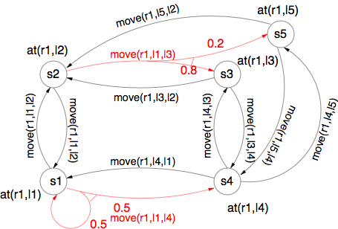
Example
Robot r1 starts
at location l1
  State s1 in
  the diagram
Objective is to
get r1 to location l4
  State s4 in
  the diagram
Start
Goal

Slide 10
Example
No classical plan (sequence of actions) can be a solution, because we can’t guarantee we’ll be in a state where the next action is applicable
  e.g.,
    π = ⟨move(r1,l1,l2), move(r1,l2,l3), move(r1,l3,l4)⟩
Start
Goal

Slide 11
Policies
π₁ = {(s1, move(r1,l1,l2)),
(s2, move(r1,l2,l3)),
(s3, move(r1,l3,l4)),
(s4, wait),
(s5, wait)}
π₂ = {(s1, move(r1,l1,l2)),
(s2, move(r1,l2,l3)),
(s3, move(r1,l3,l4)),
(s4, wait),
(s5, move(r1,l5,l4))}
π₃ = {(s1, move(r1,l1,l4)),
(s2, move(r1,l2,l1)),
(s3, move(r1,l3,l4)),
(s4, wait),
(s5, move(r1,l5,l4)}
Policy: a function that maps states into actions
Write it as a set of state-action pairs
Start
Goal

Slide 12
Initial States
For every state s,
there will be a
probability P(s)
that the system begins
in the state s
Start
Goal

Slide 13
Histories
History: sequence
of system states
h = ⟨s₀, s₁, s₂, s₃, s₄, … ⟩
h₀ = ⟨s1, s3, s1, s3, s1, … ⟩
h₁ = ⟨s1, s2, s3, s4, s4, … ⟩
h₂ = ⟨s1, s2, s5, s5, s5, … ⟩
h₃ = ⟨s1, s2, s5, s4, s4, … ⟩
h₄ = ⟨s1, s4, s4, s4, s4, … ⟩
h₅ = ⟨s1, s1, s4, s4, s4, … ⟩
h₆ = ⟨s1, s1, s1, s4, s4, … ⟩
h₇ = ⟨s1, s1, s1, s1, s1, … ⟩
Each policy induces a probability distribution over histories
  If h = ⟨s₀, s₁, … ⟩ then P(h | π) = P(s₀) ∏_{i ≥ 0} P_{π(Si)} (s_{i+1} | s_{i})
move(r1,l2,l1)
Start
Goal

Slide 14
Hidden Markov Models

Slide 15
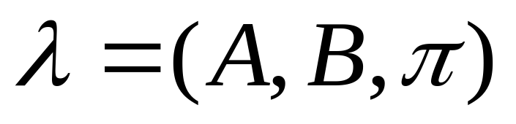
Hidden Markov Model
Set of states : S where |S|=N
Output Alphabet : V
Transition Probabilities : A = {a_{ij}}
Emission Probabilities : B = {b_{j}(o_{k})}
Initial State Probabilities : π

Slide 16


Three Basic Problems of HMM
Given Observation Sequence O ={o₁… o_{T}}
  Efficiently estimate P(O|λ)
Given Observation Sequence O ={o₁… o_{T}}
  Get best Q ={q₁… q_{T}} i.e.
    Maximize P(Q|O, λ)
How to adjust to best maximize
  Re-estimate λ

Slide 17
Solutions
Problem 1: Likelihood of a sequence
  Forward Procedure
  Backward Procedure
Problem 2: Best state sequence
  Viterbi Algorithm
Problem 3: Re-estimation
  Baum-Welch ( Forward-Backward Algorithm )

Slide 18
Problem 2
Given Observation Sequence O ={o₁… o_{T}}
  Get “best” Q ={q₁… q_{T}} i.e.
Solution :
  Best state individually likely at a position i
  Best state given all the previously observed states and observations
    Viterbi Algorithm

Slide 19
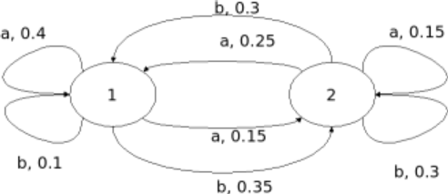
Example
Output observed – aabb
What state seq. is most probable? Since state seq. cannot be predicted with certainty, the machine is given qualification “hidden”.
Note: ∑ P(outlinks) = 1 for all states

Slide 20
Probabilities for different possible seq
1
1,1
1,2
0.4
0.15
1,1,1
1,1,2
1,2,1
1,2,2
0.16
0.06
0.0375
0.0225
1,1,1,1
1,1,1,2
1,1,2,1
1,1,2,2
0.016
0.056
0.018
0.018
...and so on

Slide 21
Viterbi for higher order HMM
If
P(s_{i}|s_{i-1}, s_{i-2}) (order 2 HMM)
then the Markovian assumption will take effect only after two levels.
(generalizing for n-order… after n levels)

Slide 22


Viterbi Algorithm
Define such that,
i.e. the sequence which has the best joint probability so far.
By induction, we have,

Slide 23
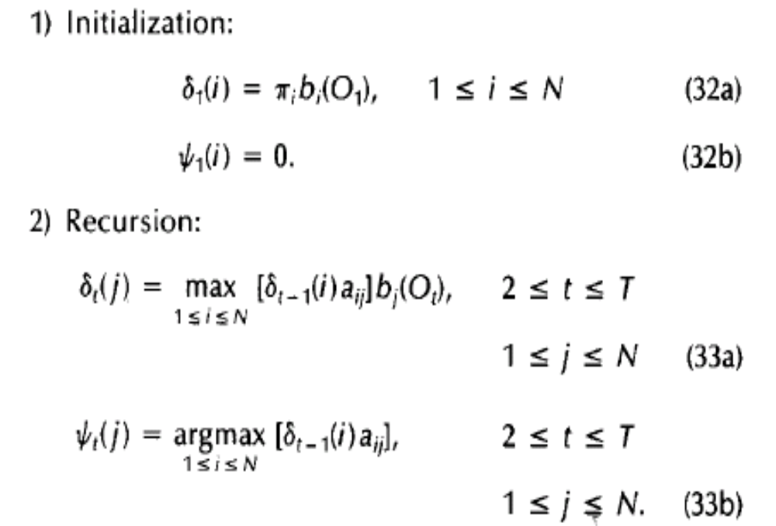
Viterbi Algorithm

Slide 24
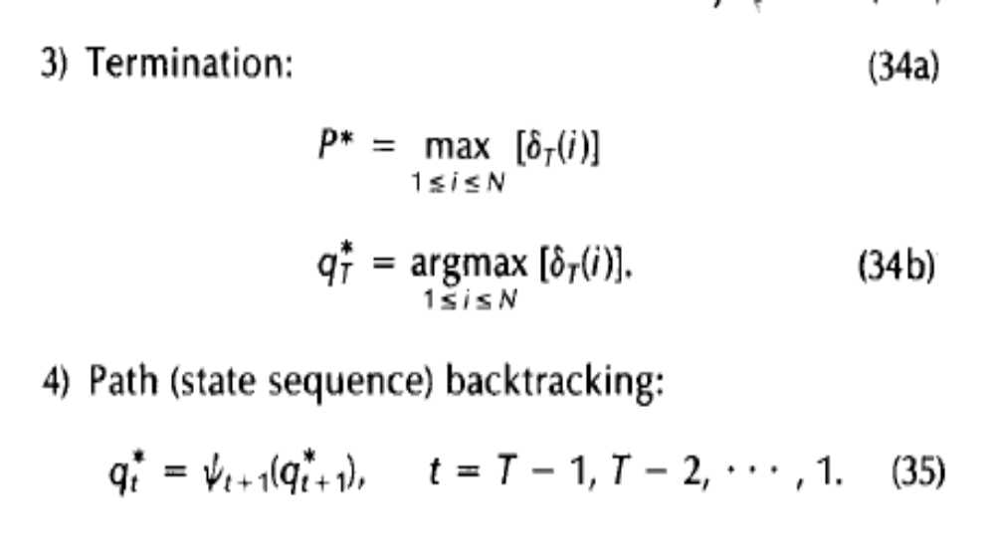
Viterbi Algorithm

