Slide 1
CS344 : Introduction to Artificial Intelligence
Pushpak Bhattacharyya
CSE Dept.,
IIT Bombay
Lecture 21- Forward Probabilities and Robotic Action Sequences

Slide 2
Hidden Markov Model

Slide 3
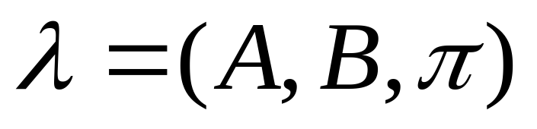
Model Definition
Set of states : S where |S|=N
Output Alphabet : V
Transition Probabilities : A = {a_{ij}}
Emission Probabilities : B = {b_{j}(o_{k})}
Initial State Probabilities : π

Slide 4
Markov Processes
Properties
  Limited Horizon :Given previous n states, a state i, is independent of preceding 0…i-n+1 states.
    P(X_{t}=i|X_{t-1}, X_{t-2} ,… X₀) = P(X_{t}=i|X_{t-1}, X_{t-2}… X_{t-n})
  Time invariance :
    P(X_{t}=i|X_{t-1}=j) = P(X₁=i|X₀=j) = P(X_{n}=i|X₀₋₁=j)

Slide 5
Hidden Markov Model
A colored ball choosing example :
Urn 1
# of Red = 30
# of Green = 50
# of Blue = 20
Urn 2
# of Red = 10
# of Green = 40
# of Blue = 50
Urn 3
# of Red =60
# of Green =10
# of Blue = 30
Probability of transition to another Urn after picking a ball:
 | U1 | U2 | U3
U1 | 0.1 | 0.4 | 0.5
U2 | 0.6 | 0.2 | 0.2
U3 | 0.3 | 0.4 | 0.3

Slide 6
Hidden Markov Model
 | U1 | U2 | U3
U1 | 0.1 | 0.4 | 0.5
U2 | 0.6 | 0.2 | 0.2
U3 | 0.3 | 0.4 | 0.3
 | R | G | B
U1 | 0.3 | 0.5 | 0.2
U2 | 0.1 | 0.4 | 0.5
U3 | 0.6 | 0.1 | 0.3
Given :
and
Observation : RRGGBRGR
State Sequence : ??
Not so Easily Computable.

Slide 7

Hidden Markov Model for the example
Here :
  S = {U1, U2, U3}
  V = { R,G,B}
For observation:
  O ={o₁… o_{n}}
And State sequence
  Q ={q₁… q_{n}}
π is
 | U1 | U2 | U3
U1 | 0.1 | 0.4 | 0.5
U2 | 0.6 | 0.2 | 0.2
U3 | 0.3 | 0.4 | 0.3
A =
 | R | G | B
U1 | 0.3 | 0.5 | 0.2
U2 | 0.1 | 0.4 | 0.5
U3 | 0.6 | 0.1 | 0.3
B=

Slide 8
Forward Probability Calculation

Slide 9
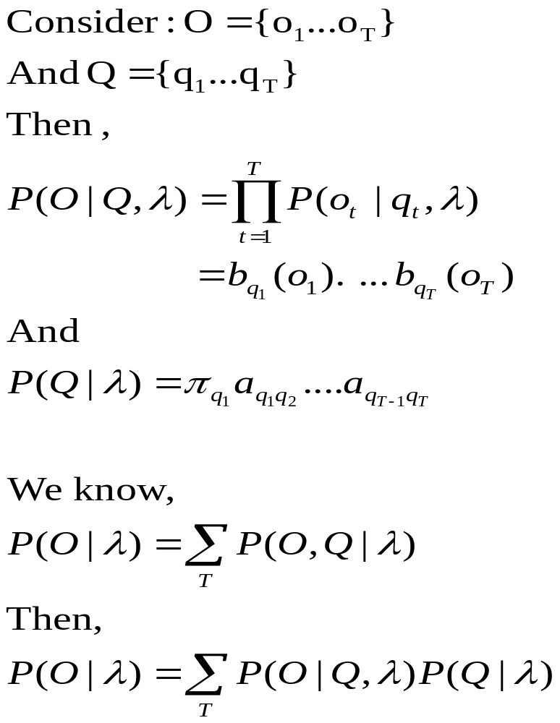
Problem 1 of the three basic problems

Slide 10
Problem 1 (contd)
Order 2TN^{T}
Definitely not efficient!!
Is there a method to tackle this problem? Yes.
  Forward or Backward Procedure

Slide 11
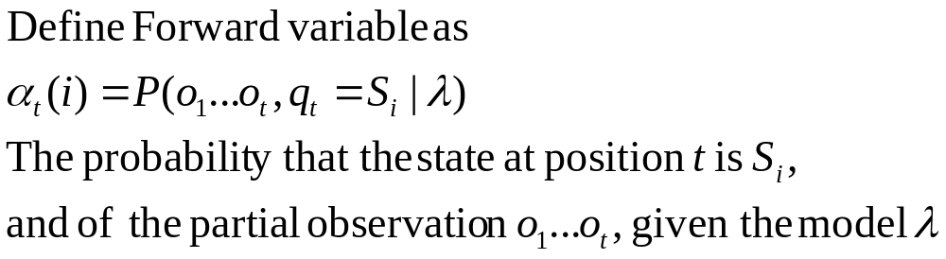
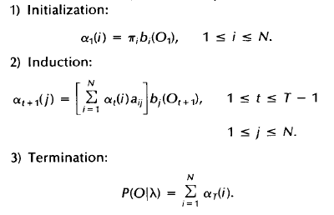
Forward Procedure
Forward Step:

Slide 12
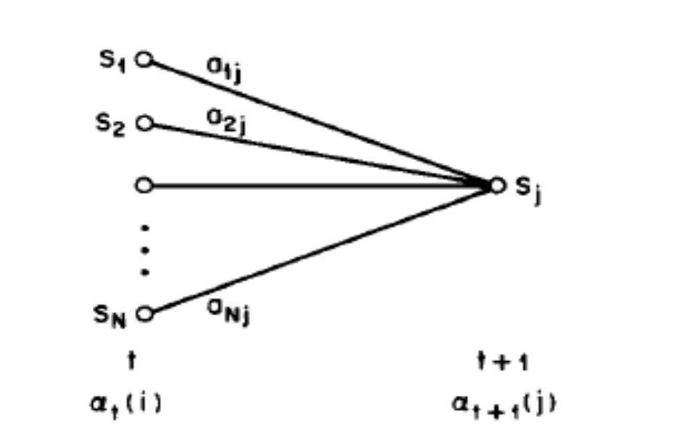
Forward Procedure

Slide 13

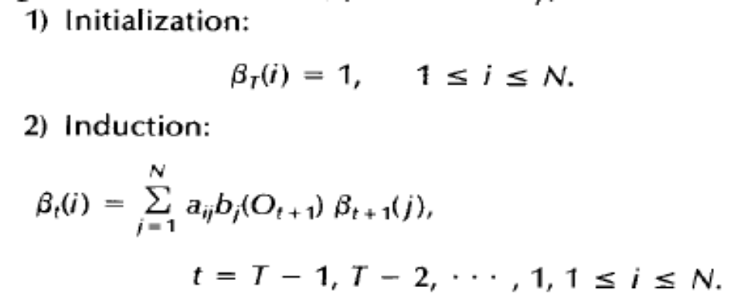
Backward Procedure

Slide 14
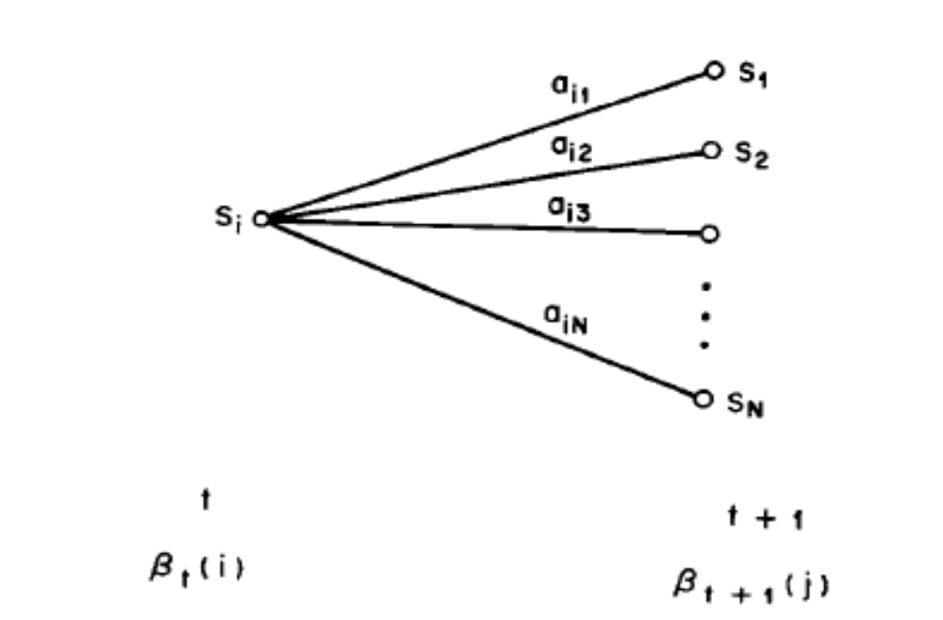
Backward Procedure

Slide 15
Forward Backward Procedure
Benefit
  Order
    N²T as compared to 2TN^{T} for simple computation
Only Forward or Backward procedure needed for Problem 1

Slide 16
Problem 2
Given Observation Sequence O ={o₁… o_{T}}
  Get “best” Q ={q₁… q_{T}} i.e.
Solution :
  Best state individually likely at a position i
  Best state given all the previously observed states and observations
    Viterbi Algorithm

Slide 17


Viterbi Algorithm
Define such that,
i.e. the sequence which has the best joint probability so far.
By induction, we have,

Slide 18
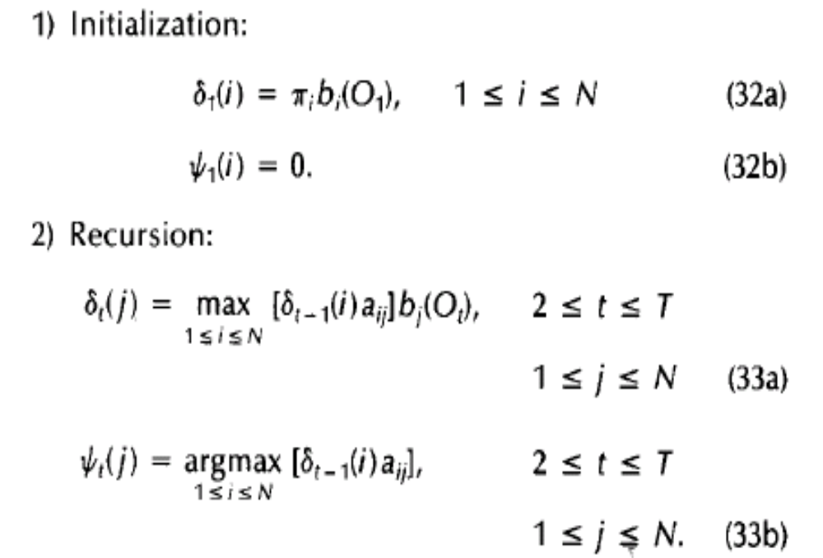
Viterbi Algorithm

Slide 19
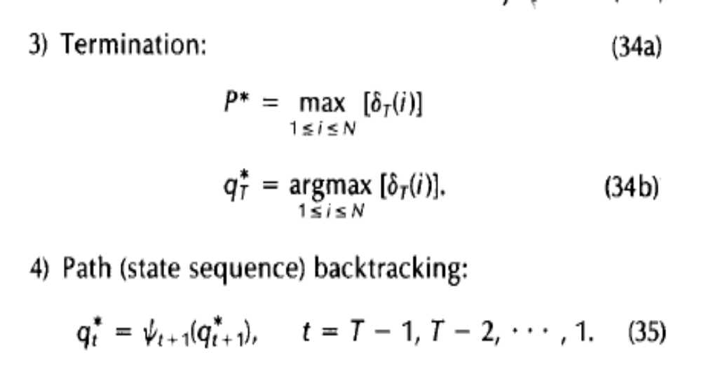
Viterbi Algorithm

Slide 20


Problem 3
How to adjust to best maximize
  Re-estimate λ
Solutions :
  To re-estimate (iteratively update and improve) HMM parameters A,B, π
    Use Baum-Welch algorithm

Slide 21

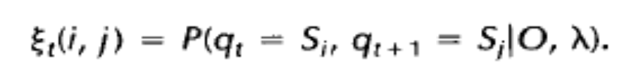
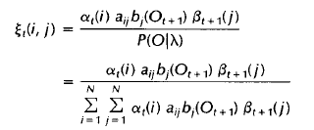
Baum-Welch Algorithm
Define
Putting forward and backward variables

Slide 22
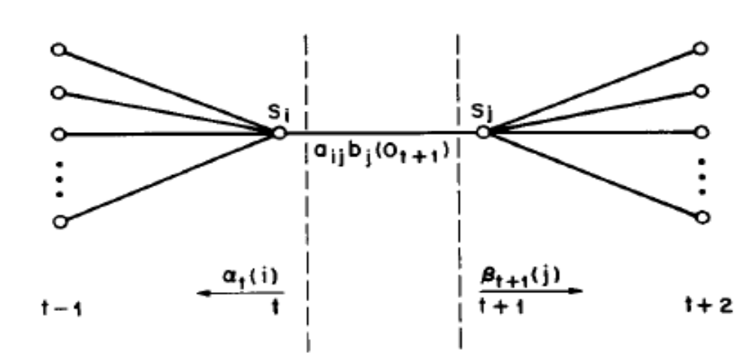
Baum-Welch algorithm

Slide 23

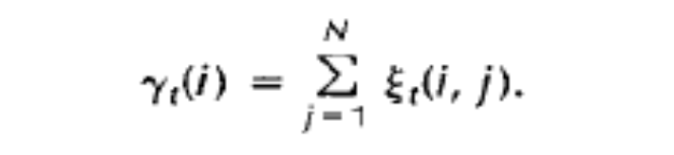
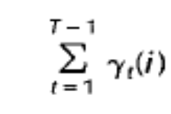
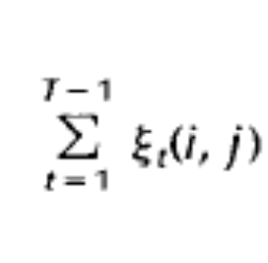
Define
Then, expected number of transitions from S_{i}
And, expected number of transitions from S_{j} to S_{i}

Slide 24
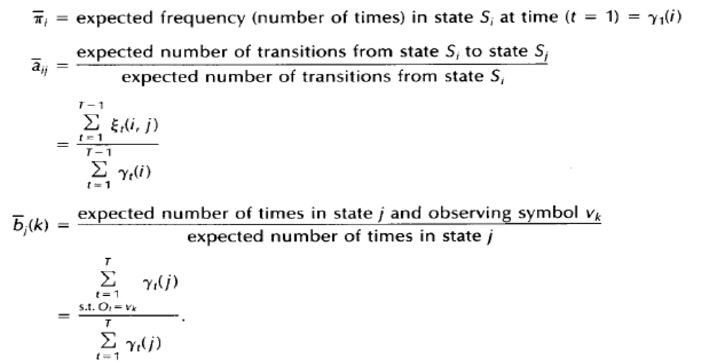

Slide 25
Baum-Welch Algorithm
Baum et al have proved that the above equations lead to a model as good or better than the previous

