Slide 1
CS344 : Introduction to Artificial Intelligence
Pushpak Bhattacharyya
CSE Dept.,
IIT Bombay
Lecture 23- Forward probability and Robot Plan; start of plan training

Slide 2
Mapping the problem to probabilistic framework
Exhaustively enumerate the states
Enumerate the operators
Define probabilities of transition
  P(O_{k},s_{j}|s_{i}) {probability of going from state s_{i} to s_{j} with the output O_{k} which can be a robotic action}

Slide 3
State Transition
Robot hand
Robot hand
C
A
B
unstack(C),
putdown(C)
A
B
C
START
pickup(B),
stack(B,A)
pickup(C),
stack(C,B)
C
Robot hand
B
B
A
A
C
GOAL

Slide 4
Training the probabilistic plan automaton
b
a
Training phase
  We start with the structure as shown.
  We have to learn the probability values.
q
r
a
b

Slide 5
Inductive Bias
Inductive bias: very important notion in Machine Learning
  Before starting to learn, “know” what should be learnt.
Two important point that ML research has revealed.
  Learning from “blank slate” is not possible; already a lot of knowledge is present in the system
  “Aimless” learning is not possible.

Slide 6
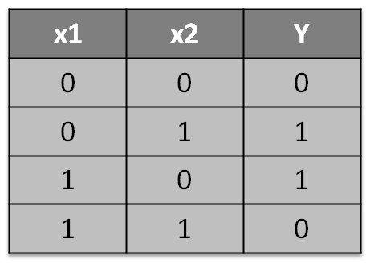
An example to illustrate inductive bias
Consider Boolean formula learning problem. There are 2 inputs and 1 output as follows.
  Give the output of learning
  for this problem.

Slide 7
Output: option-1
An expression which uses the variables to express what is learnt. The expression is as follows
  y = x₁. ~x₂ + ~x₁.x₂
  y = x₁ x₂
+

Slide 8
Output: option-2
A circuit that represents the input with xi’s and the output with y.
x1
y
x2
X-OR gate

Slide 9
Output: option-3
A feed forward neural net which has input output behavior as follows.
y
x1
x2

Slide 10
Where does the inductive Inductive Bias come in?
Inductive bias specifies choosing an option out of the many available to express what is learnt e.g. here we have 3 options – we have to choose one among them.

Slide 11
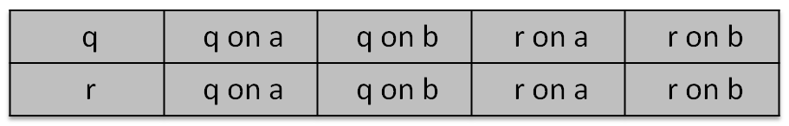
An example
b
Here q is the initial state. We need to learn the probabilities as shown below.
a
q
r
a
b
Source state (col 1) and target states with output symbols

Slide 12
An example (contd.)
Lets take an example sequence.
  # q --> q on a = 0 (no evidence)
  # q --> q on b = 3
  # q --> r on a = 3
  # q --> r on b = 0 (no evidence)
  So, P(q --> q on a ) = 0; P(q --> r on a ) = 3/6 = 1/2
a a b b a b b
q r q q q r q q

Slide 13
Basic idea
  P(q → r on a )=
  # q --> r on
  # all possible transition from q

