Slide 1
CS344 : Introduction to Artificial Intelligence
Pushpak Bhattacharyya
CSE Dept.,
IIT Bombay
Lecture 25:HMM (Training)

Slide 2
Training of the HMM
1: 0.17
0:0.67
a
b
1: 1.0
0: 0.16

Slide 3
Training of HMM
We need a training sequence
Guess Initial Values of Parameters (Probability Values)

Slide 4
Statistical Model Vs Statistical Method

Slide 5
Training of HMM
Step through iterative steps
Expectation Step : (E)
Maximization Step : (M)

Slide 6
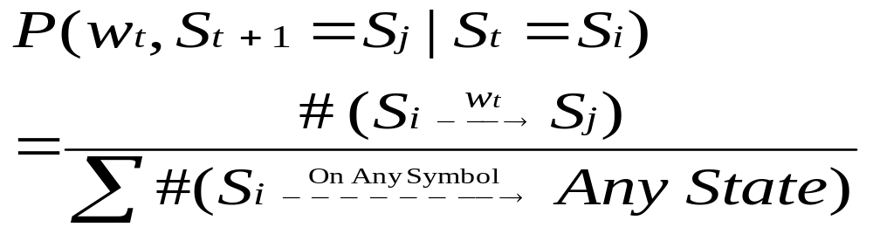

Slide 7
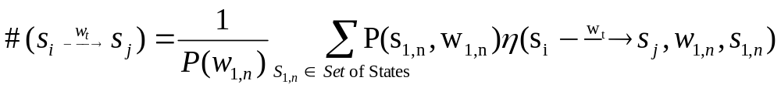
Over all sequences
The term on the right is nothing but the weighted count

Slide 8
Given String : 01011
1st iteration for the example
1: 0.17
0:0.67
Changing to 0.04(Guess)
a
b
1: 1.0
0: 0.16

Slide 9
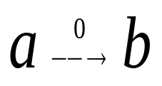
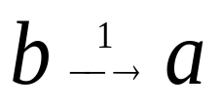
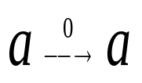
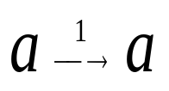
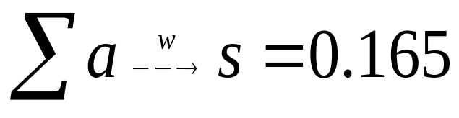
Path | P (Path)
ababaa | 0.00077 | 0.00154 | 0.00154 | 0.0 | 0.00077
abaaaa | 0.00442 | 0.00442 | 0.00442 | 0.00442 | 0.00884
aabaaa | 0.00442 | 0.00442 | 0.00442 | 0.00442 | 0.00884
aaaaaa | 0.02548 | 0.0 | 0.0 | 0.05096 | 0.07644
Total |  | 0.01 | 0.01 | 0.06 | 0.095
New(P) |  | 0.06 | 1.0 | 0.36 | 0.56

