Slide 1
CS344 : Introduction to Artificial Intelligence
Pushpak Bhattacharyya
CSE Dept.,
IIT Bombay
Lecture 26- Reinforcement Learning for Robots; Brain Evidence

Slide 2
Robotic Blocks World
Robot hand
Robot hand
C
A
B
unstack(C),
putdown(C)
A
B
C
START
pickup(B),
stack(B,A)
pickup(C),
stack(C,B)
C
Robot hand
B
B
A
A
C
GOAL

Slide 3
Paradigm Shift
Not the highest probability plan sequence
But the plan with the highest reward
Learn the best policy
With each action of the robot is associated a reward

Slide 4
To learn the policy not the plan
Reinforcement Learning

Slide 5
Perspective on Learning
Learning
  adaptive changes in system
  enable the system to do the same or similar tasks
  more effectively the next time
Types
  Unsupervised
  Supervised
  Reinforcement

Slide 6
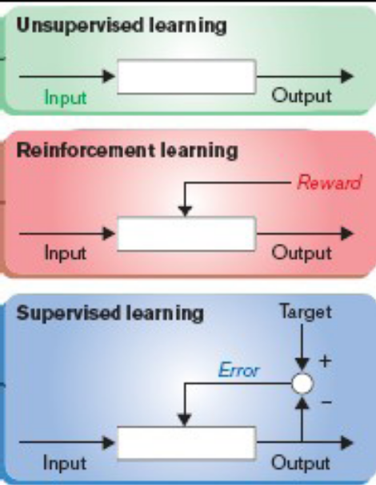
Perspective (contd)

Slide 7
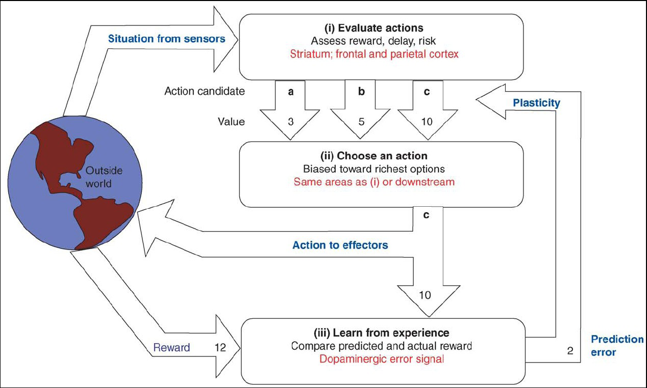
Reinforcement Learning
Trial and error process using predictions on the stimulus
Predict reward values of action candidates
Select action with the maximum reward value
After action, learn from experience to update predictions so as to reduce error between predicted and actual outcomes next time
Schematic showing the mechanism of reinforcement learning
(Source: Daw et. al. 2006)

Slide 8
Neurological aspects of reinforcement learning
(based on the seminar work by Masters students Kiran Joseph, Jessy John and Srijith P.K.)

Slide 9
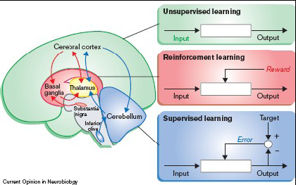
Learning (brain parts involved)
  Cerebral cortex
  Cerebellum
  Basal ganglia
Reinforcement/Reward based learning
Methodologies
  Prediction learning using classical or Pavlovian conditioning
  Action learning using instrumental or operand conditioning

Slide 10
Structures of the reward pathway
Areas involved in reward based learning and behavior
  Basal ganglia
  Midbrain dopamine system
  Cortex
Additional areas of reward processing
  Prefrontal cortex
  Amygdala
  Ventral tegmental area
  Nucleus accumbens
  Hippocampus

Slide 11
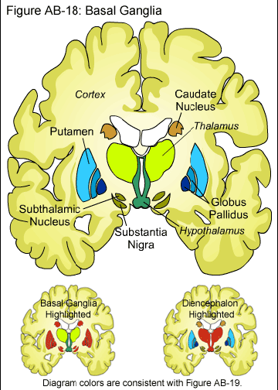
Basal Ganglia
Basal ganglia and constituent structures (Source:http://www.stanford.edu/group/hopes/basics/
braintut/f_ab18bslgang.gif)

Slide 12
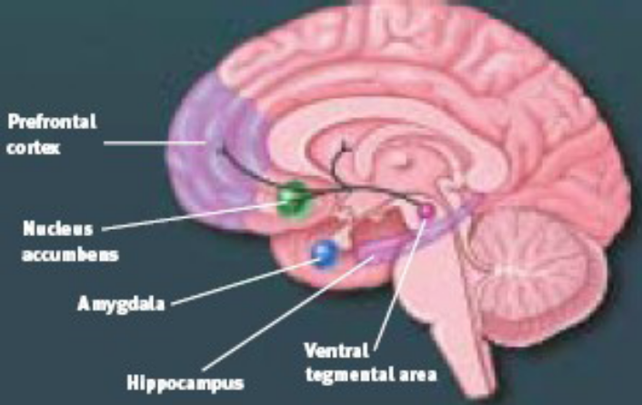
Other relevant brain parts
Prefrontal cortex
  Working memory to maintain recent gain-loss information
The amygdala
  Processing both negative and positive emotions
  Evaluates the biological beneficial value of the stimulus
Ventral tegmental area
  Part of DA system
Nucleus accumbens
  Receives inputs from multiple cortical structures to
  calculate appetitive or aversive value of a stimulus
Subiculum of hippocampal formation
  Tracks the spatial location and context where the reward occurs
Structures of reward pathway (Source: Brain facts: A primer
on the brain and nervous system)

Slide 13
Dopamine neurons
Two types
  From VTA to NAc
  From SNc to striatum
Phasic response of DA neurons to reward or related stimuli
  Process the reward/ stimulus value to decide the behavioral strategy
  Facilitates synaptic plasticity and learning

Slide 14
Dopamine neurons (contd)
Undergo systematic changes during learning
  Initially respond to rewards
  After learning respond to CS and not to reward if present
  If reward is absent depression in
  response Phasic response of dopamine neurons to rewards
  Response remain unchanged for different types of rewards
  Respond to rewards that are earlier or later than predicted
Parameters affecting dopamine neuron phasic activation
  Event unpredictability
  Timing of rewards
Initial response to CS before reward
  initiates action to obtain reward
Response after reward (= Reward Occurred – Reward
  Predicted)
  reports an error in predicted and actual reward learning
  signal to modify synaptic plasticity

Slide 15
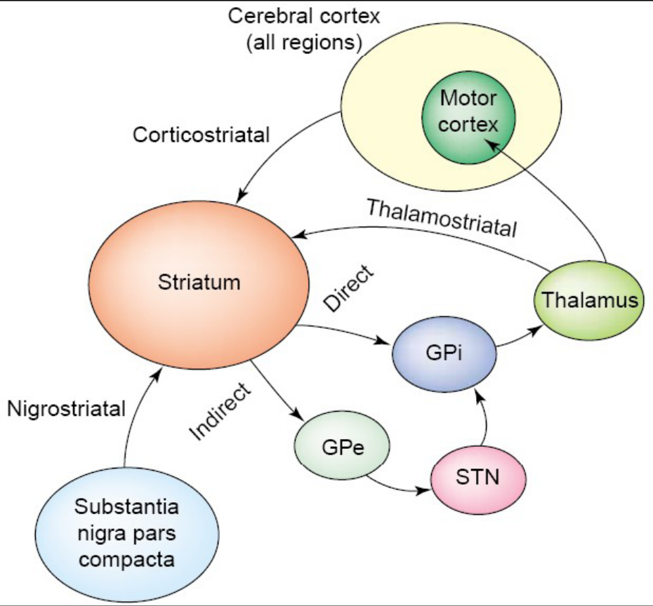
Striatum and cortex in learning
Integration of reward information into behavior through direct and indirect pathways
Learning related plastic changes in the corticostriatal synapses

Slide 16
Reinforcement Learning in Brain: observations
DA identifies the reward present
Basal Ganglia initiate actions to obtain it
Cortex implements the behavior to obtain reward
After obtaining reward DA signals error in
predictions that facilitate learning by modifying
plasticity at cortico striatal synapses

Slide 17
Some remarks

Slide 18
Relation between
Computational Complexity
&
Learning

Slide 19
Learning
Training (Loading)
Testing (Generalization)

Slide 20
Training
Internalization Hypothesis Production

Slide 21
Hypothesis Production
Inductive Bias
In what form is the hypothesis produced?

Slide 22
Name/Label
Table
Chair
Repository of labels
Tables
Chairs
Inter cluster distance
d_{inter}
Intra cluster
Distance,
d_{intra}
d_{intra}
d_{inter}
ε

Slide 23
Basic facts about Computational Reinforcement Learning
Modeled through Markov Decision Process
Additional Parameter: Rewards

Slide 24
State transition, action, reward
δ(s_{i}, a) = s_{j}
transition function with action
r(s_{i}, a_{j}) = P_{ij}
reward function

Slide 25
Important Algorithms
1. Q – learning
2. Temporal Difference Learning
Read Barto & Sutton, “Reinforcement Learning”, MIT Press

