Slide 1
CS344 : Introduction to Artificial Intelligence
Pushpak Bhattacharyya
CSE Dept.,
IIT Bombay
Lecture 5- Deduction Theorem

Slide 2



Formalization of propositional logic (review)
Axioms :
A1
A2
A3
Inference rule:
Given and A, write B
A Proof is:
A sequence of
    i) Hypotheses
    ii) Axioms
    iii) Results of MP
A Theorem is an
Expression proved from axioms and inference rules

Slide 3






Example: To prove
i) A1 : P for A and B
ii) A1: P for A and for B
iii)
A2: with P for A, for B and P for C
iv) MP, (ii), (iii)
v) MP, (i), (iv)

Slide 4






Shorthand
1. is written as and called 'NOT P'
2. is written as and called
'P OR Q’
3. is written as and called
'P AND Q'
Exercise: (Challenge)
- Prove that
$¬P$

Slide 5

A very useful theorem (Actually a meta theorem, called deduction theorem)
Statement
If
A₁, A₂, A₃ ............. A_{n} ├ B
then
A₁, A₂, A₃, ...............A_{n-1}├
├ is read as 'derives'
Given
A₁
A₂
A₃
.
.
.
.
A_{n}
B
A₁
A₂
A₃
.
.
.
.
A_{n-1}
Picture 1
Picture 2

Slide 6




Use of Deduction Theorem
Prove
i.e.,
├ F (M.P)
A├ (D.T)
├ (D.T)
Very difficult to prove from first principles, i.e., using axioms and inference rules only

Slide 7







Prove
i.e.
├ F
├ (D.T)
├ Q (M.P with A3)
P├
├

Slide 8
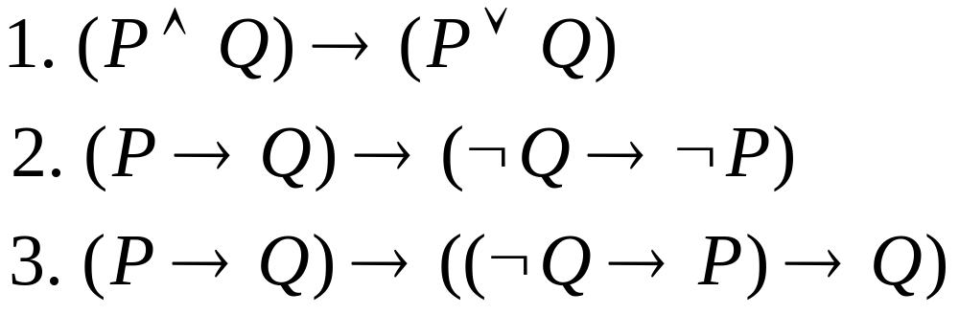
More proofs

Slide 9
Proof Sketch of the Deduction Theorem
To show that
If
A₁, A₂, A₃,… A_{n} |- B
Then
A₁, A₂, A₃,… A_{n-1} |- A_{n} →B

Slide 10
Case-1: B is an axiom
One is allowed to write
A₁, A₂, A₃,… A_{n-1} |- B
|- B→(A_{n}→B)
|- (A_{n}→B); mp-rule

Slide 11
Case-2: B is A_{n}
A_{n}→A_{n} is a theorem (already proved)
One is allowed to write
A₁, A₂, A₃,… A_{n-1} |- (A_{n}→A_{n})
i.e. |- (A_{n}→B)

Slide 12
Case-3: B is A_{i} where (i <>n)
Since A_{i} is one of the hypotheses
One is allowed to write
A₁, A₂, A₃,… A_{n-1} |- B
|- B→(A_{n}→B)
|- (A_{n}→B); mp-rule

Slide 13
Case-4: B is result of MP
Suppose
B comes from applying MP on
E_{i} and E_{j}
Where, E_{i} and E_{j} come before B in
A₁, A₂, A₃,… A_{n} |- B

Slide 14
B is result of MP (contd)
If it can be shown that
A₁, A₂, A₃,… A_{n-1} |- A_{n} →E_{i}
and
A₁, A₂, A₃,… A_{n-1} |- (A_{n} →(E_{i}→B))
Then by applying MP twice
A₁, A₂, A₃,… A_{n-1} |- A_{n} →B

Slide 15
B is result of MP (contd)
This involves showing that
If
A₁, A₂, A₃,… A_{n} |- E_{i}
Then
A₁, A₂, A₃,… A_{n-1} |- A_{n} →E_{i}
(similarly for A_{n}→E_{j})

Slide 16
B is result of MP (contd)
Adopting a case by case analysis as before,
We come to shorter and shorter length proof segments eating into the body of
A₁, A₂, A₃,… A_{n} |- B
Which is finite. This process has to terminate. QED

Slide 17
Important to note
Deduction Theorem is a meta-theorem (statement about the system)
P→P is a theorem (statement belonging to the system)
The distinction is crucial in AI
Self reference, diagonalization
Foundation of Halting Theorem, Godel Theorem etc.

Slide 18
Example of ‘of-about’ confusion
“This statement is false”
Truth of falsity cannot be decided

