Slide 1

GET CAR PRICE
An innovative project leveraging machine learning to accurately estimate used car prices.
Notes:
1

Slide 2

GET CAR PRICE
Subtitle: Predicting used car prices based on various features
By: [Dhawni Jain (S24CSEU0864)
Himanshu (S24CSEU0724)
Dev (S24CSEU0835) ]
Tools Used: Python, Flask, HTML, CSS, Pandas, Scikit-learn
Notes:
2

Slide 3




Introduction: Bridging the Gap in Car Valuation for GET CAR PRICE
This project aims to predict the selling price of a used car based on several crucial factors. By analyzing key attributes, we provide an accurate market value estimate.
Company and Model
Year of Manufacture
Fuel Type
Kilometers Driven
Ownership & Transmission
We built a Machine Learning Model and integrated it with a Flask Web App for real-time, user-friendly predictions for GET CAR PRICE.
Notes:
3

Slide 4


GET CAR PRICE: Project Objectives
1
Fair Market Estimation
Help users accurately estimate the fair market price of a used car, fostering transparency in transactions.
2
Linear Regression Application
Apply Linear Regression, a fundamental statistical model, for robust predictive analysis within the GET CAR PRICE project.
3
Interactive Web Interface
Build a dynamic and intuitive web interface using Flask for seamless user interaction for GET CAR PRICE.
4
End-to-End ML Deployment
Demonstrate comprehensive end-to-end deployment of a machine learning model, from data to web, for GET CAR PRICE.
Notes:
4

Slide 5


Dataset: The Foundation of Our Prediction
Dataset Name: quikr_car.csv
Key Features for Prediction
Data Preprocessing
Company
Removed missing values and duplicate entries to ensure data quality and integrity.
Model Name
Year
Feature Cleaning
Fuel Type
Kms Driven
Cleaned and standardized the 'price', 'kilometers', and 'owner' columns for consistency.
Owner
Transmission
Processed Data Export
Selling Price
Saved the refined dataset as cleaned_car.csv for model training.
Notes:
5

Slide 6
GET CAR PRICE: Crafting the Prediction Engine
Algorithm Used: Linear Regression
01
02
03
Import Libraries
Data Preparation
Data Splitting
Utilized essential libraries such as Pandas for data manipulation, NumPy for numerical operations, and Sklearn for machine learning functionalities.
Performed thorough cleaning and encoding of categorical data to prepare it for the model.
Divided the dataset into distinct training and testing sets to evaluate model performance objectively.
04
05
Model Training
Model Serialization
Trained the Linear Regression Model on the prepared training data, learning the intricate relationships between features and car prices.
Saved the trained model using Pickle as LinearRegressionModel.pkl for future deployment and use.
Notes:
6

Slide 7
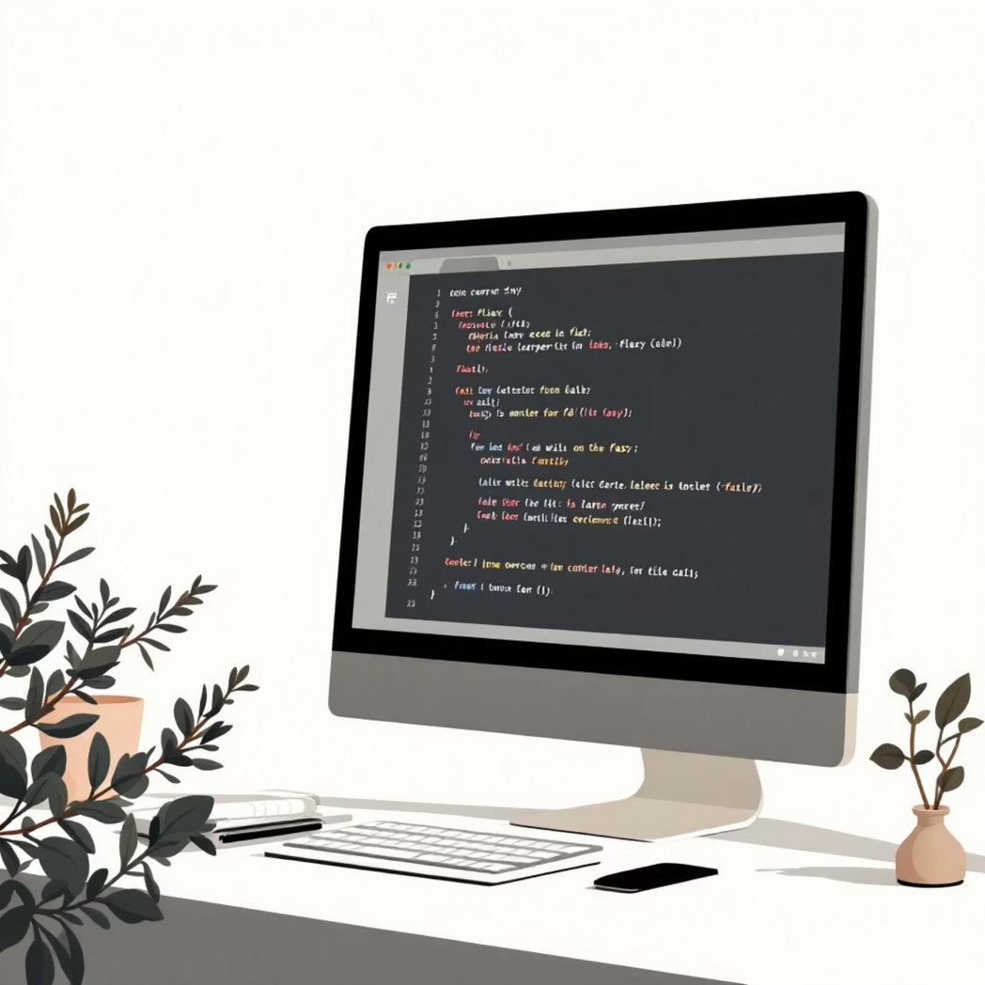
Backend: The Flask Application
The application.py file orchestrates the backend logic, seamlessly integrating our machine learning model with the web interface.
Loads the trained ML model using Pickle.
Reads the cleaned car data from cleaned_car.csv.
Renders index.html to present the user interface.
Collects user inputs from the prediction form.
Predicts the car price using the loaded ML model.
Sends the prediction result back to the frontend for display.
Libraries Used:
Flask, Pandas, Pickle
Notes:
7

Slide 8

Frontend: Interactive User Experience
The index.html file, styled with CSS, provides an intuitive and responsive interface for users to interact with our prediction model.
Frontend Features:
Dropdowns for Company, Model, Year, Fuel Type, Owner, Transmission.
Input field for Kilometers Driven.
Clearly visible Predict Button.
Clean and responsive UI for optimal user experience.
Flask Template Tags:
{{ }} → Used to display dynamic data.
{% %} → Utilized for control flow, loops, and logic within HTML.
Notes:
8

Slide 9





Working Process: From Input to Insight
Our system follows a streamlined process to deliver quick and accurate car price predictions.
User Input
User enters car details on the prediction webpage.
Data Transmission
Data is securely sent to the Flask backend (/predict route).
Backend Processing
Backend preprocesses the received data to match model requirements.
Model Prediction
The trained machine learning model calculates the car's predicted price.
Result Display
The predicted price is then prominently displayed on the same webpage.
Notes:
9

Slide 10





Technologies Used: Our Toolkit for Success
Python
Pandas & NumPy
The core programming language enabling our entire project.
Indispensable libraries for efficient data manipulation and numerical operations.
Scikit-learn
Flask
The robust library used for building and training our machine learning model.
The lightweight web framework powering our interactive application.
HTML & CSS
Pickle
The foundational languages for designing and styling our responsive frontend.
Used for serializing and deserializing our trained machine learning model.
Notes:
10

Slide 11
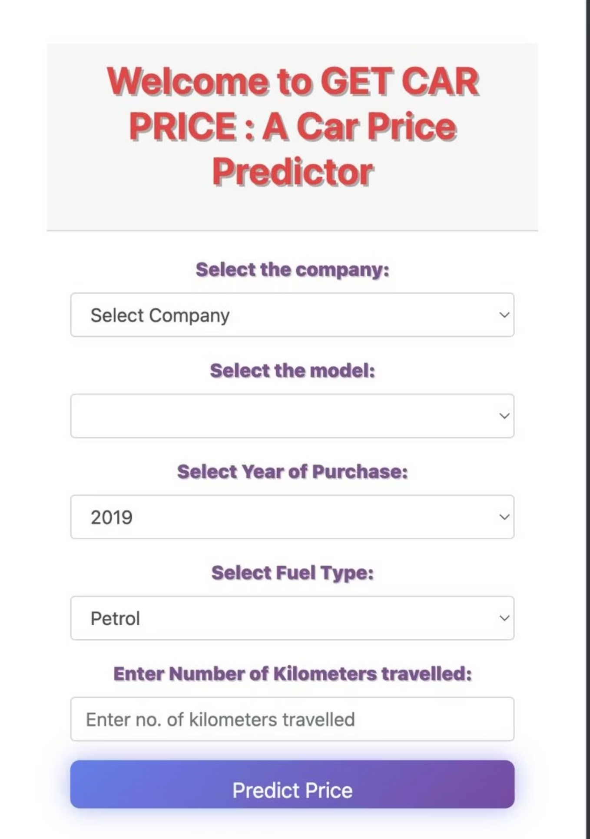
Final Project Output: GET CAR PRICE
Notes:
11

