Slide 1
Website Traffic Forecasting
Machine Learning Project
DHAYANANTH J
BIA- DS & AI

Slide 2

Project Overview: Predicting Digital Footprints
> Our objective was to forecast daily website traffic with high accuracy, dissecting various visit types to provide granular insights.
Visit Types Analyzed
Hybrid Modelling Approach
Business Impact
Unique, First-Time, and Returning visitors were individually tracked and analyzed to understand distinct user behaviors.
We employed a robust hybrid strategy, combining traditional Time Series methods with advanced Machine Learning techniques for comprehensive forecasting.
Accurate traffic predictions enable better resource allocation, strategic planning, and data-driven decision-making across the organization.

Slide 3




Data Preprocessing: Refining Raw Data
Before any analysis or modeling could begin, the raw data underwent meticulous preprocessing to ensure accuracy and consistency.
Date Conversion & Indexing
The date column was converted into a proper datetime format, and the data was chronologically sorted, with the date set as the primary index for time-series analysis.
Cleaning Visit Columns
Commas and spaces were systematically removed from the visit count columns, preparing them for numerical operations.
Numeric Conversion
All visit data was then converted into a numeric format, crucial for quantitative analysis and model input.
Missing Value Imputation
Missing values were addressed using a forward fill method, ensuring continuity in the time series data.

Slide 4
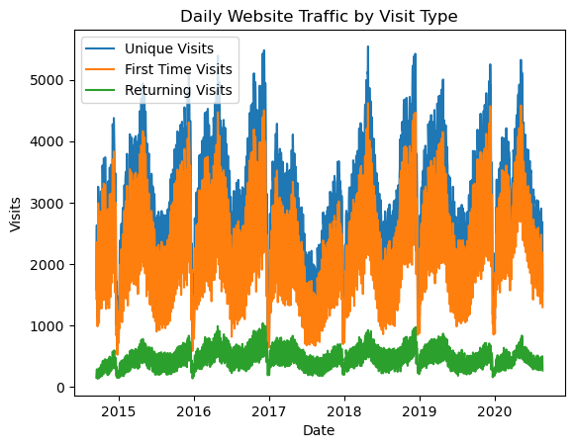
Exploratory Data Analysis: Unveiling Traffic Patterns
Daily Traffic Visualization
Visualized daily traffic trends for all visit types, providing an initial understanding of data behavior.
Website traffic shows clear seasonal patterns over time
Unique and First-Time visits drive major traffic spikes
Returning visits are stable but comparatively low
Indicates strong user acquisition but weaker retention
Traffic patterns justify the need for forecasting models for planning

Slide 5
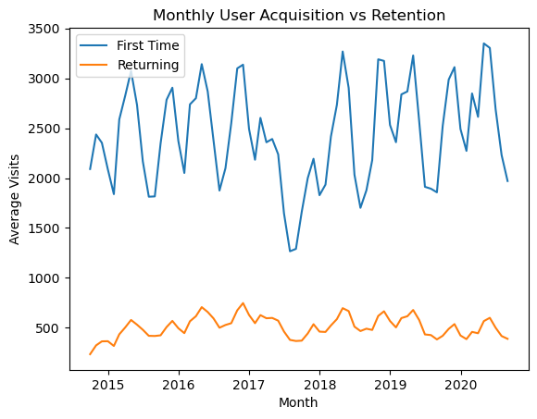
Exploratory Data Analysis: Unveiling Traffic Patterns
Monthly User Acquisition vs Retention
The website successfully attracts new users, but converting them into returning users remains a key growth opportunity.
First-Time Visits are consistently higher than Returning Visits
Acquisition shows strong monthly seasonality with clear peaks and drops
Returning Visits are more stable but significantly lower
Indicates effective user acquisition but weaker retention
Highlights an opportunity to improve user loyalty and repeat engagement

Slide 6
Time Series Modelling: ARIMA for Temporal Patterns
The AutoRegressive Integrated Moving Average (ARIMA) model was selected for its proven ability to capture intricate temporal dependencies and trends in time series data.
Temporal Pattern Capture
ARIMA was specifically used to model and forecast based on historical Unique Visits data, leveraging its strength in identifying patterns over time.
Baseline Forecasting Model
This model served as our foundational statistical forecast, providing a robust benchmark for subsequent machine learning models.
Short-Term Trend Efficiency
ARIMA proved particularly effective for short-term, trend-based forecasting, offering reliable immediate future predictions.

Slide 7



Feature Engineering for Machine Learning
To empower machine learning models, raw date information was transformed into a rich set of predictive features.
Time-Based Features
Key components such as day of the week, month, and year were extracted to provide granular temporal context.
Supervised Learning Conversion
The time series problem was expertly reframed into a supervised learning task, making it accessible for a wider array of ML algorithms.
Calendar Pattern Learning
This feature engineering enabled ML models to effectively learn and leverage recurring calendar-based patterns and cyclical trends.

Slide 8
Advanced Machine Learning Models
> Beyond traditional time series, we deployed sophisticated machine learning models to capture complex, non-linear relationships in the traffic data.
1) Random Forest Regressor
This ensemble model was chosen for its ability to handle non-linear patterns and interactions within the dataset, providing robust predictions.
2) Xgboost Regressor
XGBoost, a highly efficient gradient boosting framework, was employed for its superior accuracy and enhanced robustness against overfitting, further strengthening our predictive capabilities.
3) Complementary Strengths
These ML models complemented the ARIMA baseline by learning complex, non-linear relationships and interactions that simpler models might miss.

Slide 9



Hyperparameter Tuning: Optimizing Random Forest
To achieve peak performance and prevent overfitting, meticulous hyperparameter
tuning was conducted, specifically for the Random Forest Regressor.
GridSearchCV Application
We utilized GridSearchCV to systematically explore a predefined grid of hyperparameter values, ensuring optimal model configuration.
Key Parameter Tuning
Specific parameters such as the number of trees in the forest and the maximum depth of each tree were fine-tuned.
Performance Enhancement
This tuning process significantly improved the model's predictive accuracy and generalized better to unseen data, reducing the risk of overfitting.

Slide 10
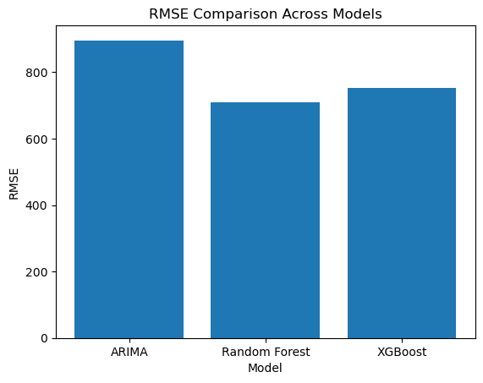

Model Evaluation: Quantifying Forecast Accuracy
Rigorous evaluation is critical to ascertain the reliability and effectiveness of our forecasting models. We focused on key metrics to provide a comprehensive assessment.
RMSE: Prediction Error Magnitude
MAPE: Percentage-Based Error
Root Mean Squared Error (RMSE) was used to measure the average magnitude of the prediction errors, providing a clear understanding of absolute error.
Mean Absolute Percentage Error (MAPE) offered an interpretable percentage-based error, making it easier to communicate performance relative to the actual values.
Model Comparison
A direct comparison of ARIMA, Random Forest, and XGBoost using these metrics allowed for an objective assessment of each model's strengths and weaknesses.

Slide 11
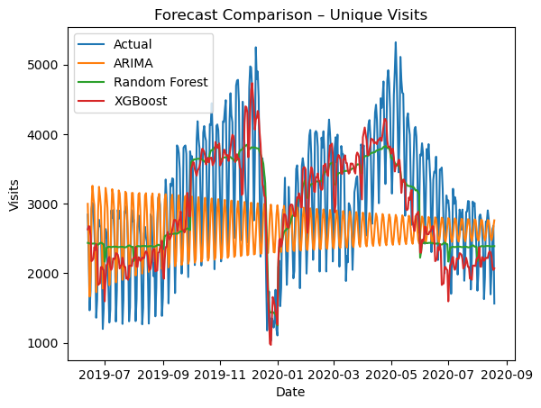
Visualization & Model Comparison
Bringing all the insights together, visual comparisons provided a clear picture of our models' performance against actual traffic, aiding in final model selection.
1
Actual vs. Forecasted Traffic
Visualizations clearly depicted how well each model's predictions aligned with the actual daily website traffic.
2
Comprehensive Forecast Comparison
Forecasts from ARIMA, Random Forest, and XGBoost were laid out side-by-side, enabling a holistic view of their predictive capabilities.
3
RMSE for Clarity
A comparative display of RMSE values offered an immediate and easy-to-understand quantitative measure of each model's accuracy.
4
Best-Performing Model Identification
These visualizations were pivotal in identifying the single best-performing model for our website traffic forecasting needs.

Slide 12
Final Conclusion:
This project successfully developed a hybrid website traffic forecasting system by combining time series and machine learning models.
Proper data preprocessing and feature engineering ensured a clean time series structure. ARIMA was used as a baseline model to capture historical trends, while machine learning models like Random Forest and Xgboost captured non-linear and calendar-based patterns.
Model performance was evaluated using RMSE and MAPE, and machine learning models showed better accuracy compared to the traditional time series approach.
Overall, the hybrid modelling approach improved forecast reliability and provided actionable insights for business planning, resource optimization, and marketing decision-making.

Slide 13
Thank you.

