Slide 1
UNIT-5

Slide 2
OPEN CV
OpenCV is a huge open-source library for computer vision, machine learning, and image processing.
OpenCV supports a wide variety of programming languages like Python, C++, Java, etc. It can process images and videos to identify objects, faces, or even the handwriting of a human.
pip install opencv-python
pip install numpy
pip install matplotlib

Slide 3
TYPES OF FILES
Following types of files are supported in OpenCV library:
Windows bitmaps – *.bmp, *.dib
JPEG files – *.jpeg, *.jpg
Portable Network Graphics – *.png
WebP – *.webp
Sun rasters – *.sr, *.ras
TIFF files – *.tiff, *.tif

Slide 4
Reading an image in OpenCV using Python
import cv2
img = cv2.imread("geeksforgeeks.png", cv2.IMREAD_COLOR)
cv2.imshow("image", img)
cv2.waitKey(0)
cv2.destroyAllWindows()

Slide 5
import cv2
path = r'geeksforgeeks.png'
img = cv2.imread(path, cv2.IMREAD_GRAYSCALE)
cv2.imshow('image', img)
cv2.waitKey(0)
cv2.destroyAllWindows()

Slide 6
HISTOGRAM EQUALISATION
import cv2
import numpy as np
img = cv2.imread(\'F:\\do_nawab.png\', 0)
equ = cv2.equalizeHist(img)
cv2.imshow(\'image\', res)
cv2.waitKey(0)
cv2.destroyAllWindows()

Slide 7
DISPLAYING TEXT IN IMAGE
import cv2
path = r'C:\Users\Rajnish\Desktop\geeksforgeeks\geeks.png'
image = cv2.imread(path)
font = cv2.FONT_HERSHEY_SIMPLEX
org = (50, 50)
fontScale = 1
color = (255, 0, 0)
thickness = 2
image = cv2.putText(image, 'OpenCV', org, font, fontScale, color, thickness, cv2.LINE_AA)
cv2.imshow(window_name, image)

Slide 8
DRAWING A CIRCLE
import cv2
path = r'C:\Users\Rajnish\Desktop\geeksforgeeks\geeks.png'
image = cv2.imread(path)
window_name = 'Image'
center_coordinates = (120, 50)
radius = 20
color = (255, 0, 0)
thickness = 2
image = cv2.circle(image, center_coordinates, radius, color, thickness)
cv2.imshow(window_name, image)

Slide 9
DRAWING A RECTANGLE
import cv2
path = r'C:\Users\Rajnish\Desktop\geeksforgeeks\geeks.png'
image = cv2.imread(path)
window_name = 'Image‘
start_point = (5, 5)
end_point = (220, 220)
color = (255, 0, 0)
thickness = 2
image = cv2.rectangle(image, start_point, end_point, color, thickness)
Cv2.imshow(window_name, image)

Slide 10
import cv2
import numpy as np
cap = cv2.VideoCapture('Spend Your Summer Vacations\
Wisely! Ft. Sandeep Sir _ GeeksforGeeks.mp4')
if (cap.isOpened()== False):
print("Error opening video file")
while(cap.isOpened()):
# Capture frame-by-frame
ret, frame = cap.read()
if ret == True:
# Display the resulting frame
cv2.imshow('Frame', frame)
# When everything done, release the video capture object
cap.release()
# Closes all the frames
cv2.destroyAllWindows()

Slide 11
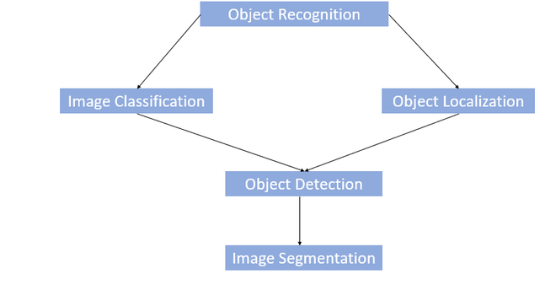
OBJECT RECOGNITION

Slide 12
Stepwise Implementation:
Step 1: Loading the image
Step 2: Converting the image to grayscale
Step 3: Loading the required haar-cascade XML classifier file
Step 4: Applying the face detection method on the grayscale image
This is done using the cv2::CascadeClassifier::detectMultiScale method, which returns boundary rectangles for the detected faces (i.e., x, y, w, h). It takes two parameters namely, scaleFactor and minNeighbors.
Step 5: Iterating through rectangles of detected faces
Rectangles are drawn around the detected faces by the rectangle method of the cv2 module by iterating over all detected faces.

Slide 13
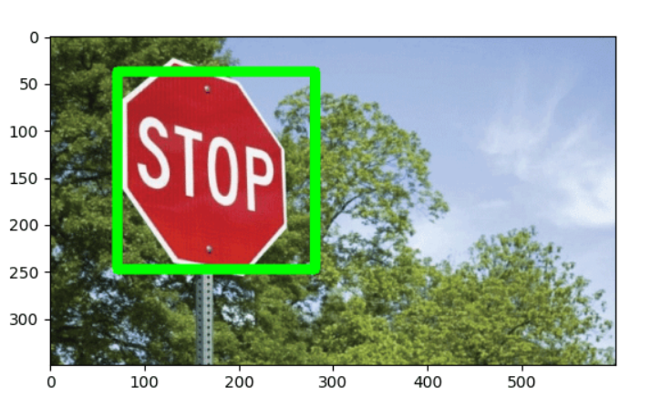

Slide 14
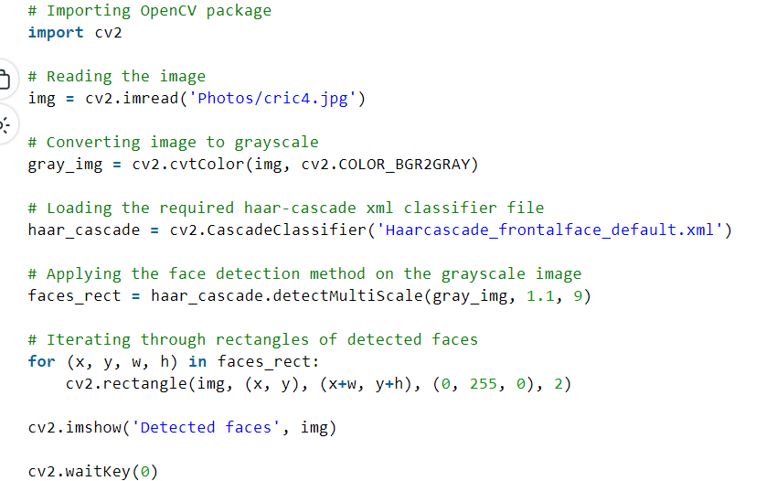

Slide 15
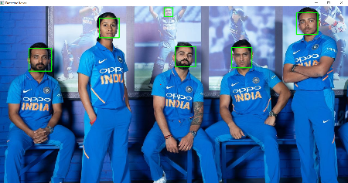

Slide 16
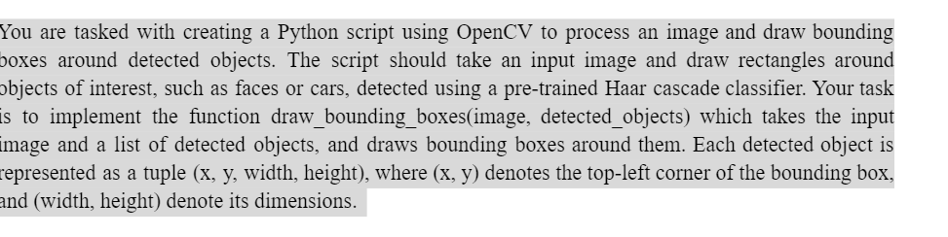

Slide 17
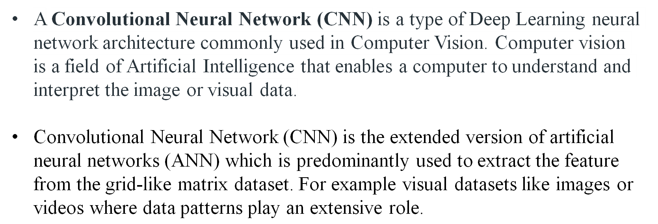

Slide 18

Key Components of CNNs
Convolutional Layer
Activation Functions
Pooling Layer
Fully Connected Layer
Dropout Layer

Slide 19
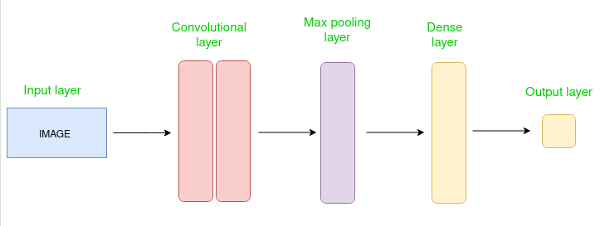

Slide 20
1. Convolutional Layer
The convolutional layer is the core building block of a CNN. It consists of a set of learnable filters (or kernels) that are convolved with the input data.
Filters (Kernels): Small matrices that move across the input data to detect features.
Stride: The number of pixels by which the filter moves. Stride of 1 means the filter moves one pixel at a time.
Padding: Adding extra pixels around the input data to ensure that the filters fit properly. Types of padding include 'valid' (no padding) and 'same' (output size is the same as input size).

Slide 21
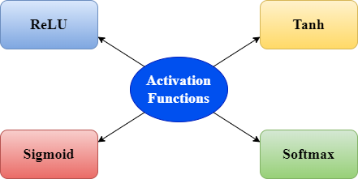
2.Activation Functions
Convolutional layer is designed along with the specific activation function to learn intricate structures. Activation functions introduce non-linearity into the model, enabling it to learn complex patterns. Common activation functions used in CNNs are:

Slide 22
Situations for Using Specific Activation Functions:
ReLU:
  Most commonly used in hidden layers of CNNs for a wide variety of tasks due to its simplicity and effectiveness.
  Situations where quick convergence and handling of large datasets are required.
Sigmoid:
  Output layer for binary classification tasks.
  Situations where probabilities or decisions between two classes are needed.

Slide 23
4. Tanh:
  Hidden layers in neural networks where centering data can help with convergence.
  Situations where an output range between -1 and 1 is useful, often in regression problems or as intermediate representations.
5. Softmax:
  Output layer for multiclass classification tasks.
  Situations where a probability distribution over multiple classes is required to determine the most likely class.

Slide 24
3. Pooling Layer
Pooling layers are used to reduce the spatial dimensions of the input volume, thus reducing the number of parameters and computations in the network.
Max Pooling: Selects the maximum value from each window.
Average Pooling: Computes the average of all values in the window.

Slide 25
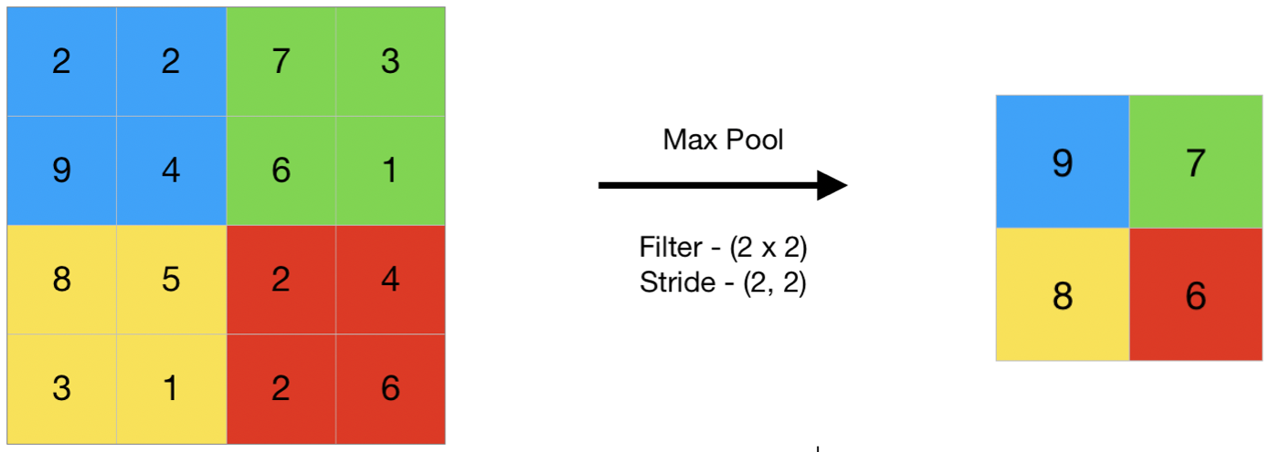
Maximum Pooling Layer:

Slide 26
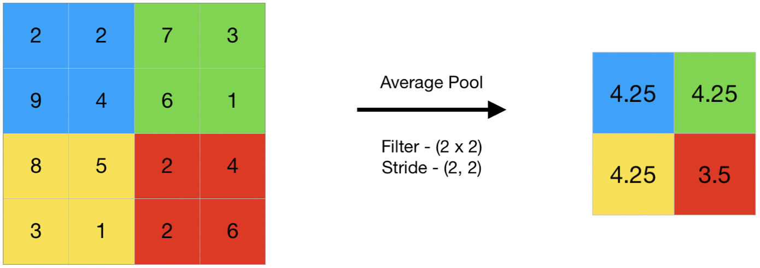
Average Pooling Layer:

Slide 27
4. Fully Connected Layer
Fully connected layers are used at the end of the CNN to combine the features learned by the convolutional and pooling layers. Each neuron in a fully connected layer is connected to every neuron in the previous layer. Fully Connected Neural Network Layer consists of 3 blocks:
Input Layer
Hidden Layer
Output Layer
5. Dropout Layer
Dropout layers are used to prevent overfitting. During training, randomly selected neurons are ignored (dropped out).

Slide 28
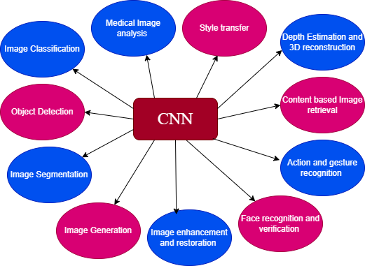
CNN used for Various Tasks

Slide 29
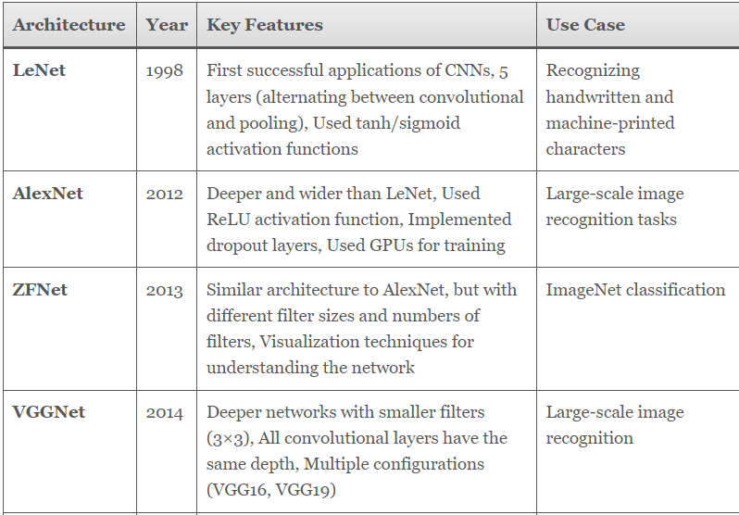

Slide 30
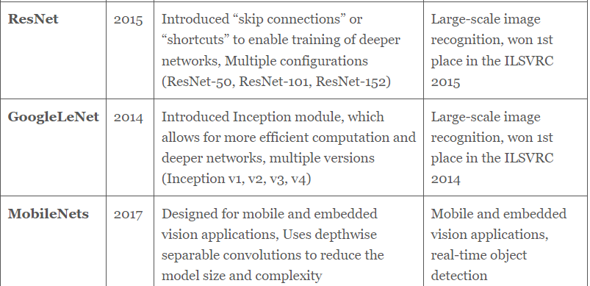

Slide 31
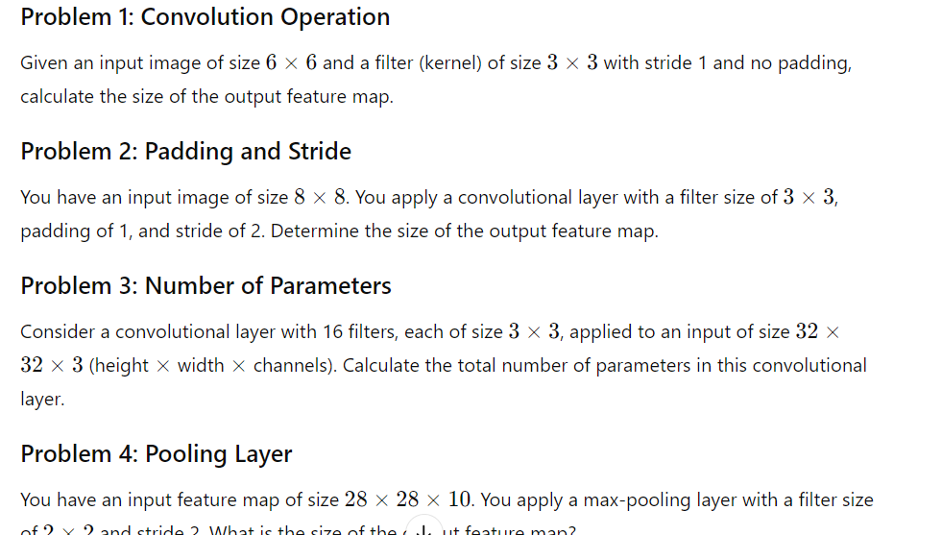

Slide 32
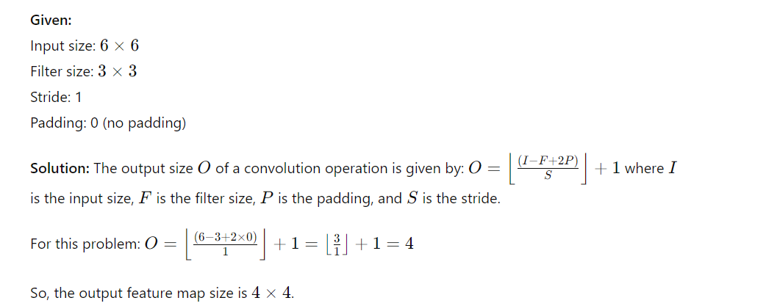

Slide 33
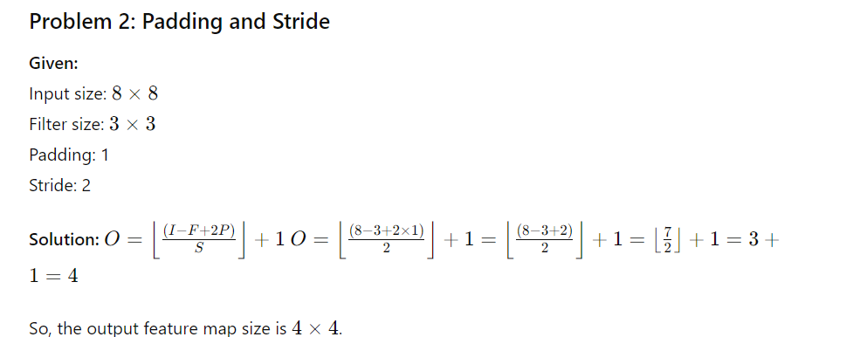

Slide 34
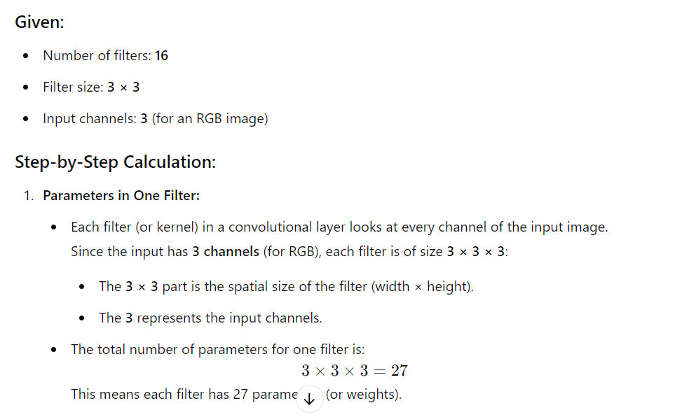

Slide 35
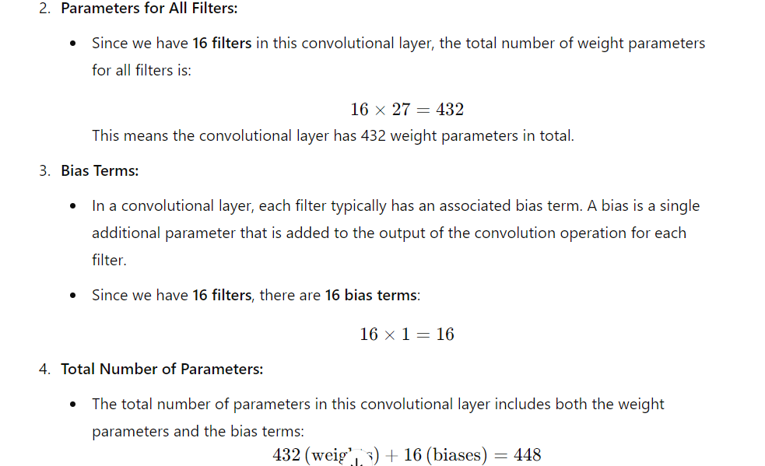

Slide 36
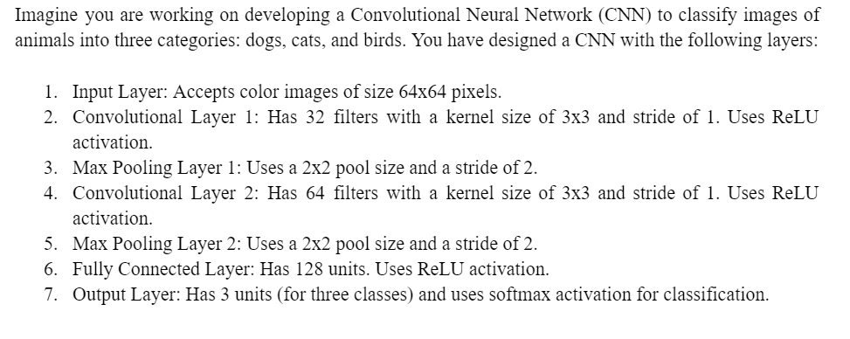

Slide 37
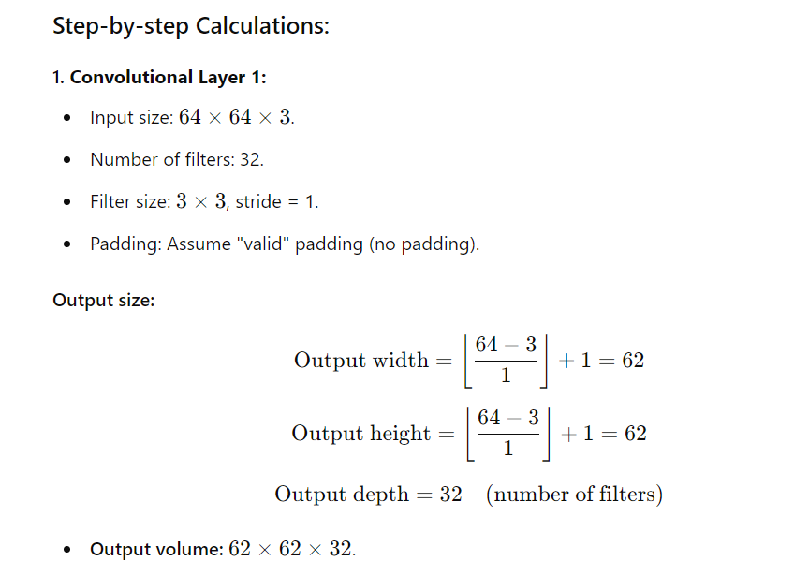
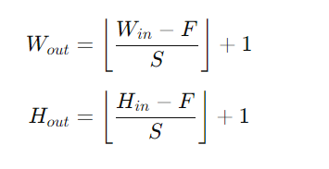

Slide 38
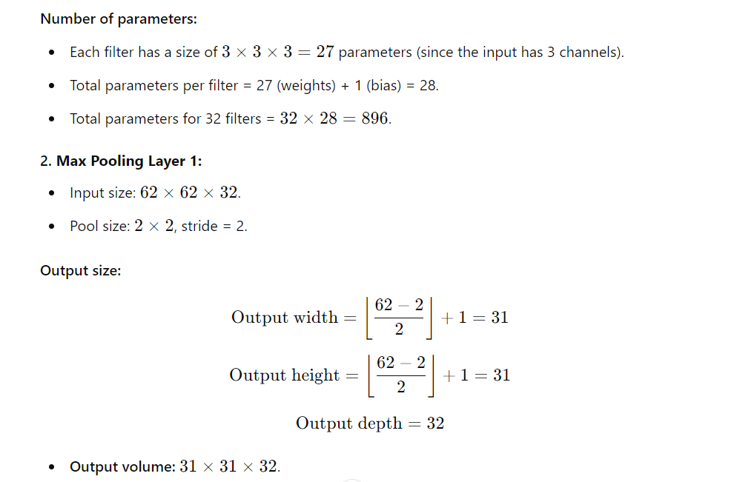

Slide 39
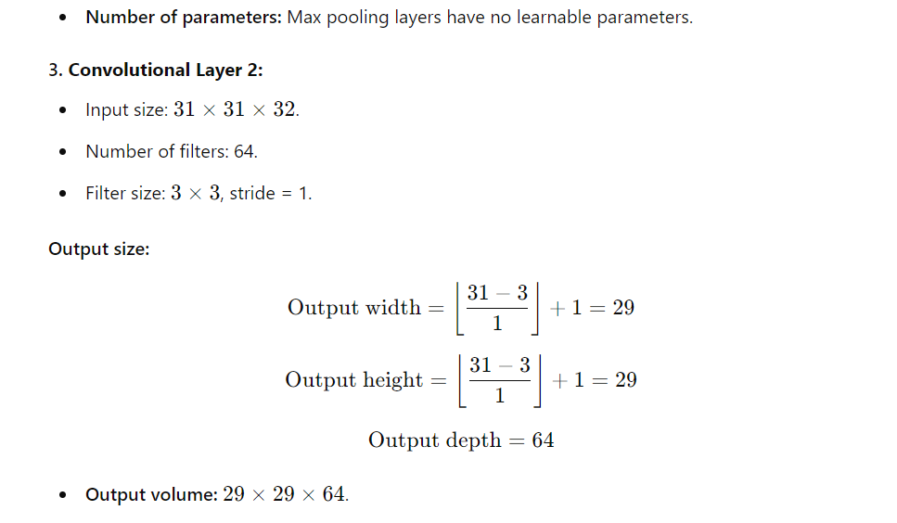

Slide 40
