Slide 1
Implementation of Link-State Routing Protocol
Nagaraj, Dhayalini
CWID-A20359686
Main Campus, Section -02
Seat No: 53

Slide 2
Link-state routing protocol
Link-state routing protocols are one of the two main classes of routing protocols used in packet switching networks for computer communications the other being distance-vector routing protocols.
Examples :
Open Shortest Path First (OSPF)
Intermediate system to intermediate system (IS-IS).

Slide 3
Algorithm
Distance value is assigned to every node: Zero is set for the initial node and all other nodes are set to infinity.
The initial node should be marked as current and all the other nodes are marked as unvisited.
The initial node is the current node, the other unvisited nodes are considered and the tentative distance is calculated.
The newly calculated distance is compared and the smallest distance is assigned to the nodes.
If all the neighbours of the current node is considered then mark the current node as visited and remove it from the unvisited set. A visited node will never be checked.
If the destination node has been marked visited (when planning a route between two specific nodes) or if the smallest tentative distance among the nodes in the unvisited set is infinity (when planning a complete traversal; occurs when there is no connection between the initial node and remaining unvisited nodes), then stop. The algorithm has finished.
Otherwise, select the unvisited node that is marked with the smallest tentative distance, set it as the new "current node", and go back to step 3.

Slide 4
Implementation
Read the input file and store the values in Hashmap such that each node represent a key and value is a array of edge object that contains the key, other nodes and its edge weight.
The minimum weight is set as 0.
Compare the edge weight of the source router to all the other routers.
The minimum weight is update as the source router moves to other router through intermediate router which has a minimum distance.

Slide 5
Implementation(cont.)
The path of the router is saved in direct nodes if there is a direct connection from the source router to other router or in indirect nodes if there is no direct connection from source router to other routers.
The path cost is also update and saved in a map.
This continues till all the nodes are marked as visited nodes.

Slide 6
To Run the Program
The above algorithm is implemented in JAVA and submitted as executable JAR file
The JAR file is executed via command prompt using the following command:
$java –jar <filename>

Slide 7
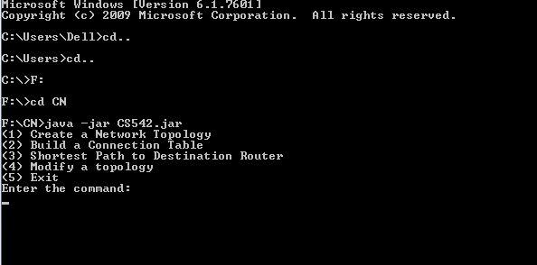
Working
Once the code is executed it displays the menu option.

Slide 8
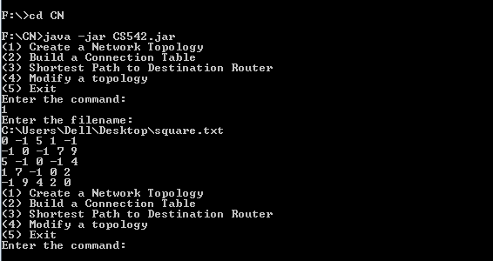
Working(cont)
When the user input is 1, it prompts to enter the input file.
Once the input file is entered, the file is read and displayed. The menu options are displayed again.

Slide 9
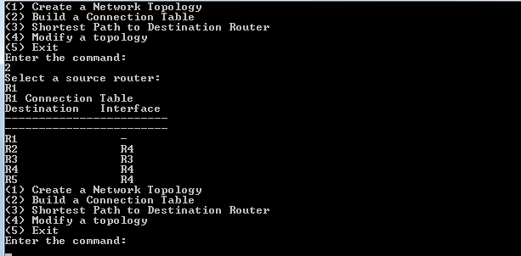
Working(c0nt)
When the user option is 2,the user is requested to enter the source router.
The program displays the connection table and returns to the main menu.

Slide 10
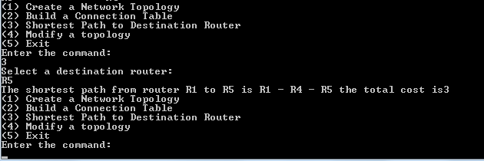
Working(c0nt)
When the user option is 3,the user is requested to enter the destination router.
The program displays the shortest path, the cost and returns to the main menu.

Slide 11
Working(c0nt)
When the user option is 4,the user should enter a router that has to be removed.
The updated connection table for the source router and the destination router is displayed.
The shortest path and its cost is displayed and return to the main menu.

Slide 12
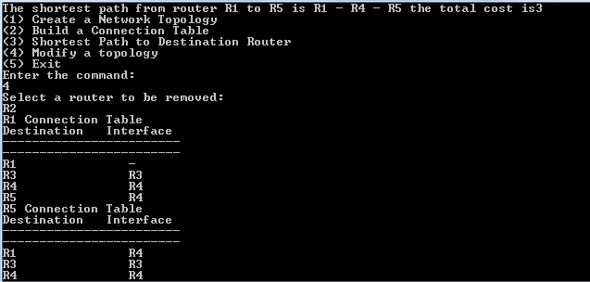
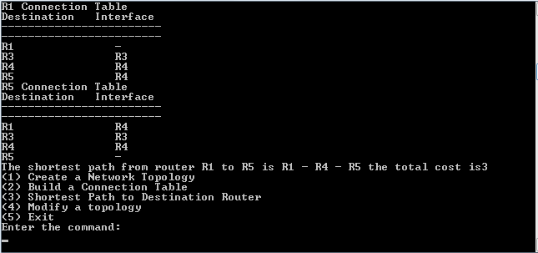
Working(c0nt)

Slide 13
Working(c0nt)
If the source or destination is the router to be removed then only the connection is table is displayed and the shortest path, cost will not be displayed.
The topology can be modified only once. To modify it again the input file should be loaded again.

Slide 14
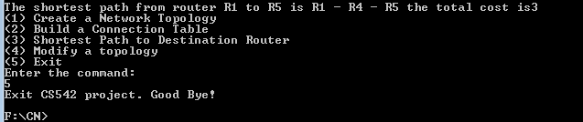
Working(c0nt)
When the user option is 5, a message is displayed and the program exits.

Slide 15
Testing
The Link state routing protocol implementation has been tested with different input files.
The maximum numbers of nodes tested is 8
All the menu options were tested while testing different cases and the program works fine.

Slide 16
Thank You

