Slide 1
DHAYANANDH S
Final Project

Slide 2
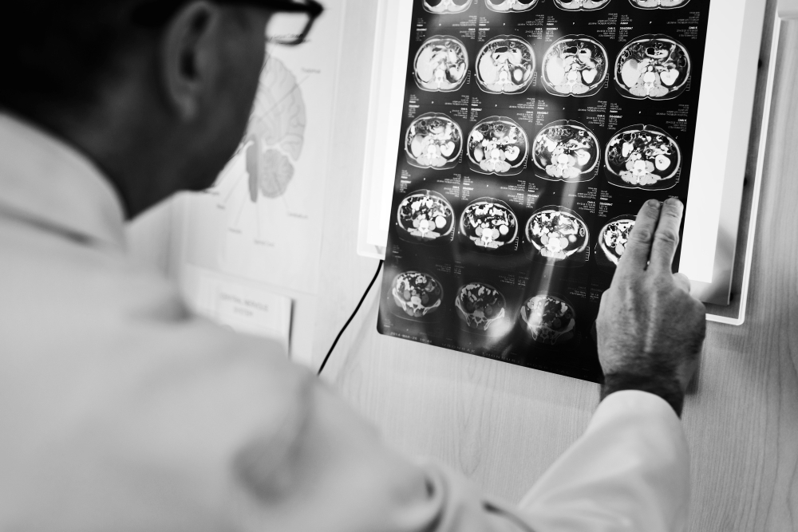
PROJECT TITLE
CNN-based Image Classification for Medical Diagnosis (Pneumonia Detection)

Slide 3


AGENDA
The project aims to develop a Convolutional Neural Network (CNN)-based system for the automated detection of pneumonia in medical imaging, specifically focusing on chest X-ray images. By leveraging deep learning techniques, the system seeks to improve the efficiency and accuracy of pneumonia diagnosis, ultimately benefiting patients and healthcare providers.
Data Preprocessing
Building Model Structure
Training Data in Model
Model Performance
Model Evaluation
Model Prediction
Classification Report

Slide 4

PROBLEM STATEMENT
Pneumonia is a serious respiratory infection that can be life-threatening if not diagnosed and treated promptly. However, the traditional method of diagnosing pneumonia through manual interpretation of chest X-ray images by radiologists can be time-consuming and subjective, leading to potential delays and errors in diagnosis and treatment.

Slide 5

PROJECT OVERVIEW
The project will involve collecting and preprocessing a large dataset of chest X-ray images to train and validate the CNN model. State-of-the-art deep learning techniques will be employed to ensure the model's accuracy and generalizability. The trained model will then be integrated into a user-friendly interface that allows healthcare professionals to upload chest X-ray images and receive automated pneumonia diagnosis results.
Additionally, the project will focus on ensuring the ethical and responsible use of AI in healthcare. Measures will be taken to address issues such as data privacy, bias mitigation, and model interpretability. The project will also aim to educate healthcare professionals about the capabilities and limitations of AI in medical diagnosis, fostering trust and collaboration between humans and AI systems in healthcare settings.

Slide 6
WHO ARE THE END USERS?
The end users of this system include healthcare professionals such as radiologists, pulmonologists, and general practitioners who are involved in the diagnosis and treatment of pneumonia. Additionally, the system can benefit patients by providing faster and more accurate diagnosis, leading to timely treatment and improved outcomes.

Slide 7

YOUR SOLUTION AND ITS VALUE PROPOSITION
Solution: CNN-based Image Classification for Medical Diagnosis
Value Proposition: Our CNN-based system offers a faster and more accurate method of diagnosing pneumonia compared to traditional manual methods. By automating the diagnosis process using CNNs, our system can analyze chest X-ray images quickly and accurately, reducing the time and effort required by healthcare professionals to make a diagnosis. This can lead to earlier detection of pneumonia, timely treatment, and improved patient outcomes.

Slide 8

THE WOW IN YOUR SOLUTION
One of the key advantages of our solution is its ability to analyze chest X-ray images with a high level of accuracy, matching or even exceeding the performance of human radiologists. Additionally, our system can process images much faster than humans, making it ideal for use in busy healthcare settings where quick diagnoses are crucial.
8

Slide 9
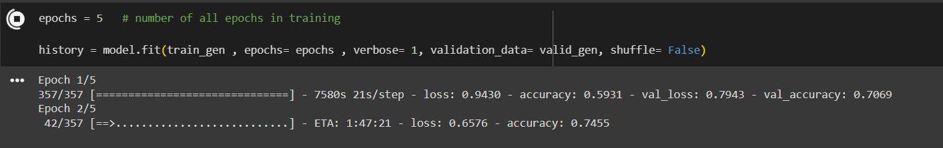
MODELLING
The modelling phase of the CNN-based Image Classification for Medical Diagnosis project involves several key steps to develop and train CNN model for classifying X-ray images. Here is an overview of the modelling phase:
The CNN model will be trained on a dataset of chest X-ray images labeled as either pneumonia-positive or pneumonia-negative. The model will consist of multiple convolutional layers followed by pooling layers and fully connected layers. We will use techniques such as data augmentation and transfer learning to improve the model's performance.
9

Slide 10

APPLICATIONS
Medical Diagnosis Assistance: The CNN model will serve as a supplementary tool for healthcare professionals, assisting them in interpreting chest X-ray images and identifying potential cases of pneumonia.
Resource Optimization: By automating the initial screening process, the model can help prioritize cases for further review by medical experts, optimizing time and resources in busy healthcare settings.
Remote Healthcare: In regions with limited access to medical facilities or expert radiologists, the CNN model can be deployed as a remote diagnostic tool, enabling early detection and intervention for pneumonia cases.
Research and Training: The dataset and trained model can be valuable resources for medical researchers and students studying pneumonia detection algorithms and deep learning applications in medical imaging.
Public Health Surveillance: By providing accurate and efficient pneumonia detection, the project contributes to public health efforts by facilitating early identification and monitoring of pneumonia outbreaks.

Slide 11
RESULTS
The trained CNN model is expected to achieve a high level of accuracy in classifying chest X-ray images as pneumonia-positive or pneumonia-negative. This will be validated using a separate test dataset. The ultimate goal is to develop a reliable and efficient tool for the automated diagnosis of pneumonia, aiding healthcare professionals in providing timely and accurate treatment to patients.
https://colab.research.google.com/drihttps://colab.research.google.com/drive/1ods52W51Whbmst4YzJ0dj6OKitPOQOQmve/1ZAc6WqTbrvzU_HV0zAHDStSA1QxCfExy
11

