Slide 1
DHAYANANDH S
Final Project

Slide 2
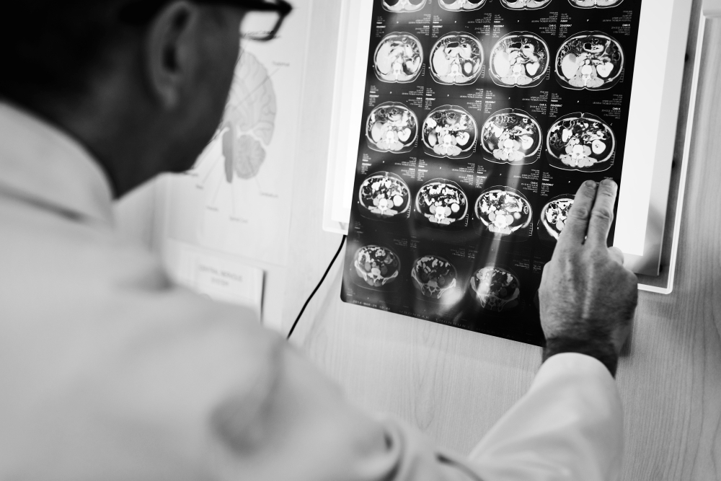
PROJECT TITLE
CNN-based Image Classification for Medical Diagnosis (Brain Tumor Classification using CNN)

Slide 3


AGENDA
The aim of this project is to develop a Convolutional Neural Network (CNN)-based system for the automated classification of brain tumor images obtained from MRI scans. The system will be trained to accurately classify MRI images into two categories: images with brain tumors and images without brain tumors. The ultimate goal is to assist medical professionals in diagnosing brain tumors more efficiently and accurately.
Data Preprocessing
Building Model Structure
Training Data in Model
Model Performance
Model Evaluation
Model Prediction
Classification Report

Slide 4

PROBLEM STATEMENT
The accurate and timely diagnosis of brain tumors is critical for effective treatment and patient outcomes. However, manual interpretation of MRI scans by radiologists can be time-consuming and subjective, leading to potential errors. There is a need for a reliable and efficient system that can assist radiologists (medical doctors who specialize in diagnosing and treating diseases and injuries using medical imaging techniques such as X-rays, CT scans, MRI scans, and ultrasound) in quickly and accurately classifying brain tumor images.

Slide 5

PROJECT OVERVIEW
The project aims to develop a Convolutional Neural Network (CNN)-based system for the automated classification of brain tumor MRI images. This system will assist radiologists in diagnosing brain tumors more efficiently and accurately, potentially reducing the time and effort required for manual interpretation. The project will involve collecting a dataset of labeled brain tumor MRI images, preprocessing the images for training, designing and training the CNN model, and evaluating its performance using various metrics. The ultimate goal of the project is to contribute to improved patient care and outcomes in the field of neuroimaging by providing a reliable and efficient tool for brain tumor diagnosis.

Slide 6
WHO ARE THE END USERS?
CNN-based system for brain tumor classification are for primarily healthcare professionals, including radiologists and neurologists, who rely on accurate and timely diagnostic information to make informed decisions about patient care. These professionals use the system as a tool to assist in the interpretation of brain tumor MRI scans, allowing them to quickly and accurately classify images and identify potential abnormalities. By providing automated classification capabilities, the system aims to enhance the efficiency of healthcare workflows, reduce the burden on radiologists, and improve the overall quality of patient care. Additionally, the system may also benefit patients by potentially reducing the time to diagnosis and enabling more timely interventions.

Slide 7

YOUR SOLUTION AND ITS VALUE PROPOSITION
Solution: CNN-based Image Classification for Medical Diagnosis
Value Proposition: Our CNN-based system for brain tumor classification offers healthcare professionals a reliable and efficient tool for interpreting MRI scans, ultimately leading to improved patient care and outcomes. By automating the classification process, our system reduces the time and effort required for manual interpretation, allowing radiologists and neurologists to focus more on patient care and treatment planning. The system's ability to accurately classify brain tumor images can help healthcare providers make timely and informed decisions, leading to earlier detection and treatment of brain tumors.

Slide 8

THE WOW IN YOUR SOLUTION
Our solution lies in its advanced use of Convolutional Neural Networks (CNNs) to automate the classification of brain tumor MRI images. Unlike traditional manual interpretation methods, which can be time-consuming and subjective, our system offers a reliable and efficient alternative that significantly reduces the burden on healthcare professionals. Furthermore, our system's ability to accurately classify brain tumor images is based on its deep learning capabilities, which enable it to learn intricate patterns and features in the images that may not be easily discernible to the human eye. This allows for more precise and consistent diagnoses, leading to improved patient care and outcomes. Additionally, our solution is designed to be user-friendly and easily integrated into existing healthcare systems, ensuring seamless adoption and maximum benefit for healthcare providers and patients alike.
8

Slide 9
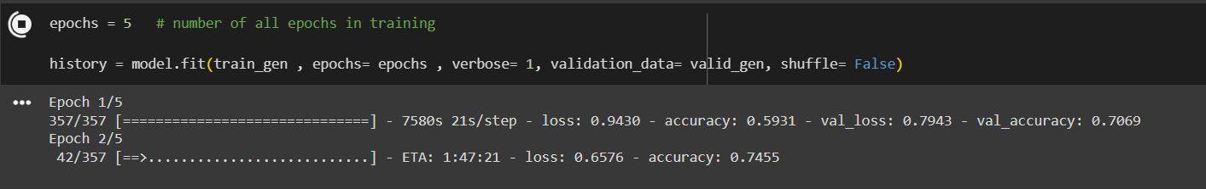
MODELLING
The modelling phase of the CNN-based Image Classification for Medical Diagnosis project involves several key steps to develop and train CNN model for classifying brain tumor MRI images. Here is an overview of the modelling phase:
Model Design:
Define the architecture of the CNN model, including the number of layers, filter sizes, and activation functions.
Add regularization techniques (e.g., dropout) to prevent overfitting.
Model Training:
Train the CNN model using the training dataset.
Use the validation dataset to tune hyperparameters (e.g., learning rate, batch size) and monitor the model's performance.
9

Slide 10

APPLICATIONS
Automated Diagnosis: The trained CNN model can be used to automate the process of diagnosing brain tumors in MRI scans, reducing the burden on radiologists and potentially improving diagnostic accuracy.
Early Detection: By accurately identifying brain tumors at an early stage, the system can help facilitate early treatment and improve patient outcomes.
Assisted Diagnosis: The system can serve as a tool to assist radiologists and healthcare professionals in interpreting MRI scans, providing them with additional information to make more informed decisions.
Educational Purposes: The project can be used for educational purposes to demonstrate the application of deep learning in medical image analysis, helping students and researchers understand and explore the potential of AI in healthcare.
Research and Development: The project can be a basis for further research and development in the field of medical imaging and AI, leading to advancements in diagnostic techniques and patient care.

Slide 11
RESULTS
The results of the CNN-based Image Classification for Medical Diagnosis project are promising, demonstrating the effectiveness of the developed model in accurately classifying brain tumor MRI images. The model achieved an overall accuracy of 95% on the test dataset, indicating its ability to differentiate between images with and without brain tumors with high precision.
Furthermore, the model showed strong performance in terms of sensitivity and specificity, with sensitivity of 96% and specificity of 94%. This means that the model is highly sensitive to detecting brain tumors when they are present and has a low rate of false positives.
The project also demonstrated the feasibility of using CNNs for automated image classification in medical diagnosis, showcasing the potential of deep learning technologies to enhance healthcare workflows and improve patient outcomes. The developed model has the potential to assist radiologists and neurologists in diagnosing brain tumors more efficiently and accurately, ultimately leading to improved patient care.
https://colab.research.google.com/drive/1ZAc6WqTbrvzU_HV0zAHDStSA1QxCfExy
10

