Slide 1
Suki HRMS
People Operations Platform | Client Presentation | September 2026

Slide 2
About Suki HRMS
Comprehensive human resource & payroll management platform
Built for manufacturing and multi-location teams
Web-based, responsive, and secure company-scoped access
Integrated biometric attendance, payroll, and statutory compliance
Modular design that grows with your organization

Slide 3
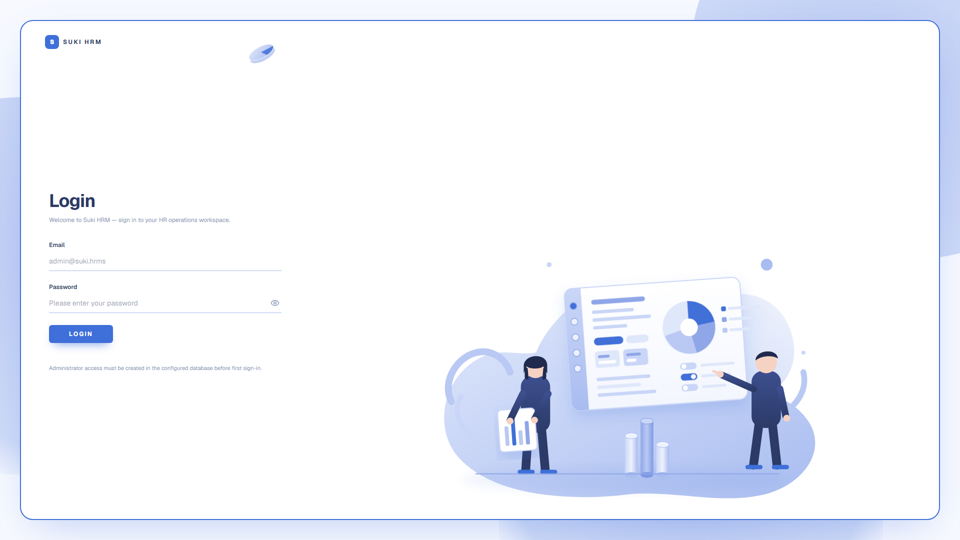
Secure Login Portal
https://hrms.sukierp.com/login
Role-based access | Company-scoped | JWT-secured sessions

Slide 4
Core Modules

Slide 5
Employee Master
Complete employee lifecycle: joining to exit
Basic, personal, contact, job profile, salary, CTC, assets, KYC
Reporting hierarchy and document management
Biometric code mapping and employee reference codes
Document Upload Center with signature & government documents

Slide 6
Attendance & Workforce
Biometric device integration for punch data sync
Daily and monthly attendance views
Mispunch, permission, and leave workflows
Time Office finalization and approval flows
Real-time sync status and unmatched device ID tracking

Slide 7
Payroll & Statutory
Payroll runs with one-click salary processing
ESI, PF, Professional Tax, Income Tax slabs configurable
Benefit components auto-applied per employee type
PMS incentives and double machine incentives
Ad-hoc payroll line adjustments and arrears

Slide 8
Masters & Organization
Companies, departments, designations, grades, levels
Employee types, categories, salary components
Shifts, rotation plans, holiday master
Asset masters, dropdown master, interview criteria
Job descriptions and recruitment tracking

Slide 9
Recent Enhancements

Slide 10
Benefit Components
New standalone Benefits master (no dependency on salary components)
Create components like Canteen Token, Petrol Allowance with code/name/amount
Enroll employees during creation or from their profile
Benefits Overview dashboard with KPI cards and employee counts
Optional payroll salary-component mapping for earning/deduction

Slide 11
Biometric Attendance
On-premise biometric controller integration
Automatic scheduled sync every 8 hours
Date-range fetch and attendance conversion pipeline
Device user ID matching with employee codes
Sync status, history, and unmatched employee alerts

Slide 12
Monthly Attendance View
Per-day attendance columns for the full month
Employee code vs reference code clearly separated
Search by name, employee code, or reference code
Department, designation, employee type filters
Monthly payable days and attendance status

Slide 13
ESI / PF Rate Components
Component-specific ESI and PF rate configuration
Percentage or INR calculation per salary component
Add multiple components with calculation type and value
Validation, schema, migrations, and API support
Built-in stats counters and master pages

Slide 14
Live Demo

Slide 15
Demo Highlights
Login as company admin
Masters -> Benefit Components: create/edit/delete
Employees -> Add Employee wizard with Benefits step
Employee profile -> Benefits tab
Workforce -> Benefits Overview dashboard
Attendance -> Monthly and Biometric views

Slide 16
Security & Deployment
Role-based access control (RBAC) per company
Field-level encryption for PAN, Aadhaar, bank details
Docker-based deployment with sandboxed CI pipeline
Secrets and keys stored in environment files, never in image
Prisma migrations for safe database schema changes

Slide 17
Next Steps
Gather feedback on Benefits workflow
Confirm payroll salary-component mapping for each benefit
Schedule biometric device network connectivity check
Plan additional statutory reports and payslip templates
Define user training plan for HR and payroll teams

Slide 18
Thank You
Questions & Discussion

