Slide 1

DATA STORYTELLING & STATISTICAL VALIDATION
Sales Performance & Customer Insights
Presented By:

Slide 2


The Analytical Framework
Our 4-Step Analytical Approach
Task 1: Data Preparation and meticulous cleaning of 1,000 transaction records.
Task 2: Exploratory Data Analysis (EDA) and sales pattern visualization.
Task 3: Interactive Dashboard development for dynamic business tracking.
Task 4: Data Storytelling and rigorous Statistical Validation.

Slide 3



Overview of the Dataset
1,000
Rs. 139.4M
Demographics & Key Trends
TRANSACTIONS
Average Customer Age: 41.4 years
Gender Split: 51.1% Male | 48.9% Female
TOTAL REVENUE
Top Revenue City: Kolkata (Rs. 19.52M)
Peak Sales Month: March (Rs. 13.06M)
Rs. 139,399
8 Cities
Key Correlations: Strong positive link between Sales and Quantity (r=0.65) / Price (r=0.69).
MARKET COVERAGE
AVG TRANSACTION

Slide 4
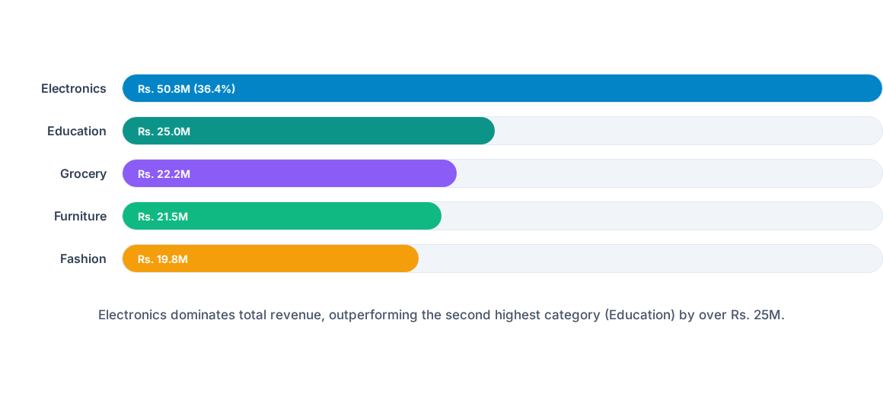
Revenue Distribution by Category

Slide 5


Beyond the Surface: The Value Gap
Observed Average Transaction Values
Grocery: Rs. 145,305
Electronics: Rs. 143,442
Education: Rs. 140,627
The Statistical Inquiry
Furniture: Rs. 135,356
Are these variations statistically significant across product lines, or simply random sampling noise?
Fashion: Rs. 127,153
Maximum Observed Spread: Rs. 18,152

Slide 6

Statistical Validation
Testing the Business Hypothesis with Rigorous Statistical ANOVA Methods

Slide 7







Hypothesis Formulation
Null (H₀)
Alternative (H₁)
Methodology
Average sales are equal across all product categories.
At least one category has a different average sales value.
Test Type: Welch's ANOVA
Significance Level: α = 0.05
Selected to handle potential variance differences across groups.

Slide 8
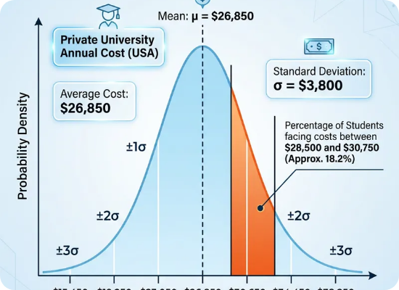

Test Results & ANOVA Output
Key Output Metrics
Levene’s Test (Variance) | P = 0.4182
F-Statistic | 0.7842
Degrees of Freedom | (4.0, 429.6)
Final P-Value | 0.5359
Decision: 0.5359 > 0.05. Fail to Reject H₀.

Slide 9

Interpretation: The Reality Check
No Statistical Difference
Sample Sensitivity
We do not have sufficient statistical evidence to claim that "Grocery" orders are inherently higher value than "Fashion" orders.
The observed mean range (Rs. 127K to 145K) is mathematically expected even if all categories shared the exact same population mean.

Slide 10


The Real Driver: Volume vs. Value
Volume is King
Electronics dominates total revenue (Rs. 50.78M) because it commands 35.4% of total orders (354 transactions).
Revenue leadership is Volume-Driven, not Ticket-Price-Driven. Executive management should focus on preserving these order counts.

Slide 11

Recommendations for Leadership
Protect Electronics Volume: Maintain market share and inventory in the transaction count driver.
Avoid Pricing Biases: Do not adjust prices based on random sample averages across categories.
Expand Data Scale: Collect 10,000+ transaction rows to detect subtle localized trends with higher power.

Slide 12

< Thank You ! >
ApexPlanet Data Analytics Internship | Dhayanithi M

