Slide 1

steganography application
CAPSTONE PROJECT
Presented By:
1. Dhayanithi K - Madha Engineering College – B.E Computer Science and Engineering

Slide 2
OUTLINE
Problem Statement (Should not include solution)
Proposed System/Solution
System Development Approach (Technology Used)
Algorithm & Deployment
Result (Output Image)
Conclusion
References

Slide 3


Problem Statement
Design and develop a user-friendly Tkinter GUI application that implements steganography, allowing users to encode and decode secret messages within image files. The application should provide a simple and intuitive interface for users to perform steganography technique.

Slide 4
Proposed Solution
The proposed Tkinter GUI application aims to provide a user-friendly solution for steganography, enabling users to encode and decode secret messages within image files. The application will leverage data analytics and image processing techniques to conceal and extract hidden information accurately. The solution will consist of the following components:
User Interface:
Develop a clean and intuitive graphical user interface (GUI) using the Tkinter library.
Implement necessary UI elements such as buttons, text boxes, and file dialogs for user interactions.
Image Selection:
Allow users to select an image file from their file system for encoding or decoding.
Validate the selected file to ensure it is an image in a supported format (e.g., PNG, JPEG).
Message Handling:
Provide a text box or text area for users to enter the secret message they want to encode or decode.
Implement character limit restrictions or guidelines if necessary.
Steganography Implementation:
Develop functions to encode and decode secret messages using steganography techniques. ¡Implement the Least Significant Bit (LSB) technique, where the least significant bits of image pixels store encoded data. ¡Ensure the visual integrity of the original image is maintained as much as possible after encoding.

Slide 5
Proposed Solution
Encoding Process:
Implement a function to handle the encoding process. ¡Call the steganography encoding function with the selected image and user-provided secret message.
Prompt the user to save the encoded image file with a new name or location.
Display appropriate success or error messages to the user.
Decoding Process:
Implement a function to handle the decoding process.
Call the steganography decoding function with the selected encoded image file.
Display the decoded secret message to the user in a new window or text box. Display appropriate success or error messages to the user.
Deployment:
Deploy the application as a standalone executable or distribute it as a Python package. ¡Ensure the application is compatible with different operating systems and configurations.
Evaluation:
Assess the application's performance using appropriate metrics, such as encoding/decoding time and accuracy. ¡Gather user feedback and continuously improve the application's usability and functionality.

Slide 6
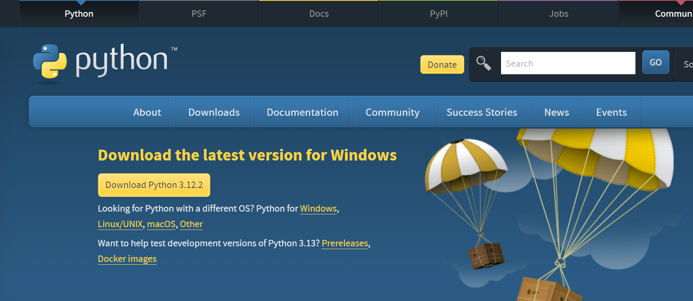
System Approach
System requirements:
Python: The application is developed using Python, a popular and versatile programming language. Users need to have Python installed on their systems to run the application. https://www.python.org/downloads/

Slide 7
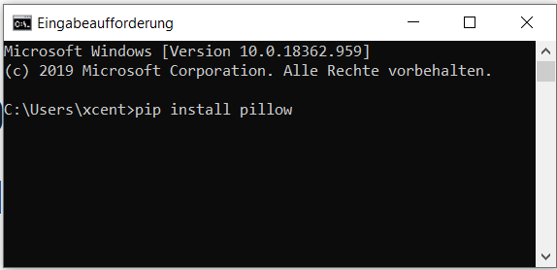
System Approach
Library requirements to built this Steganography app:
Tkinter: This is a standard Python library for building graphical user interfaces (GUIs). It provides a comprehensive set of widgets and tools for creating cross-platform desktop applications.
pip install tk
Pillow (PIL): The Python Imaging Library (PIL), also known as Pillow, is a library for image processing. It supports various image formats and provides functionality for opening, manipulating, and saving images, which is essential for the steganography application.
pip install pillow

Slide 8
Algorithm & Deployment
The provided code implements the steganography technique known as Least Significant Bit (LSB) encoding and decoding. The algorithm works as follows:
Encoding Algorithm:
The `encode_text` function takes an image object and a text message as input.
The text message is converted into a binary string using the ASCII values of each character.
The binary string is then encoded into the least significant bits (LSBs) of the RGB pixel values of the image.
The function iterates over each pixel of the image and encodes the binary data into the LSBs of the red, green, and blue channels.
A new image object is created with the encoded message embedded within the pixel data.
The function returns the encoded image object.

Slide 9
Algorithm & Deployment
Decoding Algorithm:
The decode_text function takes an encoded image object as input.
The function iterates over each pixel of the image and extracts the LSBs from the red, green, and blue channels, reconstructing the binary data.
The binary data is then converted back into a text string using ASCII values.
The function returns the decoded text message.
The algorithm leverages the fact that the human eye is less sensitive to changes in the least significant bits of pixel values. By modifying the LSBs, the algorithm can embed secret data within the image without significantly altering its visual appearance.
It's important to note that the LSB encoding technique has limitations in terms of the amount of data that can be embedded within an image before visual distortions become noticeable. Additionally, the encoded data is not encrypted, which means that anyone with knowledge of the steganography technique can potentially decode the hidden message.

Slide 10
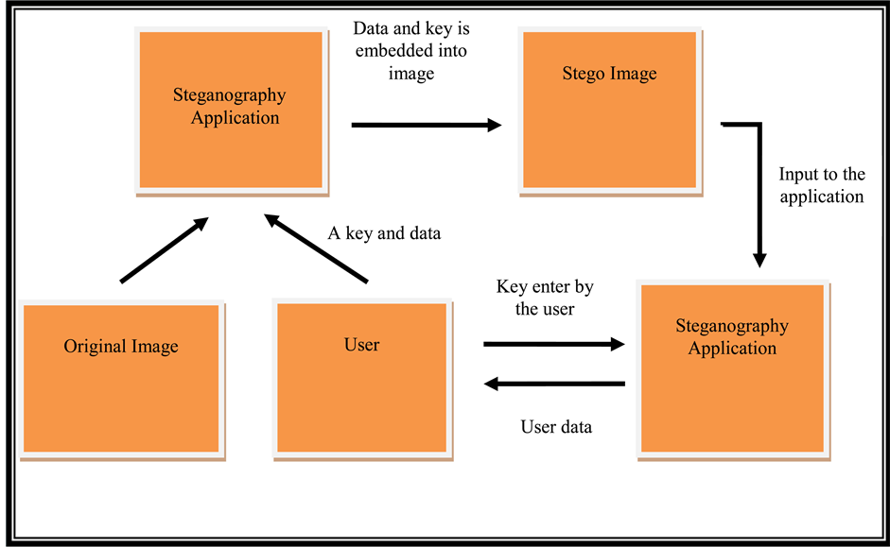
Algorithm & Deployment

Slide 11
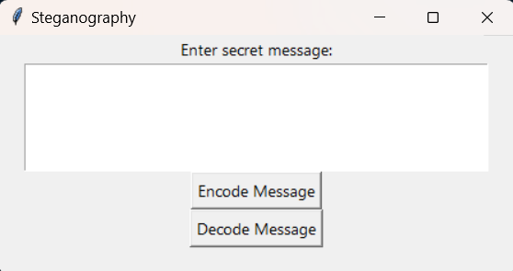
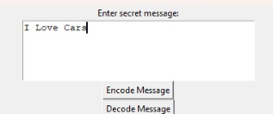
Result
Encoding:
Step1 : Enter the secret message

Slide 12
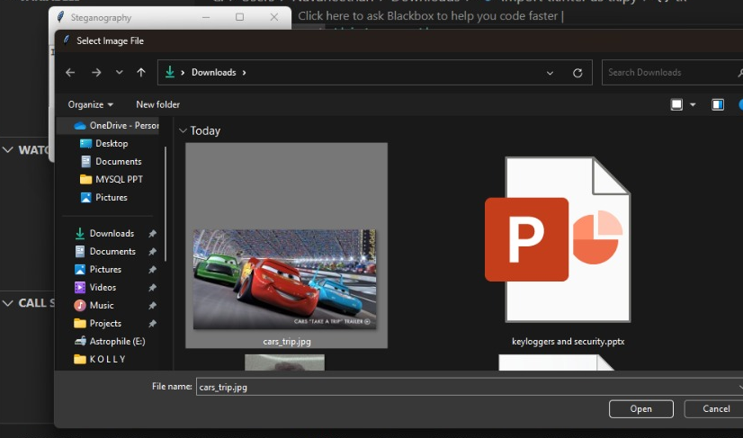
Result
Encoding:
Step2 : Input the image in which message to be encoded

Slide 13
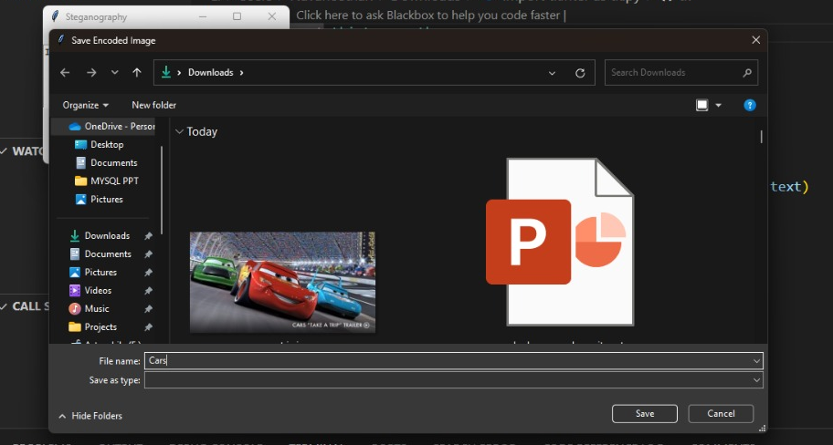
Result
Encoding:
Step3 : Save the resultant image

Slide 14
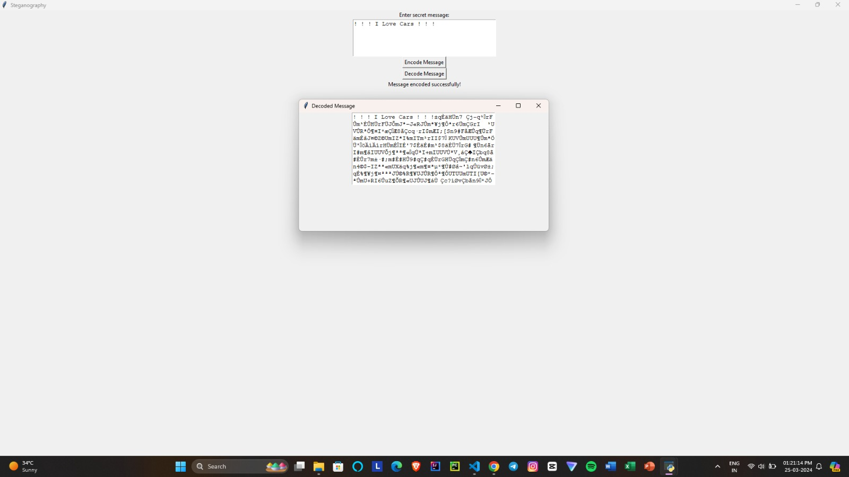
Result
Encoding:
Step4 : Success Message display

Slide 15
Result
Decoding:

Slide 16
Conclusion
Summarize the findings and discuss the effectiveness of the proposed solution. Highlight any challenges encountered during the implementation and potential improvements. Emphasize the importance of accurate bike count predictions for ensuring a stable supply of rental bikes in urban areas.
The provided code demonstrates a Tkinter GUI application for steganography, which allows users to encode and decode secret messages within image files. The application implements the Least Significant Bit (LSB) technique, a popular method for steganography that modifies the least significant bits of the pixel values in an image to embed the secret message.
While the LSB technique is a simple and effective method for steganography, it has limitations in terms of the amount of data that can be embedded without causing noticeable visual distortions. Additionally, the encoded data is not encrypted, making it vulnerable to detection and decoding if the steganography technique is known.
To enhance the security and robustness of the application, several improvements can be considered, such as implementing encryption techniques, exploring alternative steganography methods (e.g., transform domains, adaptive techniques), and incorporating additional security measures like key-based encryption or obfuscation techniques.

Slide 17
References
Tkinter Documentation: https://docs.python.org/3/library/tkinter.html
Pillow (PIL) Documentation: https://pillow.readthedocs.io/en/stable/
"Steganography Using Least Significant Bit Algorithm" by Monika Agrawal and Priyanka Mishra: https://www.ijser.org/researchpaper/Steganography-Using-Least-Significant-Bit-Algorithm.pdf
"A Survey on Steganography Techniques" by Shashikala Channalli and Ajay Jadhav: https://arxiv.org/abs/1708.03577
"An Overview of Steganography Techniques" by Mehdi Kharrazi, Husrev T. Sencar, and Nasir Memon: https://www.cs.gmu.edu/~mkhahrah/publications/Kharrazi_SPMag2005.pdf

Slide 18
THANK YOU

