Slide 1
GMIT Timetable App
A cross platform app for GMIT Students & Staff members.

Slide 2
Overview
This is an Timetable application designed and built for the students and staff members for GMIT Galway. Upon registering and logging into the app, the main page displays an option to select any course in GMIT. We designed this application to provide easier access for students and staff to view their timetables while providing them push notifications to alert users before their next class and to alert them of what class they have and where it is being held.

Slide 3
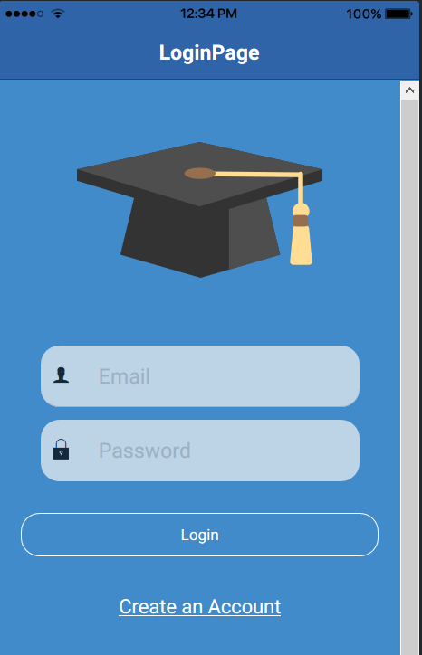
Login Page
Initially when the user open the app for the first time they will be asked to login with their account details. If they never used the app before they must register a new one.

Slide 4
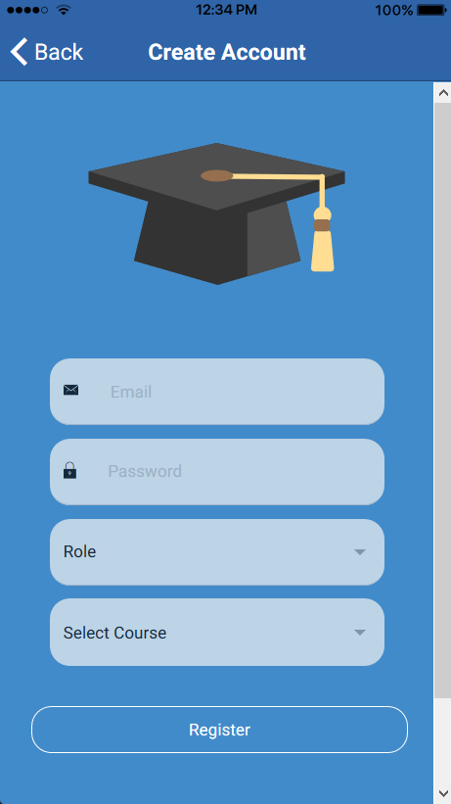
Register Page
Once the user clicks “Create an Account”, they are brought to this page, they are asked to enter in their email, new password, their role and asked to select their course.

