Slide 1

Recruit Restaurant Visitor Forecasting
ALY 6015 Intermediate Analytics
Submitted to:
Joseph Manseau
Deepak Natarajan (001088182) Ashlesha Kshirsagar (001082234)

Slide 2
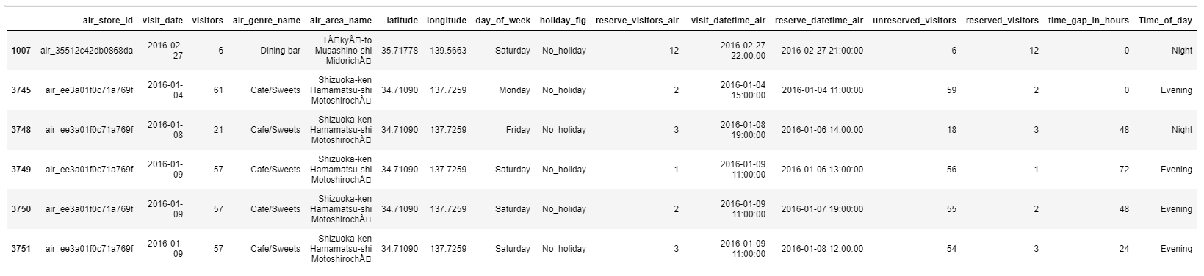
Goal Predicting the visitors demand for Japanese Restaurants Time Series Analysis – Which model is the best fit for the dataset Regression Problem Decision Tree
Overview
Data:
Day wise data from January 2016 to April 2017.
Total records of 87181 and 15 features
Dataset consists of features like total number of visitors of different air stores in Japan including the reserved date and time, month of reserve and visit, time of visit in day and day of week, holiday details, genre and area name of restaurants.

Slide 3
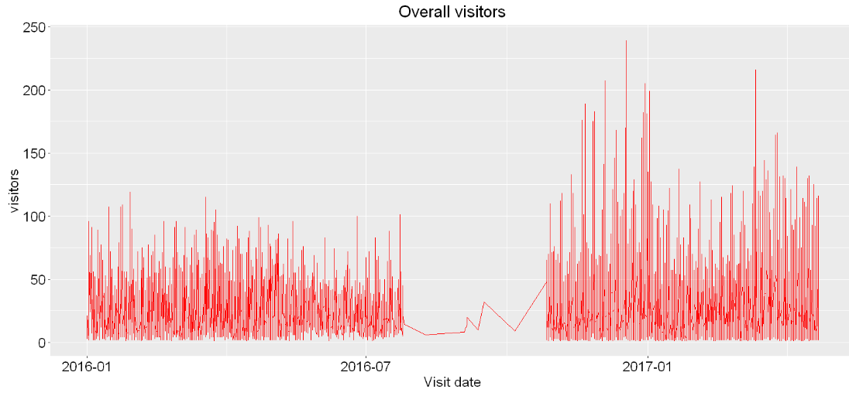
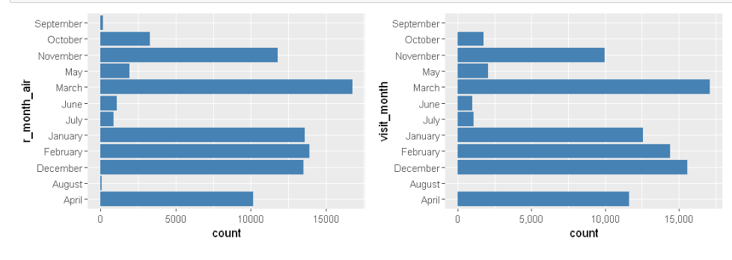
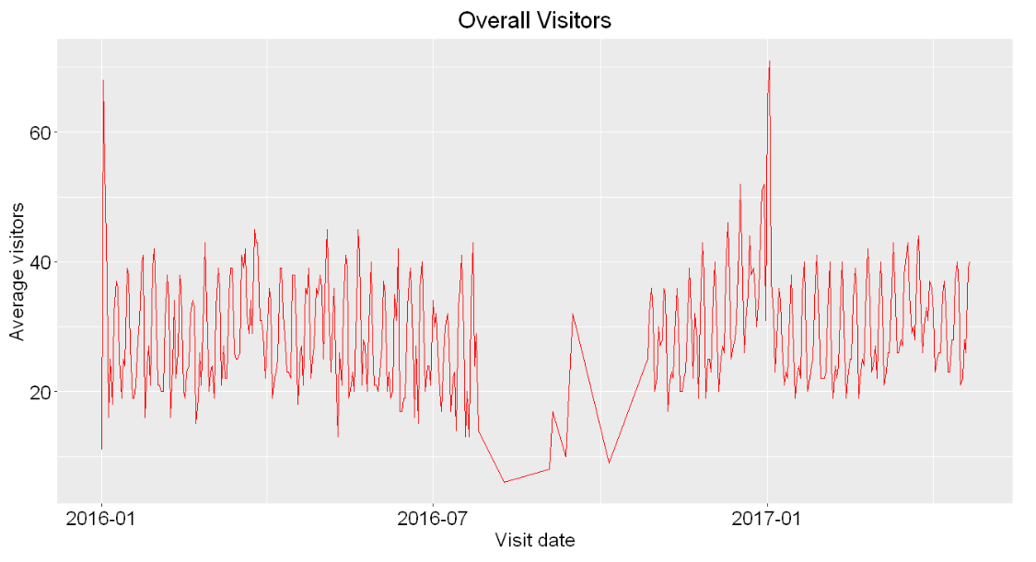
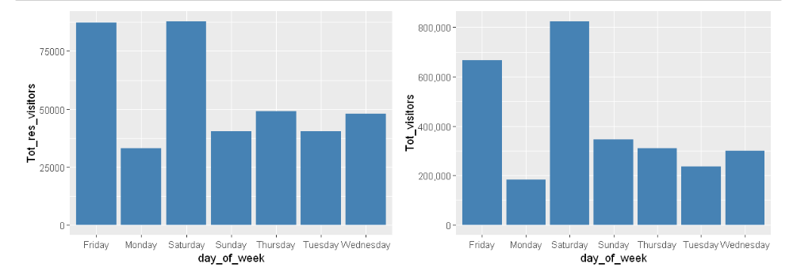
Feature Visualizations
1.Average visitors count on each day from January 2016 to July 2016 range from 15 to 45 visitors and we can also see a large spike of visitor count of above 60 Jan 1
2.Total visitors count on each day from November 2016 to April 2017 ranges from 0 to 250 visitors which increase after some irregularity from July to Nov 2016.
3.Friday and the weekend appear to be the most popular days, which is to be expected. Monday and Tuesday have the lowest numbers of average visitors
4.Reservations are made typically for the dinner hours in the evening.
5.The same days were holidays in late Apr / May in 2016 as in 2017.
6.Visitors count increase from the month of March- May and it is highest in the month of December

Slide 4
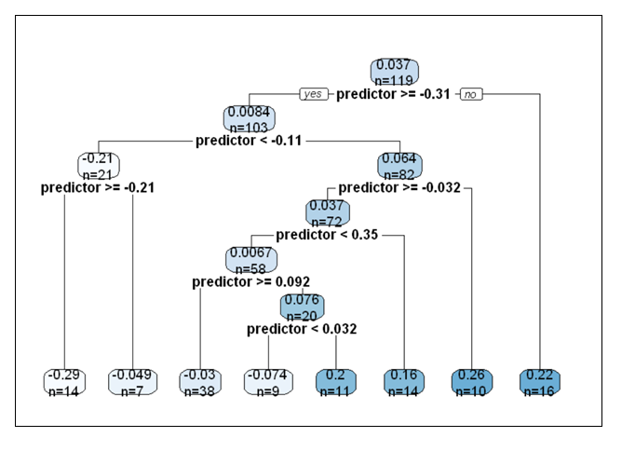
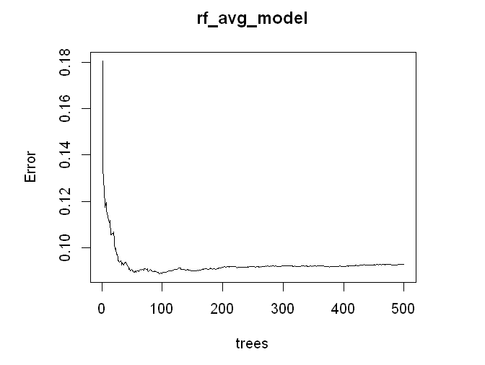
Decision Tree
Random Forest
mean squared error decrease as we increase the number of decision trees and reaches the lowest point on the range of 70 to 80 trees
Decision tree Regressor is the regression equivalent of the Decision tree algorithm.
We build a decision tree model to predict the average visitors and got the root mean squared error of 0.165 in test data for next 52 days from November 2016 in Japanese restaurants.
The Root mean squared error for Random Forest is 0.179

Slide 5
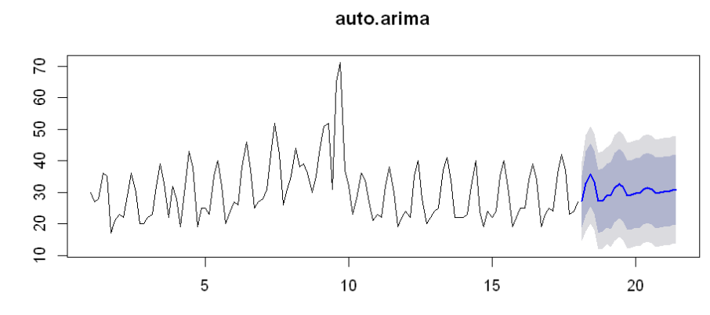
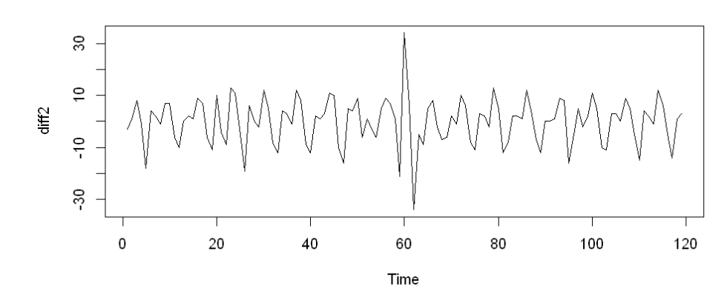
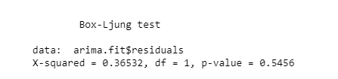
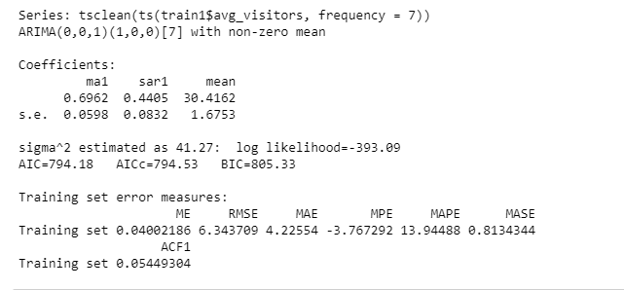
Time Series analysis – ARIMA Model
1.P value is 0.5456 – Accepts the Null hypothesis – Model – Adequate
2.17- 48 average Visitors – 95 % Confidence interval
3. RMSE Value – 6.34

Slide 6
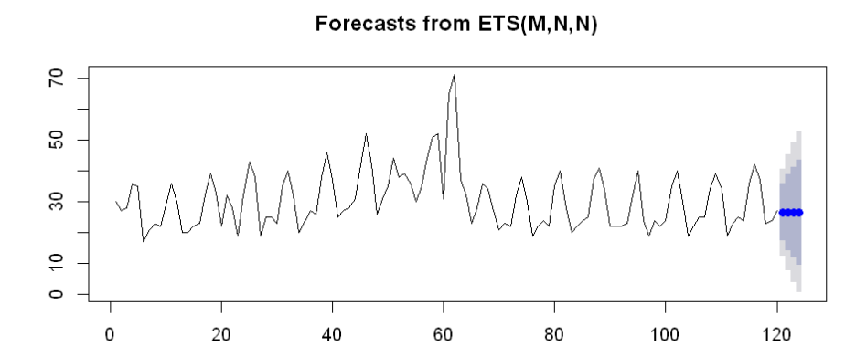
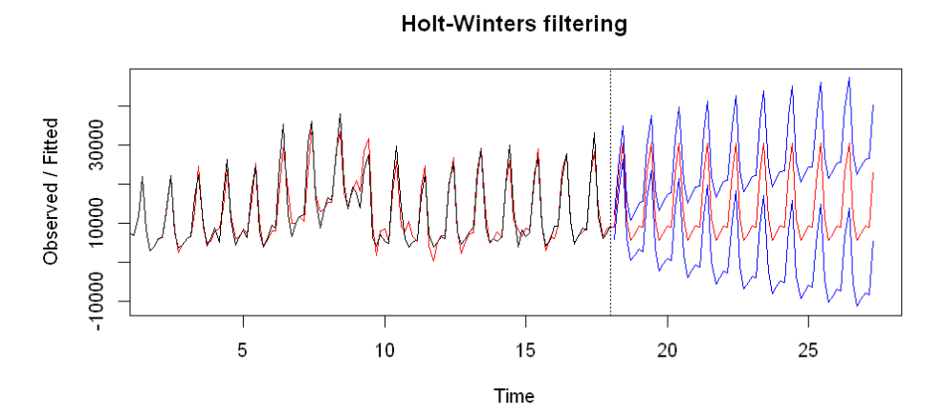
ETS and Holt Winters Method For forecasting
ETS models with seasonality or non-damped trend or both have two-unit roots(i.e., they need two levels of differencing to make them stationary).
RMSE – 8.93
1.This method is used to capture seasonality.
2.RMSE -6.63

Slide 7
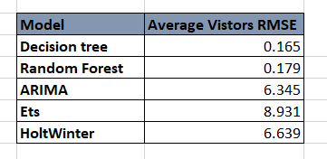
Conclusion
We can observe that our time series models, and other machine learning models are performed well in predicting the average visitors demand on the test data for Japanese restaurants that has next 52 days demand from November 2016. Decision tree and Random Forest performed better with Root mean squared error of 0.165 and 0.179 respectively than the classic time series models like ARIMA, Exponential smoothing and Holt winter method which has the RMSE of 6.345, 8.931 and 6.639 respectively.
Reference
1.Gardner, E. S. (1985). Exponential smoothing: The state of the art. Journal of Forecasting, 4(1), 1–28. https://doi.org/10.1002/for.3980040103
2. Time Series Analysis - an overview | ScienceDirect Topics. (2020). Retrieved 14 February 2020, from https://www.sciencedirect.com/topics/medicine-and-dentistry/time-series-analysis

