Slide 1

ATLIQ HARWARE CONSUMER GOODS
Atliq Hardware, a fictional corporation, stands out as a major computer hardware manufacturer in India and has a robust global presence.
Despite its prominence, the management recognizes a need for more timely and informed decisions backed by data insights.
There's a strategic initiative to enhance the data analytics team by onboarding junior data analysts.
In order to evaluate potential candidates comprehensively, Tony Sharma, the Director of Data Analytics, plans to organize a SQL challenge. This challenge will assess both technical skills and soft skills.
The company has identified 10 specific ad hoc requests for which they are seeking valuable insights.

Slide 2
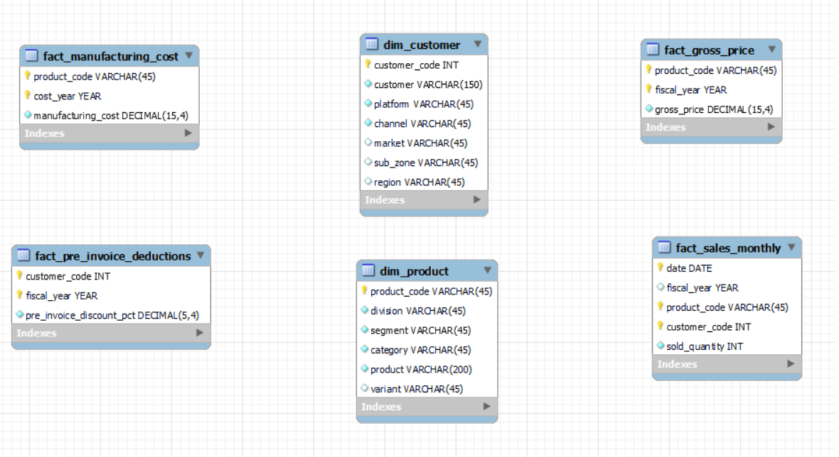
ATLIQ HARWARE CONSUMER GOODS
INPUT DATA AND SCHEMA

Slide 3
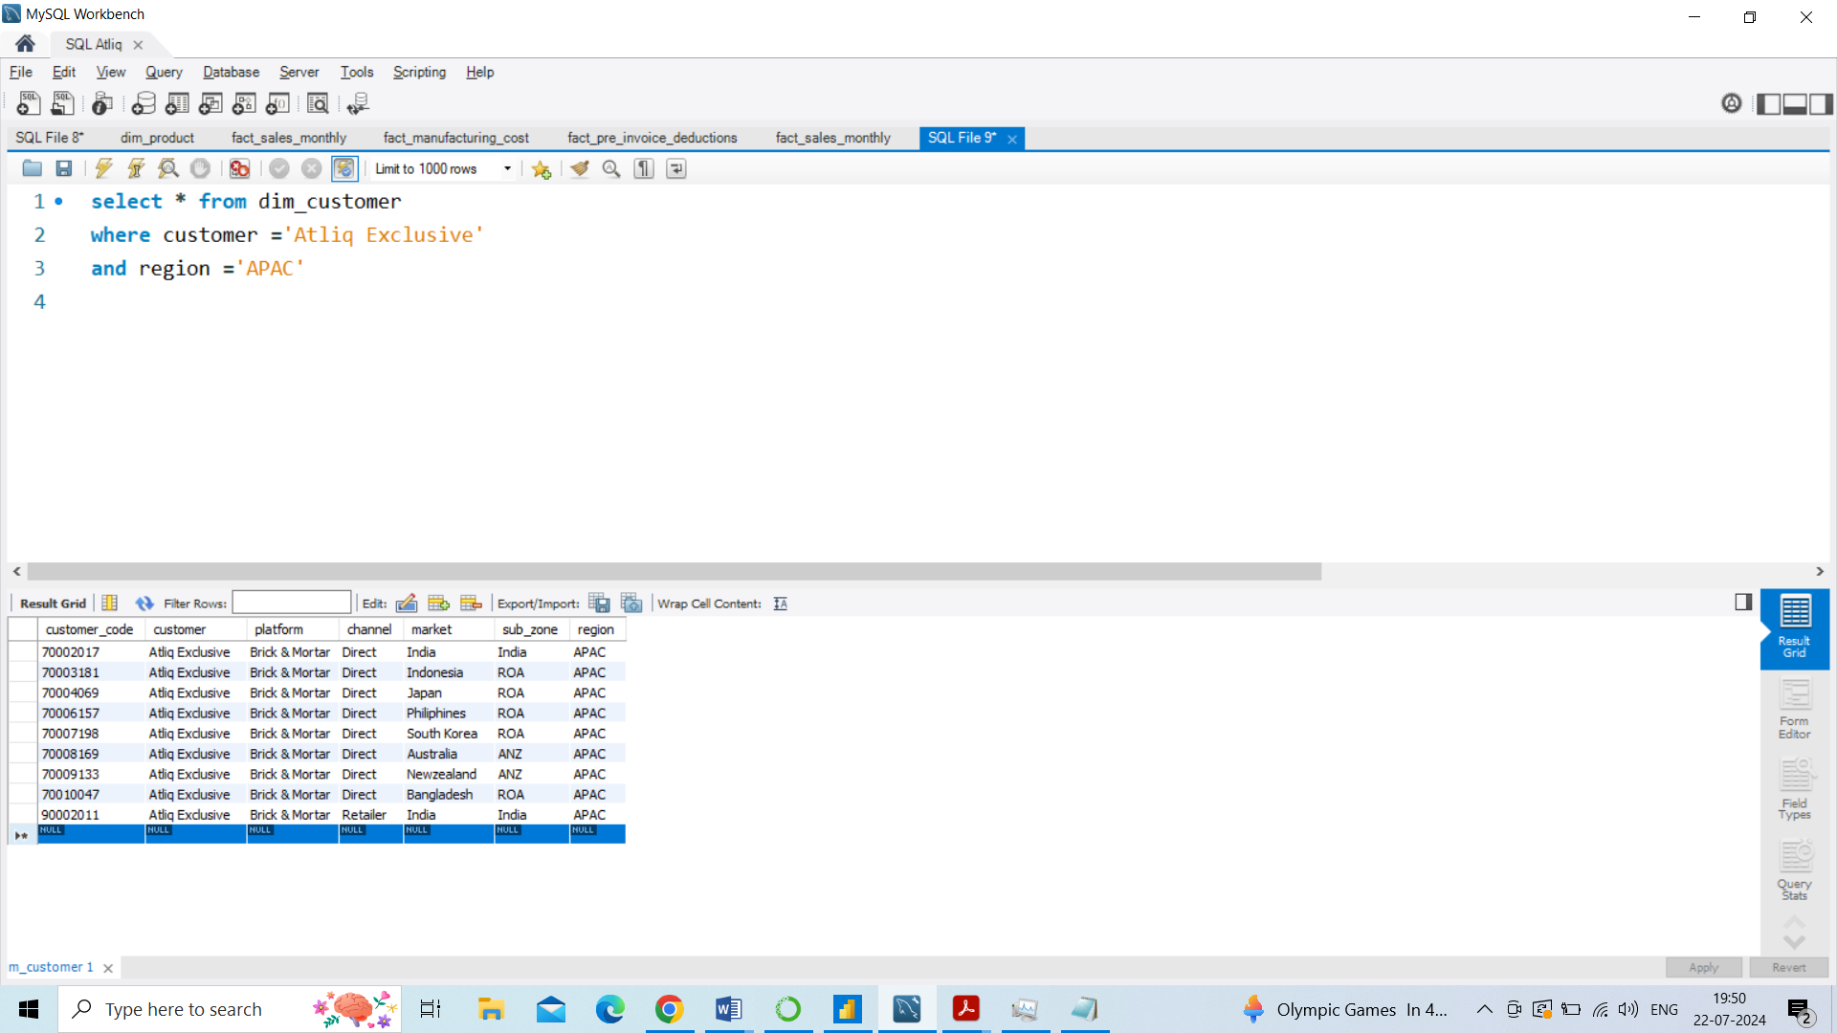
ATLIQ HARWARE CONSUMER GOODS
AD-HOC REQUEST: 1
QUESTION 1: Provide the list of markets in which customer "Atliq Exclusive" operates its business in the APAC region.
INSIGHTS:
Atliq Exclusives have eight market in Asia and Pacific regions

Slide 4
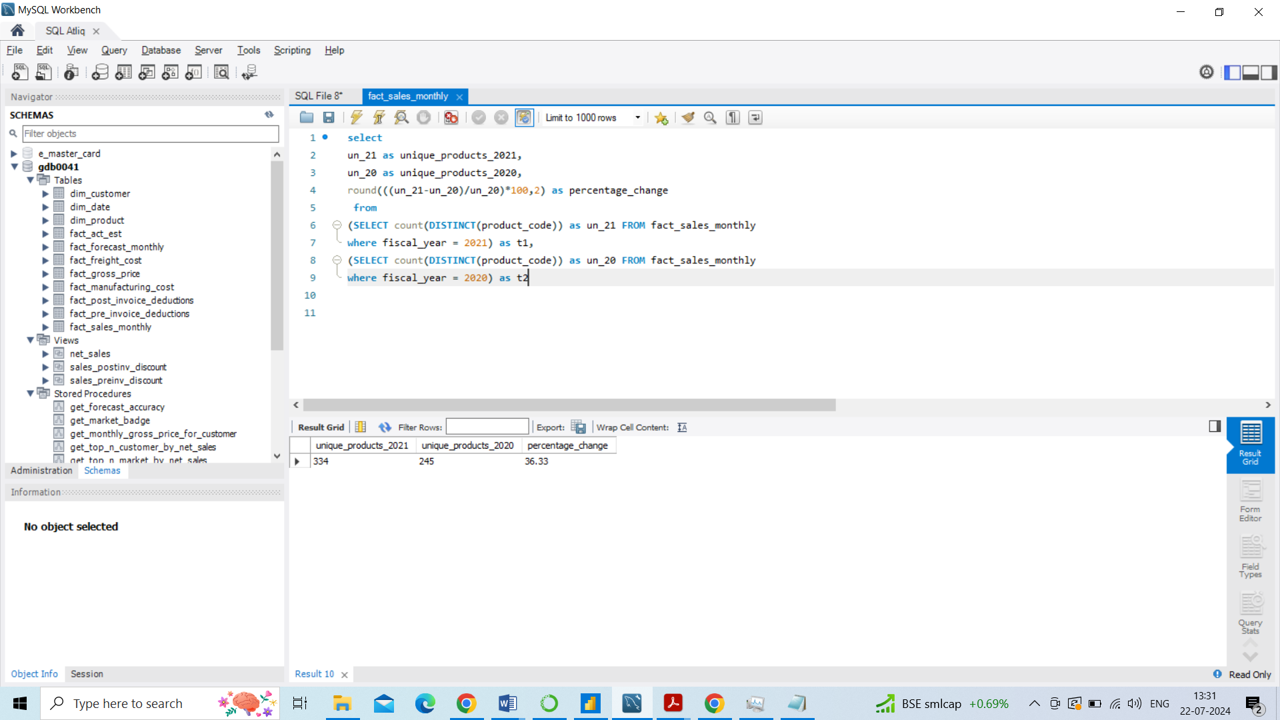
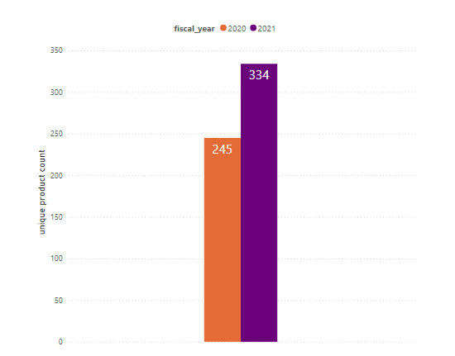
ATLIQ HARWARE CONSUMER GOODS
AD-HOC REQUEST: 2
QUESTION 2: What is the percentage of unique product increase in 2021 vs. 2020?
INSIGHTS:
The unique product count in FY-2020 is 245 and in FY-2021 is 334 which has a significance increase of 36.33 percentage

Slide 5
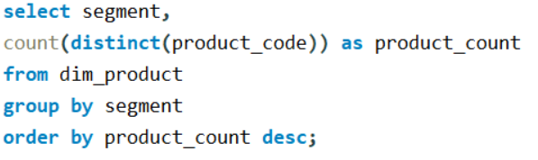
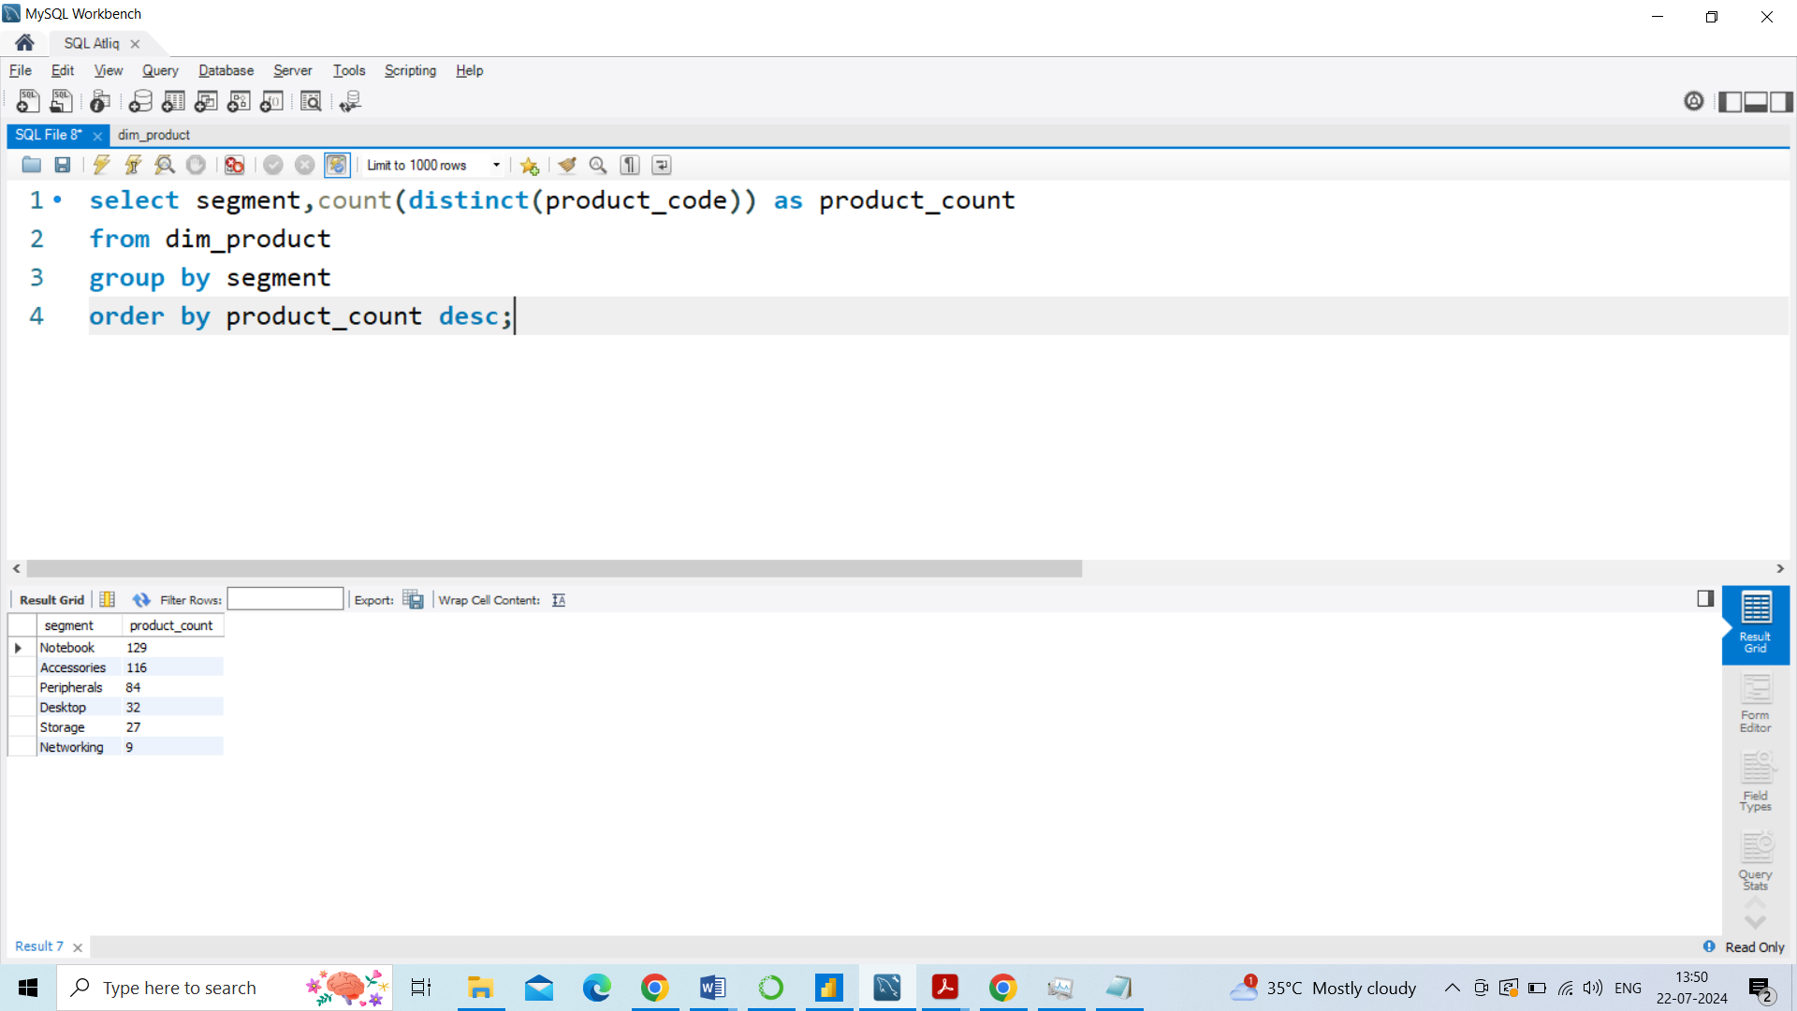
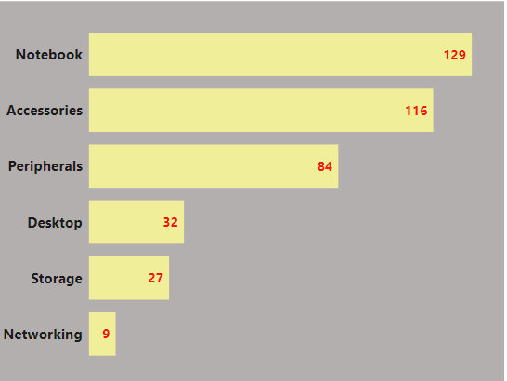
ATLIQ HARWARE CONSUMER GOODS
AD-HOC REQUEST: 3
QUESTION 3: Provide a report with all the unique product counts for each segment and sort them in descending order of product counts
INSIGHTS:
Atliq hardware have a good sale on notebook, accessories, peripherals segments
They also can strategies any method to increase the sales for desktop, storage, networking segments

Slide 6
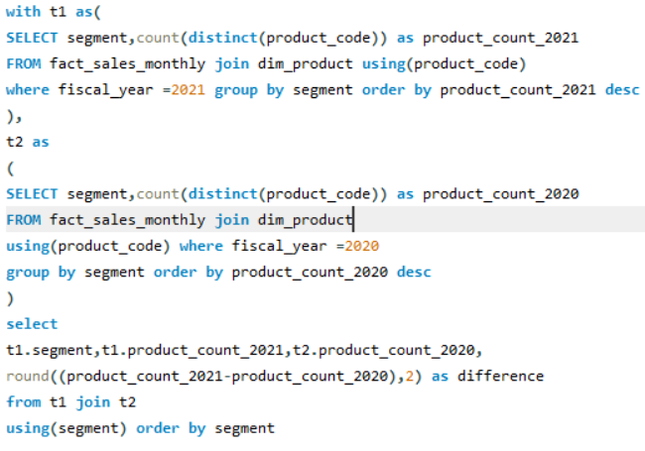
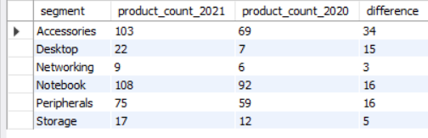
ATLIQ HARWARE CONSUMER GOODS
AD-HOC REQUEST: 4
QUESTION 4: Which segment had the most increase in unique products in 2021 vs 2020?
INSIGHTS:
Comparing 2021 and 2020 it has shown a significant increase in Accessories segment introducing new 34 products next comes the Notebook and Peripherals segment

Slide 7
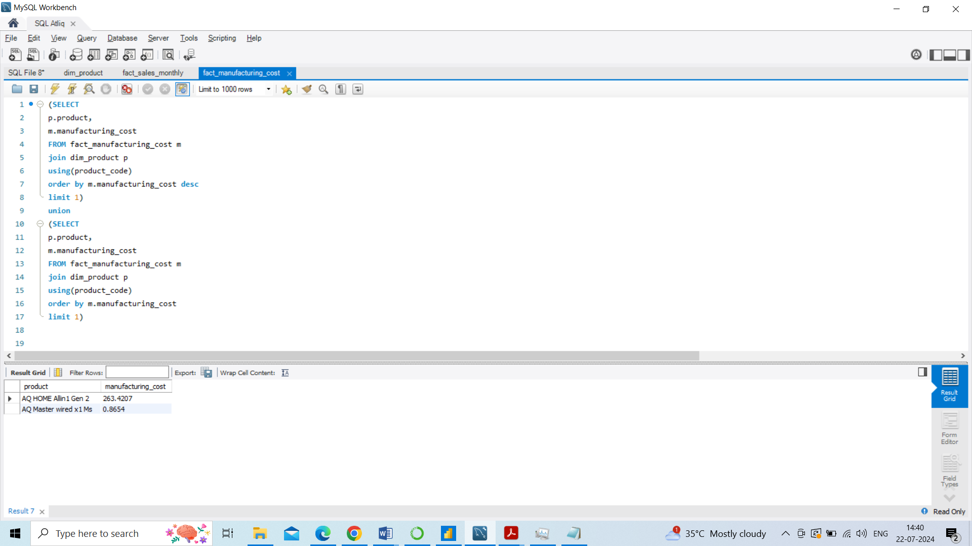
ATLIQ HARWARE CONSUMER GOODS
AD-HOC REQUEST: 5
QUESTION 5: Get the products that have the highest and lowest manufacturing costs.
INSIGHTS:
Highest Manufacturing product: AQ Home Allin 1 Gen 2
Low Manufacturing product: AQ Master wired x1 Ms

Slide 8
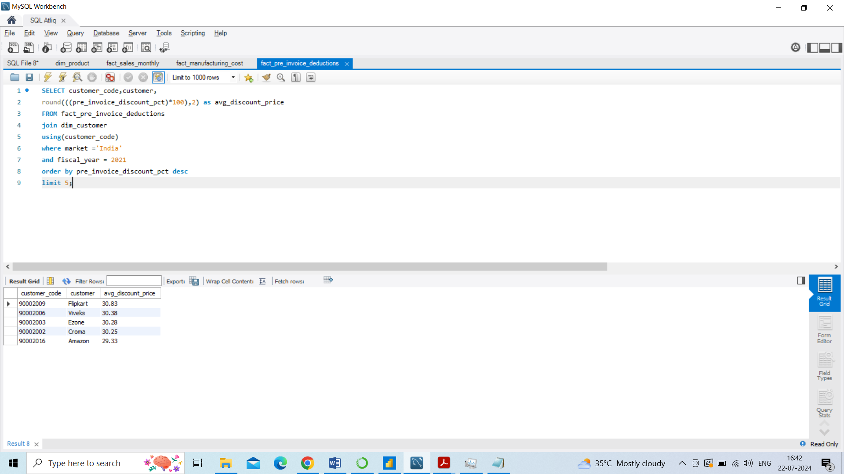
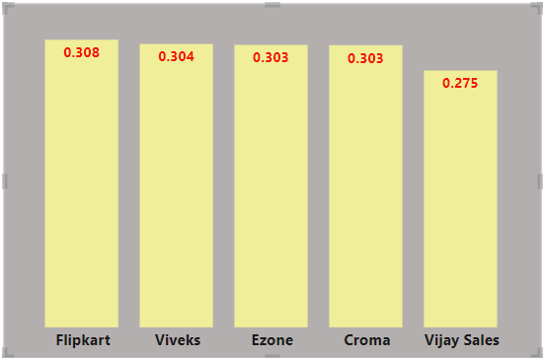
ATLIQ HARWARE CONSUMER GOODS
AD-HOC REQUEST: 6
QUESTION 6: Generate a report which contains the top 5 customers who received an average high pre_invoice_discount_pct for the fiscal year 2021 and in the Indian market.
INSIGHTS:
Flipkart holds the high discount of 30.8% in the Indian market for FY-2021
Similarly all the top 5 customer more over same discount ranging from 30.8 to 27.5

Slide 9
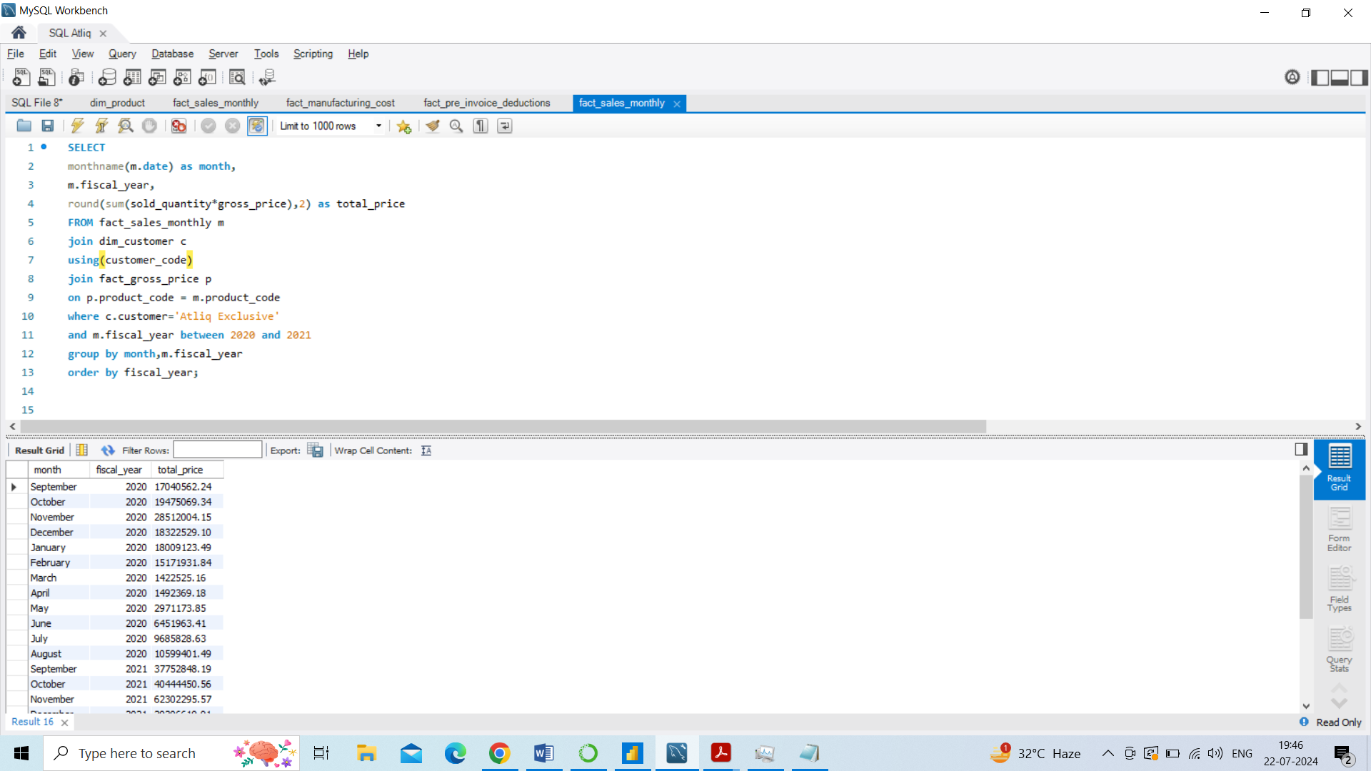
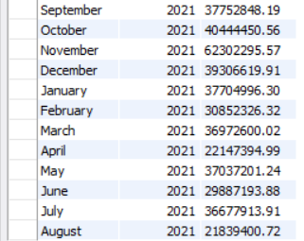
ATLIQ HARWARE CONSUMER GOODS
AD-HOC REQUEST: 7
QUESTION 7: Get the complete report of the Gross sales amount for the customer “Atliq Exclusive” for each month . This analysis helps to get an idea of low and high-performing months and take strategic decisions.

Slide 10
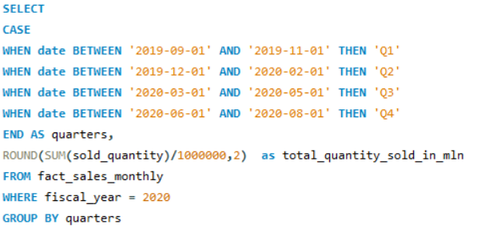
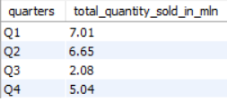
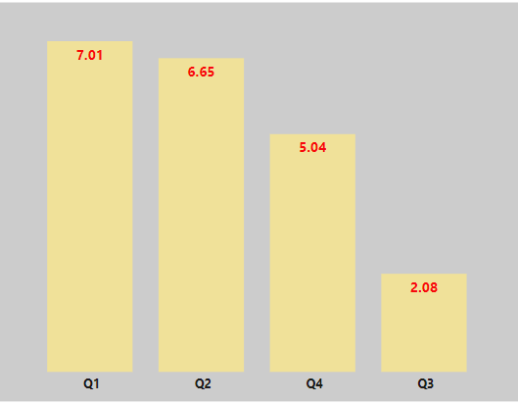
ATLIQ HARWARE CONSUMER GOODS
AD-HOC REQUEST: 8
QUESTION 8: In which quarter of 2020, got the maximum total_sold_quantity?
INSIGHTS:
In Q3 (being the lowest) and Q4 there is reduction in total quantity sold one of the reasons might be due to covid
In Q1 and Q2 the quantity sold was good and also the strongest quarters of the year

Slide 11
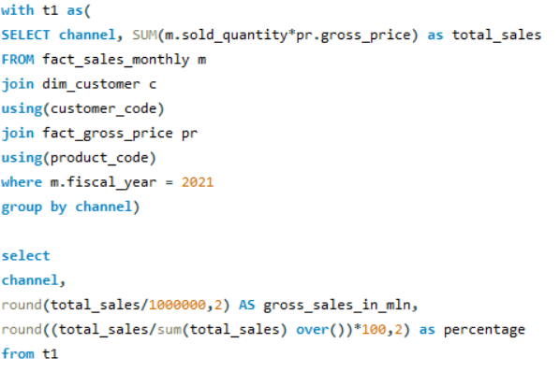

ATLIQ HARWARE CONSUMER GOODS
AD-HOC REQUEST: 9
QUESTION 9: Which channel helped to bring more gross sales in the fiscal year 2021 and the percentage of contribution?
INSIGHTS:
In Atliq hardware 73% for overall sales retailers contribute more when compared to direct and distributor both stands the same

Slide 12
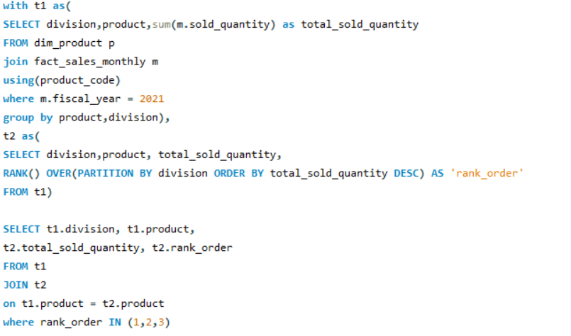
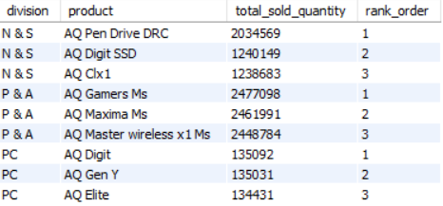
ATLIQ HARWARE CONSUMER GOODS
AD-HOC REQUEST: 10
QUESTION 10: Get the Top 3 products in each division that have a high total_sold_quantity in the fiscal year 2021?
INSIGHTS:
N & S Division : 3 best sellers are external devices
P& A Division: 3 best sellers are mouse
PC Division : 3 best seller are personal laptop

