Slide 1

EDA CASE STUDY loan risk analysis by
AYUSH and DHEERAJ

Slide 2

About The Problem
The loan providing companies find it hard to give loans to the people due to their insufficient or non-existent credit history. Because of that, some consumers use it as their advantage by becoming a defaulter. The objective is to use EDA to analyse the patterns present in the data. This will ensure that the applicants capable of repaying the loan are not rejected.

Slide 3
CURRENT APPLICATION DATA

Slide 4
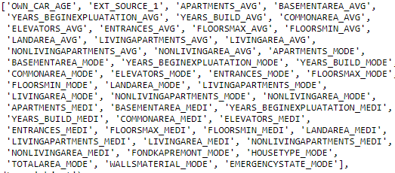
Null values
For the sake of this analysis we have dropped the below 49 variables which had more than 40% missing value.

Slide 5
EXPLORATION

Slide 6
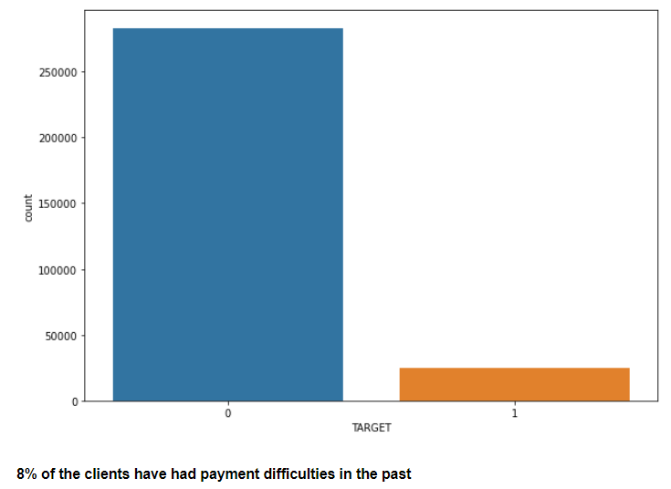
dfdfdfd
Most of the Clients seem to be paying the loans on correct time regularly.

Slide 7
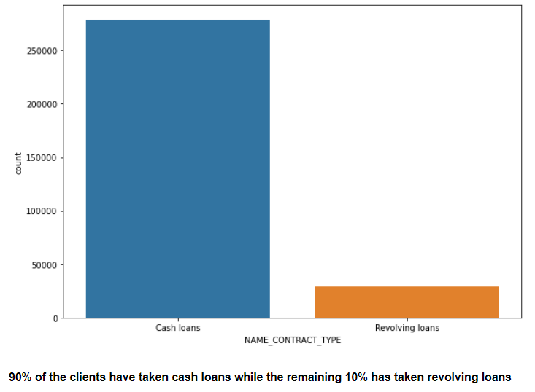
Most preferred loan contract type of the clients is cash loan.

Slide 8
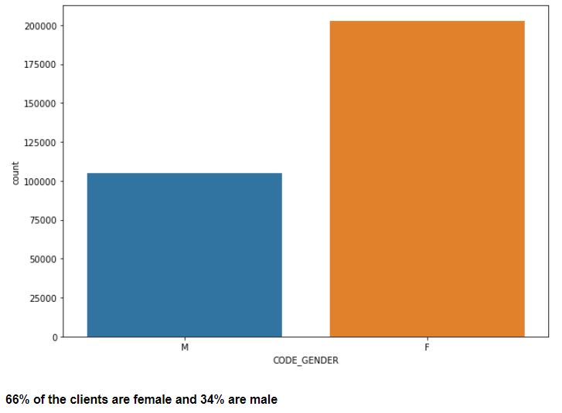
Loan requirement is high among Female clients than male clients.

Slide 9
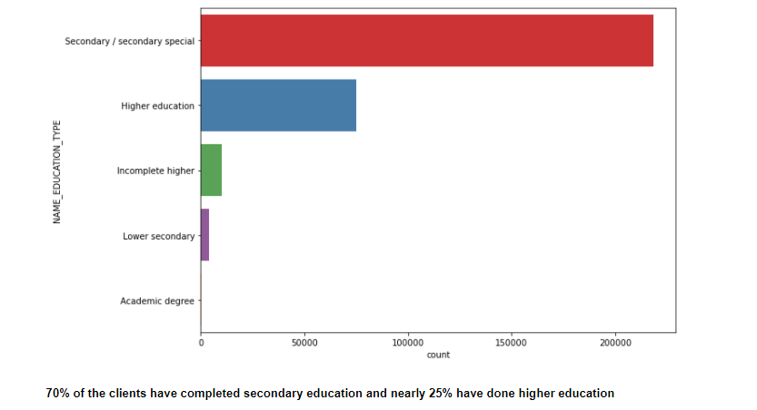
Count of clients based on Education type of the clients.

Slide 10
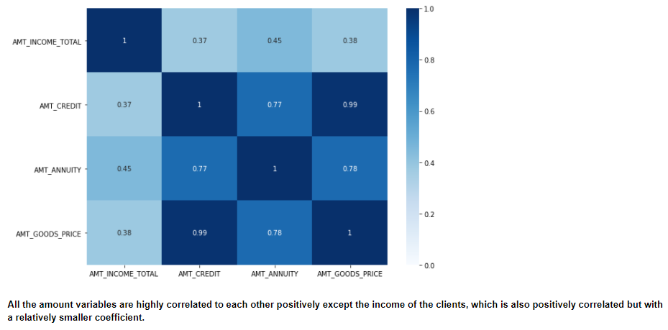
Loan Credit amount, Annuity amount, Goods price on which the loan is taken and the income of the clients are fairly correlated.

Slide 11
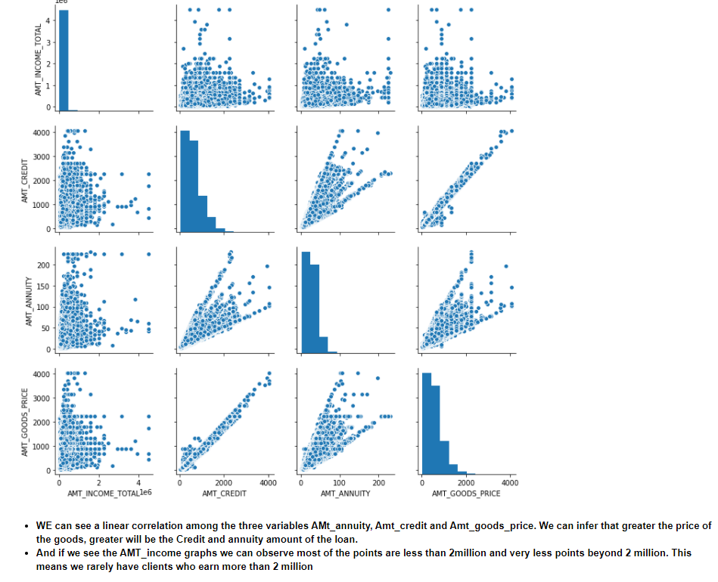

Slide 12
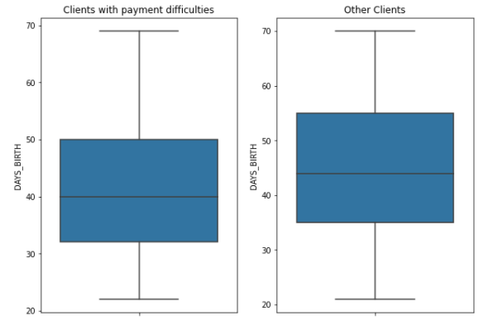
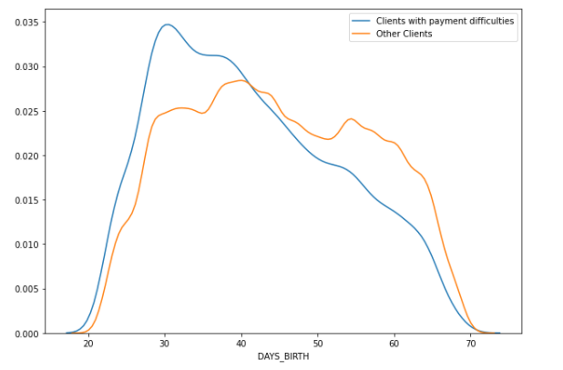
Effect of Client age on the Target.

Slide 13
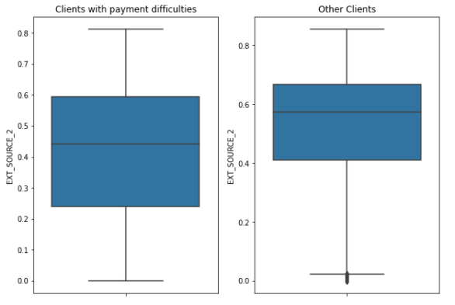
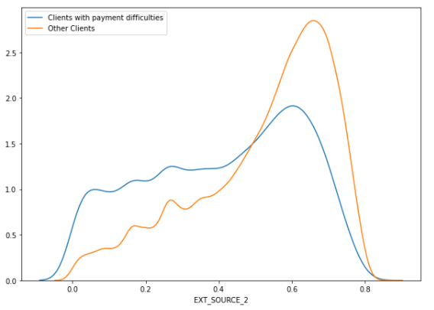
Effect of the scores of the client on the Target variable.
Clients with payment difficulties seem to have relatively lower scores.

Slide 14
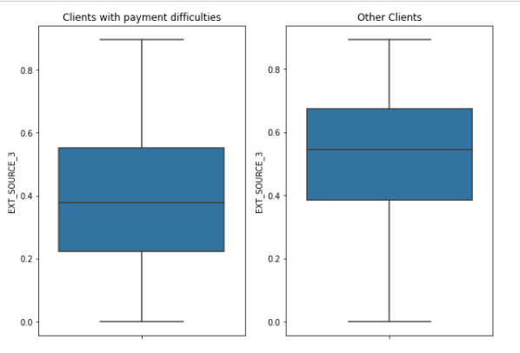
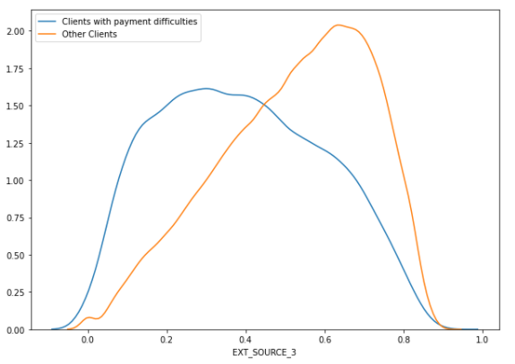
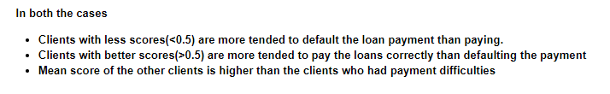

Slide 15
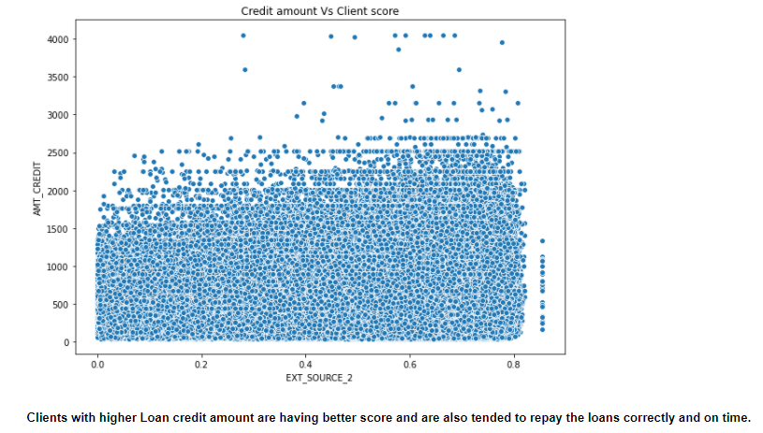
Credit amount Vs the score of the client.

Slide 16
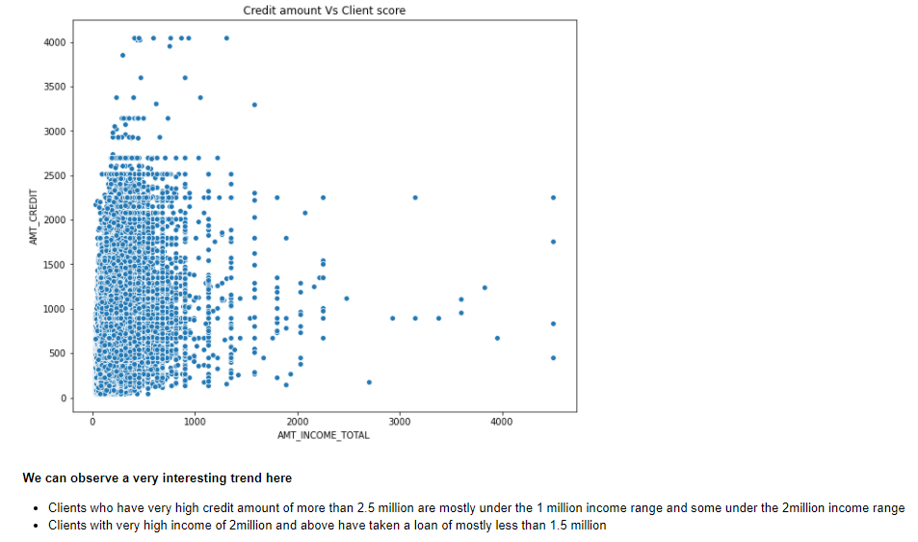
Credit amount Vs the income of the client.

Slide 17
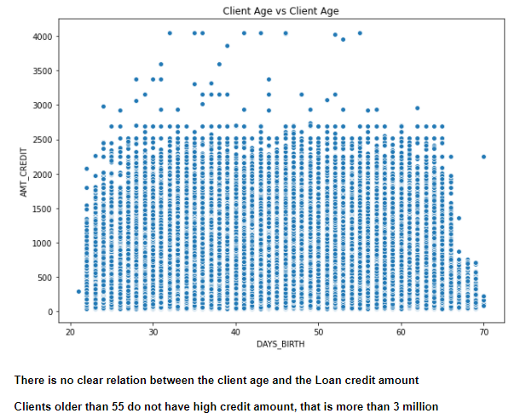
Credit amount Vs the age of the client.

Slide 18
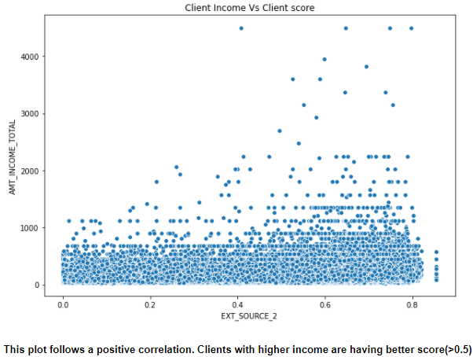
Income of the client Vs the score of the client.

Slide 19
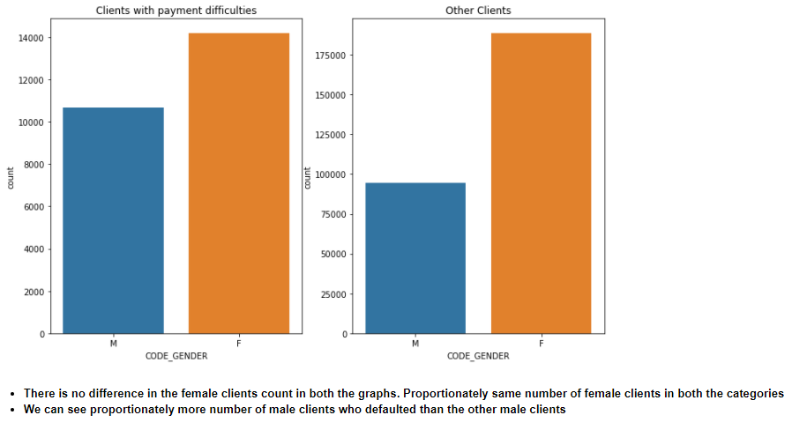
Effect of Gender of client on the Target variable.

Slide 20
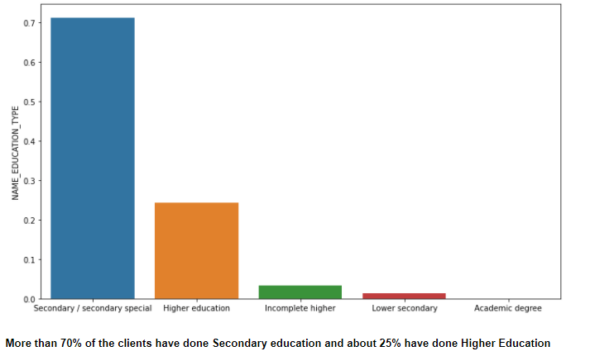
Count of clients based on Education Type.

Slide 21
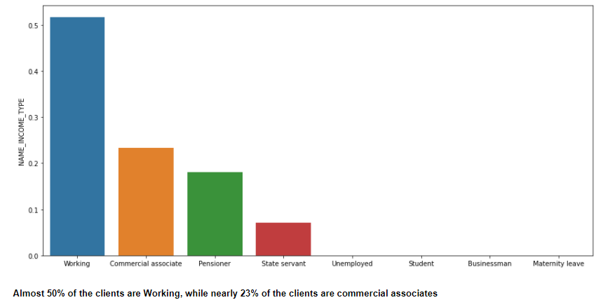
Count of clients based on Income Type.

Slide 22
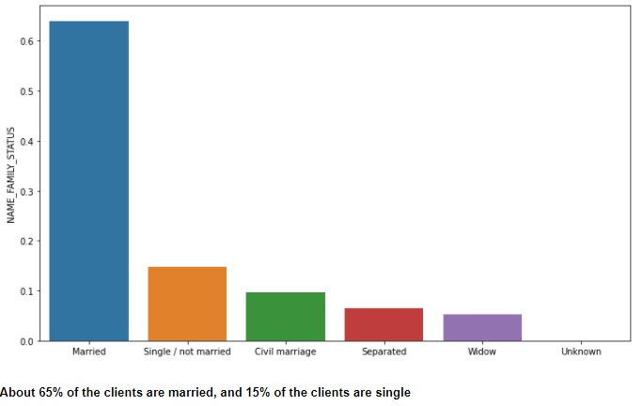
Count of clients based on Family Status.

Slide 23
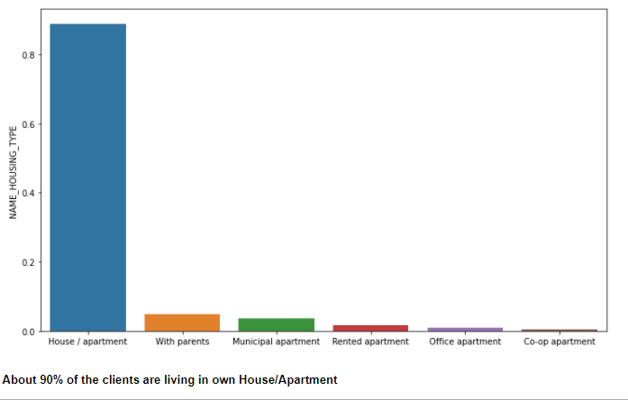
Count of clients based on Housing Type.

Slide 24
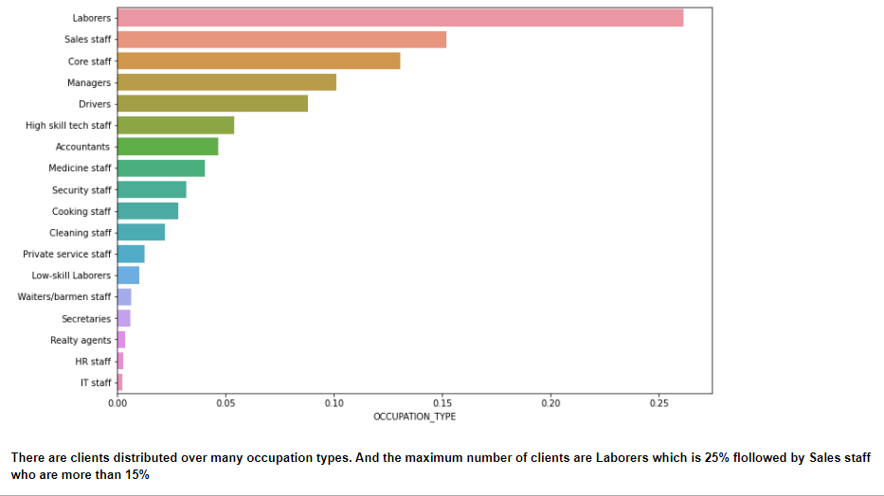
Count of clients based on Occupation Type.

Slide 25
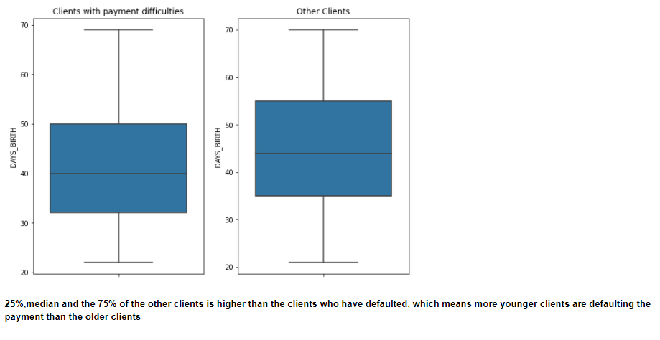
Old age clients seem to be regular in their payment than the younger ones.

Slide 26
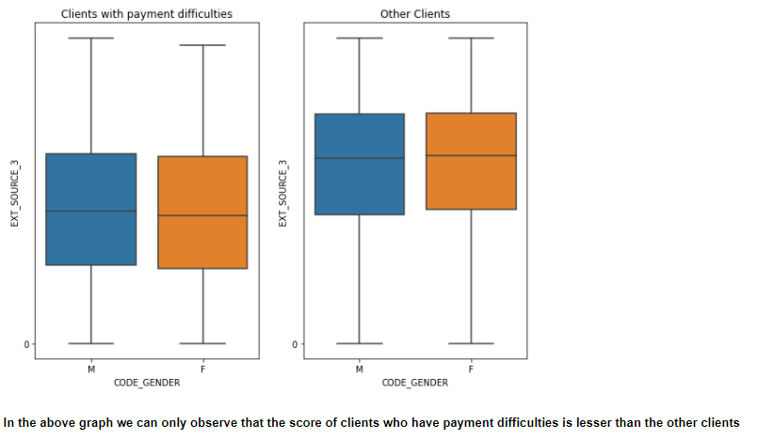
Scores are actually telling true story here. Scores of the clients who have defaulted is lower than the score of other clients.

Slide 27
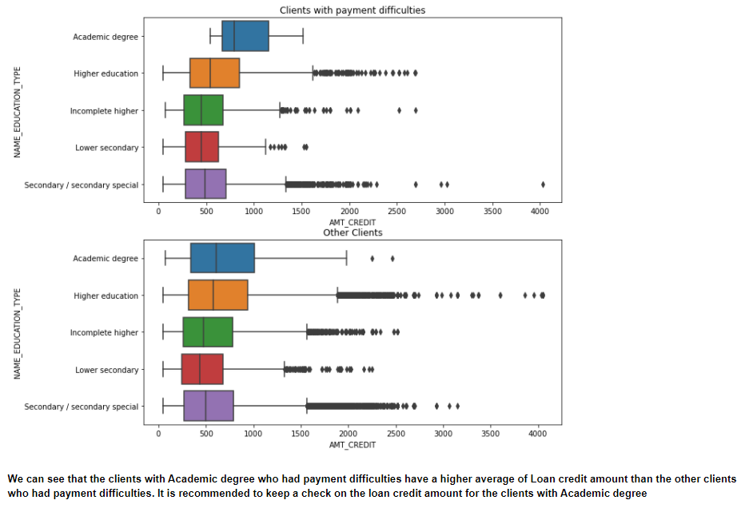

Slide 28
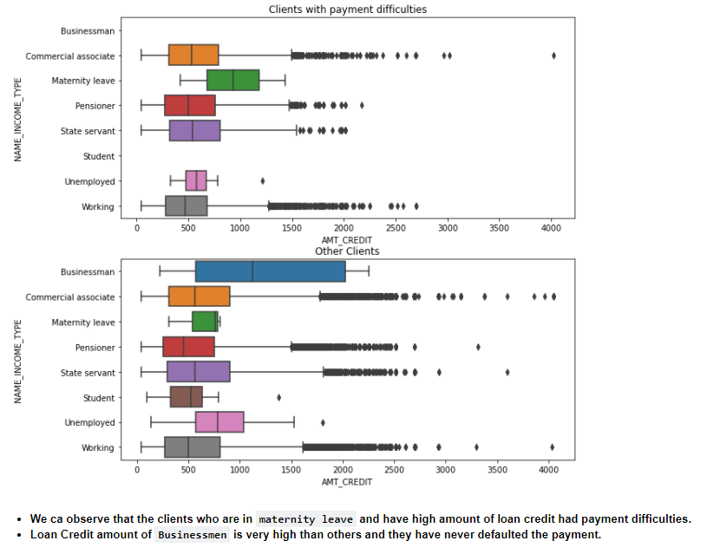

Slide 29
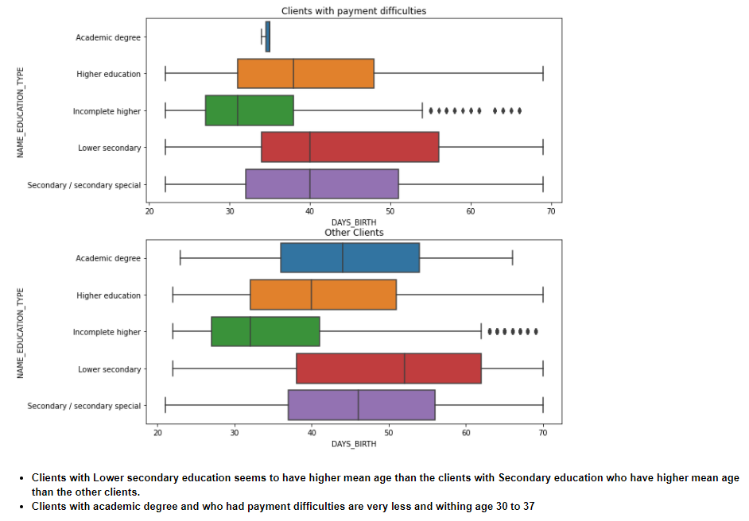

Slide 30
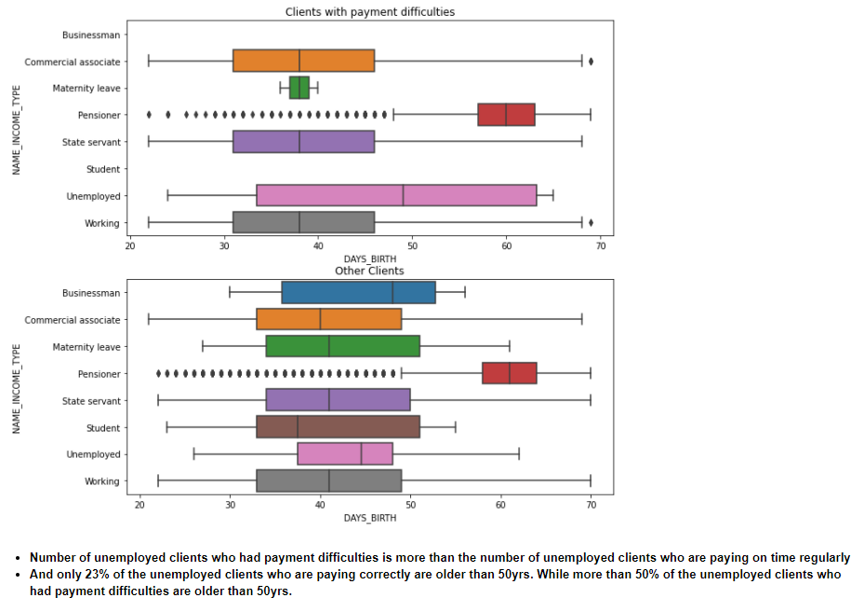

Slide 31
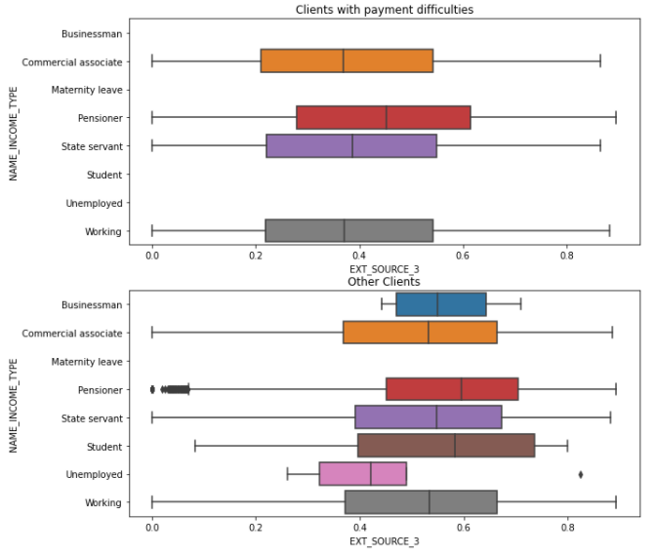

Slide 32
PREVIOUS APPLICATION DATA

Slide 33
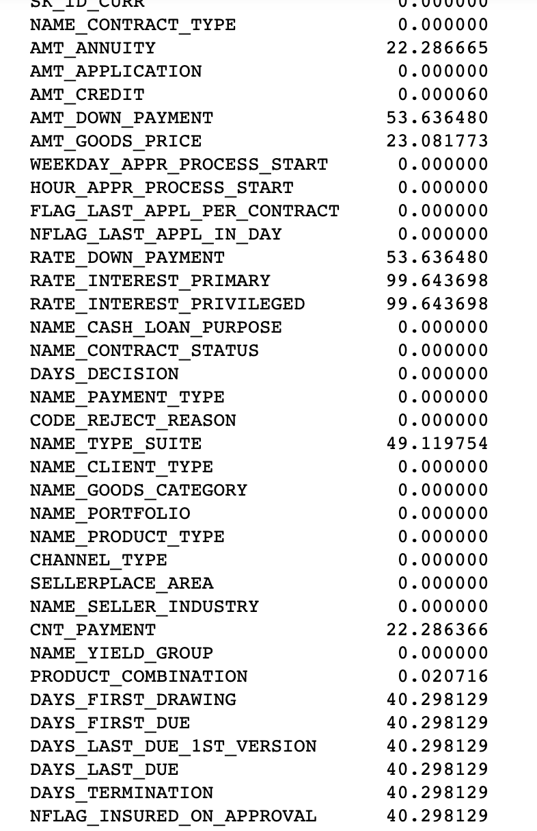
Null values
For the sake of this analysis we have dropped the variables with more than 40% missing value.

Slide 34
EXPLORATION

Slide 35
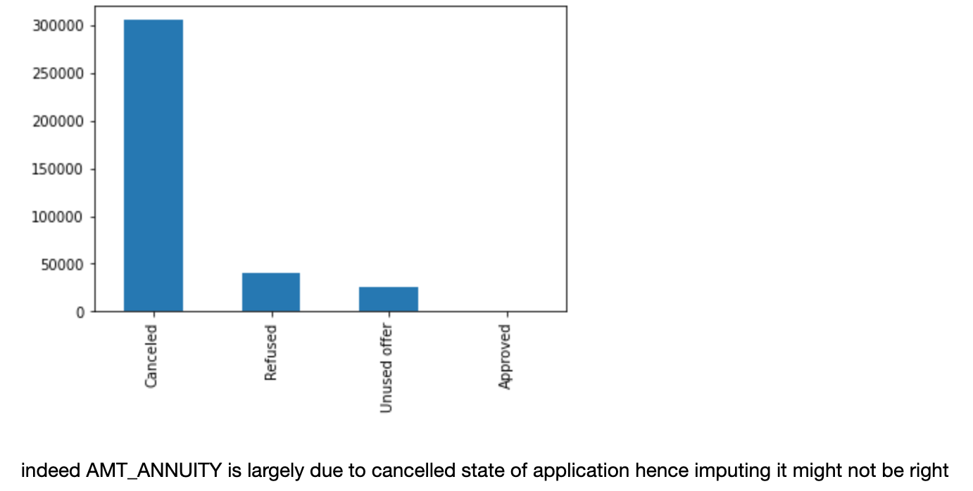
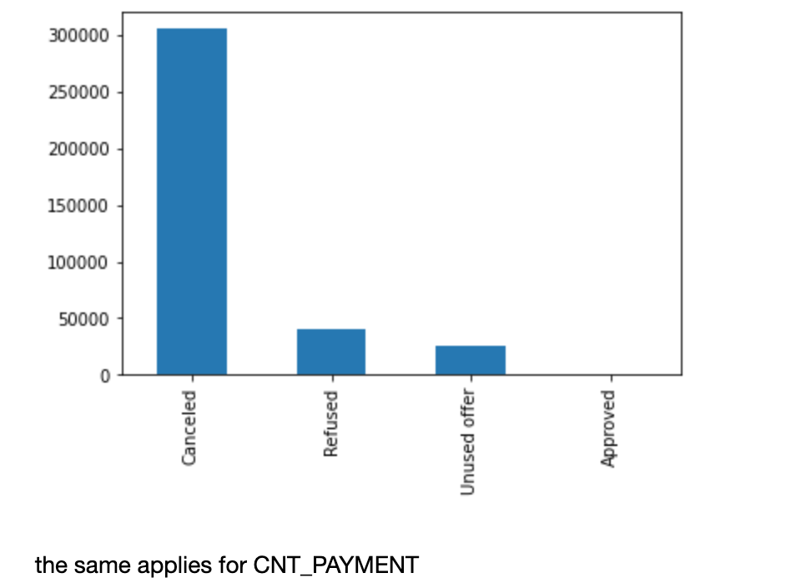
CANCELED state mostly have missing values maybe these nulls mean something and hence imputing it with mean may not be a good reason

Slide 36
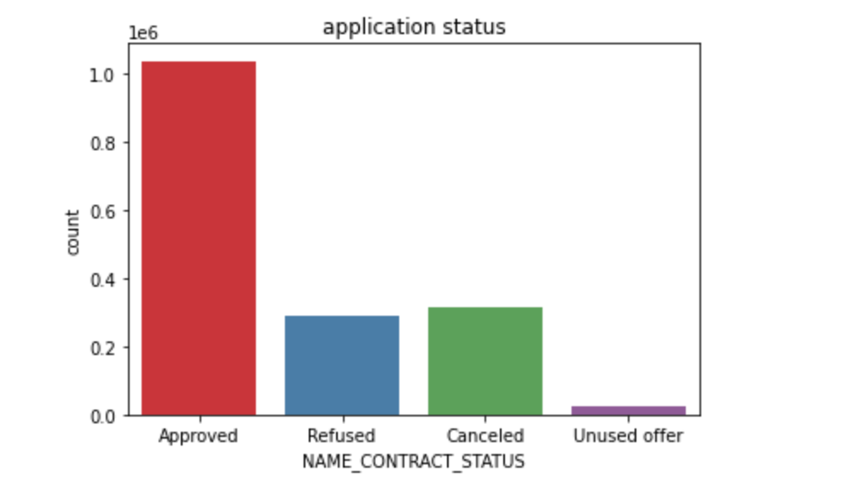
Distribution of Application status
Approved seem to dominate here and unused is way less

Slide 37
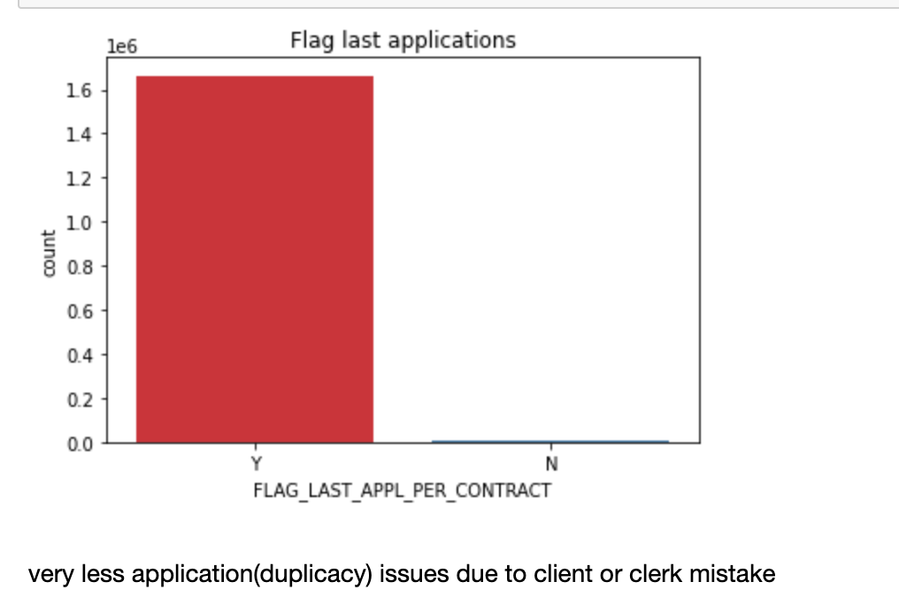

Slide 38
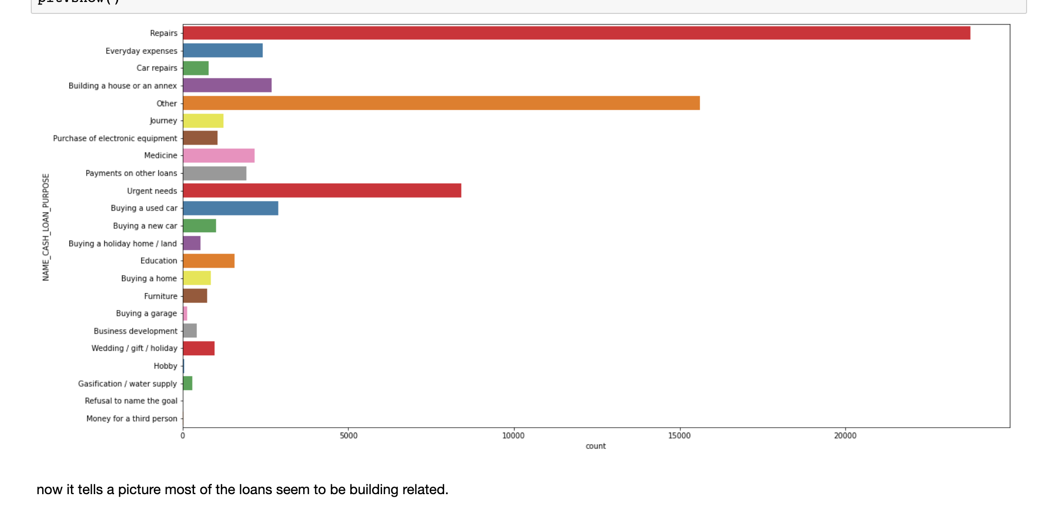
most of the loans are under category XAP and XNA the rest are way to less honestly they seem to be null values as in the value of purpose was not captured so they added XNA and XAP lets see the same graph without XNA and XAP and it seems that Repairs related loans are prominent.

Slide 39
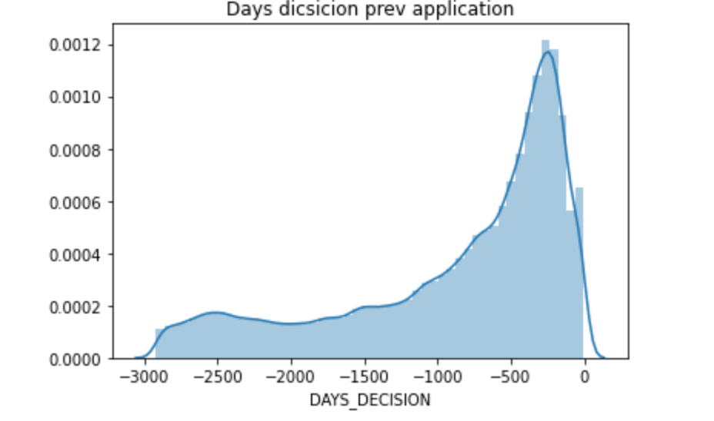
Most of the days since last application lie around 500 days but the range is quite varied.

Slide 40
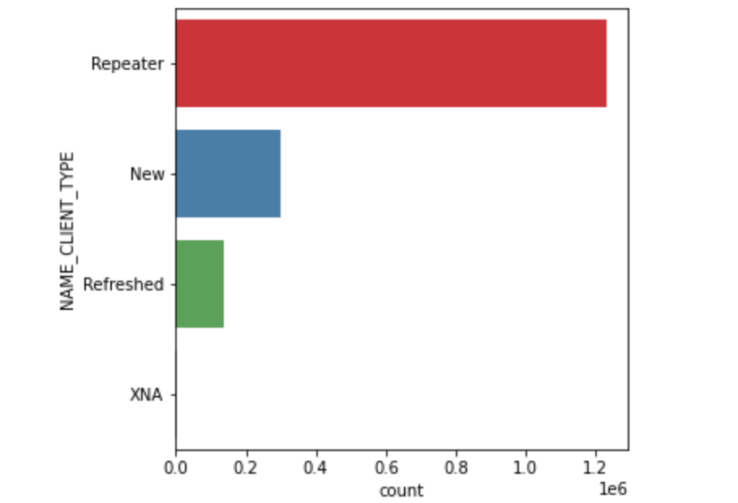
loyalty does matter most of the customers are repeated customer followed by new customers

Slide 41
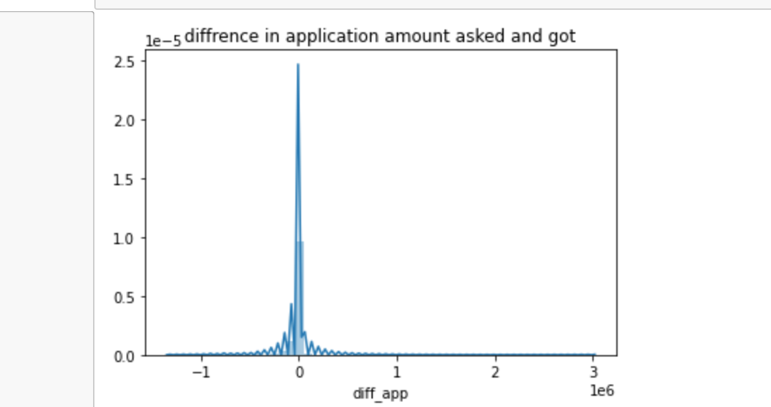
Most users seem to get what they asked for

Slide 42
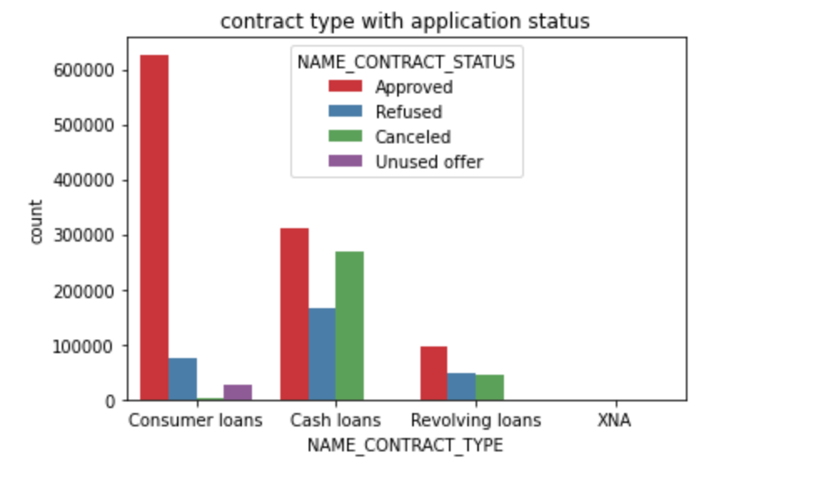
Approved loans in general are more , specifically consumer loans are the most approves and it rarely gets canceled.
cash loans have highest canceled count

Slide 43
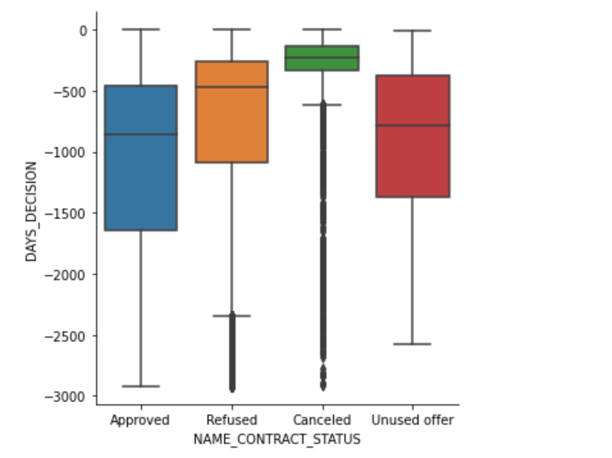
Approved loans and unused loans seem to not have an outlier mostly Approved are done within -1500 days whereas others seem to be alot earlier

Slide 44
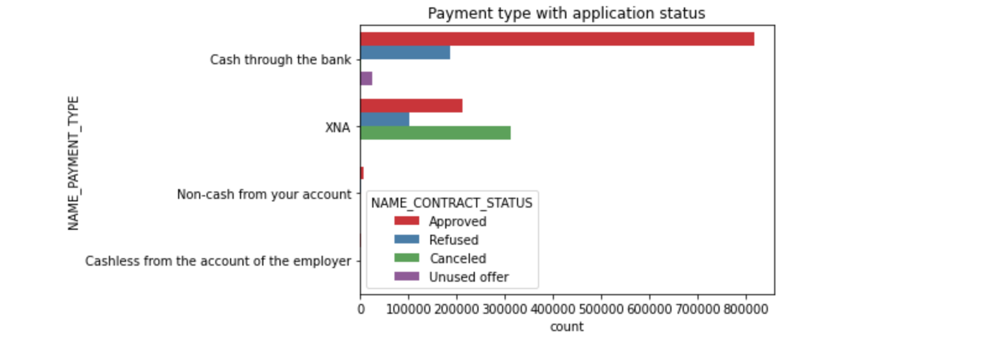
Cash through bank seem to be most approved

Slide 45
Merging the data frames

Slide 46
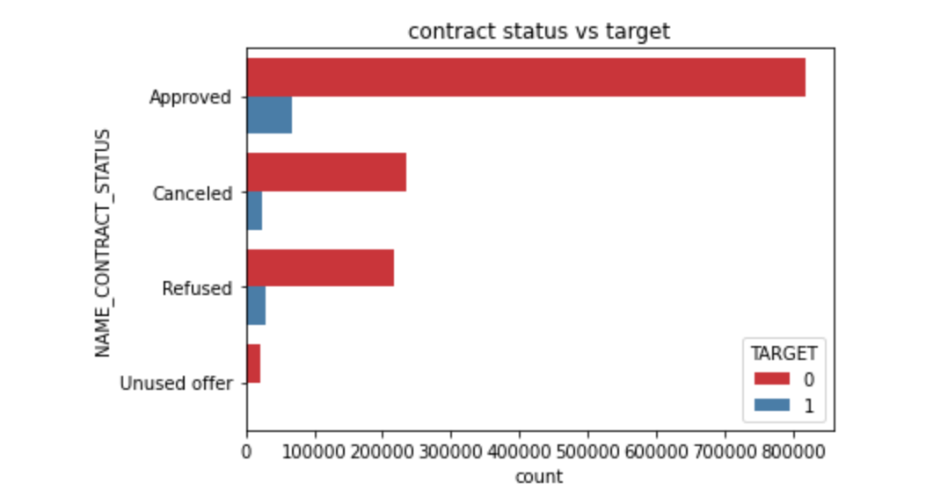
contract status vs target

Slide 47
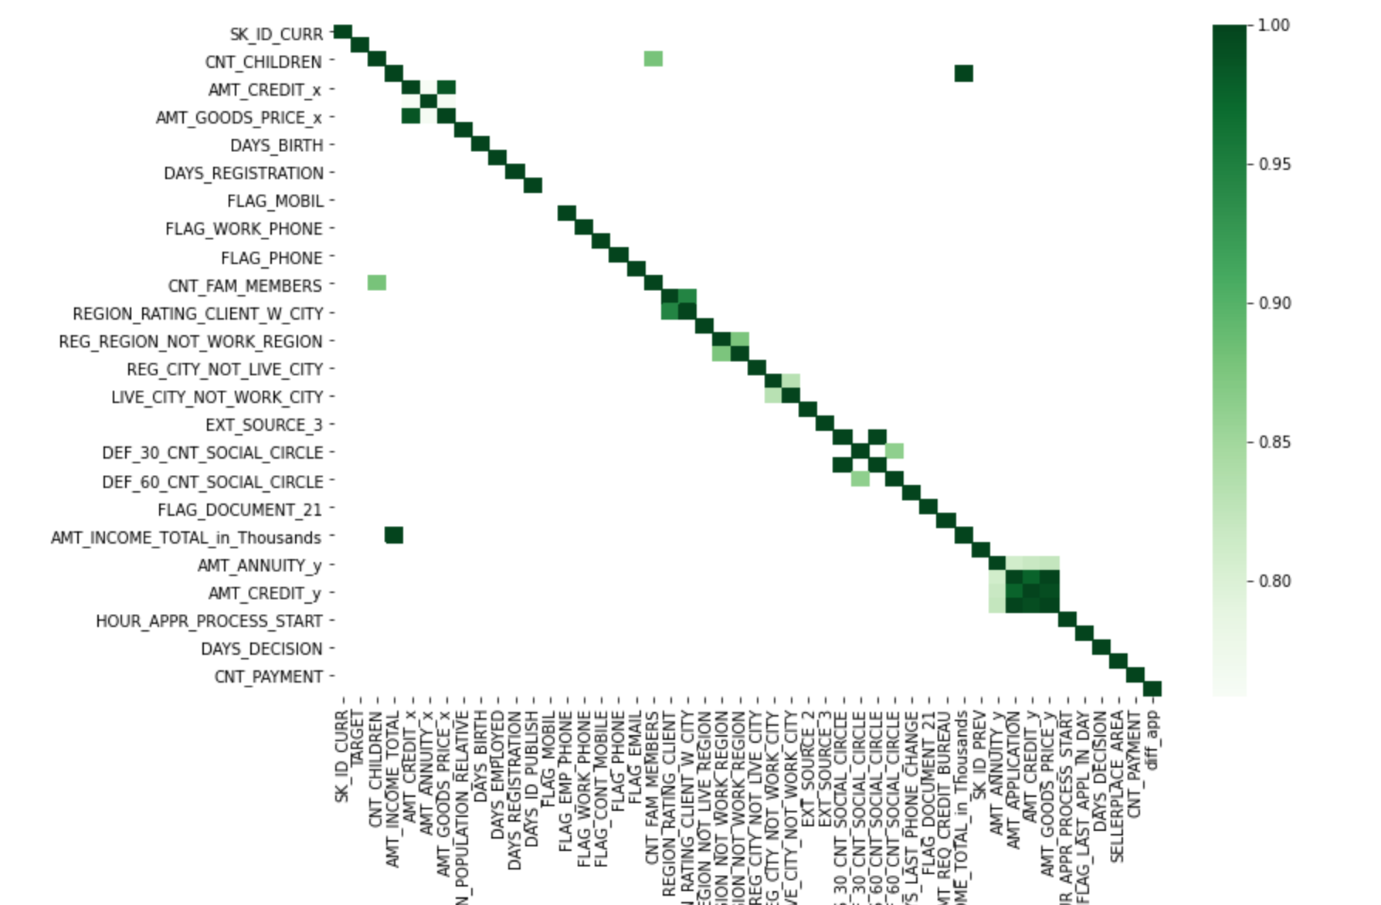
Top correlations amount related fields are correlated

Slide 48
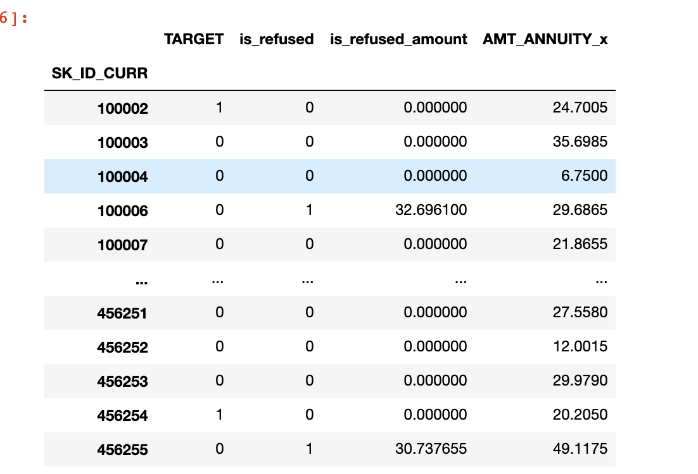
Since there are multipule current application entries lets group by the current application entry on SK_CURR_ID and get the max values , was refused previously and respective amounts for further analysis.

Slide 49
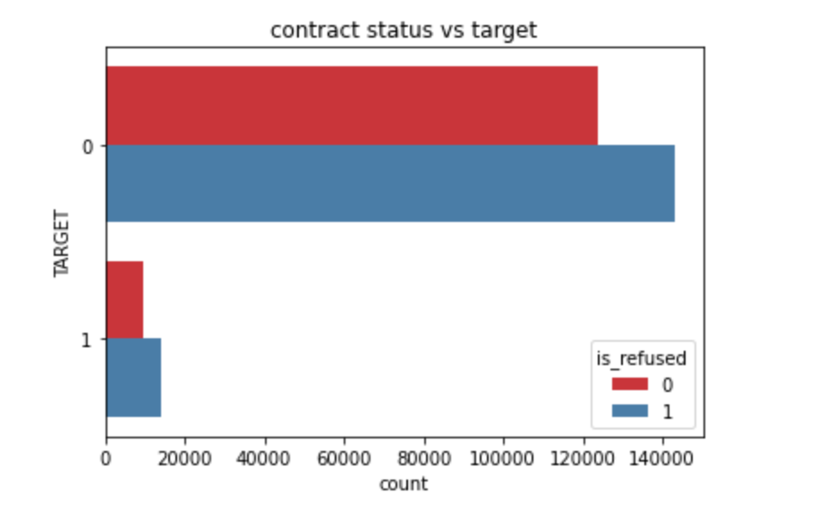
if we naively used only the refused and canceled states in past we could have lost a lot of buisness . though we could have mitigated the risk abit but the business lost is way too much.

Slide 50
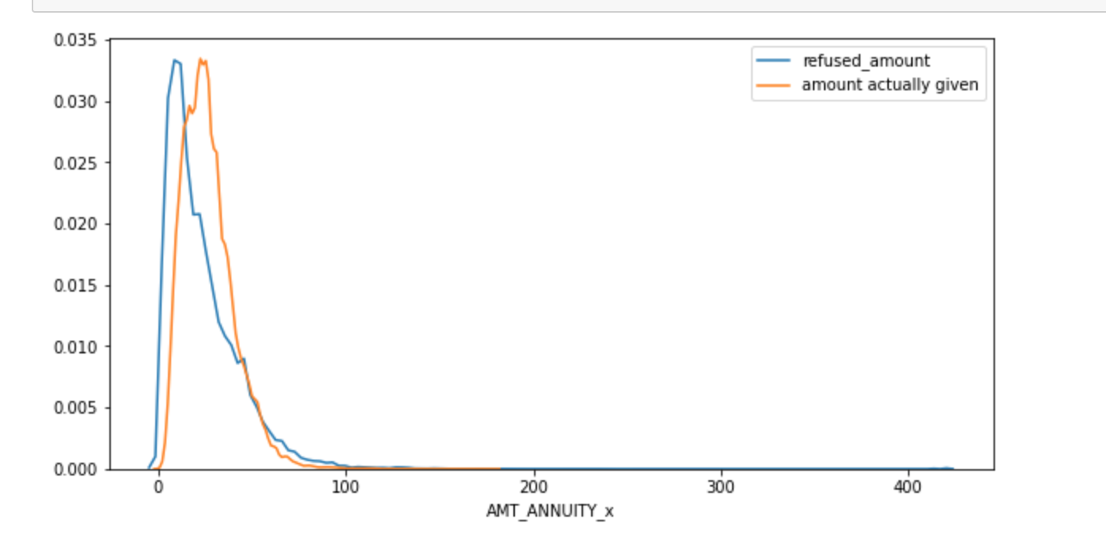
lets check the amount factor for refused and actual loan amounts
It seems that the amount does play a role refused and actual applications are indeed off. for lower amounts amount disbursed was more than the refused amount as the amount increases the amount_refused seems to catch up to amount given and even higher for some cases.

Slide 51
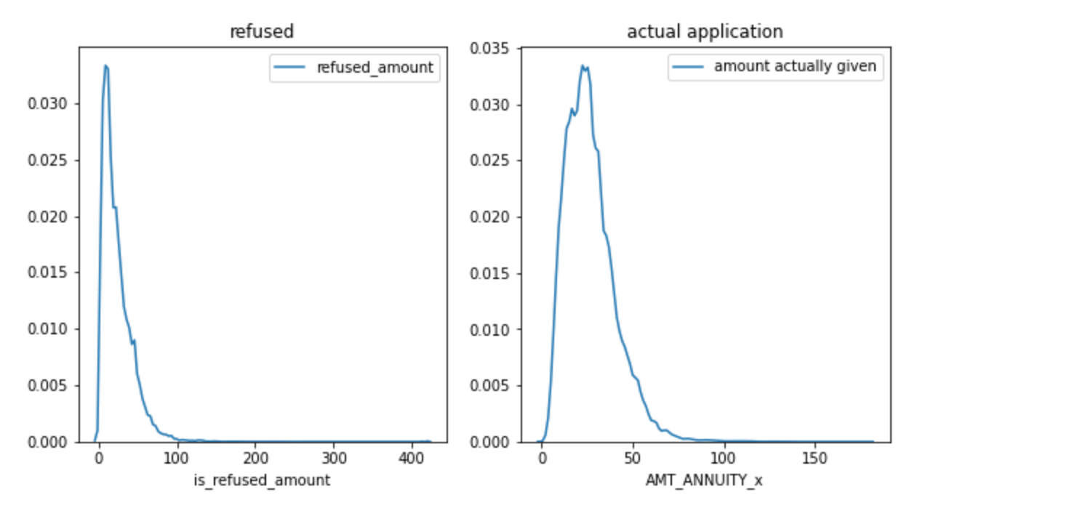

Slide 52
THANK you!!!!!

