Slide 1

Welcome
dheerajlaksh@gmail.com

Slide 2
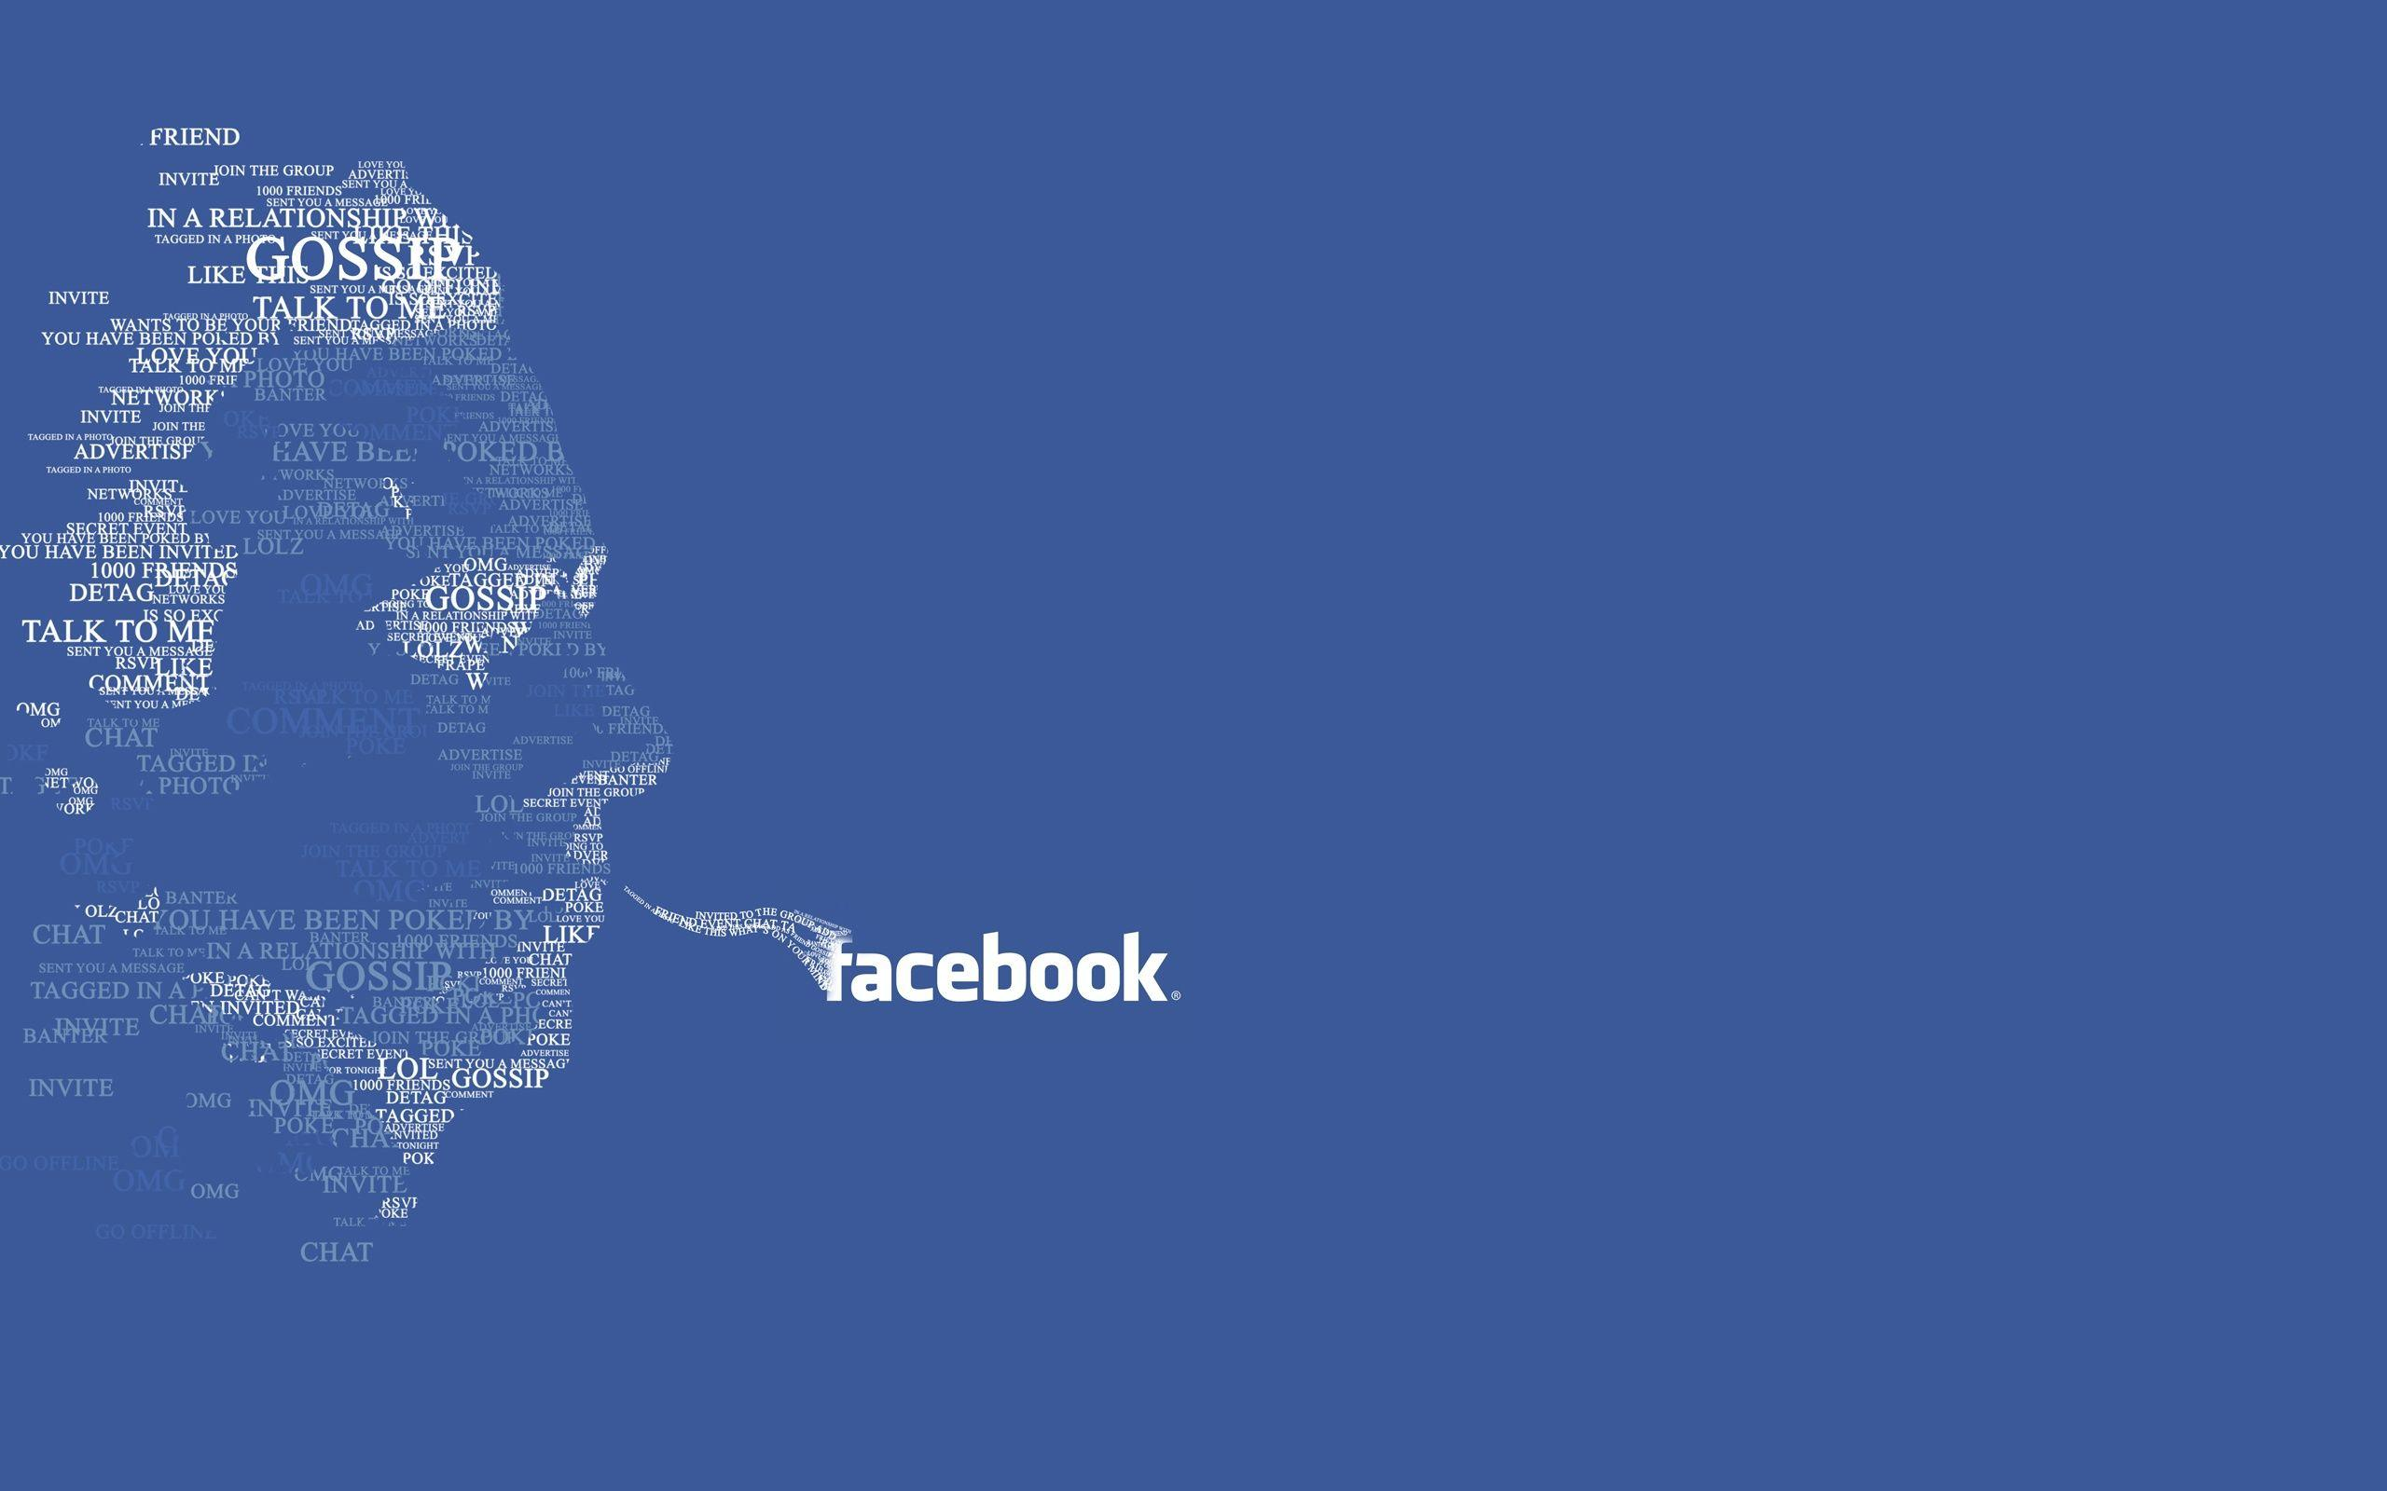
Exploratory Data Analysis
Using Facebook Data
By Dheeraj Soni
dheerajlaksh@gmail.com

Slide 3

Facebook is an American Company founded in 2004 by Mark Zuckerberg, along with his friends at Harvard College
Facebook has its HQ in California and has Offices in 80+ cities worldwide with 17 data centers globally.
As of 2020, Facebook had 2.6 Billion users wordwide, of which 290 Millions users were from India, the highest in the world.
In February 2015, Facebook announced it had reached two million active advertisers
It is considered one of the Big Five companies in U.S
dheerajlaksh@gmail.com

Slide 4
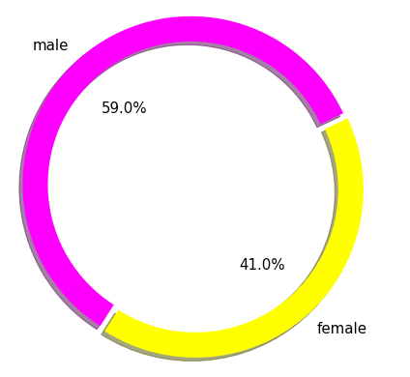


Facebook User’s
Gender | Count
Male | 57,327
Female | 39,837
TOTAL | 97,164
dheerajlaksh@gmail.com

Slide 5

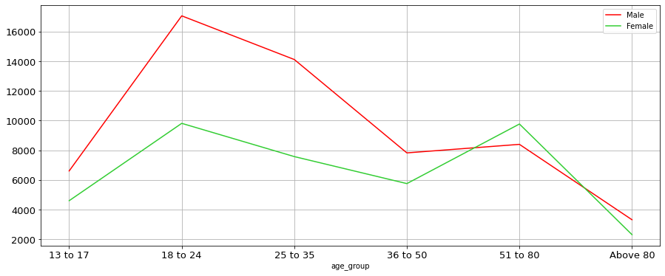
Gender & Age-wise User Count
17,058
14,116
9,815
9,770
7,825
8,400
6,608
7,576
5,756
4,604
3,320
2,316
If we see the Youngest & Oldest User,
We have 467 Users who are 13yrs youngsters and 196 Users with age of 113yrs old
dheerajlaksh@gmail.com

Slide 6

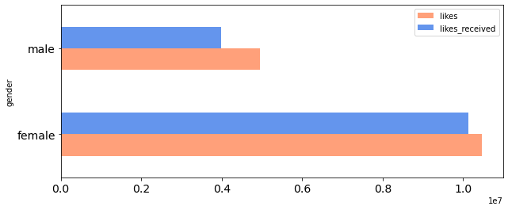


Gender Based Total Likes & Received
(Count in Millions)
3.98
4.96
10.12
10.47
On Average, Female users gives 41 Likes and receives 30 likes,
Whereas, Male gives 5 Likes and receives 4 likes.
23yrs Male has given highest likes of 25,111,
and 17yrs Female has received highest likes of 2,61,197
dheerajlaksh@gmail.com

Slide 7
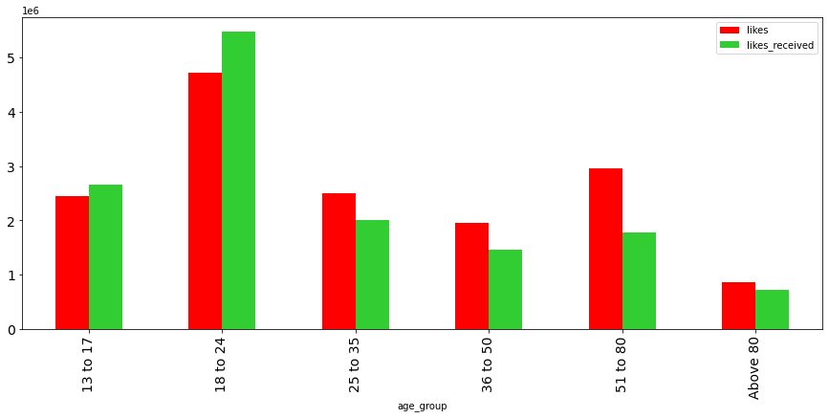
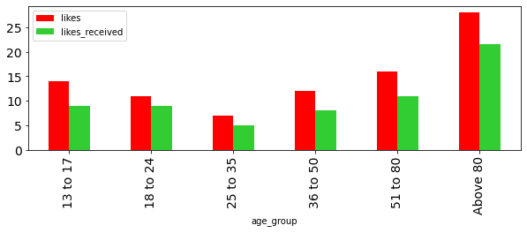
Age-wise Total Likes & Received
(Count In Millions)
Average Per User
dheerajlaksh@gmail.com

Slide 8

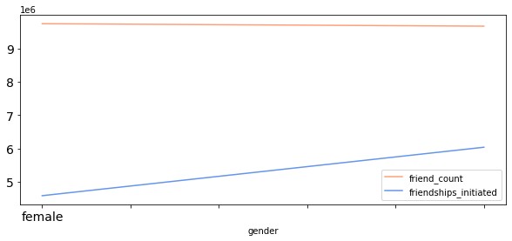
Gender-wise Friends Count & Friends Initiated
9.74
9.67
6.03
4.58
(Count in Millions)
On Average, Female user has 98 friends & sends new friends request to 50,
Whereas, Male user has 77 friends & send new friends request to 45
An Female User aged 103yrs has the highest friend count of 4,923 &
A Male User aged 19yrs has highest friends initiated count of 4,144
dheerajlaksh@gmail.com

Slide 9
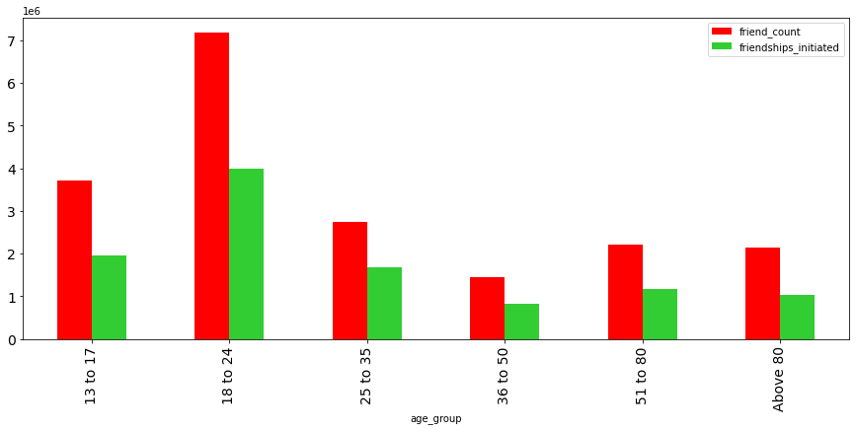

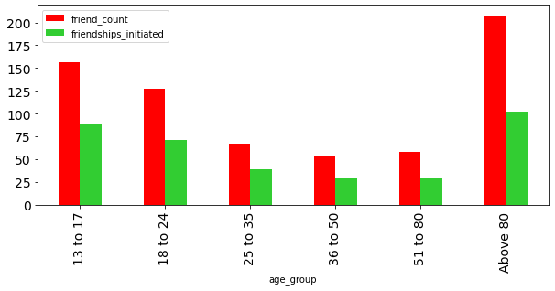
Age-wise Friends Count & Friends Initiated
(Count In Millions)
Average Count Per User
dheerajlaksh@gmail.com

Slide 10
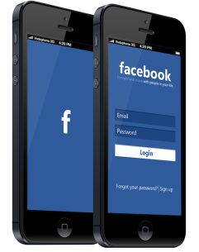
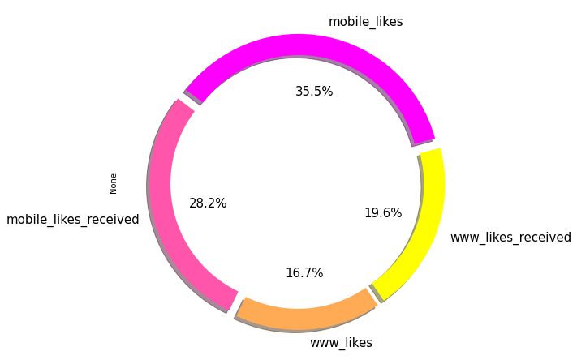
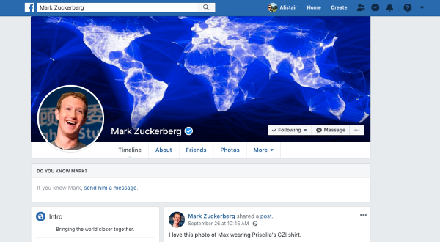
Application Usage
63.70%
Mobile Usage | (In Millions)
Likes | 10.49
Likes Received | 8.31
TOTAL | 18.80
Web Page Usage | (In Millions)
Likes | 4.94
Likes Received | 5.79
TOTAL | 10.73
36.30%
dheerajlaksh@gmail.com

Slide 11
Actionable Insights
Need to get focus on getting more Female users as they are more active than Male users
As female user’s are more active, we can show more ads related to ladies product to generate revenue from ads
Need to advertise Facebook more so that more users can join & in-active users become active.
dheerajlaksh@gmail.com

Slide 12



Thank You
dheerajlaksh@gmail.com

