Slide 1
Cardiovascular Disease Prediction Using Machine Learning Techniques
A comprehensive approach leveraging data preprocessing, feature engineering, and various ML models.
By: Dheeraj
Reg: 24MCS1059

Slide 2
Introduction
Background: Cardiovascular disease is the leading cause of mortality worldwide.
Goal: Use machine learning to predict cardiovascular disease based on medical data.
Motivation: Early diagnosis can reduce mortality and healthcare costs.

Slide 3
Data Description
Dataset Source: Kaggle Cardiovascular Disease Dataset(70,000 records)
Features Overview:
12 attributes (e.g., age, gender, blood pressure, cholesterol).
Target variable: Presence or absence of cardiovascular disease(cardio).
Distribution Summary:
Balanced classes in the target variable.
High number of unique entries for certain features (e.g., age, weight).

Slide 4
# Explanation of each column in the dataset:
# 1. id:
# - A unique identifier for each patient in the dataset.
# 2. age:
# - Age of the patient in days.
# 3. gender:
# - Gender of the patient (1 = female, 2 = male).
# 4. height:
# - Height of the patient in centimeters.
# 5. weight:
# - Weight of the patient in kilograms.
# 6. ap_hi:
# - Systolic blood pressure (higher number) in mmHg.
# 7. ap_lo:
# - Diastolic blood pressure (lower number) in mmHg.
# 8. cholesterol:
# - Cholesterol levels (1 = normal, 2 = above normal, 3 = well above normal).
# 9. gluc:
# - Glucose levels (1 = normal, 2 = above normal, 3 = well above normal).
# 10. smoke:
# - Whether the patient smokes or not (0 = No, 1 = Yes).
# 11. alco:
# - Whether the patient drinks alcohol or not (0 = No, 1 = Yes).
# 12. active:
# - Whether the patient is physically active or not (0 = No, 1 = Yes).
# 13. cardio:
# - Presence or absence of cardiovascular disease (0 = Absent, 1 = Present). This is the target variable we aim to predict.

Slide 5
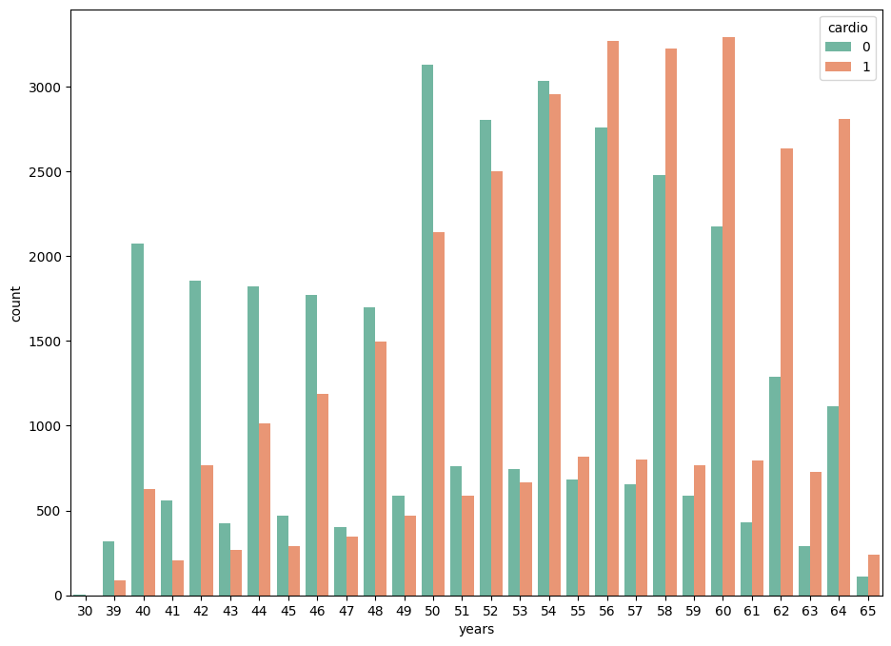
Key Observations:
Age Distribution and Cardio: The plot shows a general trend where the number of individuals with cardiovascular disease tends to increase with age. This is expected, as the risk of developing cardiovascular disease generally increases with age.
Prevalence of Cardio: The plot shows a clear distinction between the number of individuals with and without cardiovascular disease across different age groups. At younger ages, the number of individuals with cardio is lower, while it gradually increases as we move towards older ages.
Age Groups with Higher Prevalence: The plot shows that the prevalence of cardiovascular disease becomes increasingly significant for individuals aged 50 or older. These age groups have a higher number of individuals with cardio compared to other age groups.
In essence, the plot highlights a positive correlation between age and the likelihood of having cardiovascular disease in the dataset. It provides valuable insight into how the presence of cardiovascular disease is related to age, which could be crucial for building predictive models or understanding risk factors associated with the disease.

Slide 6
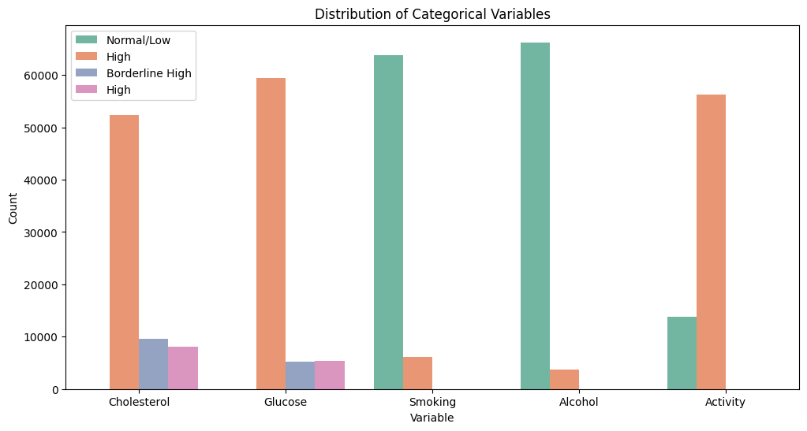
Key Observations:
Prevalence of Categorical Variables: The plot provides insights into the relative frequencies of various levels within each categorical variable. For instance, it can show the proportions of individuals with normal, borderline, or high cholesterol levels.
Potential Associations with Cardio (Implicit): While the plot doesn't directly show the relationship with cardiovascular disease, it indirectly provides a foundation for understanding potential associations. By comparing the counts of each category across the "hue" parameter, we can identify potential patterns linked to the likelihood of cardiovascular disease. For example, we might see higher frequencies of individuals with high cholesterol levels among those with cardiovascular disease.
Imbalanced Categories: The plot might reveal any significant imbalances in the frequencies of certain categories within the variables. For instance, if the majority of individuals are non-smokers, this might affect the predictive power of smoking as a risk factor for cardiovascular disease.
Risk Factor Identification: By examining the relative frequencies of certain categories (like high cholesterol or smoking) within each variable, the plot can help identify potential risk factors for cardiovascular disease.

Slide 7
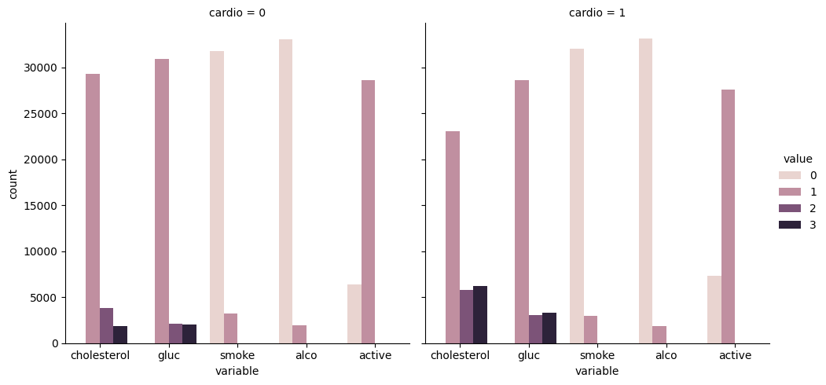
Cholesterol and Glucose Levels: These plots might show that individuals with higher cholesterol and glucose levels have a higher likelihood of having cardiovascular disease.
Smoking and Alcohol Consumption: The plots could reveal that smokers and those who consume alcohol are more likely to have cardiovascular disease.
Physical Activity: The plots may demonstrate that individuals who are physically inactive have a higher likelihood of having cardiovascular disease compared to those who are active.
Potential Risk Factors: These plots help identify potential risk factors for cardiovascular disease beyond age. These risk factors can be further explored and analyzed to gain a deeper understanding of their relationship with cardiovascular disease.

Slide 8
Numerical Columns: ['id', 'age', 'height', 'weight', 'ap_hi', 'ap_lo']
Categorical Columns: ['gender', 'cholesterol', 'gluc', 'smoke', 'alco', 'active', 'cardio']

Slide 9
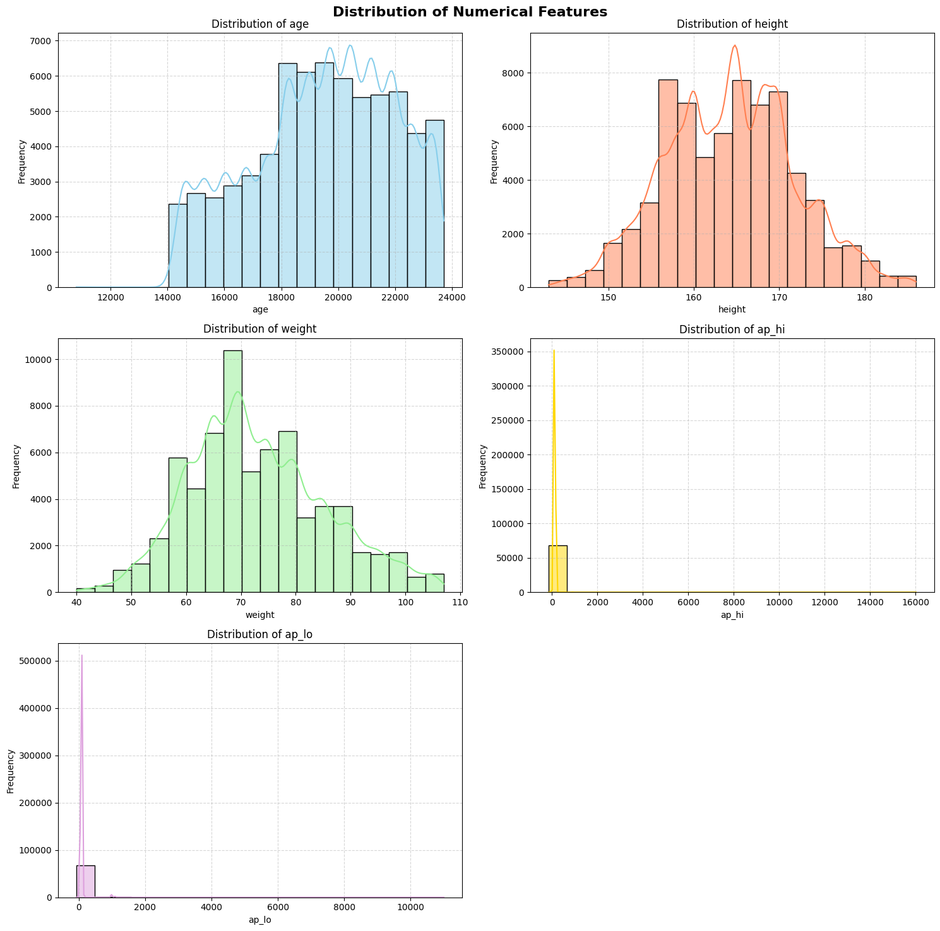
Distribution of Numerical Features
Key Observations from Subplots:
Age: Most patients are concentrated in the middle age range, indicating a potential higher prevalence of cardiovascular diseases in this group.
Height: A relatively normal distribution of height values.
Weight: A right-skewed distribution with potential outliers.
ap_hi & ap_lo: Both blood pressure features exhibit skewed distributions. It is important to address potential outliers affecting the model.
bmi: The distribution of BMI can be useful to study the correlation between BMI and the probability of CardioVascular Disease.
gluc: Shows high values for normal blood glucose.
cholesterol: Similar to gluc, shows high values for normal blood glucose.

Slide 10
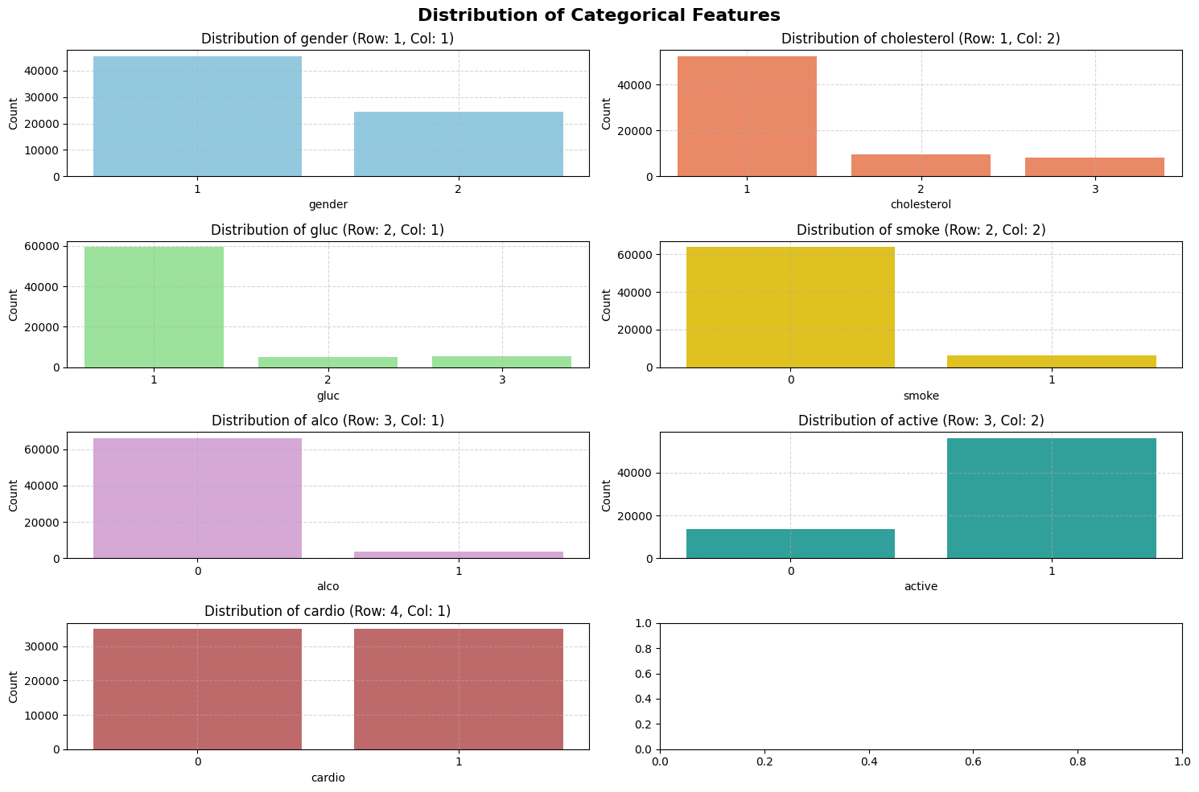
Gender: There's a slightly higher count of female patients compared to male patients.
Cholesterol: Most patients have normal cholesterol levels, with a smaller proportion having above-normal or well-above-normal levels.
Glucose: Similar to cholesterol, most patients have normal glucose levels, with fewer having above-normal or well-above-normal levels.
Smoke: A significant majority of patients do not smoke.
Alcohol: The majority of patients do not drink alcohol.
Active: Most patients are physically active.
Cardio: There's a relatively balanced distribution between patients with and without cardiovascular disease, although the absence of the disease seems to be slightly more prevalent.

Slide 11
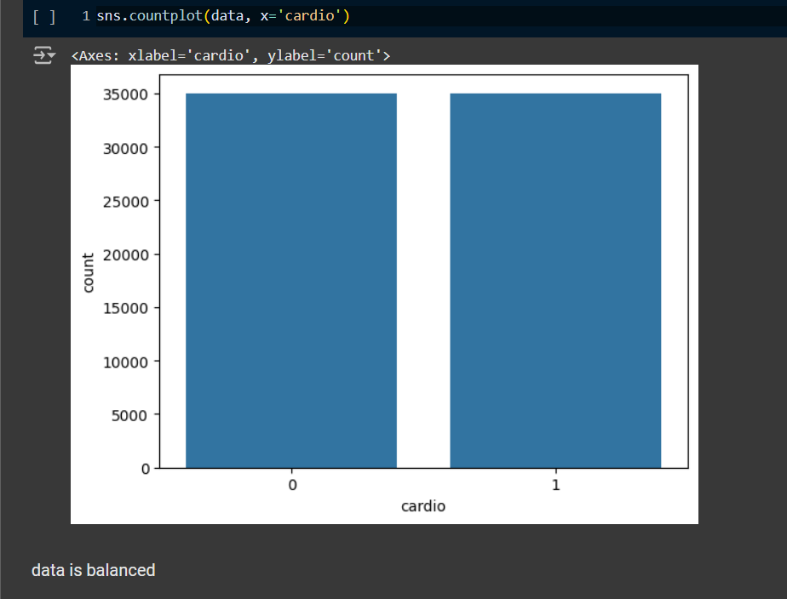

Slide 12
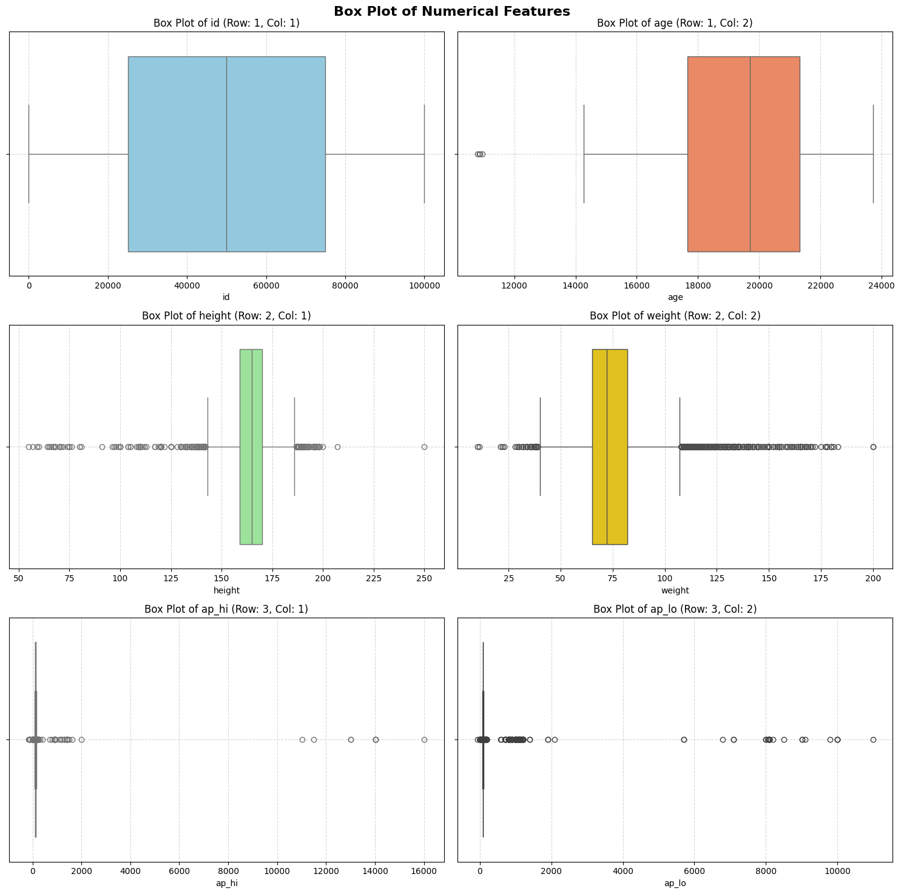
Data Preprocessing and Cleaning
Handling Missing Values:
No missing values
Removing Outliers:
Identified and removed outliers(capping) in weight, height,
and blood pressure.
Standardizing Features:
Scaled numerical features using MinMaxScaler.

Slide 13
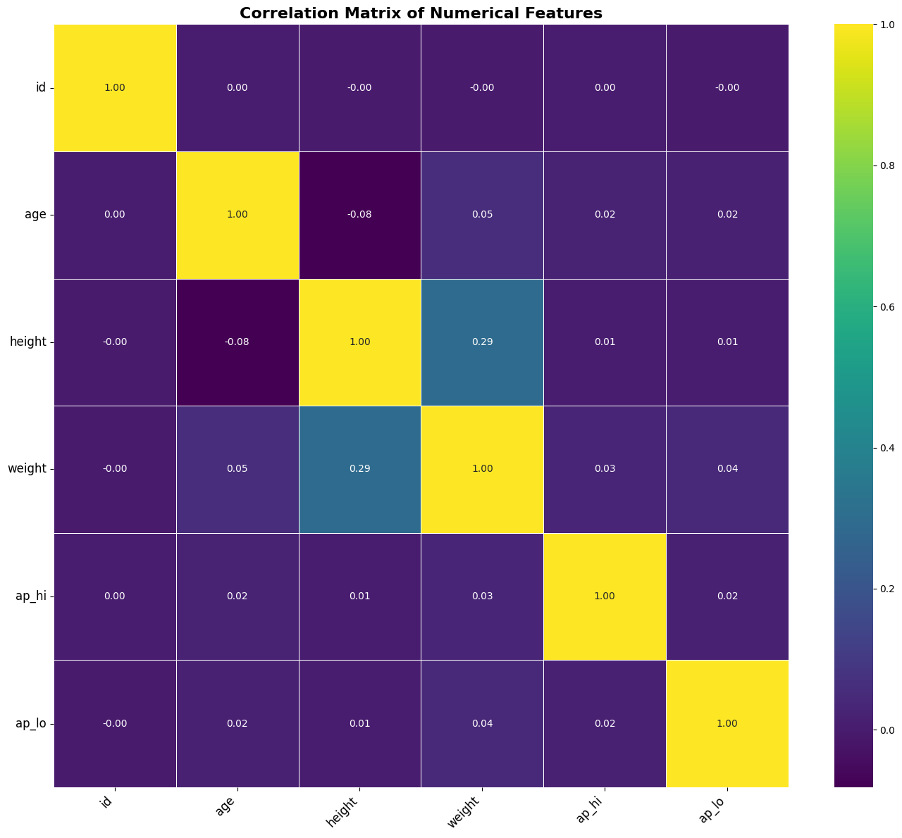
Heatmap
Key Observations from the Heatmap:
Age and Cardio: A strong positive correlation exists between age and the presence of cardiovascular disease. This is expected as cardiovascular risks tend to increase with age.
Weight and Cardio: A moderate positive correlation between weight and cardiovascular disease is observed, suggesting that higher weight might be associated with increased cardiovascular risks.
BMI and Cardio: There's also a moderate positive correlation between BMI and cardiovascular disease.
Systolic and Diastolic Blood Pressure (ap_hi & ap_lo): A strong positive correlation between systolic and diastolic blood pressure is expected as they are both indicators of overall blood pressure.
Height and Weight: A moderate positive correlation exists between height and weight, indicating that taller individuals tend to weigh more.
Other Correlations: Some other correlations are also present, but they are weaker than the ones mentioned above.
In essence, the heatmap reveals important relationships between various numerical features and the presence of cardiovascular disease. These insights are valuable for understanding which factors might be significant predictors of the disease and can guide model development.

Slide 14
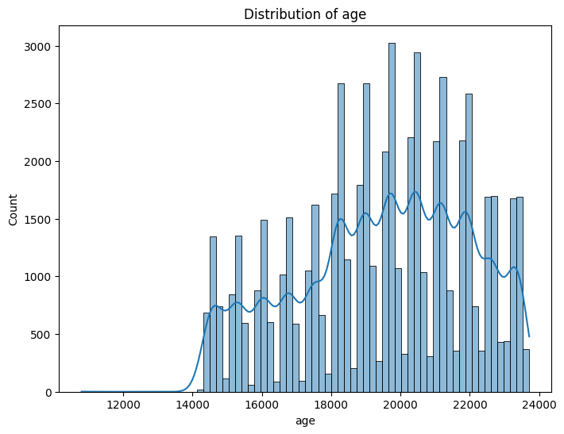
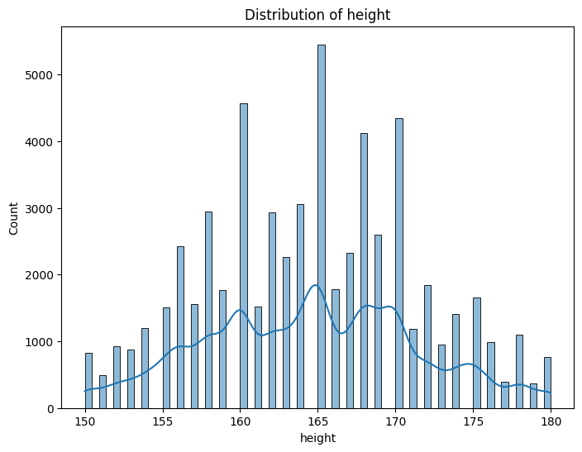
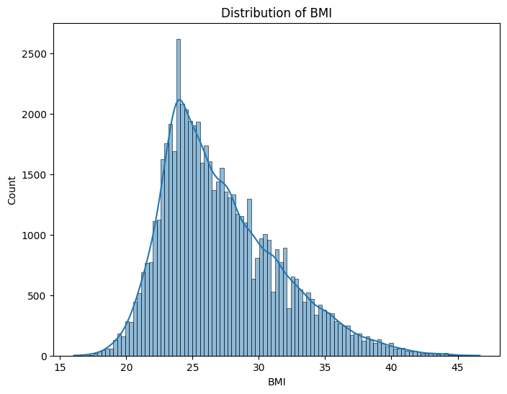
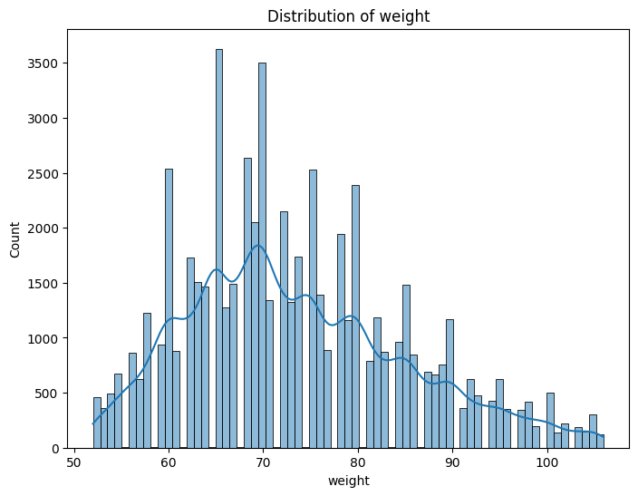
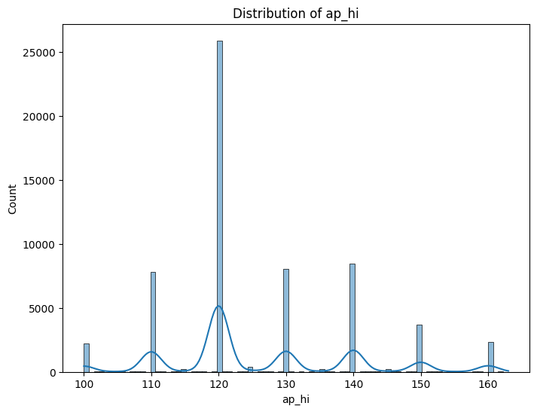
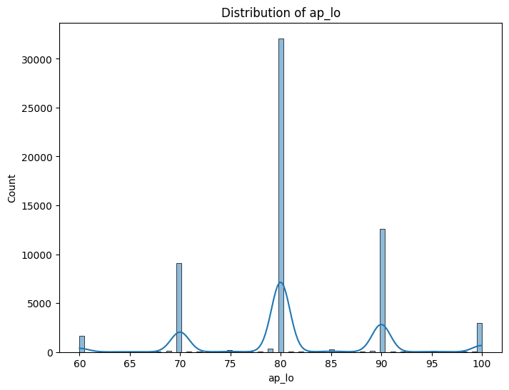
Distribution

Slide 15
Key Observations and Insights from the Plots
* Age and Cardio: Strong positive correlation, meaning older individuals are more likely to have cardiovascular disease.
* Blood Pressure (ap_hi, ap_lo): Strong positive correlation, as expected, indicating that individuals with higher systolic pressure tend to have higher diastolic pressure as well.
* Weak or No Correlation: Many variables show weak or no significant correlation with cardiovascular disease, suggesting that they may not be as crucial for predicting it independently.
* Gender and Cardio: Very slight correlation, meaning gender has a very weak relationship with the risk of cardiovascular disease.
* BMI: Right-skewed distribution with possible outliers. This means that there are some individuals with unusually high BMI values.
* Alcohol Consumption: Boxplots combined with gender and cardio status could indicate whether alcohol consumption is linked to higher BMI or cardiovascular disease risk, potentially revealing differential effects depending on gender.
Insights:
* Age is a significant risk factor for cardiovascular disease.
* Blood pressure is strongly linked to cardiovascular health.
* Further investigation is needed for other variables (e.g., cholesterol, glucose, smoking, active) to understand their individual impact on cardiovascular disease risk.
* BMI might be a relevant predictor of cardiovascular disease, especially when considered with gender and alcohol consumption.
* These visualizations help to formulate hypotheses about potential relationships between features and the risk of cardiovascular disease.

Slide 16
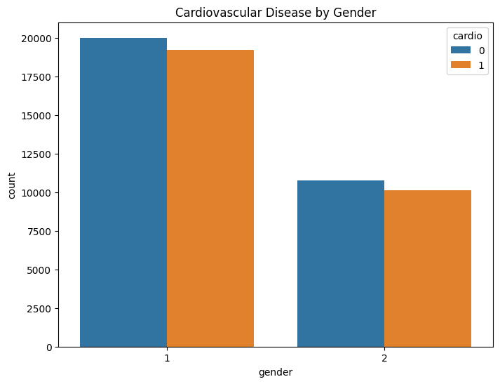
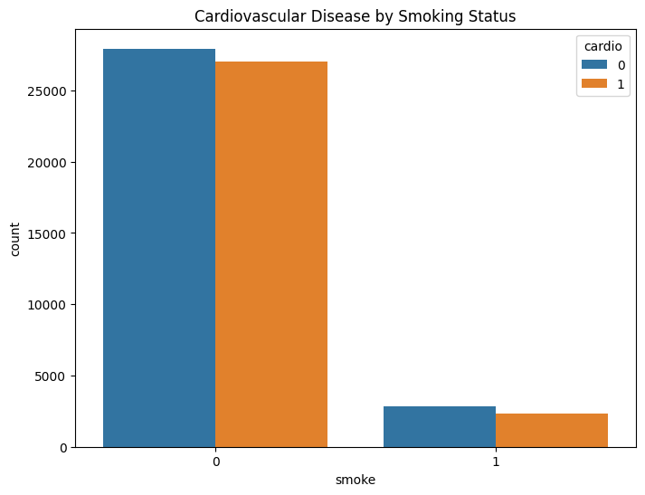
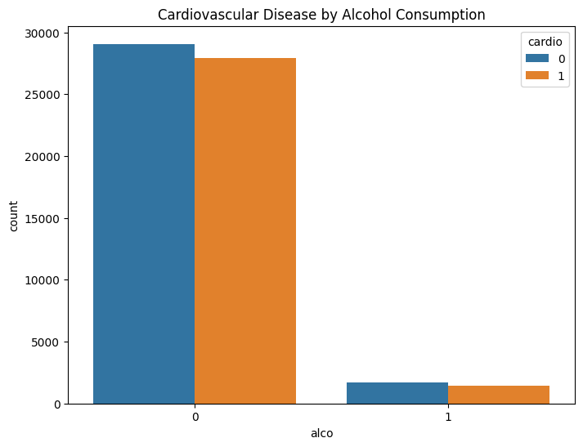
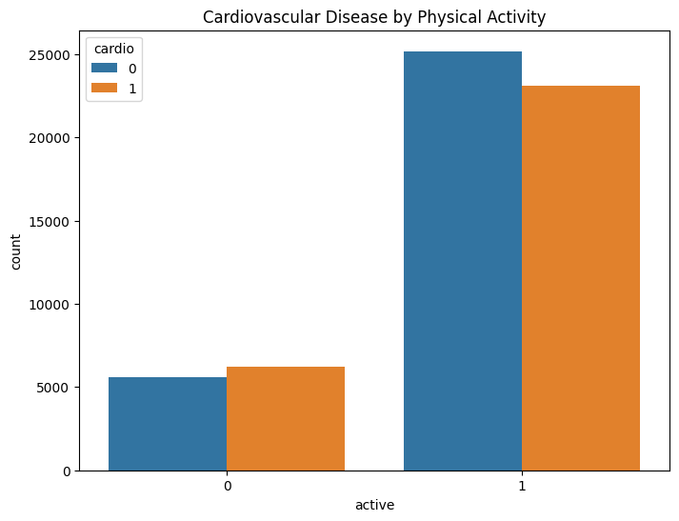
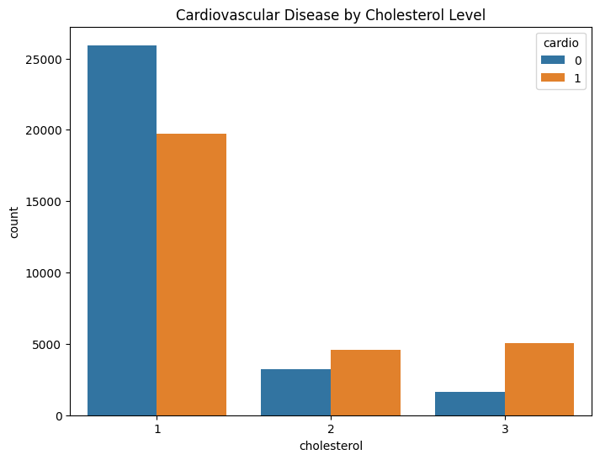
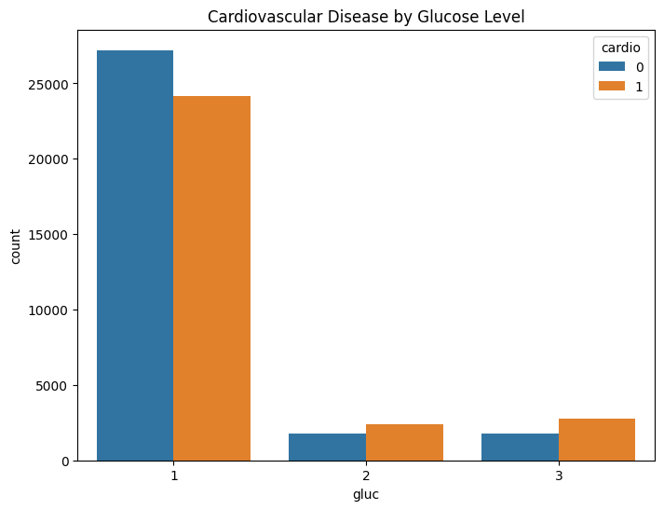
Bivariate analysis

Slide 17
Key Observations and Insights from Countplots:
Cardiovascular Disease by Gender:
Possible Insights: If one gender has a significantly higher proportion of individuals with cardiovascular disease, it indicates a potential gender-related risk factor.
Cardiovascular Disease by Smoking Status:
- If a larger proportion of smokers have cardiovascular disease, it suggests a potential link between smoking and increased risk.
Cardiovascular Disease by Alcohol Consumption:
- If alcohol consumption is associated with a higher proportion of individuals with cardiovascular disease, it suggests a potential link between alcohol and increased risk.
Cardiovascular Disease by Physical Activity
- If a higher proportion of individuals with cardiovascular disease are less physically active, it suggests that physical activity might be a protective factor against cardiovascular disease.
Cardiovascular Disease by Cholesterol Level:
Cardiovascular Disease by Cholesterol Level
- If higher cholesterol levels are associated with a greater proportion of individuals with cardiovascular disease, it suggests a potential link between high cholesterol and increased risk.
Cardiovascular Disease by Glucose Level:
-If higher glucose levels are associated with a greater proportion of individuals with cardiovascular disease, it suggests a potential link between high glucose and increased risk.

Slide 18
Feature Engineering
Binning Continuous Variables:
Converted continuous variables (age, MAP) to categorical bins to enhance model interpretability.
New Features:
Calculated BMI and MAP as additional features.
Binned MAP into specific intervals for improved classification.
Encoding Categorical Features:
Transformed categorical data using one-hot encoding for use in ML models.

Slide 19
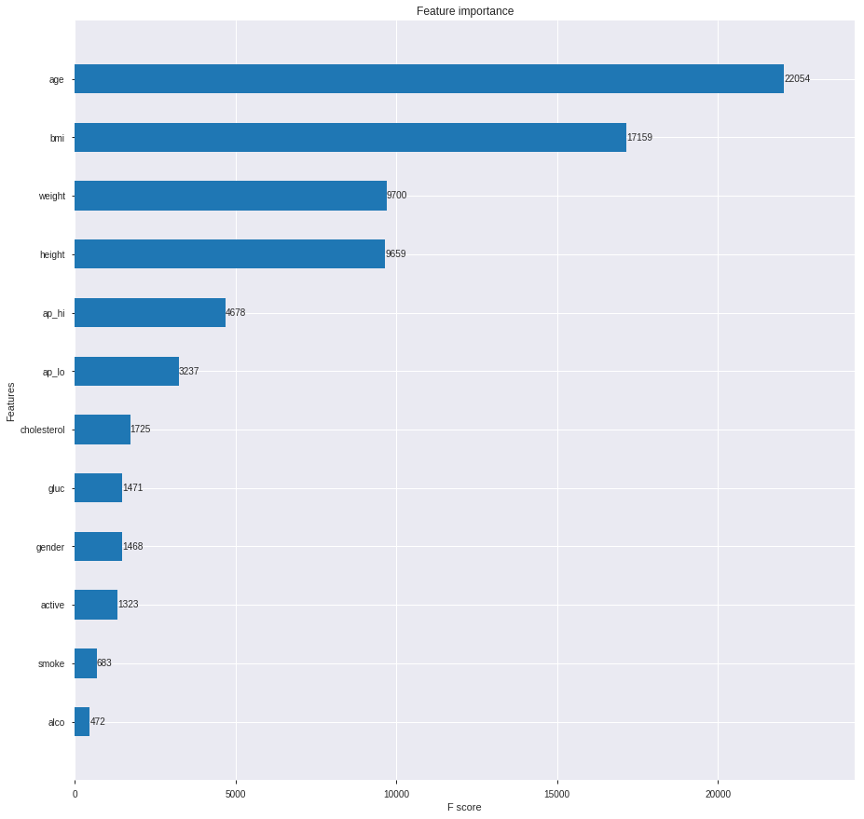

Slide 20
Exploratory Data Analysis (EDA)
Distribution of Numerical Features:
Histograms for age, height, weight, blood pressure.
Correlation Analysis:
Heatmap showing strong correlations between age and cardiovascular disease.
BMI and MAP as additional contributing factors.
Gender-wise Analysis:
Proportion of disease presence across gender.

Slide 21
Model Selection and Training
Machine Learning Models Applied:
Logistic Regression
Decision Tree Classifier
Random Forest Classifier
K-Nearest Neighbors (KNN)
Support Vector Classifier (SVC)
Neural Network (Perceptron)
XGBoost
Pipelines and Cross-Validation:
Used pipelines to streamline training and evaluation.
Cross-validated results to ensure robustness.

Slide 22
Model Evaluation Metrics
Metrics Used:
Accuracy: Measures overall correctness.
Precision and Recall: Evaluate model effectiveness for positive cases.
F1 Score: Harmonic mean of precision and recall.
ROC AUC: Measures trade-off between true positive rate and false positive rate.

Slide 23
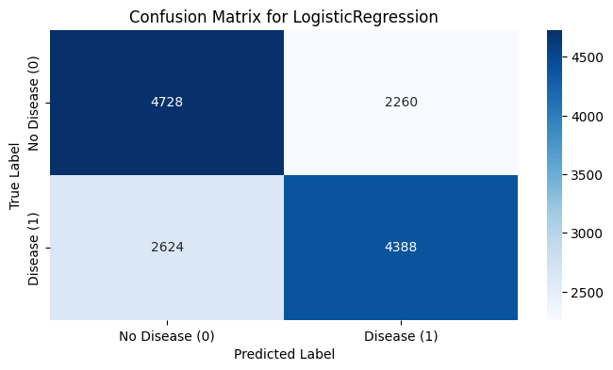
Accuracy_Score of LogisticRegression(solver='liblinear') model on Training Data is: 64.42857142857143
Accuracy_Score of LogisticRegression(solver='liblinear') model on Testing Data is: 65.11428571428571
Precision Score of LogisticRegression(solver='liblinear') model is: 0.6600481347773767
Recall Score of LogisticRegression(solver='liblinear') model is: 0.6257843696520251
F1 Score of LogisticRegression(solver='liblinear') model is: 0.6424597364568082

Slide 24
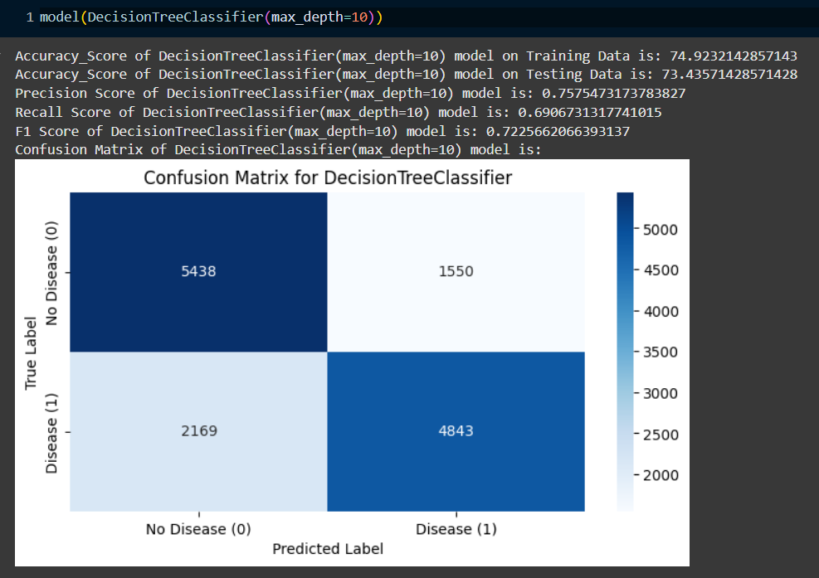

Slide 25
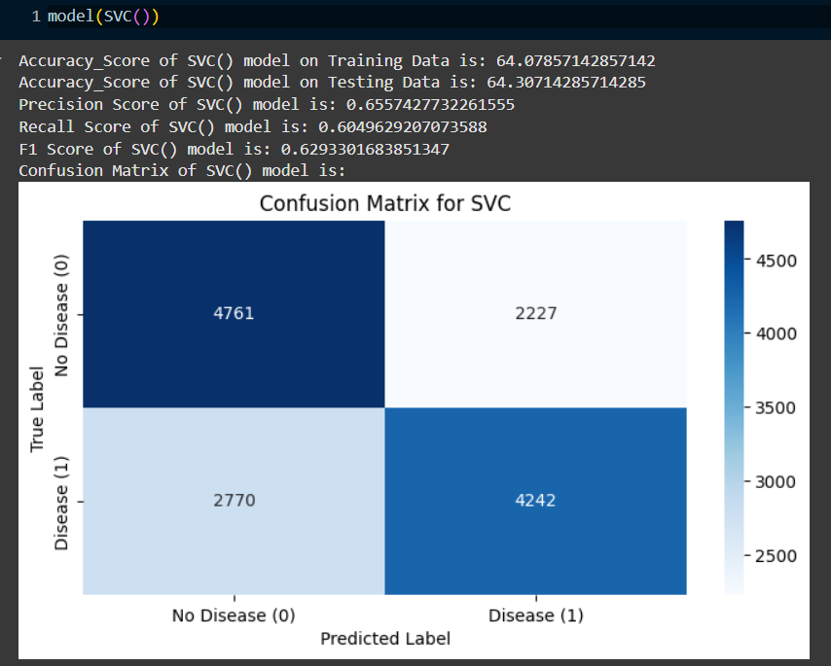
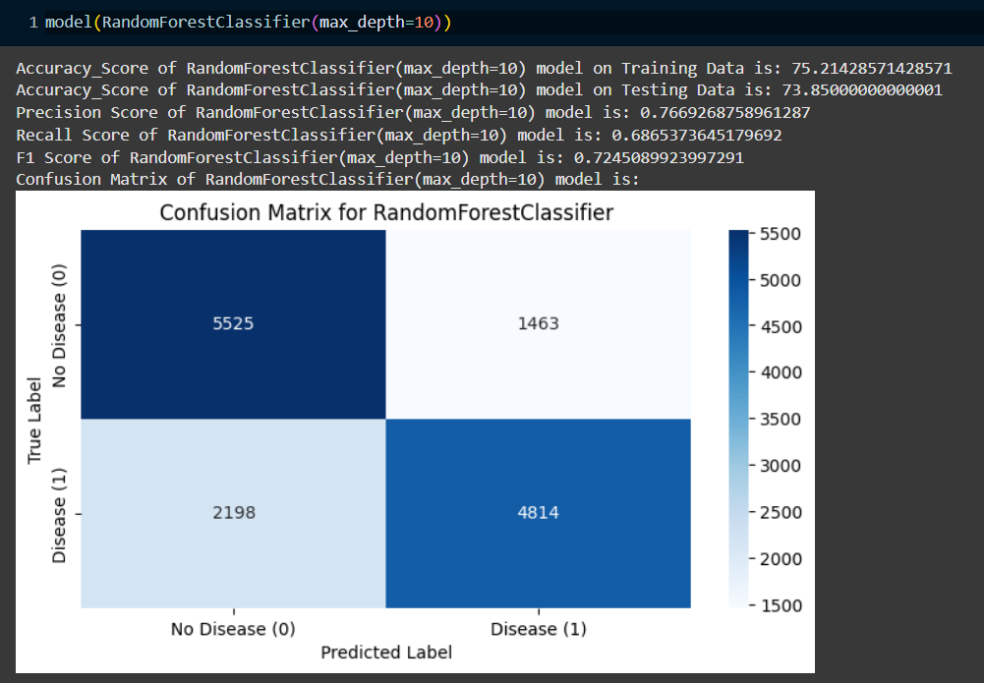

Slide 26
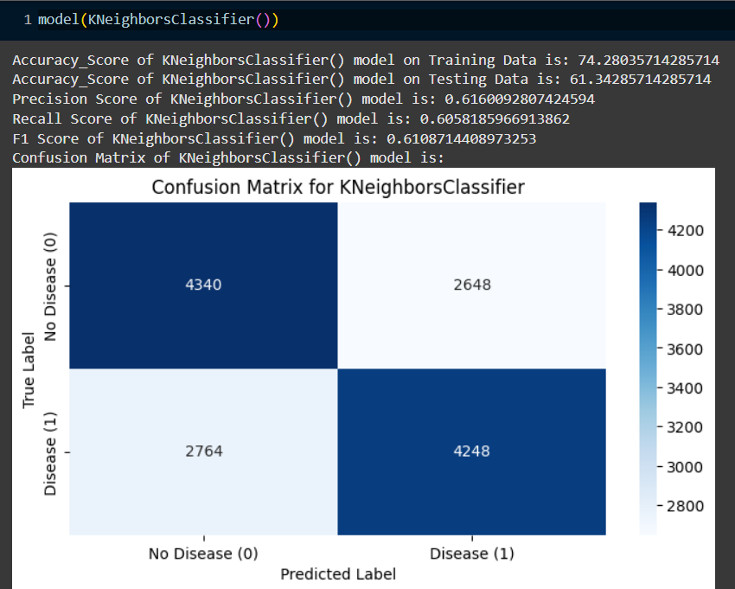
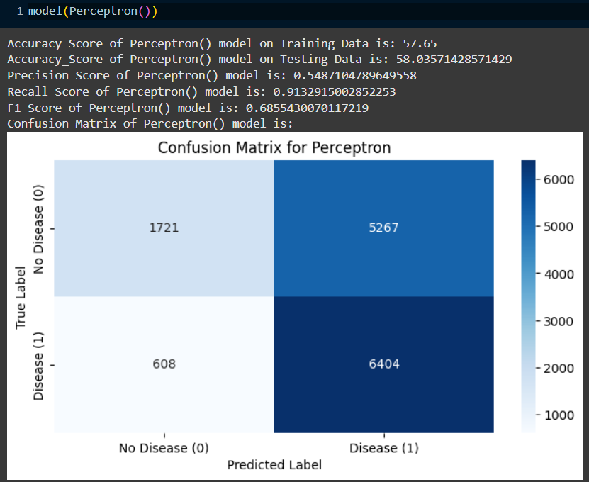

Slide 27
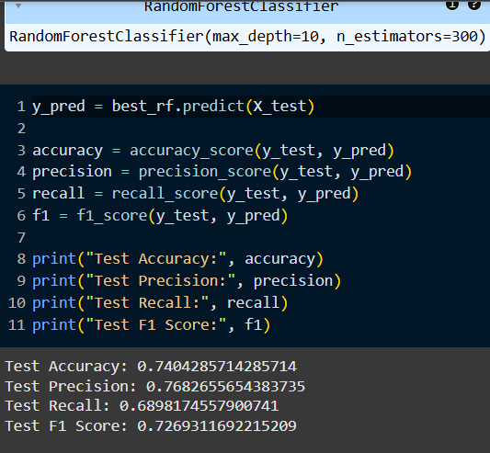
Hyperparameter Tuning
Grid Search for Optimal Parameters:
Explored parameter space for Random Forest, Gradient Boosting,
and XGBoost.
Best Parameters and Results:
Reported accuracy and optimal configurations for top-performing models.
Result Improvement:
Increased accuracy by fine-tuning parameters (Random Forest, XGBoost).

Slide 28
Results Comparison
Performance Comparison of Models:
Bar chart of accuracy, precision, recall, and F1-score for each model.
ROC Curves for Top Models:
Visual comparison of ROC AUC for Random Forest, XGBoost, and MLP.
Key Observations:
Random Forest and XGBoost achieved the highest accuracy and AUC.

Slide 29
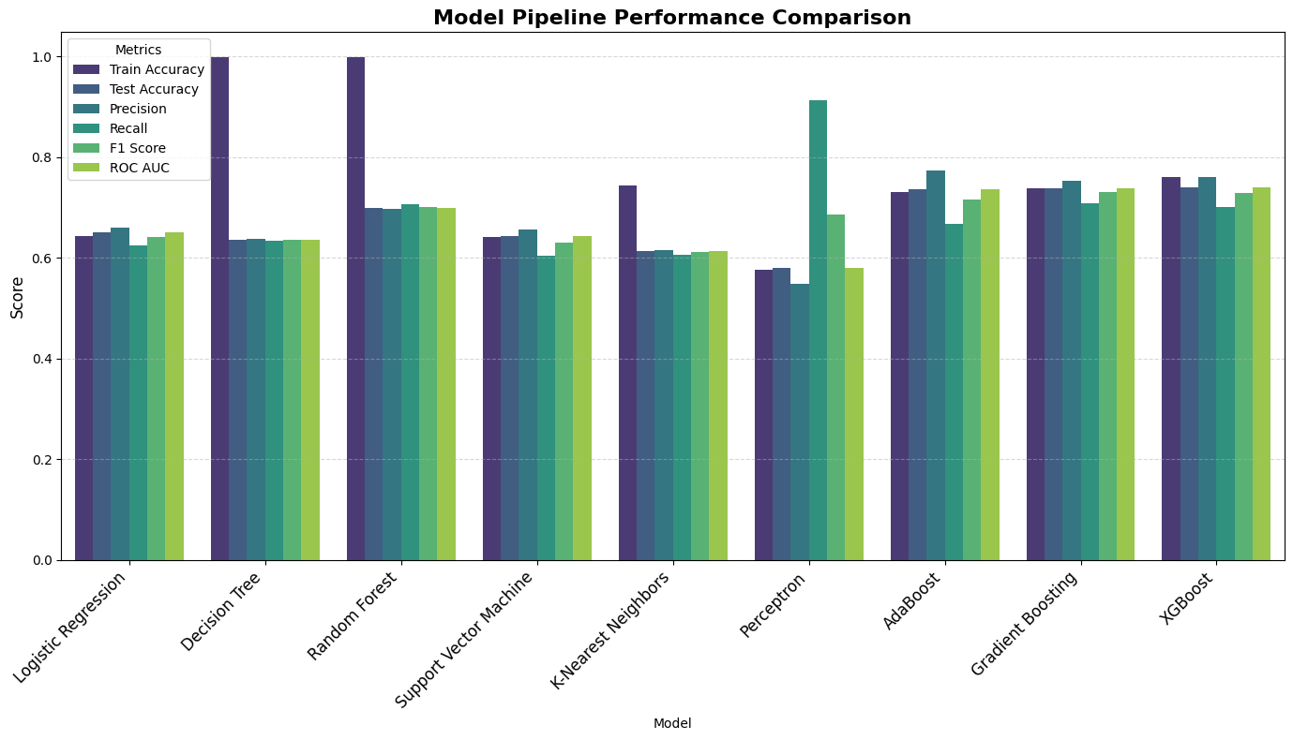

Slide 30
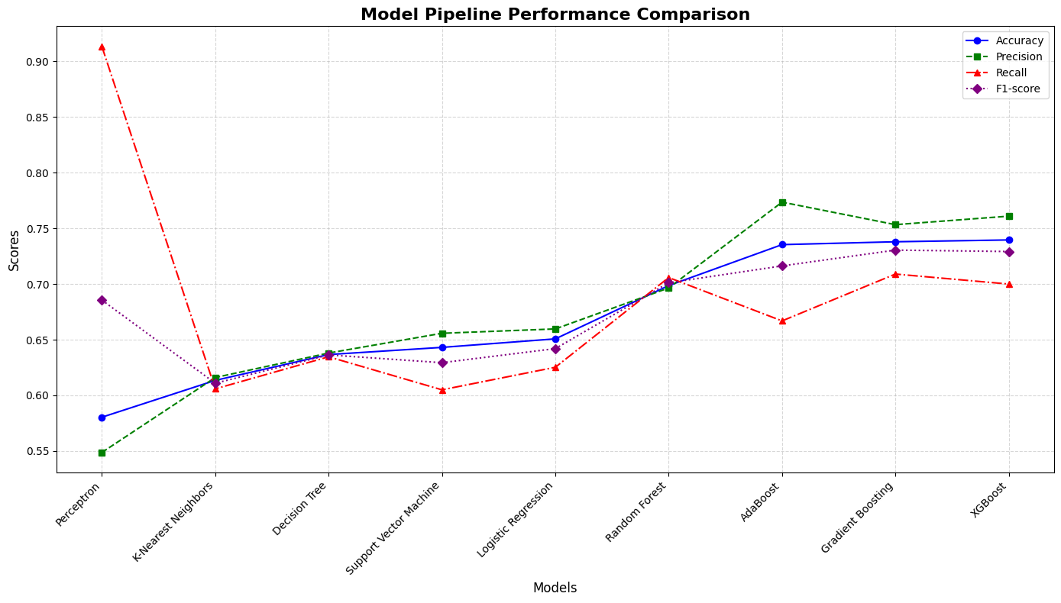

Slide 31
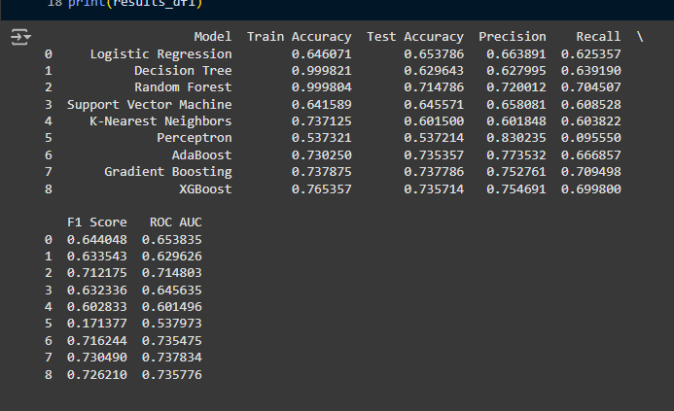

Slide 32
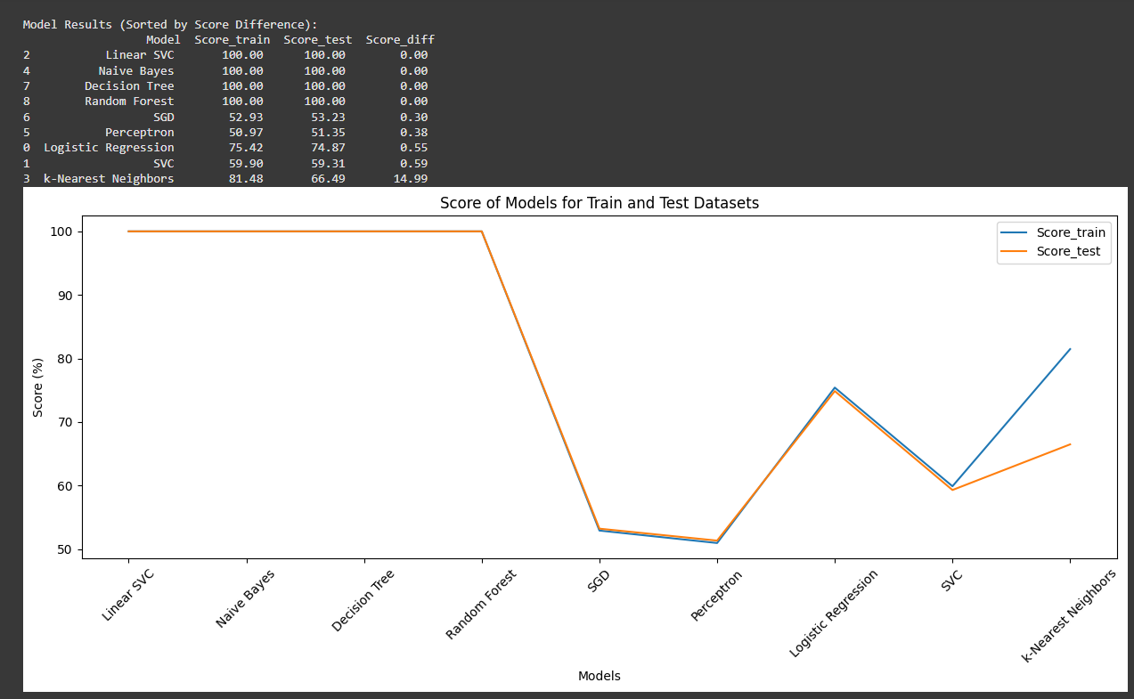
Outlier treatment imputing
Without data transformation
Changing model parameters
Models are overfitted

Slide 33
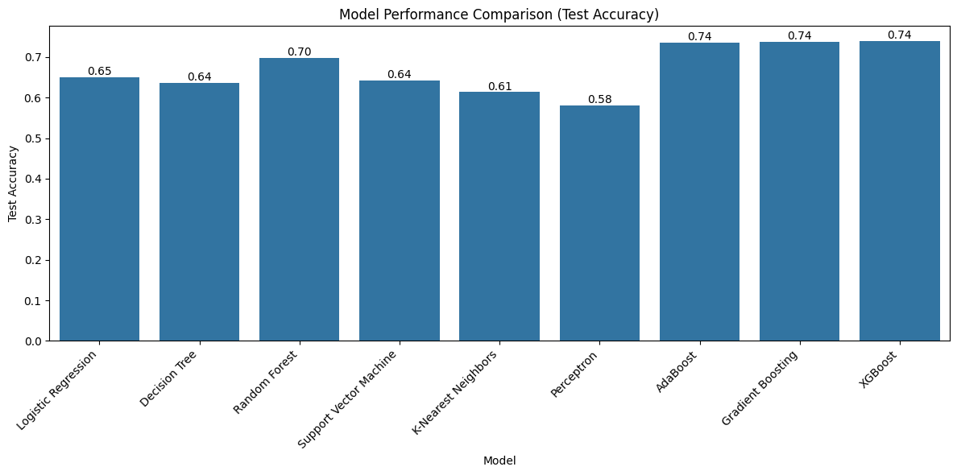
After hyperparameter tuning of adaboost, gradient bossing, XGB boost

Slide 34
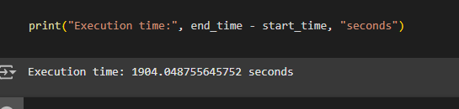
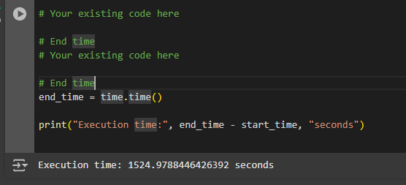
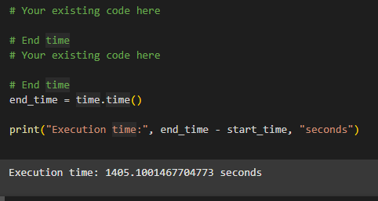
CPU VS GPU VS TPU PERFORMANCE COMPARISON
Execution times for each computational device were
Recorded:
• CPU: 1904.05 seconds
• GPU: 1524.98 seconds
• TPU: 1405.10 seconds
The TPU exhibited the fastest execution time, providing
nearly a 26% improvement over CPU performance.
Fig CPU
Fig GPU
Fig TPU

Slide 35
Limitations and Future Directions
Challenges:
Data limitations (imbalanced classes, potential overfitting on specific patterns).
Generalizability: Results may vary on different datasets.
Future Research:
Explore other models (e.g., ensemble methods with more advanced neural networks).
Apply interpretability techniques to explain model predictions.

Slide 36
Conclusion and Insights
Overall Findings:
Random Forest and XGBoost outperformed other models in accuracy and predictive power.
Feature engineering and hyperparameter tuning significantly boosted model performance.
Key Takeaways:
Cardiovascular disease prediction is feasible with ML using routine clinical data.
Multilayer perceptron (MLP) has shown promising results with cross-validation.
Future Work:
Extend analysis to include genetic and lifestyle factors.
Use deep learning architectures for enhanced predictions.

