Slide 1
Data Mining:
Concepts and Techniques
— Chapter 4 —
Source Slides from Data Mining: Concepts and Techniques
-Jiawei Han and Micheleline Kamber

Slide 2
Chapter 4: Data Cube Computation and Data Generalization
Efficient Computation of Data Cubes
Exploration and Discovery in Multidimensional Databases
Attribute-Oriented Induction ─ An Alternative Data Generalization Method

Slide 3
Efficient Computation of Data Cubes
Preliminary cube computation tricks (Agarwal et al.’96)
Computing full/iceberg cubes: 3 methodologies
  Top-Down: Multi-Way array aggregation (Zhao, Deshpande & Naughton, SIGMOD’97)
  Bottom-Up:
    Bottom-up computation: BUC (Beyer & Ramarkrishnan, SIGMOD’99)
    H-cubing technique (Han, Pei, Dong & Wang: SIGMOD’01)
  Integrating Top-Down and Bottom-Up:
    Star-cubing algorithm (Xin, Han, Li & Wah: VLDB’03)
High-dimensional OLAP: A Minimal Cubing Approach (Li, et al. VLDB’04)
Computing alternative kinds of cubes:
  Partial cube, closed cube, approximate cube, etc.

Slide 4
Preliminary Tricks (Agarwal et al. VLDB’96)
Sorting, hashing, and grouping operations are applied to the dimension attributes in order to reorder and cluster related tuples
Aggregates may be computed from previously computed aggregates, rather than from the base fact table
  Smallest-child: computing a cuboid from the smallest, previously computed cuboid
  Cache-results: caching results of a cuboid from which other cuboids are computed to reduce disk I/Os
  Amortize-scans: computing as many as possible cuboids at the same time to amortize disk reads
  Share-sorts: sharing sorting costs cross multiple cuboids when sort-based method is used
  Share-partitions: sharing the partitioning cost across multiple cuboids when hash-based algorithms are used

Slide 5
Multi-Way Array Aggregation
The Multiway Array Aggregation (or simply MultiWay) method computes a full data cube by using a multidimensional array as its basic data structure.
A different approach is developed for the array-based cube construction.
(1) Partition the array into chunks.
(2) Compute aggregates by visiting cube cells.

Slide 6
A chunk is a subcube that is small enough to fit into the memory available for cube computation.
Chunking is a method for dividing an n-dimensional array into small n-dimensional chunks.
The chunks are compressed so as to remove wasted space resulting from empty array cells (i.e., cells that do not contain any valid data, whose cell count is zero).

Slide 7
The chunks are compressed so as to remove wasted space resulting rom empty array cells (i.e., cells that do not contain any valid data, whose cell count is zero).
For instance, “chunkID + offset” can be used as a cell addressing mechanism to compress a sparse array structure and when searching for cells within a chunk.
Such a compression technique is powerful enough to handle sparse cubes, both on disk and in memory.

Slide 8
(2) Compute aggregates by visiting (i.e., accessing the values at) cube cells.
The order in which cells are visited can be optimized so as to minimize the number of times that each cell must be revisited, thereby reducing memory access and storage costs.
The trick is to exploit this ordering so that partial aggregates can be computed simultaneously, and any unnecessary revisiting of cells is avoided.

Slide 9
Example
Multiway array cube computation.
Consider a 3-D data array containing the three dimensions A, B, and C.
The 3-D array is partitioned into small, memory-based chunks.
Dimension A is organized into four equal-sized partitions, a0, a1, a2, and a3.
Dimensions B and C are similarly organized into four partitions each.
Chunks 1, 2, . . . , 64 correspond to the subcubes a0b0c0, a1b0c0, . . . , a3b3c3, respectively.

Slide 10
Example
Suppose that the cardinality of the dimensions A, B, and C is 40, 400, and 4000, respectively.
Thus, the size of the array for each dimension, A, B, and C, is also 40, 400, and 4000, respectively.
The size of each partition in A, B, and C is therefore 10, 100, and 1000, respectively.
Full materialization of the corresponding data cube involves the computation of all of the cuboids defining this cube.

Slide 11
Example
The resulting full cube consists of the following cuboids:
The base cuboid, denoted by ABC (from which all of the other cuboids are directly or indirectly computed).
This cube is already computed and corresponds to the given 3-D array.
The 2-D cuboids, AB, AC, and BC, which respectively correspond to the group-by’s AB, AC, and BC. These cuboids must be computed.
The 1-D cuboids, A, B, and C, which respectively correspond to the group-by’s A, B, and C.

Slide 12
Example
These cuboids must be computed.
The 0-D (apex) cuboid, denoted by all, which corresponds to the group-by (); that is, there is no group-by here.
This cuboid must be computed.
It consists of one value.
If, say, the data cube measure is count, then the value to be computed is simply the total count of all of the tuples in ABC.

Slide 13
For example, when chunk 1 (i.e., a0b0c0) is being scanned (say, for the computation of the 2-D chunk b0c0 of BC, as described above), all of the other 2-D chunks relating to a0b0c0 can be simultaneously computed.
That is, when a0b0c0 is being scanned, each of the three chunks, b0c0, a0c0, and a0b0, on the three 2-D aggregation planes, BC, AC, and AB, should be computed then as well.
In other words, multiway computation simultaneously aggregates to each of the 2-D planes while a 3-D chunk is in memory.

Slide 14
Example
Therefore, the largest 2-D plane is BC (of size 400x4000 = 1, 600, 000).
The second largest 2-D plane is AC (of size 40x4000 = 160, 000).
AB is the smallest 2-D plane (with a size of 40x400 = 16, 000).

Slide 15
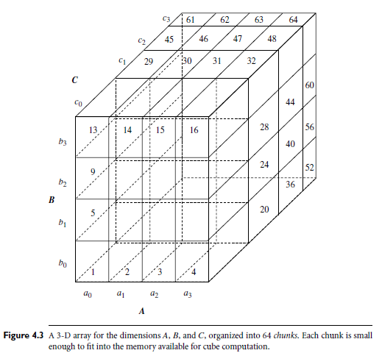
Multi-way Array Aggregation for Cube Computation (MOLAP)

Slide 16
Multi-way Array Aggregation for Cube Computation (MOLAP)
Partition arrays into chunks (a small subcube which fits in memory).
Compressed sparse array addressing: (chunk_id, offset)
Compute aggregates in “multiway” by visiting cube cells in the order which minimizes the # of times to visit each cell, and reduces memory access and storage cost.
C
c3
61
62
63
64
c2
45
46
47
48
c1
29
30
31
32
What is the best traversing order to do multi-way aggregation?
c 0
B
60
b3
13
14
15
16
44
9
28
56
b2
B
40
24
52
b1
5
36
20
b0
1
2
3
4
a0
a1
a2
a3
A

Slide 17
Multi-way Array Aggregation for Cube Computation
C
c3
61
62
63
64
c2
45
46
47
48
c1
29
30
31
32
c 0
B
60
b3
13
14
15
16
44
B
9
28
56
b2
40
5
24
52
b1
36
20
b0
1
2
3
4
a0
a1
a2
a3
A

Slide 18
Multi-way Array Aggregation for Cube Computation
C
c3
61
62
63
64
c2
45
46
47
48
c1
29
30
31
32
c 0
B
60
b3
13
14
15
16
44
B
9
28
56
b2
40
5
24
52
b1
36
20
b0
1
2
3
4
a0
a1
a2
a3
A

Slide 19
Multi-Way Array Aggregation for Cube Computation (Cont.)
Method: the planes should be sorted and computed according to their size in ascending order
  Idea: keep the smallest plane in the main memory, fetch and compute only one chunk at a time for the largest plane
Limitation of the method: computing well only for a small number of dimensions
  If there are a large number of dimensions, “top-down” computation and iceberg cube computation methods can be explored

Slide 20
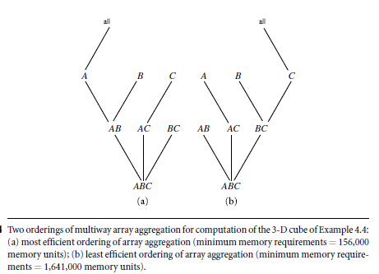
Multi-Way Array Aggregation for Cube Computation (Cont.)

Slide 21
Bottom-Up Computation (BUC)
BUC is an algorithm for the computation of sparse and iceberg cubes.
UnlikeMultiWay, BUC constructs the cube from he apex cuboid toward the base cuboid.
BUC prune during construction, using the Apriori property.
A lattice of cuboids, making up a 3-D data cube with the dimensions A, B, and C.
The apex (0-D) cuboid, representing the concept all (that is, (*,*,*)), is at the top of the lattice.
This is the most aggregated or generalized level.
The 3-D base cuboid, ABC, is at the bottom of the lattice.
It is the least aggregated (most detailed or specialized) level.
This representation of a lattice of cuboids, with the apex at the top and the base at the bottom, is commonly accepted in data warehousing

Slide 22
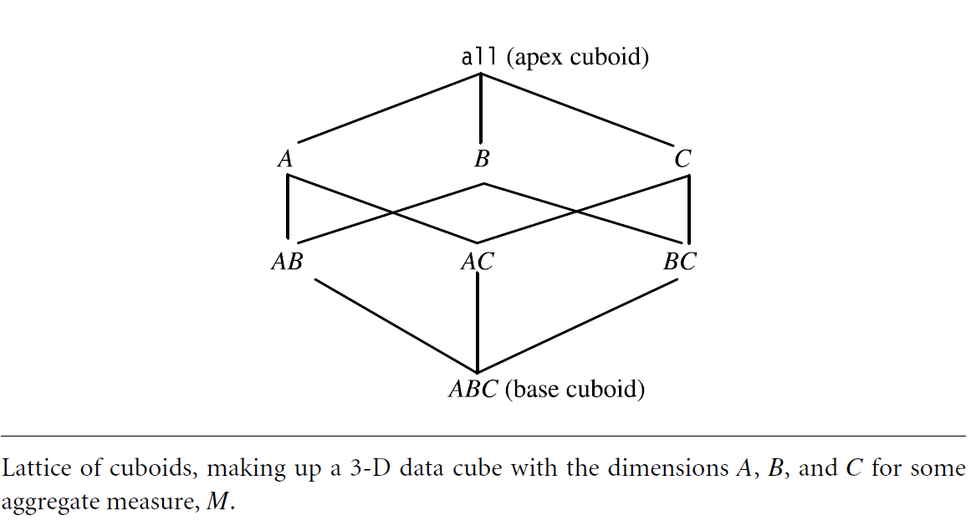
Bottom-Up Computation (BUC)

Slide 23
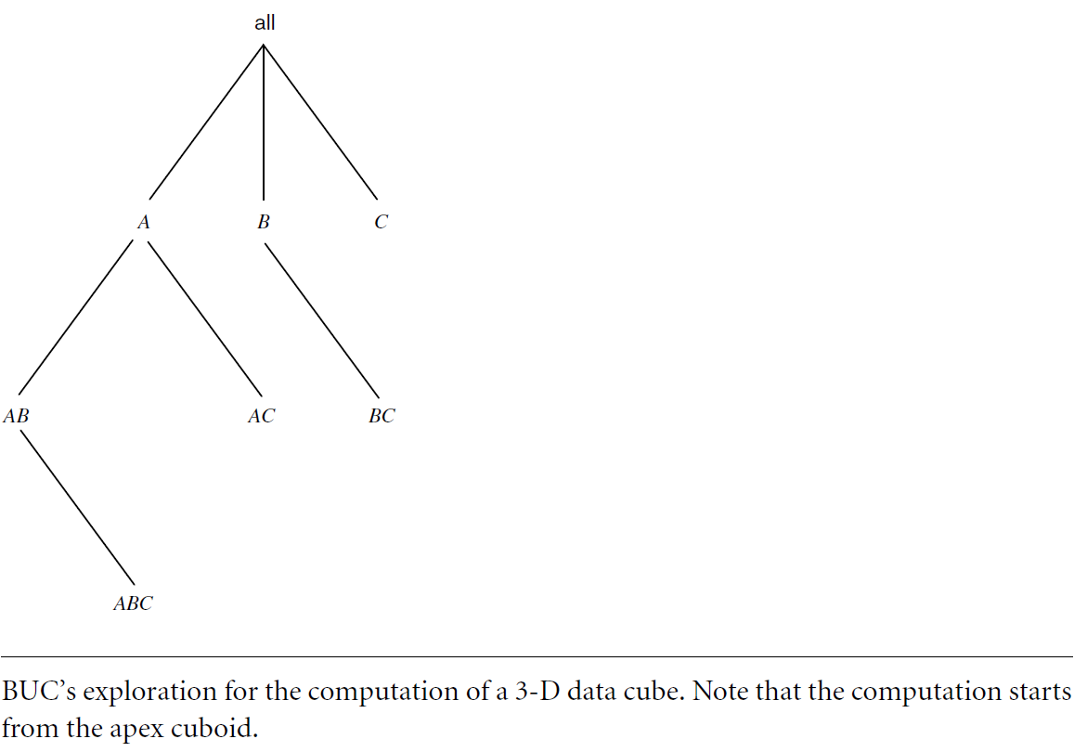
BUC’s exploration for the computation of a 3-D data cube

Slide 24
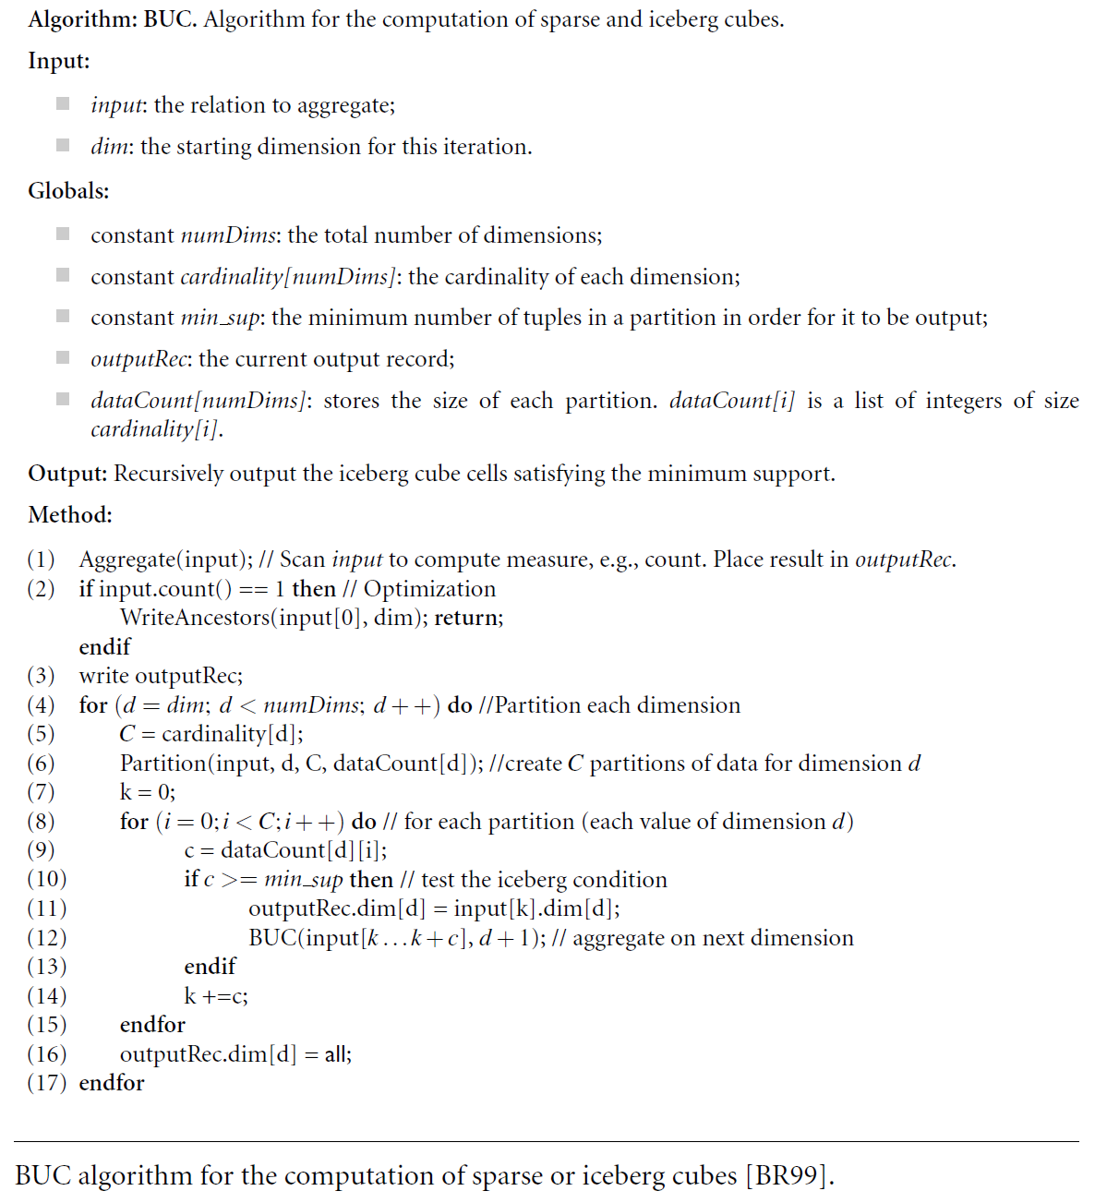

Slide 25
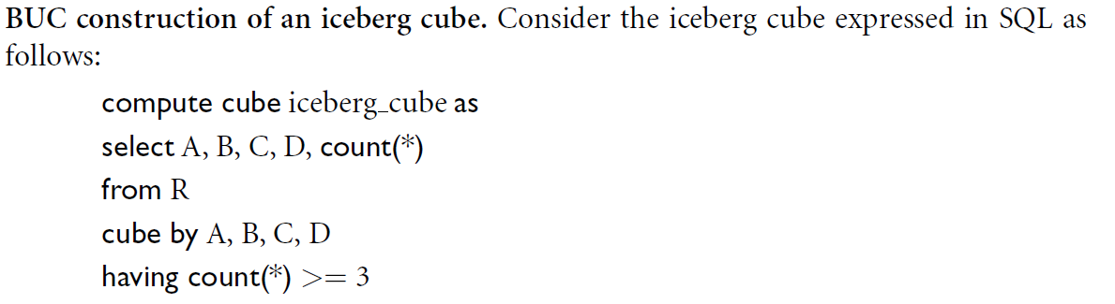

Slide 26
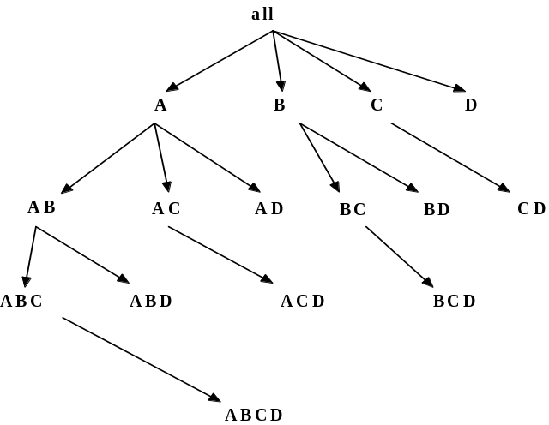
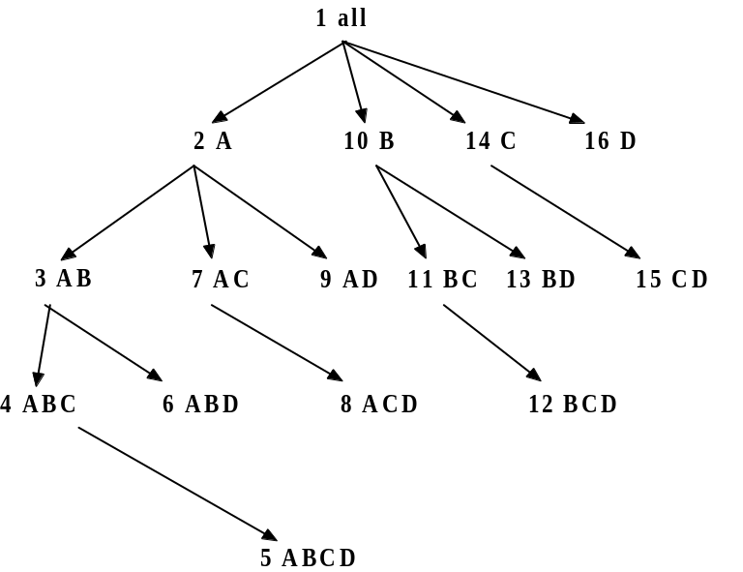
Bottom-Up Computation (BUC)
BUC (Beyer & Ramakrishnan, SIGMOD’99)
Bottom-up cube computation
Divides dimensions into partitions and facilitates iceberg pruning
  If a partition does not satisfy min_sup, its descendants can be pruned
  If minsup = 1 ⇒ compute full CUBE!
No simultaneous aggregation

Slide 27
Star-Cubing: An Integrating Method
the Star-Cubing algorithm for computing iceberg cubes.
Integrate the top-down and bottom-up methods
Explores both multidimensional aggregation (similar to MultiWay) and Apriori-like pruning (similar to BUC).
It operates from a data structure called a star-tree.
  performs lossless data compression
  reducing the computation time and
  memory requirements.

Slide 28
Star-Cubing
Star-Cubing algorithm works based on
  cuboid trees,
  star-nodes, and
  star-trees
cuboid tree

Slide 29
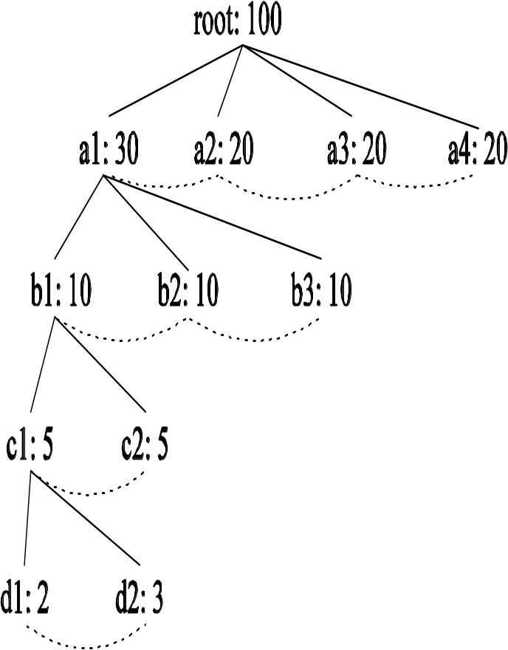
cuboid tree
The cuboid tree of the base cuboid, ABCD .
Each level represents a dimension.
Each node represents an attribute value.
Each node has four fields: the attribute value, aggregate value, pointer(s) to possible descendant(s), and pointer to possible sibling.
Tuples in the cuboid are inserted one by one into the tree.
A path from the root to a leaf node represents a tuple.
For Example, node c2 in the tree has an aggregate (count) value of 5, which indicates that there are five cells of value (a1, b1, c2, ).
Collapses common prefixes to save memory
With aggregate values at internal nodes, we can prune based on shared dimensions.

Slide 30
star-node and star-tree
If the single dimensional aggregate on an attribute value p does not satisfy the iceberg condition, it is useless to distinguish such nodes in the iceberg cube computation.
The node p can be replaced by * so that the cuboid tree can be further compressed.
The node p in an attribute A is a star-node if the single dimensional aggregate on p does not satisfy the iceberg condition; otherwise, p is a non-star-node.
A cuboid tree that is compressed using star-nodes is called a star-tree.

Slide 31
Star Attributes and Star Nodes
Intuition: If a single-dimensional aggregate on an attribute value p does not satisfy the iceberg condition, it is useless to distinguish them during the iceberg computation
  E.g., b₂, b₃, b₄, c₁, c₂, c₄, d₁, d₂, d₃
Solution: Replace such attributes by a *. Such attributes are star attributes, and the corresponding nodes in the cell tree are star nodes
A | B | C | D | Count
a1 | b1 | c1 | d1 | 1
a1 | b1 | c4 | d3 | 1
a1 | b2 | c2 | d2 | 1
a2 | b3 | c3 | d4 | 1
a2 | b4 | c3 | d4 | 1

Slide 32
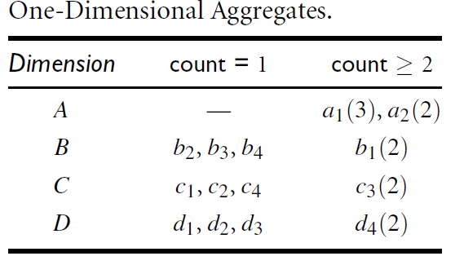
Star-tree construction
A | B | C | D | Count
a1 | b1 | c1 | d1 | 1
a1 | b1 | c4 | d3 | 1
a1 | b2 | c2 | d2 | 1
a2 | b3 | c3 | d4 | 1
a2 | b4 | c3 | d4 | 1
A base cuboid table with 5 tuples and 4 dimensions.
The cardinalities for dimensions A, B, C, D are 2, 4, 4, 4, respectively.
The one-dimensional aggregates for all attributes
Suppose min sup = 2 in the iceberg condition.

Slide 33
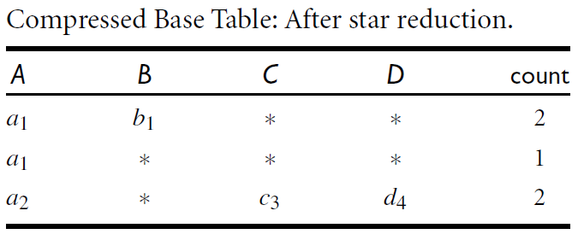
Star-tree construction
All the other values are below the threshold and thus become star-nodes.
By collapsing star-nodes, the reduced base table
The table contains two fewer rows and also fewer distinct values than the previous one.

Slide 34
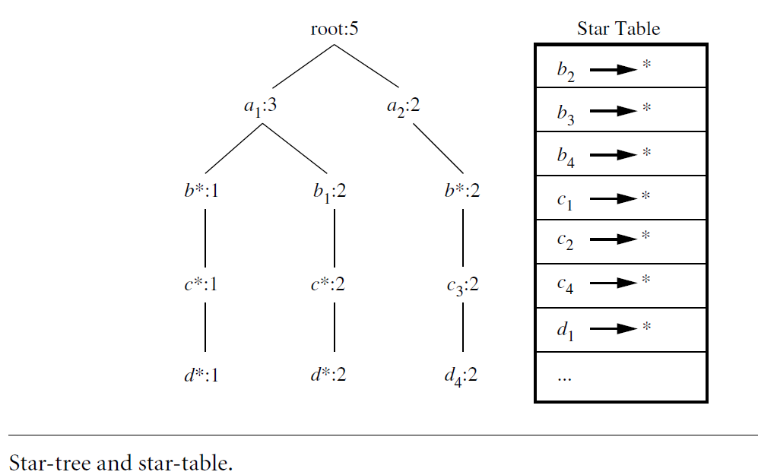
Star-tree construction
We use the reduced base table to construct the cuboid tree because it is smaller.
The resultant star-tree is shown here.
The star-table is constructed for each star-tree

Slide 35
Star-tree construction
By collapsing star-nodes, the star-tree provides a lossless compression of the original data.
It provides a good improvement in memory usage, yet the time required to search for nodes or tuples in the tree is costly.
To reduce this cost, the nodes in the star-tree are sorted in alphabetic order for each dimension, with the star-nodes appearing first.
Nodes are sorted in the order *, p1, p2, … , pn at each level.

Slide 36
Star-Cubing
Star-Cubing using the star-tree generated
Start the process of aggregation by traversing in a bottom-up fashion.
Use the depth-first traversal

Slide 37
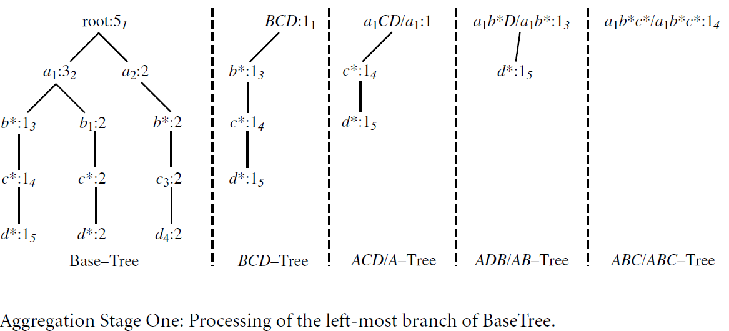
Star-Cubing
The first stage (i.e., the processing of the first branch of the tree)
The leftmost tree in the figure is the base star-tree.
Each attribute value is shown with its corresponding aggregate value.
Subscripts by the nodes in the tree show the order of traversal
The remaining four trees are BCD, ACD=A,ABD=AB, ABC=ABC. They are the child trees of the base star-tree

Slide 38
Star-Cubing
When the algorithm is at step 1, the BCD child tree root is created.
At step 2, the ACD=A child tree root is created.
At step 3, the ABD=AB tree root and the b node in BCD are created.
When the algorithm has reached step 5, the trees in memory are exactly as shown in figure previous slide.
The depth-first traversal has reached a leaf at this point, it starts backtracking.
Before traversing back, the algorithm notices that all possible nodes in the base dimension (ABC) have been visited.
This means the ABC=ABC tree is complete, so the count is output and the tree is destroyed.
Similarly, upon moving back from d* to c* and seeing that c* has no siblings, the count in ABD=AB is also output and the tree is destroyed.

Slide 39
Star-Cubing
A node must satisfy two conditions in order to generate child trees:
  (1) the measure of the node must satisfy the iceberg condition; and
  (2) the tree to be generated must include at least one non-star (i.e., nontrivial) node.
If all the nodes were star-nodes, then none of them would satisfy min sup.
Therefore, it would be a complete waste to compute them.

Slide 40
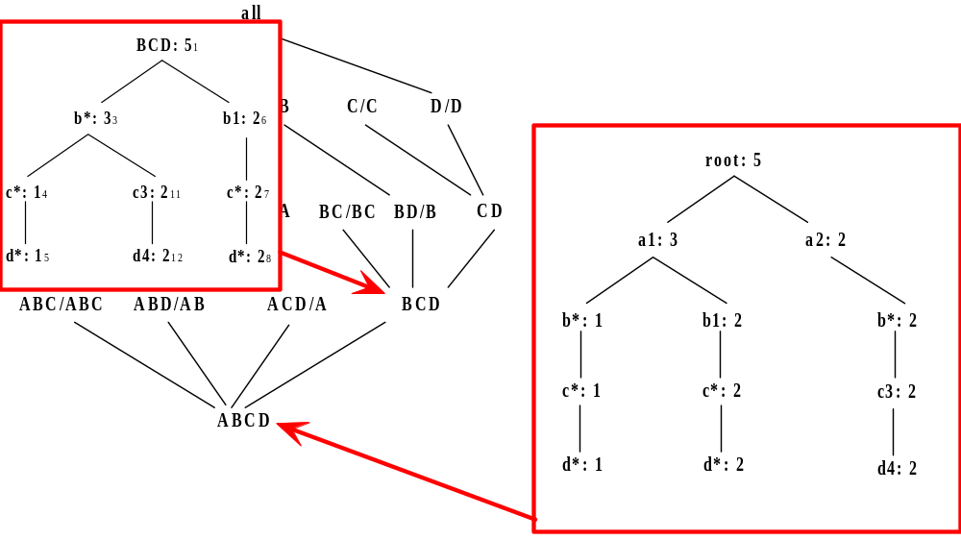
Star-Cubing Algorithm—DFS on Lattice Tree

Slide 41
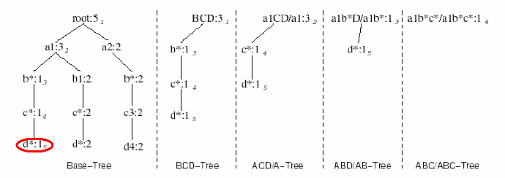
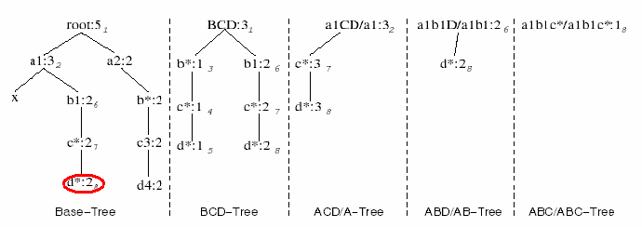
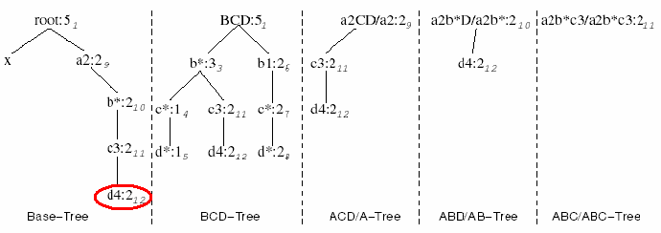
Star-Cubing Algorithm—DFS on Star-Tree

Slide 42
Star-Cubing
Star-Cubing can also be used for full cube computation.
When computing the full cube for a dense data set, Star-Cubing’s performance is comparable with MultiWay and is much faster than BUC.
If the data set is sparse, Star-Cubing is significantly faster than MultiWay and faster than BUC, in most cases.
For iceberg cube computation, Star-Cubing is faster than BUC, where the data are skewed and the speedup factor increases as min sup decreases

Slide 43
Attribute –Oriented Induction
Attribute –Oriented Induction (AOI): An Alternative Method for Data Generalization and Concept Description.
Data generalization summarizes data by replacing relatively low-level values (such as numeric values for an attribute age) with higher-level concepts (such as young, middleaged, and senior).

Slide 44
Attribute-Oriented Induction
How it is done?
  Collect the task-relevant data (initial relation) using a relational database query
  Perform generalization by attribute removal or attribute generalization
  Apply aggregation by merging identical, generalized tuples and accumulating their respective counts
  Interactive presentation with users

Slide 45
Basic Principles of Attribute-Oriented Induction
Data focusing: task-relevant data, including dimensions, and the result is the initial relation
Attribute-removal: remove attribute A if there is a large set of distinct values for A but (1) there is no generalization operator on A, or (2) A’s higher level concepts are expressed in terms of other attributes
Attribute-generalization: If there is a large set of distinct values for A, and there exists a set of generalization operators on A, then select an operator and generalize A
Attribute-threshold control: typical 2-8, specified/default
Generalized relation threshold control: control the final relation/rule size

Slide 46
Attribute-Oriented Induction: Basic Algorithm
InitialRel: Query processing of task-relevant data, deriving the initial relation.
PreGen: Based on the analysis of the number of distinct values in each attribute, determine generalization plan for each attribute: removal? or how high to generalize?
PrimeGen: Based on the PreGen plan, perform generalization to the right level to derive a “prime generalized relation”, accumulating the counts.
Presentation: User interaction: (1) adjust levels by drilling, (2) pivoting, (3) mapping into rules, cross tabs, visualization presentations.

Slide 47
Example
DMQL: Describe general characteristics of graduate students in the Big-University database
  use Big_University_DB
  mine characteristics as “Science_Students”
  in relevance to name, gender, major, birth_place, birth_date, residence, phone#, gpa
  from student
  where status in “graduate”
Corresponding SQL statement:
  Select name, gender, major, birth_place, birth_date, residence, phone#, gpa
  from student
  where status in {“Msc”, “MBA”, “PhD” }

Slide 48



Class Characterization: An Example
Initial Relation
Prime Generalized Relation

Slide 49
Attribute-Oriented Induction
Attribute-oriented induction is performed on the initial working relation of Table.
For each attribute of the relation, the generalization proceeds as follows:
1. name: Since there are a large number of distinct values for name and there is no generalization operation defined on it, this attribute is removed.
2. gender: Since there are only two distinct values for gender, this attribute is retained and no generalization is performed on it.

Slide 50
Attribute-Oriented Induction
3. major: Suppose that a concept hierarchy has been defined that allows the attribute major to be generalized to the values {arts&science, engineering, business} .
Suppose also that the attribute generalization threshold is set to 5, and that there are more than 20 distinct values for major in the initial working relation. By attribute generalization and attribute generalization control, major is therefore generalized by climbing the given concept hierarchy.

Slide 51
Attribute-Oriented Induction
4. birth place: This attribute has a large number of distinct values; therefore, we would like to generalize it. Suppose that a concept hierarchy exists for birth place, defined
5. birth date: Suppose that a hierarchy exists that can generalize birth date to age, and age to age range, and that the number of age ranges (or intervals) is small with respect to the attribute generalization threshold.
6. residence: Suppose that residence is defined by the attributes number, street, residence city, residence province or state, and residence country.

Slide 52
Attribute-Oriented Induction
7. phone#: As with the attribute name above, this attribute contains too many distinct values and should therefore be removed in generalization.
8. gpa: Suppose that a concept hierarchy exists for gpa that groups values for grade point average into numerical intervals like {3.75–4.0, 3.5–3.75,. . .}, which in turn are grouped into descriptive values, such as {excellent, very good,. . .}.
  The attribute can therefore be generalized.

Slide 53
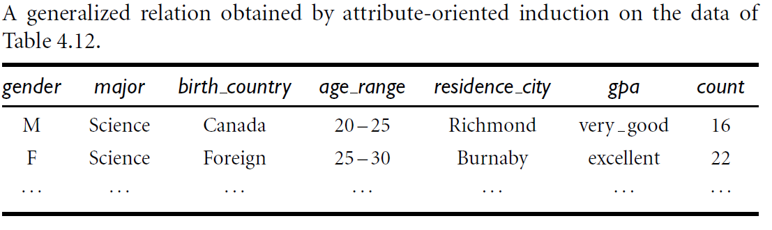
Attribute-Oriented Induction

Slide 54
References (I)
S. Agarwal, R. Agrawal, P. M. Deshpande, A. Gupta, J. F. Naughton, R. Ramakrishnan, and S. Sarawagi. On the computation of multidimensional aggregates. VLDB’96
D. Agrawal, A. E. Abbadi, A. Singh, and T. Yurek. Efficient view maintenance in data warehouses. SIGMOD’97
R. Agrawal, A. Gupta, and S. Sarawagi. Modeling multidimensional databases. ICDE’97
K. Beyer and R. Ramakrishnan. Bottom-Up Computation of Sparse and Iceberg CUBEs.. SIGMOD’99
Y. Chen, G. Dong, J. Han, B. W. Wah, and J. Wang, Multi-Dimensional Regression Analysis of Time-Series Data Streams, VLDB'02
G. Dong, J. Han, J. Lam, J. Pei, K. Wang. Mining Multi-dimensional Constrained Gradients in Data Cubes. VLDB’ 01
J. Han, Y. Cai and N. Cercone, Knowledge Discovery in Databases: An Attribute-Oriented Approach, VLDB'92
J. Han, J. Pei, G. Dong, K. Wang. Efficient Computation of Iceberg Cubes With Complex Measures. SIGMOD’01

Slide 55
References (II)
L. V. S. Lakshmanan, J. Pei, and J. Han, Quotient Cube: How to Summarize the Semantics of a Data Cube, VLDB'02
X. Li, J. Han, and H. Gonzalez, High-Dimensional OLAP: A Minimal Cubing Approach, VLDB'04
K. Ross and D. Srivastava. Fast computation of sparse datacubes. VLDB’97
K. A. Ross, D. Srivastava, and D. Chatziantoniou. Complex aggregation at multiple granularities. EDBT'98
S. Sarawagi, R. Agrawal, and N. Megiddo. Discovery-driven exploration of OLAP data cubes. EDBT'98
G. Sathe and S. Sarawagi. Intelligent Rollups in Multidimensional OLAP Data. VLDB'01
D. Xin, J. Han, X. Li, B. W. Wah, Star-Cubing: Computing Iceberg Cubes by Top-Down and Bottom-Up Integration, VLDB'03
D. Xin, J. Han, Z. Shao, H. Liu, C-Cubing: Efficient Computation of Closed Cubes by Aggregation-Based Checking, ICDE'06
W. Wang, H. Lu, J. Feng, J. X. Yu, Condensed Cube: An Effective Approach to Reducing Data Cube Size. ICDE’02
Y. Zhao, P. M. Deshpande, and J. F. Naughton. An array-based algorithm for simultaneous multidimensional aggregates. SIGMOD’97

