Slide 1
Baseball Data

Slide 2
Overview
Dataset: Contains various attributes about the MLB
Key attributes: playerID, teamID, yearID, games (G), wins (W), errors (E), ERA, BGP, and IPouts.
Stakeholders/Audience: Ourselves
Analyses:
Pitcher by ERA
Errors per Team
Manager Wins
Triples per Team

Slide 3
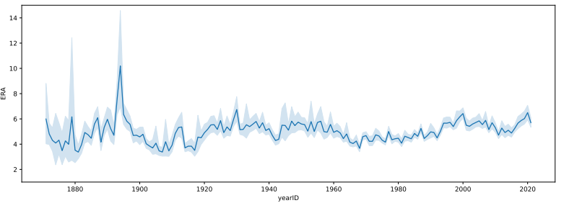
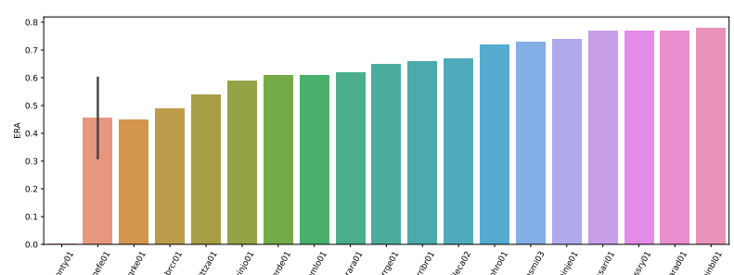
Pitcher Analysis
Question: Who are the best pitcher and what are there average ERA’s per year?
Analysis:
ERA just before 1900 (~10)
Remained consistent from 1930-Present (~5)
Results:
Help managers or teams to determine if their pitcher is above or below the average

Slide 4
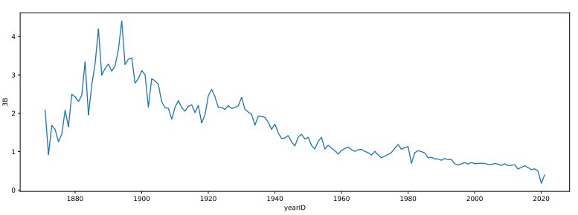
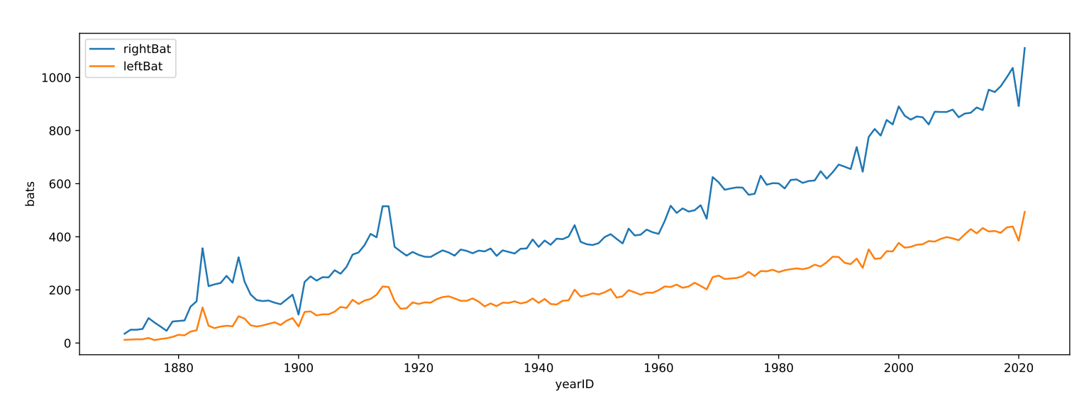
Triples Analysis
Question: How many triples are hit each year? Who is more likely to get triples?
Analysis:
Lft vs Rt handed hitters
Dual training between defensive and offensive positions
Results:
Lft hitters more likely - can hit to right field easier
Specifically seen in 1900
Players more rounded in skill early in MLB versus later in MLB

Slide 5
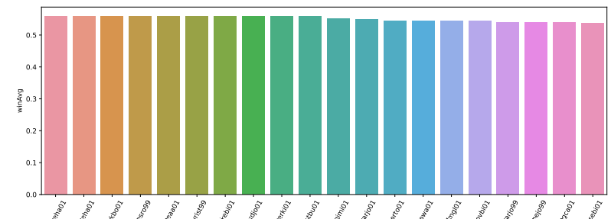
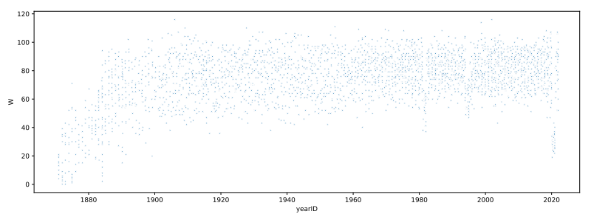
Manager Analysis
Question: What are the average number of wins for a manager per year and who are the best managers based on average number of wins?
Analysis:
Standard season set in 1961
Sort by W/G
Results:
Best winning average around 56%

Slide 6
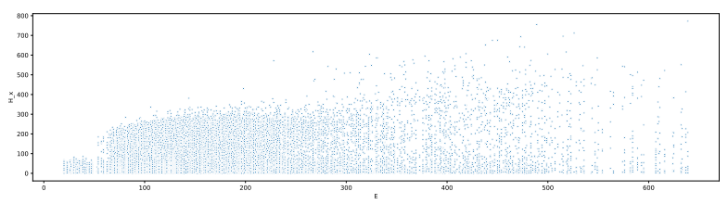
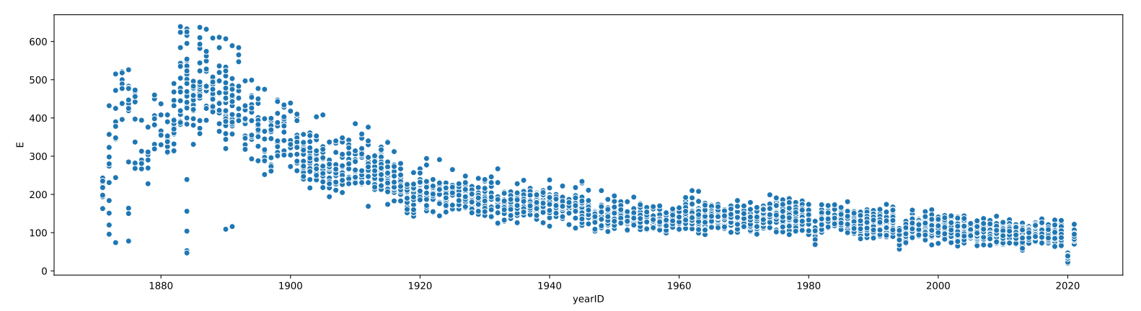
Errors Analysis
Question: What is the amount of error per year?
Analysis:
Errors higher before 1900
Shortstop and second base more likely to get errors
Results:
Advancement in technology
Change of rules/more following rules
Practice reaction times for specific positions

Slide 7
Conclusion
Usefulness of insights
Determining if the given pitcher is above or below the MLB average
Which players to bat and what order
If a given manager is beneficial to their team winning
The advantage of technology in disputing errors in a game.
All these insights could have potential to change the outcome of a game and a player or manager's career.

