Slide 1

Fake news detection
Disinformation Detection
Presented by,
KNIGHT RADIANTS

Slide 2
Outline
Abstract
Major problem on hand
Introduction
About data set
Workflow
EDA, Data cleaning and Pre-processing
Word 2 Vector
Tokenization
Architecture of model
Analysis and Prediction
Future enhancements.

Slide 3
Abstract
The way in which news consumption is done has changed over the years with introduction of social media. But, with this advancement, the reliability of information on the internet has emerged as a crucial issue of modern society.
PROBLEM STATEMENT
The proliferation of fake news on social media and internet is deceiving people to an extent which needs to be stopped.
Our goal is to develop a reliable model that classifies a given news article as either fake or true.

Slide 4
Introduction
This project aims to develop a method for detecting and classifying news stories using Natural Language Processing.
The main goal is to identify fake news, which is a classic text classification issue.
We gathered our data, preprocessed the text, and translated our articles into supervised model features.
Our goal is to develop a model that classifies a given news article as either fake or true.

Slide 5

Major problem
By clicking on a clickbait, users are led to a page that contains false information.
Fake news influences people’s perceptions.
The rise of fake news has become a global problem that even major tech companies like Facebook and google are struggling to solve, due to the nature of the problem.

Slide 6
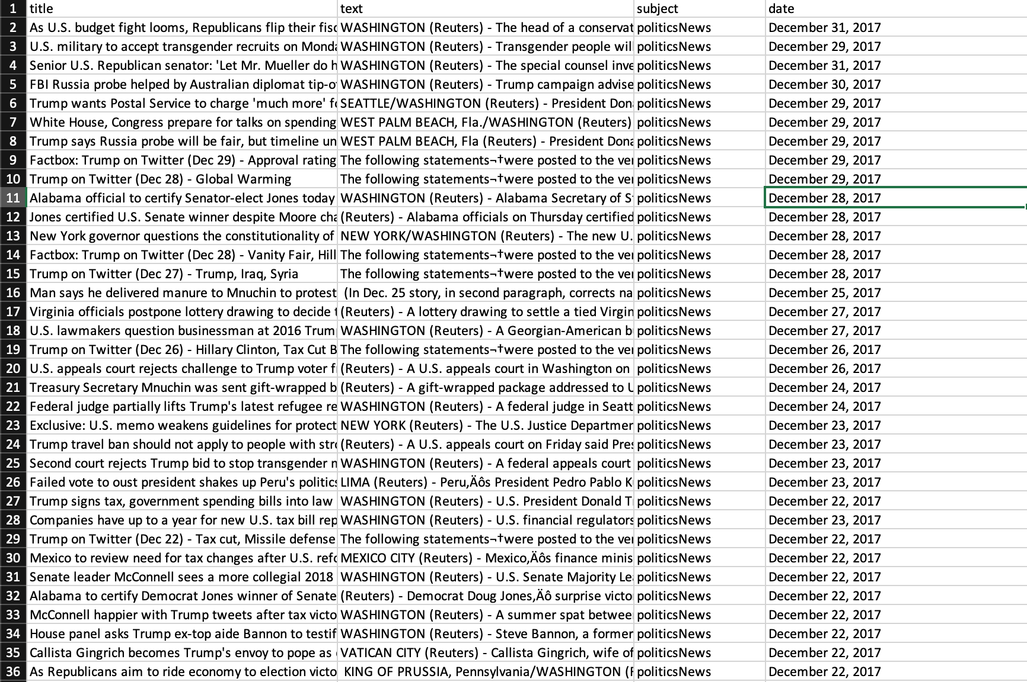
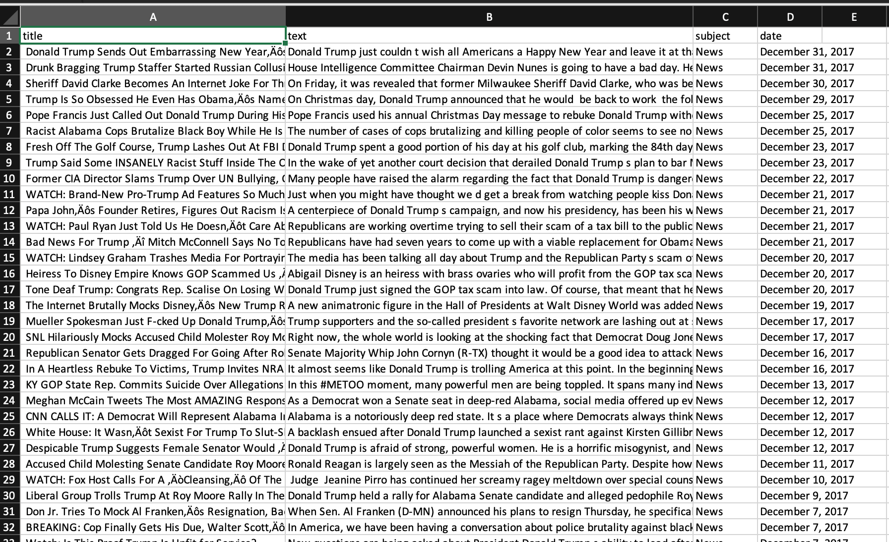
Dataset
Dataset published for research paper purposes. Can be found on Kaggle website.
Size of dataset is
23503 rows and 4columns for fake data
21418 rows and 4columns for true data

Slide 7

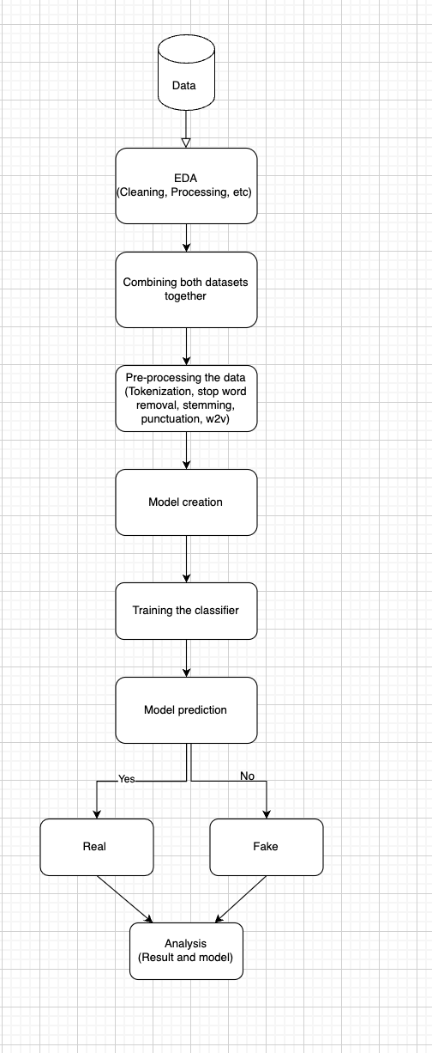
Workflow

Slide 8
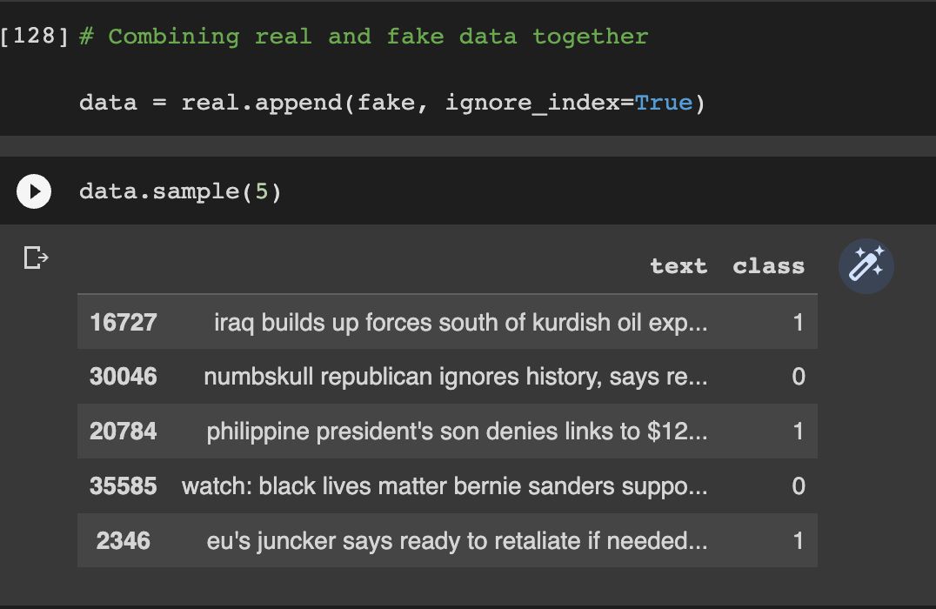
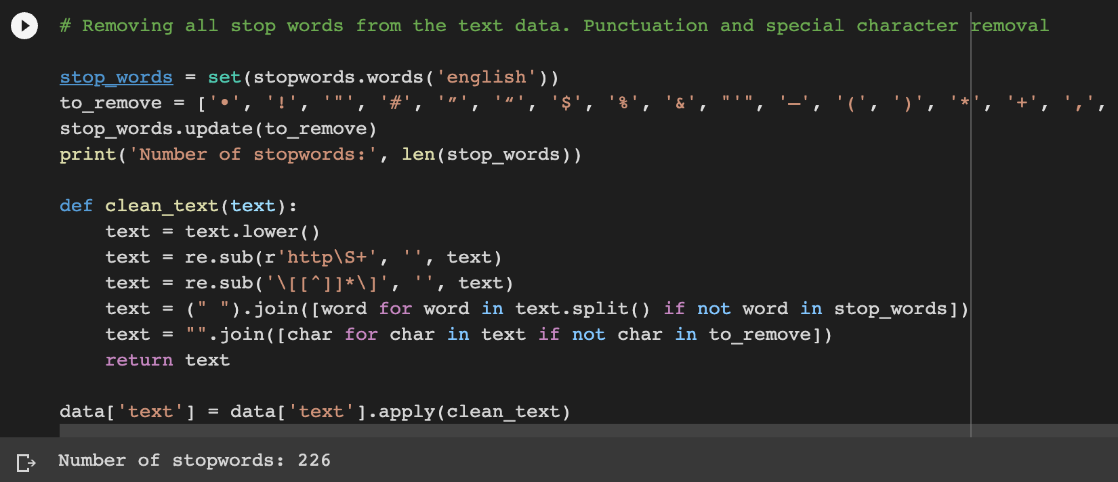
EDA, Data cleaning & Pre-processing
Null values in the data set
Combining of both data sets.
Patterns found in raw data
Stop word removal
Easier ways to perform stop word removal
Introducing class in combined data
Decision on what features/ columns of data to choose for training and testing the model

Slide 9
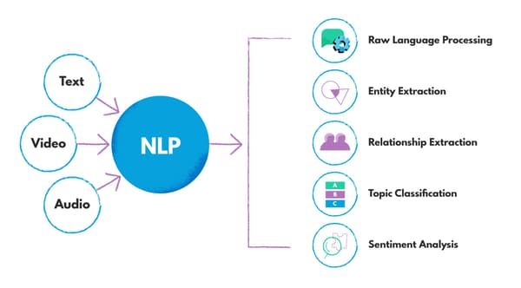
Natural Language Processing (nlp)
NLP stands for Natural Language Processing.
NLP basically is like learning a language of your own mind.
NLP boils down to the ability of a computer program to understand human language as it is spoken and written.
Acts as a building block between model and the data (text data in this case)
Main phases of NLP
Data preprocessing
Algorithm development

Slide 10
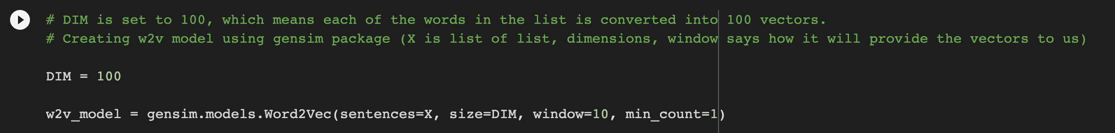
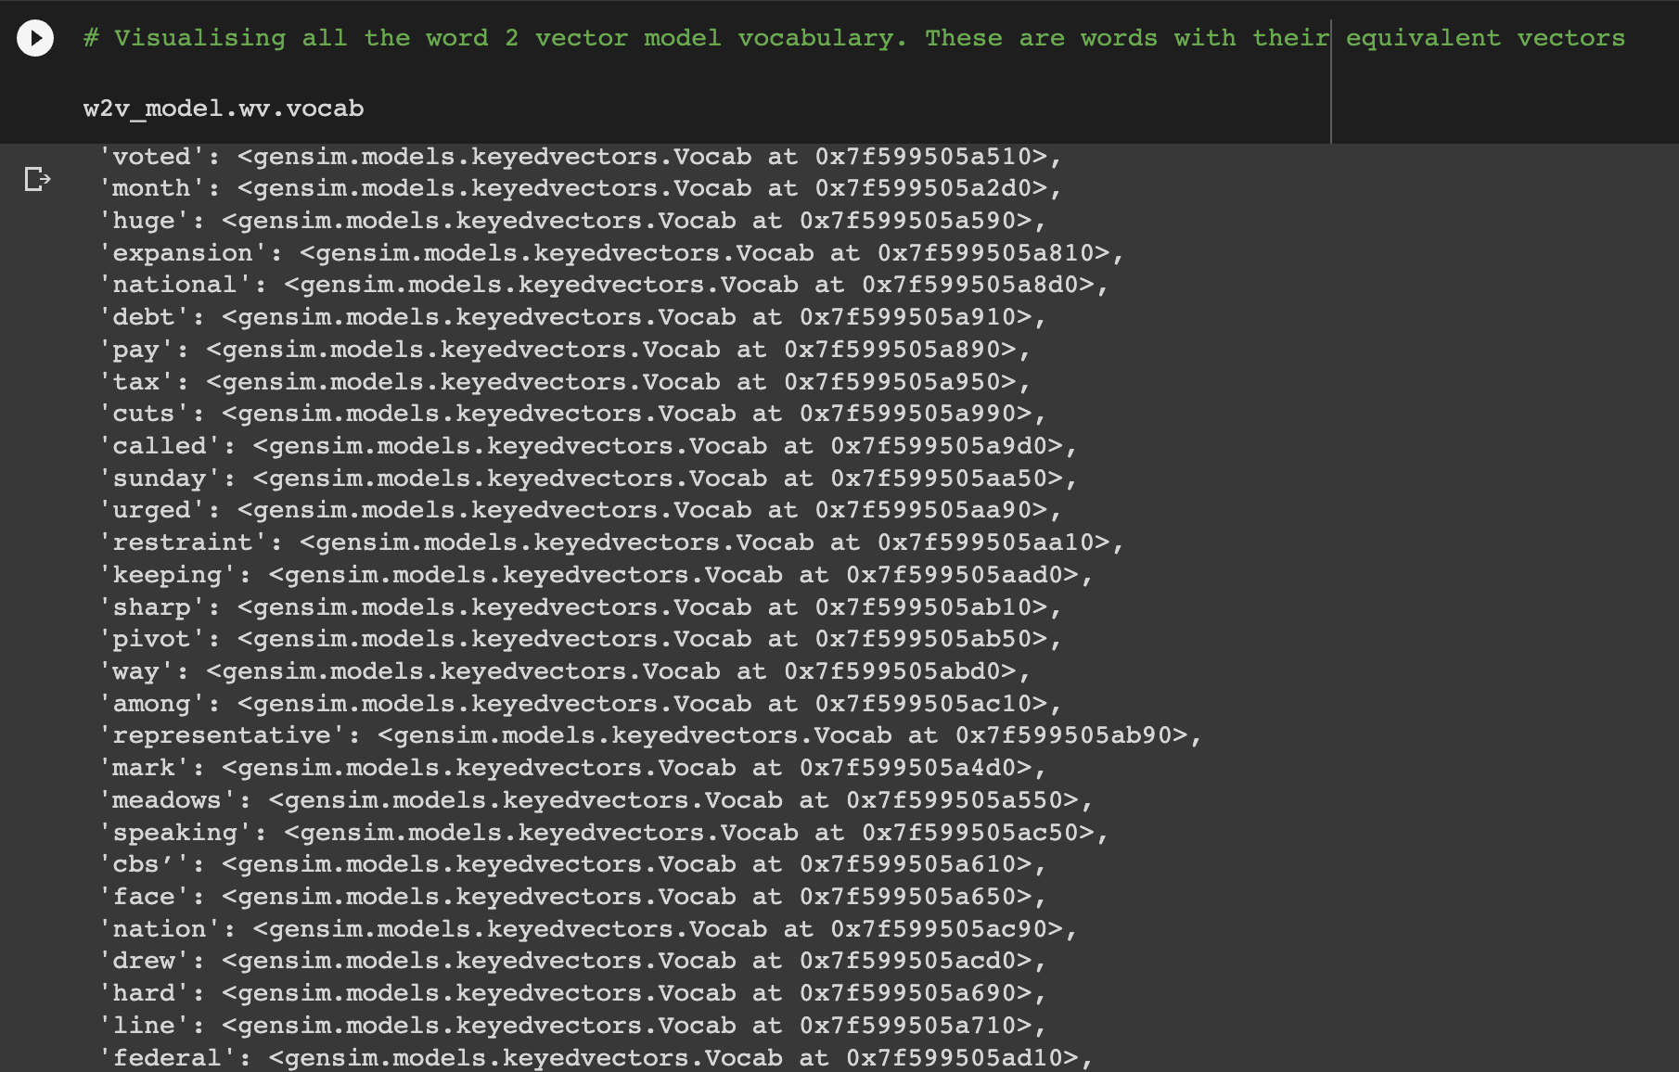
Word 2 vector (w2v)
w2v is used for word representations in vector space (tokenisation)
It is a neural network model that attempts to explain word embeddings based on text corpus.
w2v model works based on context.
What is context in w2v ?
What is Window size

Slide 11
Word 2 vector algorithmic flow
Initially we will assign a vector of random numbers to each word in the corpus.
Then, we will iterate through each word of the document and grab the vectors of the nearest n-words on either side of our target word, and concatenate all these vectors, and then forward propagate these concatenated vectors through a linear layer + SoftMax function, and try to predict what our target word was.
In this step, we will compute the error between our estimate and the actual target word and then backpropagated the error and then modifies not only the weights of the linear layer but also the vectors or embeddings of our neighbour's words.
Finally, we will extract the weights from the hidden layer and by using these weights encode the meaning of words in the vocabulary.

Slide 12
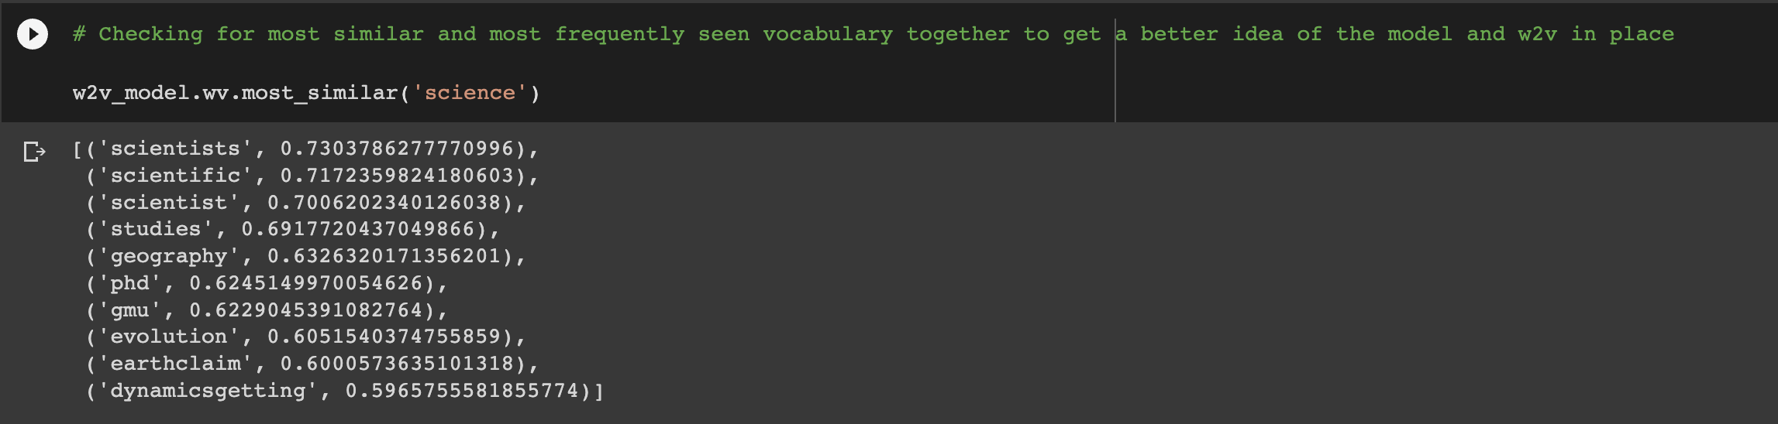
w2V

Slide 13
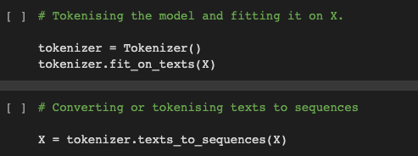
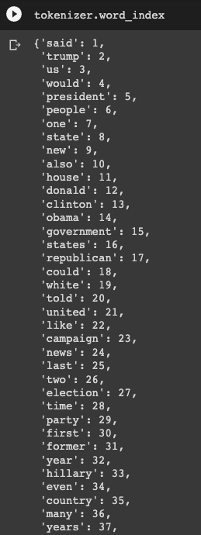
Tokenization
One of the most important steps when working with a combination of NLP and text data. Simply put we cannot work without tokenisation when dealing with NLP and text.
Tokenisation not only deals with breaking down the text, but has much more to it.
Tokenisation is a way of separating a piece of text into a smaller unit called “tokens”.
Most common way of tokenisation is splitting it based on space i.e. delimiter.
Never give up → never-give-up.
Each word is a token (Word tokenisation)
smarter → s-m-a-r-t-e-r (character tokenisation)
smarter → smart-er (subword tokenisation)
All words are processed at a token level

Slide 14
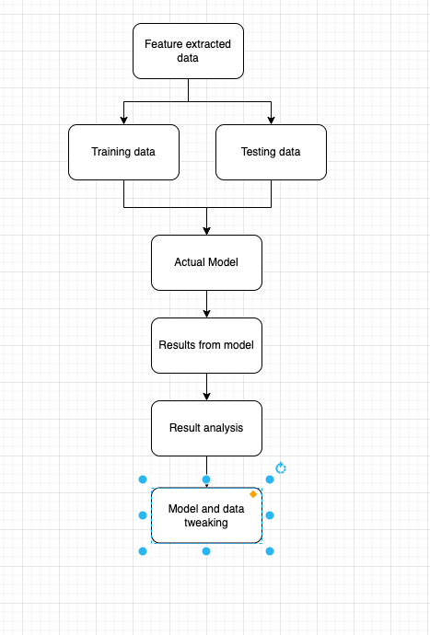
Architecture of model
Extract features from pre-processed data using NLP techniques
Split dataset to training and testing data
Using classification algorithm to train the model with feature extracted training data
Build and execute the model
We use LSTM algorithm to validate the model and data.
Test the model.
Analyze the result and tweak the data and model.

Slide 15
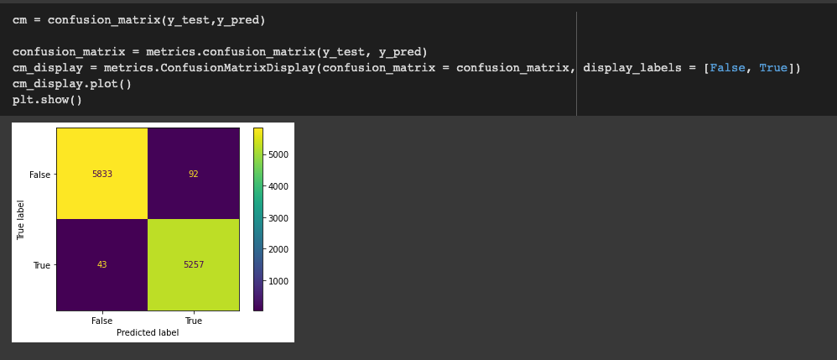
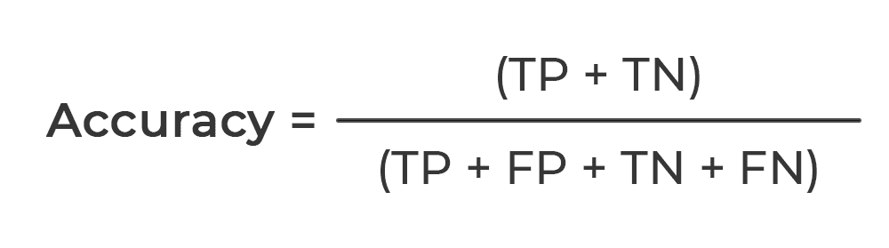
results
Confusion matrix
Training and testing accuracy
Since this is a binary classification, we use accuracy as the main metric.

Slide 16
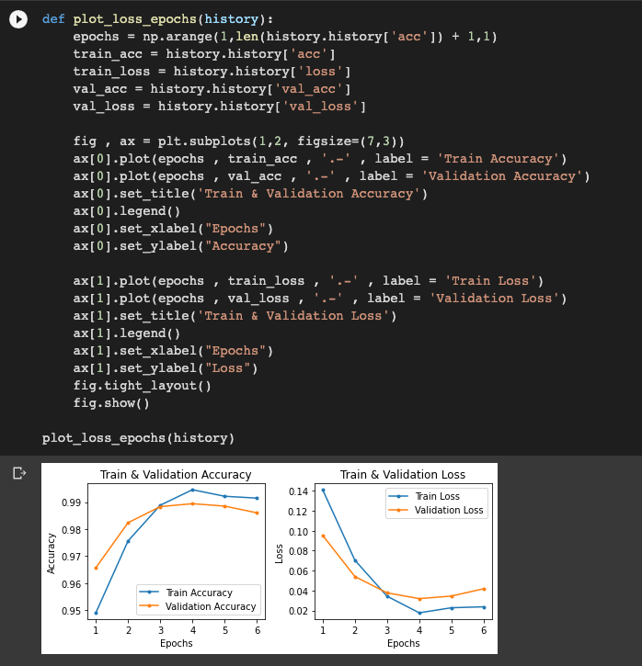
Training and validation accuracy

Slide 17
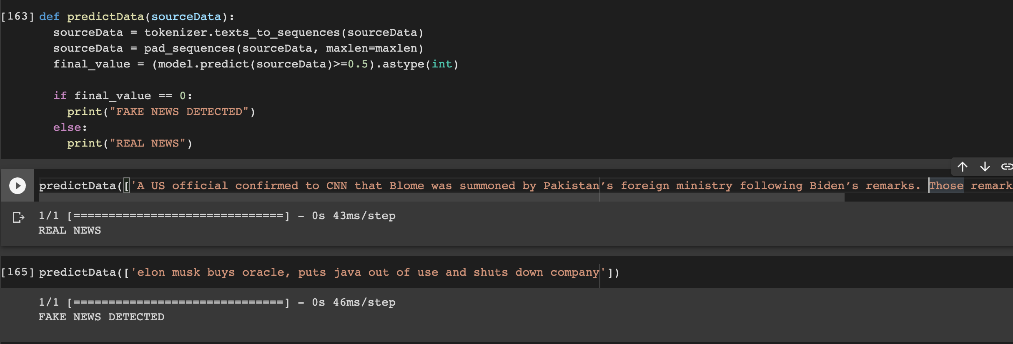
Model testing/ predicting
70-30 training and testing data split on feature extracted data.
We are using a reliable source to test our model for fake news detection.
Predicting of new source is done in a simplified manner where a function is used.
We are getting an accuracy of 98%.
To test our model, we can make up news that we know is fake and use it as a predictor.

Slide 18
Analysis of results
We see that our model is performing with a good accuracy and is accurately predicting real and fake news.
False positive and False negative values are also not very high, which means our model is effectively training and is able classify data correctly.
But we are still able to find some misclassification which can be eliminated.
We find that in frequency of words such as trump, president can be observed in fake data more than true data.
These are some of the indicators that we can find without looking at the model.

Slide 19
Future enhancements
We can create an end-to-end web application that can help users in classifying news successfully and in an error free way.
Can introduce other algorithms and create a comparative analysis and choose the best model.

