Slide 1

Project Title
Team Number: B4
NIHAAS REDDY R- AM.EN.U4CSE20157
DHEERAJ REDDY B – AM.EN.U4CSE20115
KARTHEEK REDDY T– AM.EN.U4CSE20167
AISWARYA SUDHIR – AM.EN.U4CSE20106
Guide :
Asha Ashok
Asst. Professor, School of Computing, Amritapuri
Amrita School of Computing | Amrita Vishwa Vidyapeetham | Amritapuri

Slide 2
Introduction
Brain tumors are a major health concern worldwide. Early and accurate detection of brain tumors is crucial for effective treatment and improved patient outcomes. Computer-aided detection systems can help radiologists and doctors in diagnosing tumors more precisely.
Graph theory provides a powerful mathematical framework to analyze complex relationships and patterns in medical images like MRI/CT scans of the brain. Tumors can be represented as abnormal structures/subgraphs in the overall brain connectivity graph.
Graph-based methods allow capturing both local and global context around tumors which traditional image processing techniques may miss. This can help detect tiny tumors more reliably.
Connectivity and morphological features of tumors like shape, size, boundaries can be characterized using graph theoretic measures like nodes, edges, degree distribution, clusters etc. Abnormalities in these features indicate potential tumors.

Slide 3
Motivation
Brain tumors may or may not be cancerous but nevertheless, they cause serious problems in the skull region because of the enormous pressure it puts on the cranium due to lack of space in the skull. Primary symptoms of BT being headache and dizziness.
Early and accurate detection of brain tumors is crucial for effective treatment and improved patient outcomes. Computer-aided detection systems can help radiologists and doctors in diagnosing tumors more precisely.
Successful detection of brain tumors using graphs can encourage further research in disease modeling and computer-aided diagnosis for other medical conditions.
The project will provide valuable experience in medical image analysis, deep learning, graph algorithms - important skills for healthcare and medical technologies.

Slide 4
Background Study/Related Work
Title &year | Problem | Contributions | Limitations | Open problems/Future work
Brain Tumor Detection and Classification Using Intelligence Techniques: An Overview. IEEE Access, vol. 11, pp. 12870-12886, 2023 | Early detection of brain tumors is crucial for improving treatment outcomes. However, traditional methods of brain tumor detection, such as manual visual inspection of MRI scans, are time-consuming, subjective, and prone to error. | This paper provides a comprehensive overview of intelligent techniques for brain tumor detection and classification. The authors discuss the different types of intelligent techniques that have been used for this task, as well as their advantages and limitations. | The authors acknowledge that there is still a need for more research on intelligent techniques for brain tumor detection and classification. | They suggest that future research should focus on developing more robust and accurate methods, as well as methods that can be applied to real-time data.

Slide 5
Background Study/Related Work
Enhanced Brain Tumor Classification Using Graph Convolutional Neural Network Architecture (2023) | Inaccurate brain tumor classification using traditional methods due to: Neglecting non-Euclidean distances in image data. Inability of conventional models to capture spatial relationships between pixels. Difficulty in interpreting decisions made by existing models, hindering their use in medical applications. Limited generalizability of trained models to unseen data. | Taking into account spatial relationships between pixels. Enhancing model interpretability in medical settings. Improving model generalizability. . | Computational cost of using GCNNs compared to traditional methods. Requirement for large datasets to train the GCNN effectively. Need for further research on the interpretability of GCNNs for brain tumor classification tasks. | Evaluating the performance of the proposed method on large datasets. Comparing the proposed method with existing brain tumor classification techniques. Investigating methods for further improving the interpretability of GCNN predictions. Exploring the application of this approach to other medical image classification tasks.

Slide 6
Background Study/Related Work
Image Segmentation Using Deep Learning: A Survey, published in 2021. | The paper addresses the problem of image segmentation, which is a key task in computer vision and image processing with important applications such as scene understanding, medical image analysis, robotic perception, video surveillance, augmented reality, and image compression, among others. | The paper provides a comprehensive survey of recent advances in deep learning-based image segmentation, including a detailed overview of the most popular deep learning architectures and their applications in image segmentation. The paper also discusses the challenges and limitations of deep learning-based image segmentation and identifies promising research directions for future work. | The paper does not provide a detailed comparison of the performance of different deep learning architectures on different datasets, which could be useful for researchers and practitioners in the field. | The paper identifies several open problems and promising research directions for future work, including the development of more efficient and accurate deep learning architectures for image segmentation, the integration of deep learning with other image processing techniques, and the exploration of new applications of deep learning-based image segmentation.

Slide 7
Background Study/Related Work
"A Joint Graph and Image Convolution Network for Automatic Brain Tumor Segmentation" (2021) | Accurate segmentation of brain tumors is crucial for effective treatment planning and monitoring, but manual segmentation is time-consuming and prone to inter-observer variability. Automated segmentation methods have been developed, but they often struggle with segmenting tumors that are irregularly shaped or have indistinct boundaries. | The authors propose a novel approach to brain tumor segmentation using a joint graph convolution and image convolution neural network. The graph convolutional neural network is used to capture the spatial relationships between different regions of the brain, while the image convolutional neural network is used to extract features from the MRI scans. The two networks are then combined to produce a final segmentation map. The proposed method achieves state-of-the-art performance on the BraTS 2021 challenge dataset. | The proposed method requires a large amount of training data and computational resources, which may limit its applicability in some settings. Additionally, the method may struggle with segmenting tumors that are very small or have highly irregular shapes. | The authors suggest that future work could focus on improving the efficiency of the proposed method, as well as exploring the use of other types of neural networks for brain tumor segmentation. Additionally, the authors note that the proposed method could be extended to other types of medical image segmentation tasks beyond brain tumors.

Slide 8
Background Study/Related Work
GNN Lens: A Visual Analytics Approach for Prediction Error Diagnosis of Graph Neural Networks, published in IEEE Transactions on Visualization and Computer Graphics in 2020. | Graph Neural Networks (GNNs) have achieved significant progress in graph analysis tasks, but their prediction errors are often difficult to diagnose due to the complexity of graph data. Existing methods for diagnosing prediction errors in GNNs are often limited in their ability to provide deep insights into model performance and its dependency on data characteristics. | The paper proposes a novel error-pattern-driven visual analytics system, GNN Lens, to provide model developers and users with deep insights into model performance and its dependency on data characteristics. GNN Lens comprises five views: Control Panel, Parallel Sets View, Projection View, Graph View, and Feature Matrix View. The paper also presents a case study demonstrating the effectiveness of GNN Lens in diagnosing prediction errors in GNNs. | The paper does not explicitly discuss any limitations of GNN Lens. However, it is worth noting that the effectiveness of GNN Lens may depend on the quality and quantity of data available for analysis. | The paper suggests several directions for future work, including the integration of GNN Lens with other machine learning tools, the extension of GNN Lens to other types of graph analysis tasks beyond node classification, and the exploration of new visual encodings and interaction techniques to enhance the usability and effectiveness of GNN Lens.

Slide 9
Persisting Challenges
The existing problem where the non-consideration of non-Euclidean distances in image data and the inability of conventional models to learn on pixel similarity based upon the pixel proximity.
Understanding the decisions made by GCNs is crucial, especially in medical applications. Interpreting the predictions of GCNs and explaining why a certain region is identified as a tumor or not can be challenging.
Ensuring that the trained GCN can generalize well to unseen data from different scanners, patient demographics, or imaging protocols is essential for real-world deployment.
The conventional image representation of nxn matrix has certain drawbacks and the model lack the capacity to retain and utilize the pixel related information.

Slide 10
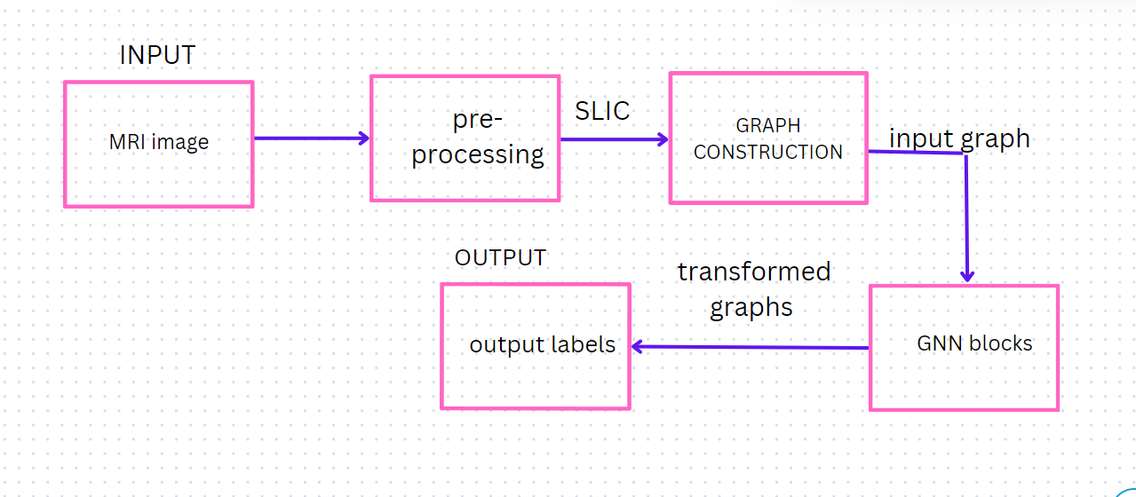
High Level Design

Slide 11
Project Objectives
Explore graph-based representations of MRI images, such as super pixel segmentation or grid-based graphs, to capture spatial relationships and structural information.
Address Non-Euclidean Distance Consideration by incorporating relational awareness in the model, enabling it to understand and utilize pixel-to-pixel relationships effectively.
To Characterize brain tumors as overall brain connectivity graph to capture both local and global context effectively.
Strive to minimize false positives and false negatives, ensuring reliable tumor detection results.
Aim to improve the accuracy when compared to traditional models.

Slide 12
Project Outcomes
Creation of a Graph Convolutional Network architecture tailored for brain tumor detection, capable of effectively processing graph representations of brain images.
The model aims to categorize the tumor, offering valuable insights for clinicians in treatment planning. By providing clinicians with accurate and reliable diagnostic information, our model has the potential to positively impact patient care
Model aims to achieve significantly higher accuracy in detecting brain tumors compared to traditional methods.

Slide 13
Project Assumptions
ASSUMPTIONS:
GCNs assume that the spatial relationships and connectivity within the brain, represented as a graph, hold significant information for tumor detection. The assumption is that preserving this topology through graph convolutions helps in identifying tumor regions.
There's an assumption that the trained model will generalize well to unseen data. This assumes that the patterns learned from the training data are applicable to new, unseen brain scans, especially those from different populations or acquired using different imaging protocols.
The effectiveness of GCNs relies on having a representative dataset that sufficiently covers the diversity of brain tumors in terms of size, shape, location, and appearance. The assumption is that the model can learn generalizable patterns from this dataset.

Slide 14
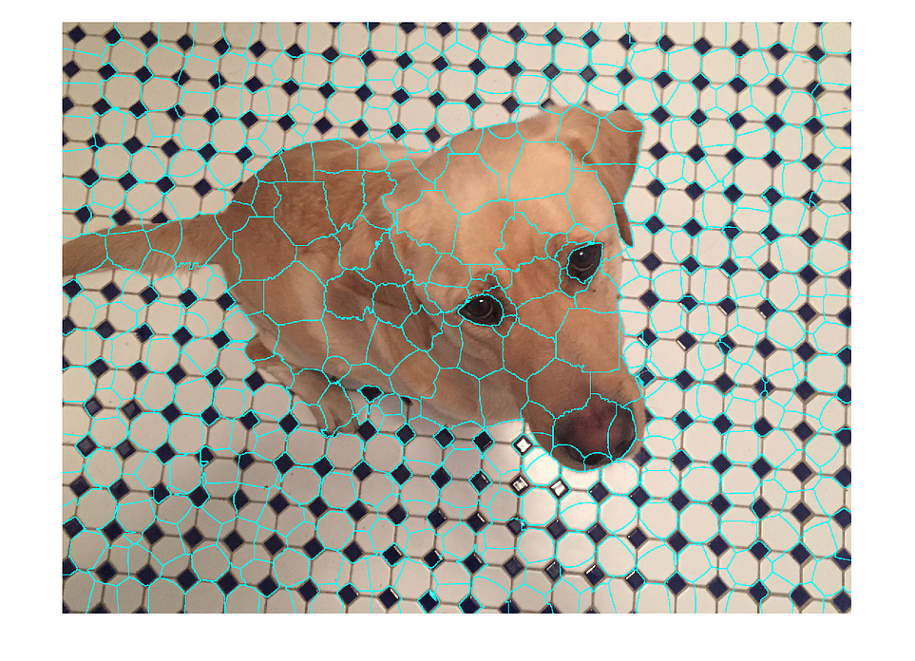
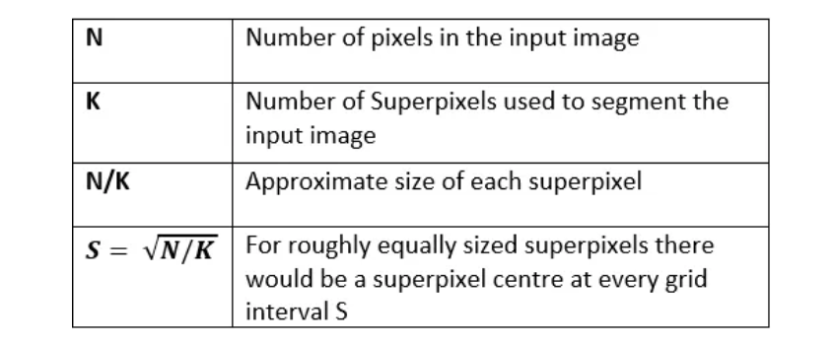
Algorithms
SLIC (Simple Linear Iterative Clustering

Slide 15
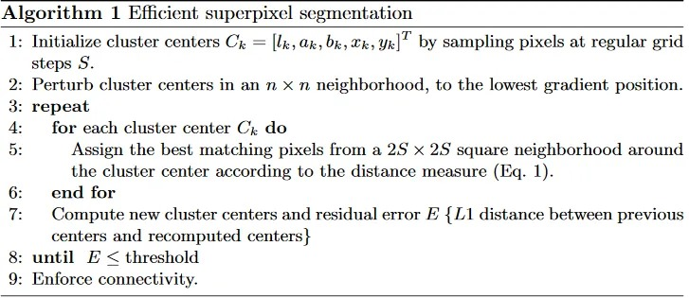
Algorithms
SLIC (Simple Linear Iterative Clustering) Algorithm for Superpixel generation

Slide 16
Algorithms
GCN:
Graph Representation: The input data is represented as a graph, typically defined by a set of nodes and edges. Node features and edge attributes can encode information about the entities and their relationships.
Graph convolution layers:
These convolutions aggregate information from a node's neighbors, considering both the node features and the edge connections.
Activation functions after the convolution layers to introduce non-linearity and improve model learning. Dropout layers might be included to prevent overfitting by randomly dropping out a certain percentage of nodes during training.
Classification layer:
This layer takes the learned node representations and integrates them to make the final class prediction for the image.

Slide 17

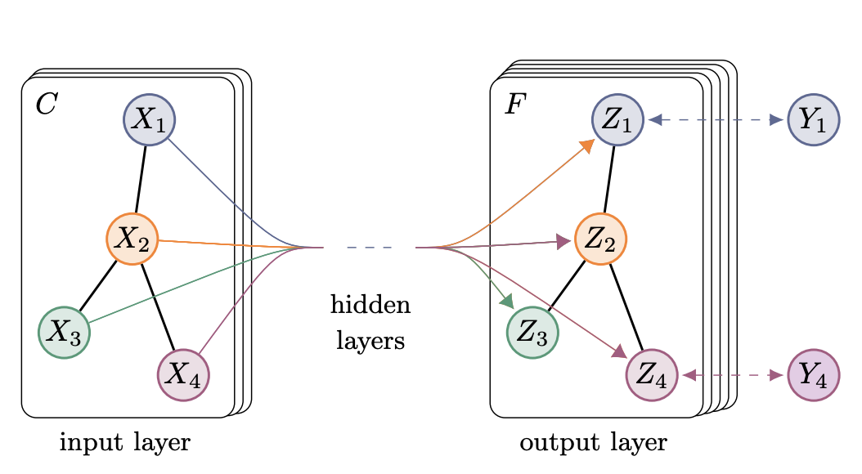
Algorithms

Slide 18
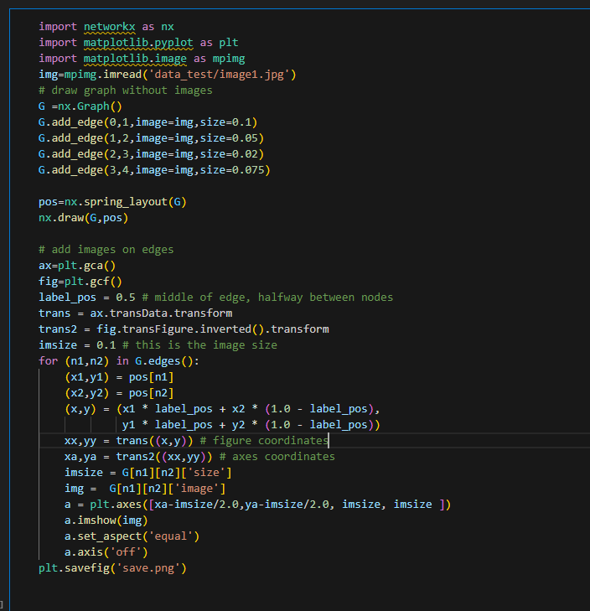
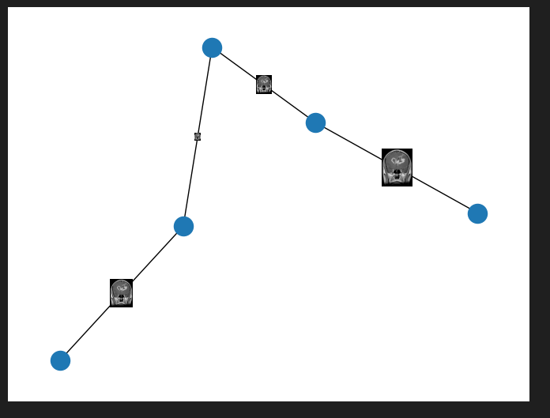
Current status

Slide 19
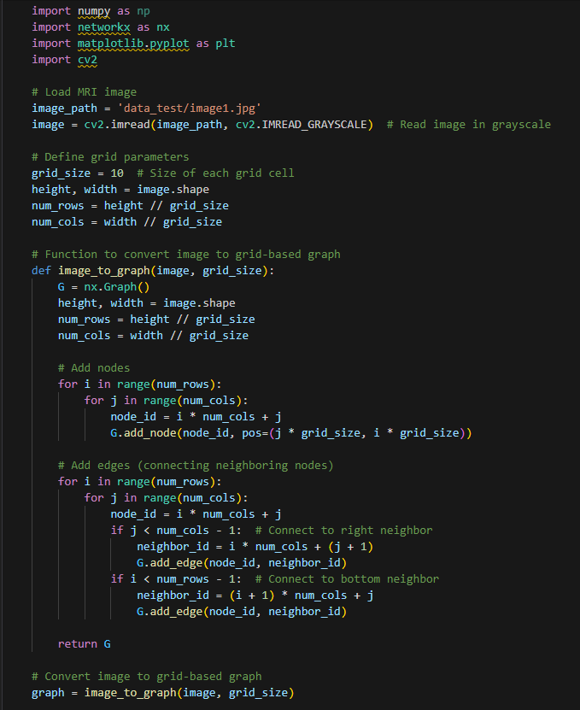
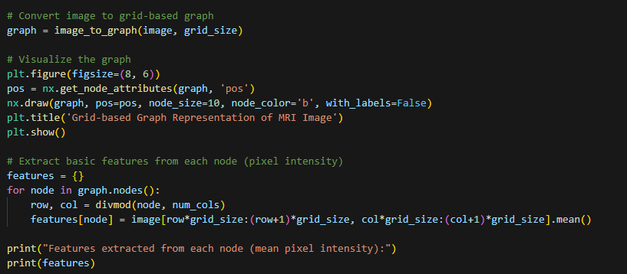
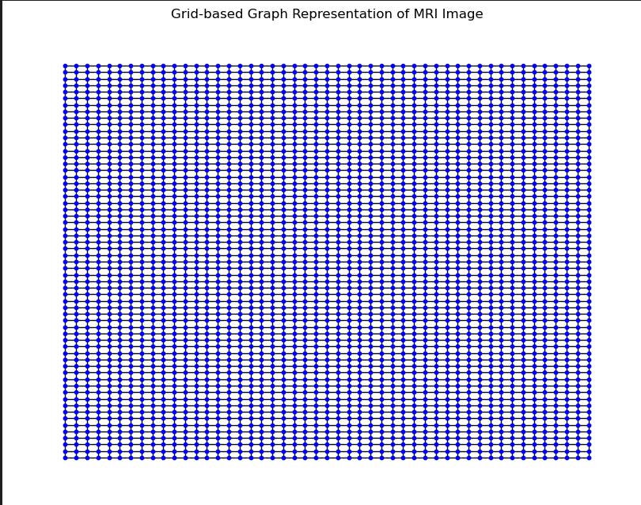

Slide 20
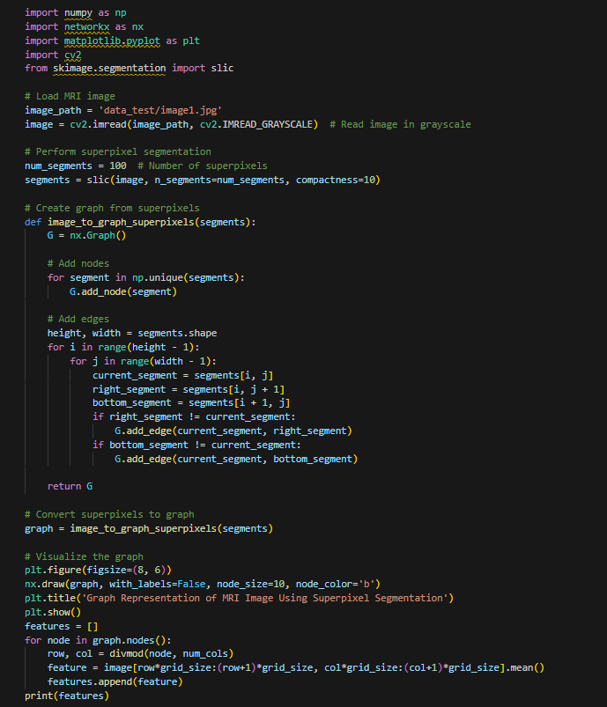
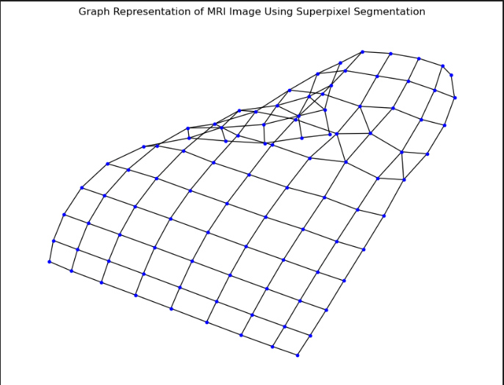

Slide 21
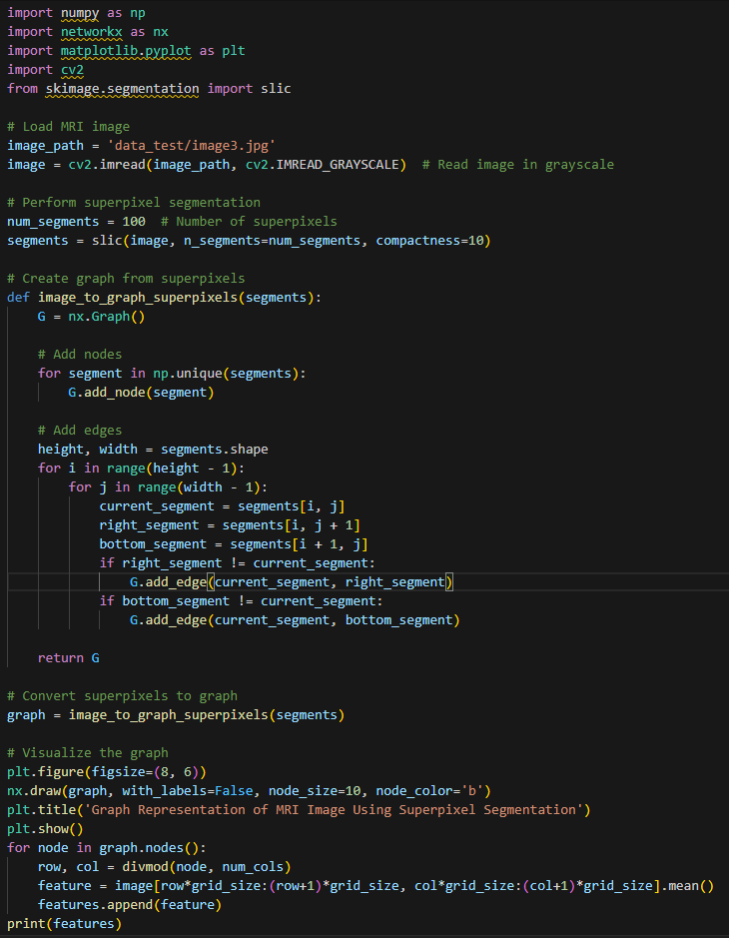
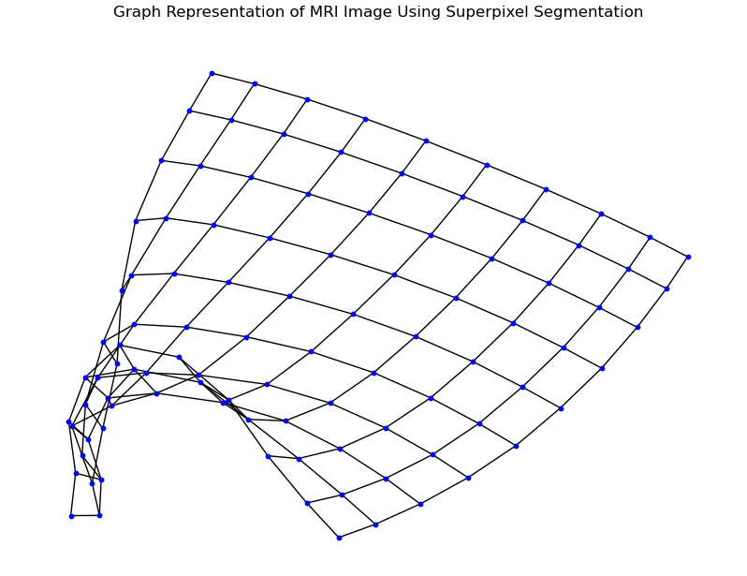

Slide 22

Conferences Targeted
http://ieee-conecct.org

Slide 23
References
Arakeri, M. & Reddy, G. Computer-aided diagnosis system for tissue characterization of brain tumor on magnetic resonance images. SIViP 9(2), 409–425 (2015).
Pereira, S., Oliveira, A., Alves, V., & Silva, C. A. On hierarchical brain tumor segmentation in MRI using fully convolutional neural networks: a preliminary study. in 2017 IEEE 5th Portuguese Meeting on Bioengineering (ENBENG), 1–4. (IEEE, 2017).
Swati, Z. N. K. et al. Brain tumor classification for MR images using transfer learning and fine-tuning. Comput. Med. Imaging Graph. 75, 3446 (2019).
Abiwinanda, N., Hanif, M., Hesaputra, S. T., Handayani, A., & Mengko, T. R. Brain tumor classification using convolutional neural network. in World Congress on Medical Physics and Biomedical Engineering 2018, 183–189. Springer, 2019).
Seetha, J. & Selvakumar Raja, S. Brain tumor classification using convolutional neural networks. Biomed. Pharmacol. J. 11(3), 1457 (2018).
Othman, M. F., & Basri, M. A. M. Probabilistic neural network for brain tumor classification. in 2011 Second International Conference on Intelligent Systems, Modelling and Simulation, 136–138. (IEEE, 2011).
Sachdeva, J., Kumar, V., Gupta, I., Khandelwal, N. & Ahuja, C. K. Segmentation, feature extraction, and multiclass brain tumor classification. J. Digit. Imaging 26(6), 1141–1150 (2013).
Deepak, S. & Ameer, P. M. Brain tumor classification using deep CNN features via transfer learning. Comput. Biol. Med. 111, 103345 (2019).
Sajjad, M. et al. Multi-grade brain tumor classification using deep CNN with extensive data augmentation. J. Comput. Sci. 30, 174182 (2019).
Mehrotra, R., Ansari, M. A., Agrawal, R. & Anand, R. S. A transfer learning approach for AI-based classification of brain tumors. Mach. Learn. Appl. 2, 100003 (2020).

Slide 24
Thank You

