Slide 1


TRAFFIC SIGN DETECTOR
INDIAN INSTITUTE OF INFORMATION TECHNOLOGY, SONEPAT
PROJECT BY:
DHEERAJ 11912020
NIKHIL ARORA 11912063
IT BRANCH (5th Semester)
SUPERVISED BY :
DR. MUKESH MANN

Slide 2
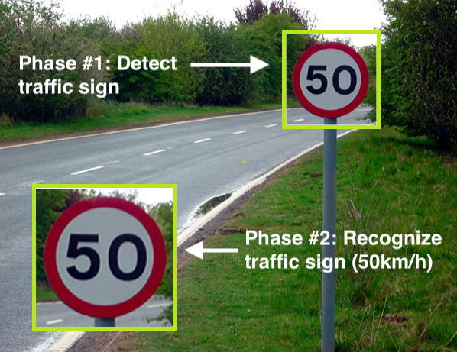
INTRODUCTION
Traffic Signs Detection.
Live Detection.
Can be Fitted in a Car.

Slide 3
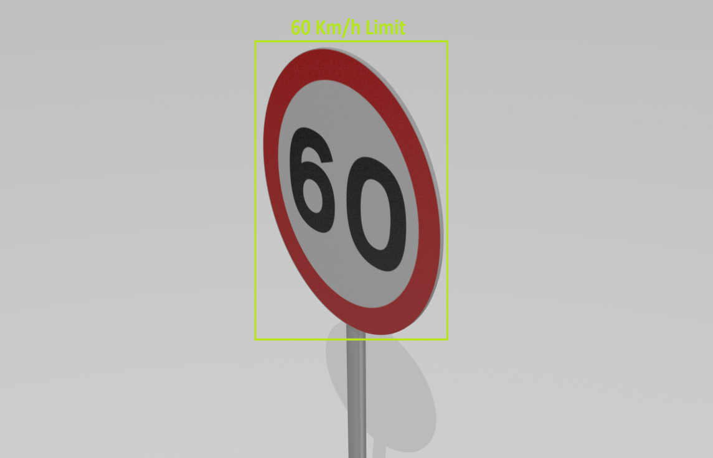
OBJECTIVES
Live Traffic Sign Detection.
Minimize Accidents.
Maximize Accuracy.

Slide 4
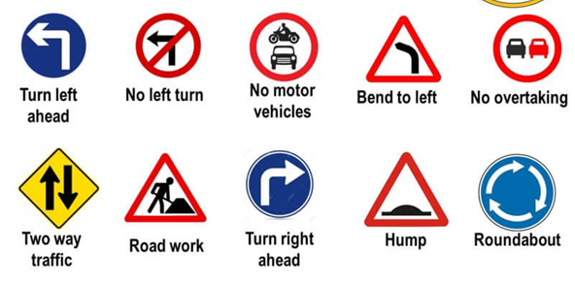
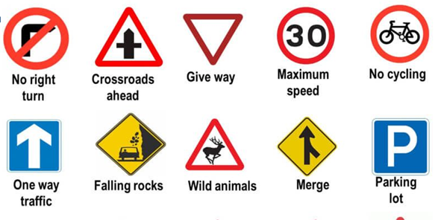
Why we choose TSD ?
Contribution to smart vehicles.
Smart vehicles will boom in coming Years.
100% Focus on Driving.
People Don't have knowledge about all Traffic Signs.

Slide 5
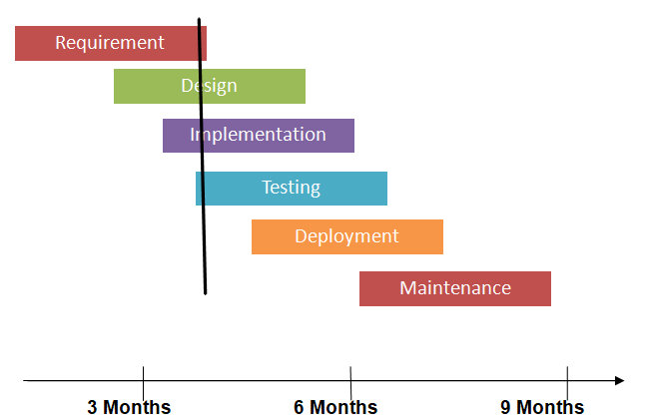
PROJECT METHODOLOGY
SASHMI MODEL

Slide 6



TECHNOLOGIES USED
Python:- For Application Development.
IDE Used:- Jupyter Notebook for Writing and executing code.
GitHub:- For collaboration purpose.

Slide 7
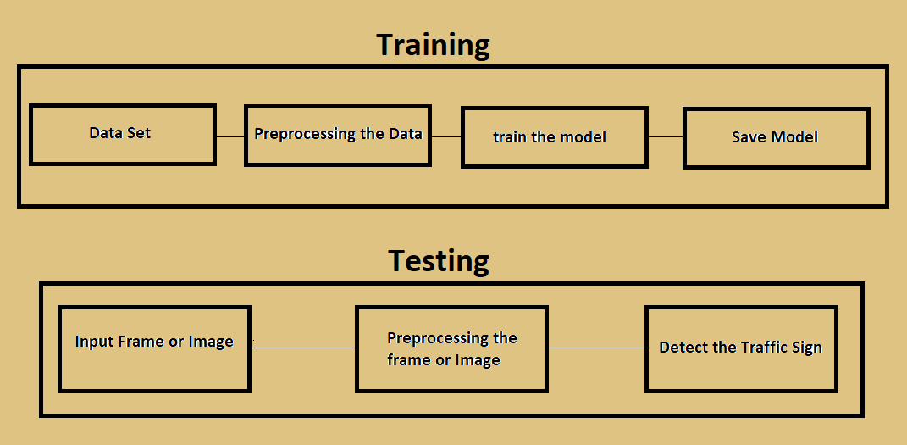
Pipeline of Project

Slide 8
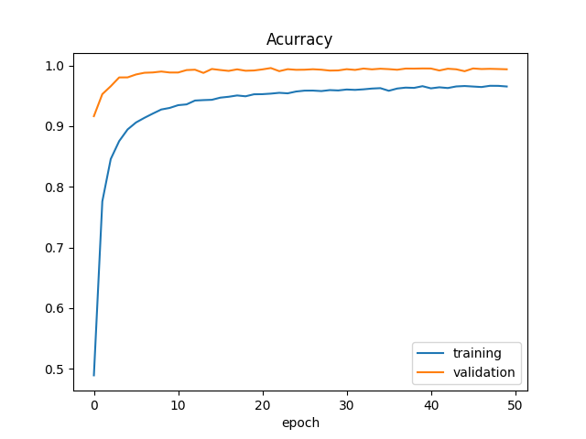
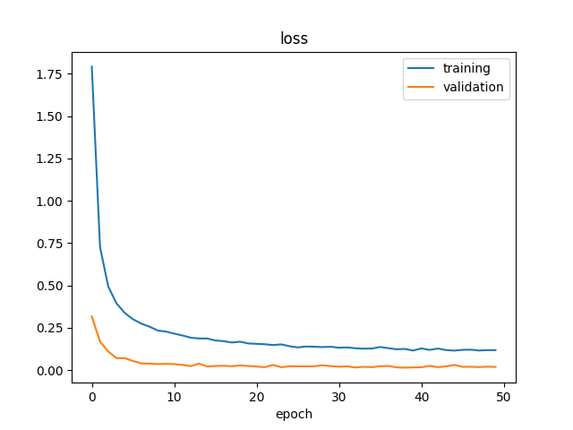
Accuracy Graph and Loss Graph

Slide 9
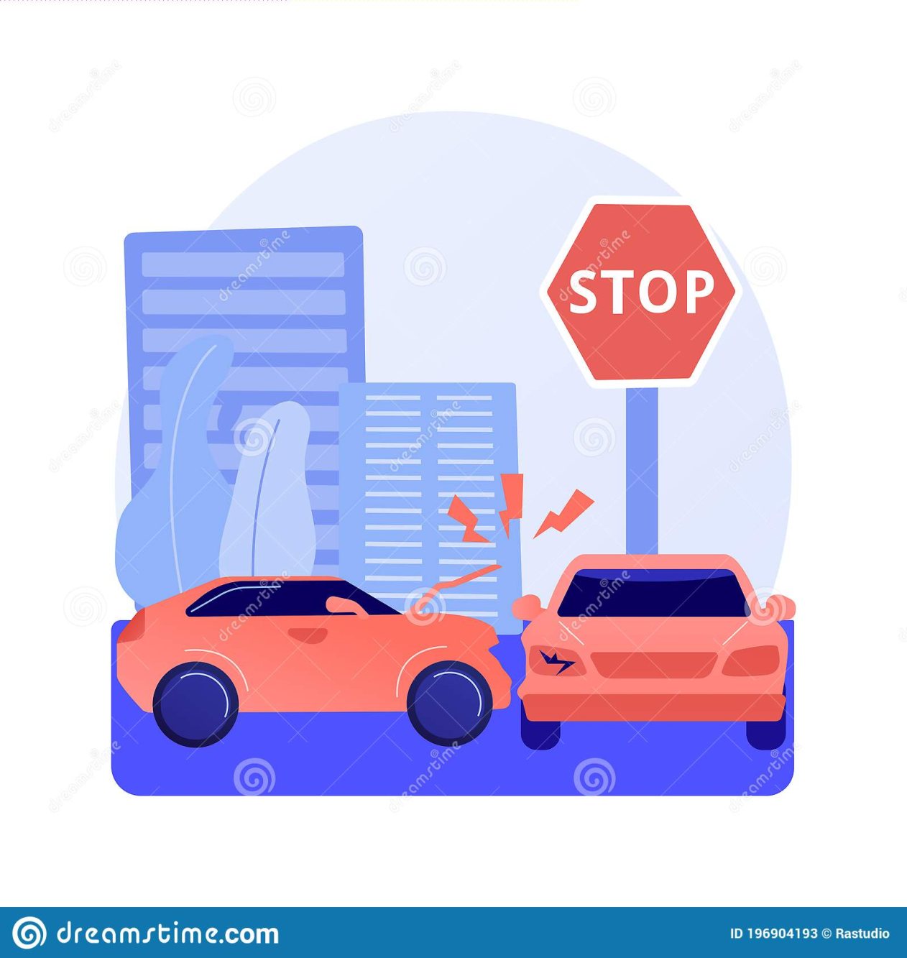
ADVANTAGES
This can be used in smart vehicles
Safe driving.
Minimize number of accidents.
Save many lives.

Slide 10
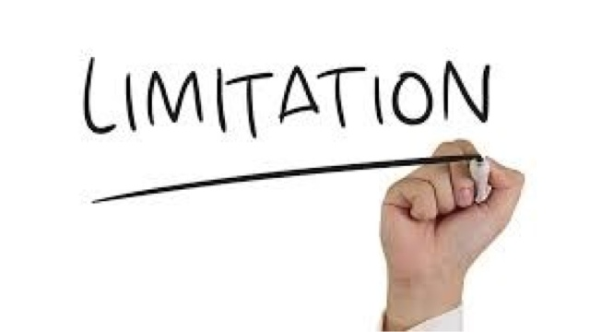
LIMITATIONS
Datasets is one main challenge.
Increases the cost of car.

Slide 11
References
Github, accessed 1 October 2021, https://en.wikipedia.org/wiki/GitHub
Software Process Models, accessed 1 October 2021, https://www.thomasalspaugh.org/pub/fnd/softwareProcess.html
Python, accessed 3 October 2021, https://en.wikipedia.org/wiki/Python_(programming_language)
OpenCv, accessed 3 October 2021, https://en.wikipedia.org/wiki/OpenCV
Jupyter Notebook, accessed 4 October 2021, https://jupyter.org/
smart Vehicles & IoT, accessed 4 October 2021, https://www.intelligenthq.com/smart-vehicles-the-internet-of-things/
Traffic Signs Classification ,accessed 4 October 2021, https://www.kaggle.com/flo2607/traffic-signs-classification?select=myData
Speed Limit, accessed 4 October 2021, https://www.dreamstime.com/dutch-road-sign-speed-limit-km-h-speed-limit-km-h-image131188815

Slide 12


