Slide 1
PROJECT REVIEW
MaintenIQ
A smart Predictive
Maintenance Decision
Support System
Machine
Multi-sensor
Motor, pump, fan or bearing setup
->
Vibration + temperature readings
Processing + ML
Clean, extract features, classify health + root cause
IoT multi-sensor monitoring + edge-cloud analytics for early machine-health decisions.
risk + root cause output
Dashboard + Alert
Status, risk, history, KPIs, action
Team members: Rajanala Sai Dheeraj, Aryan Nukala
Project focus: reduce unplanned downtime by combining vibration, temperature and maintenance history.
01
Notes:
Introduce the project as a condition-monitoring system for machines such as motors, pumps, fans, and bearings. Explain that the aim is not just to collect sensor data, but to convert vibration behavior into useful maintenance decisions before a serious breakdown occurs.

Slide 2
PROBLEM
Machine faults are visible in sensor patterns before they become failures.
Motivation: catch degradation early.
What we are solving
- Early vibration and temperature changes are hard to notice manually
- Faults can occur between scheduled inspections
- Breakdowns create downtime, repair cost and safety risk
- Operators need clear warning signals, not raw sensor noise
Subtle sensor shift
->
Degradation begins
->
Failure
Wear or imbalance grows
Downtime and repair
Vibration or heat pattern changes
Opportunity
Detect abnormal multi-sensor behavior during degradation and schedule maintenance before breakdown.
Earlier
Lower
Clearer
Smarter
Fault visibility through vibration + temperature patterns
Unplanned downtime and emergency repair risk
Maintenance decisions with trend evidence
Condition-based action instead of fixed timing
Smart Predictive Maintenance Decision-Support System
02
Notes:
Explain that machines usually do not fail instantly. Before failure, vibration patterns often change due to imbalance, wear, misalignment, looseness, or bearing problems. The challenge is that traditional methods do not continuously observe these subtle changes.

Slide 3
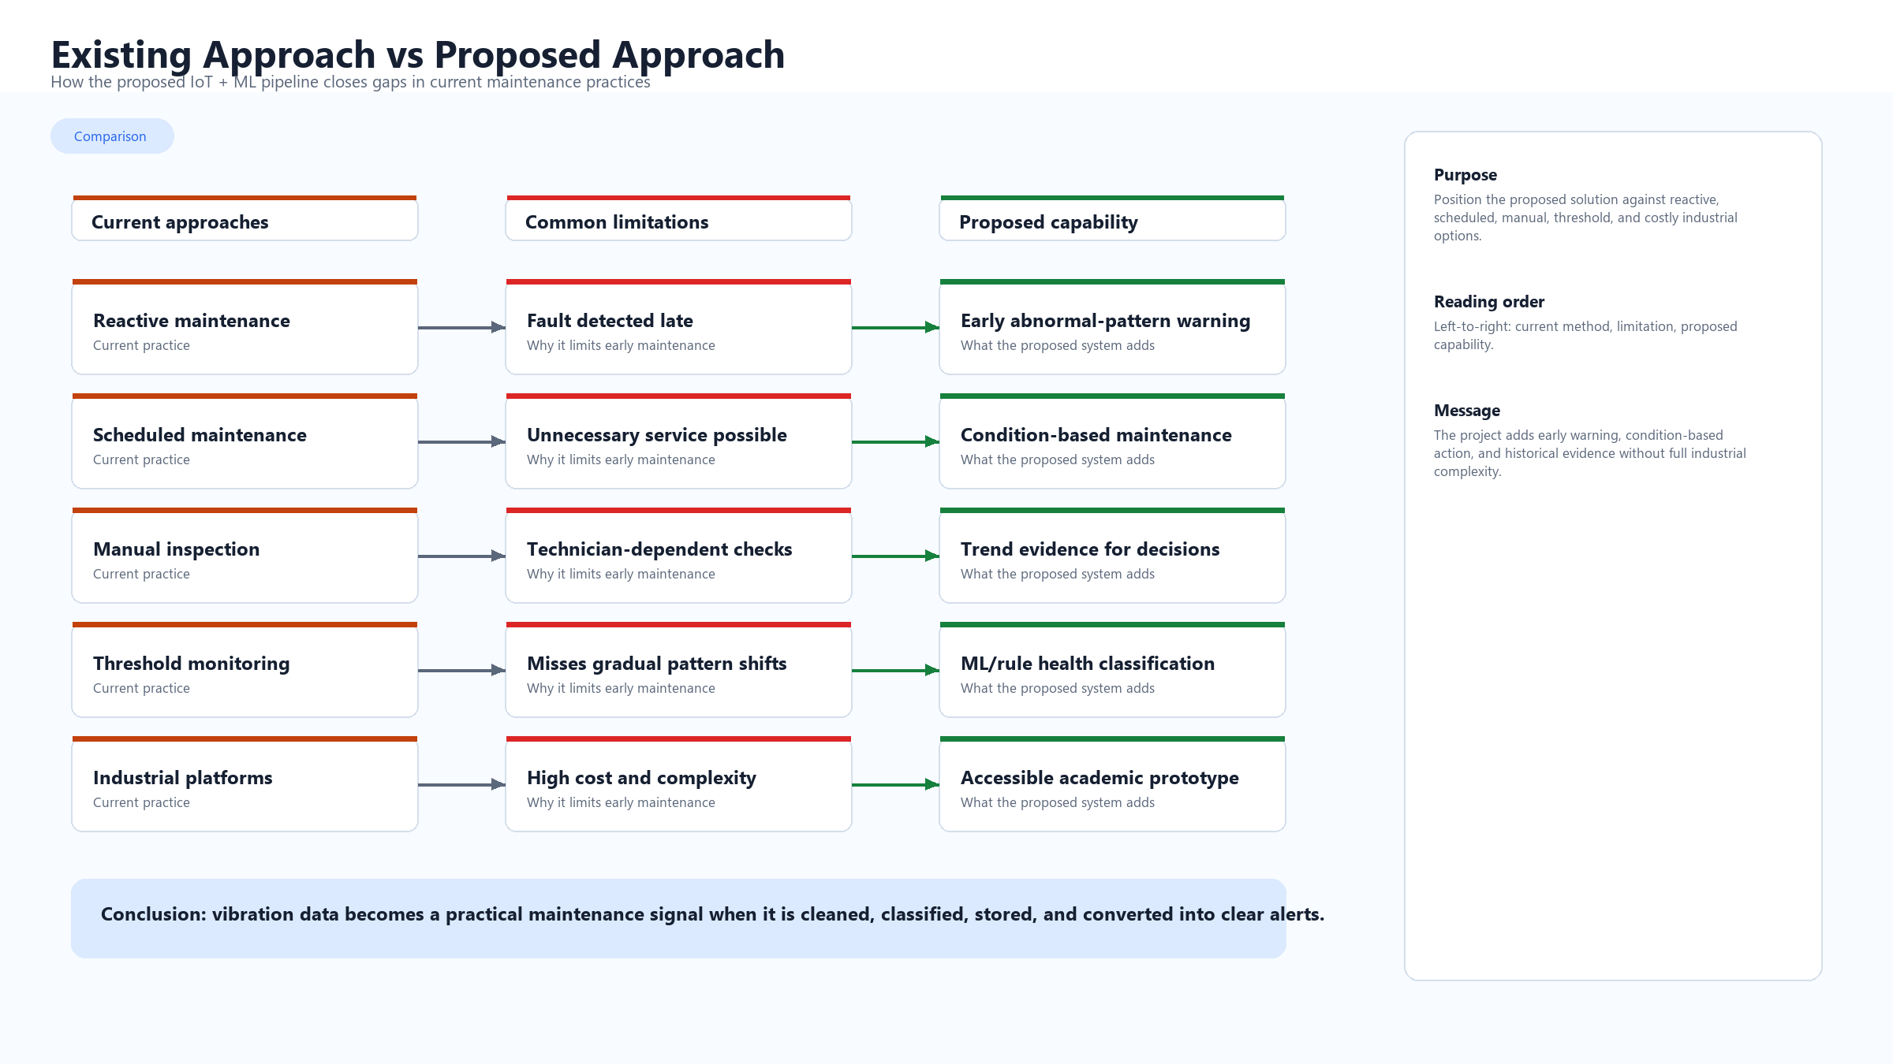

Slide 4
PROPOSED SYSTEM
Our solution turns multi-sensor readings into health, root cause, and next action.
High-level architecture.
Machine
Sensors
Gateway
Processing
ML model
Dashboard
Motor, pump, fan or bearing
->
Vibration + temperature data
->
Timestamp, tag machine ID, buffer locally
->
Clean, window, sync, extract features
->
Health, risk, probable root cause
->
Trends, alerts, history and KPIs
Main outcome
The system supports planned maintenance by detecting abnormal vibration or temperature before a major fault becomes a breakdown.
multi-sensor or dataset input
edge buffer + cloud analysis
ML/rules + root cause
dashboard + KPI output
Smart Predictive Maintenance Decision-Support System
04
Notes:
Describe the solution at a high level. The system observes vibration, cleans the data, extracts features such as RMS and peak value, uses a model or rule logic to classify health, and then communicates the result through dashboard and alerts.

Slide 5
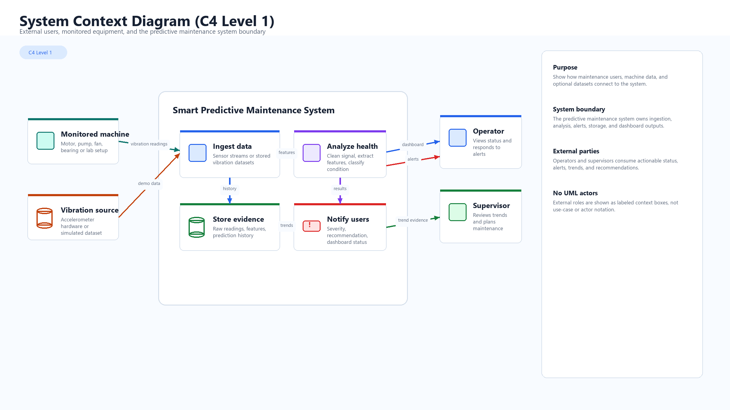

Slide 6
ARCHITECTURE
Modular components make the prototype easier to test, explain, and extend.
Component-level architecture.
Edge acquisition
Signal pipeline
Application services
Storage and UI
Sensor adapter
Preprocess
Reads vibration + temperature
Clean, normalize, window
Alert manager
Data store
Root cause, severity, action
Sensors, predictions, maintenance
Gateway
->
Features
->
->
Tags time, sensor and machine ID
RMS, peak, temp trend
Trend service
Dashboard
Retry buffer
Prediction
History + KPI tracking
Status, cause, KPIs
Handles temporary failure
Classify health + risk
Design decision: edge and cloud responsibilities stay separate; each module owns one responsibility and can be improved independently.
Smart Predictive Maintenance Decision-Support System
05
Notes:
Emphasize the modular design decision. Separating modules reduces development risk and makes future improvements easier. For example, the classifier can be upgraded without rewriting the dashboard, and the sensor input can be replaced by a dataset during demonstration.

Slide 7
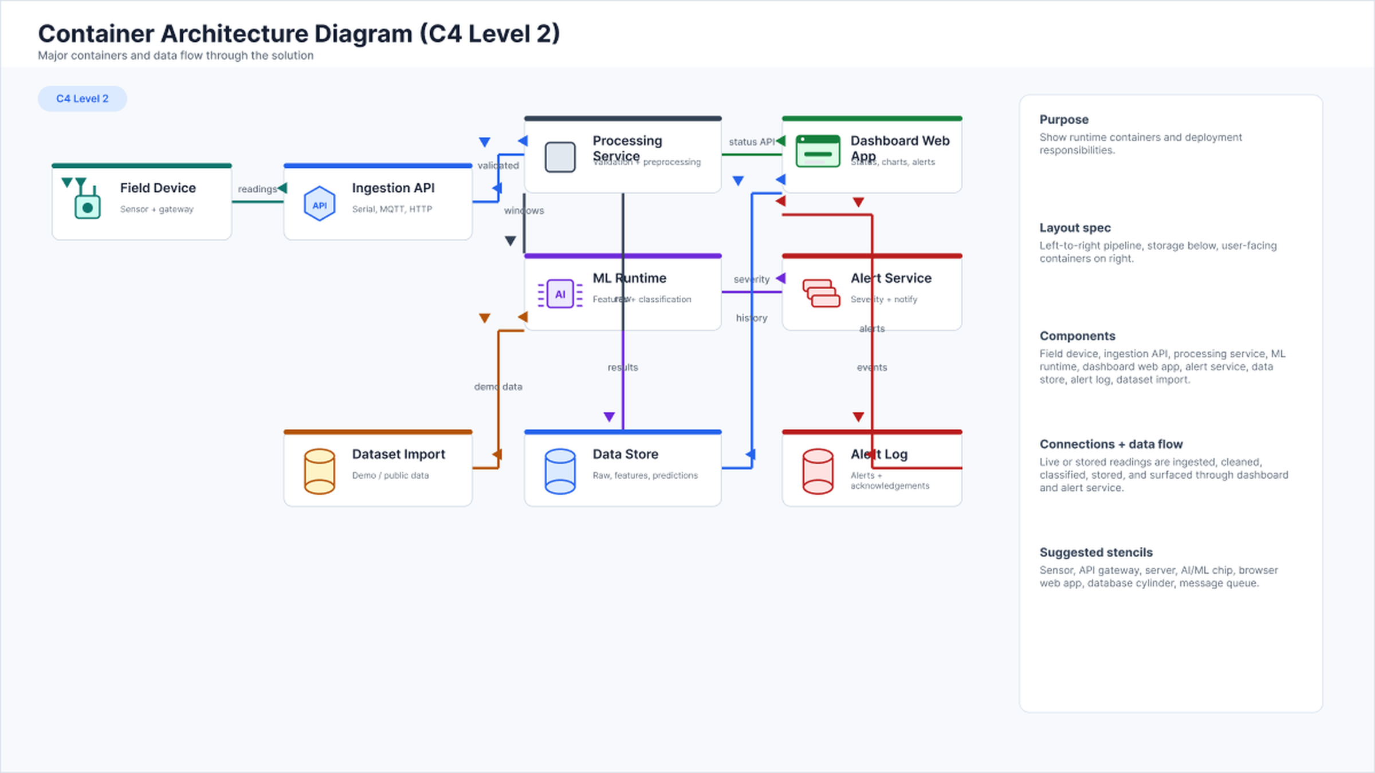

Slide 8
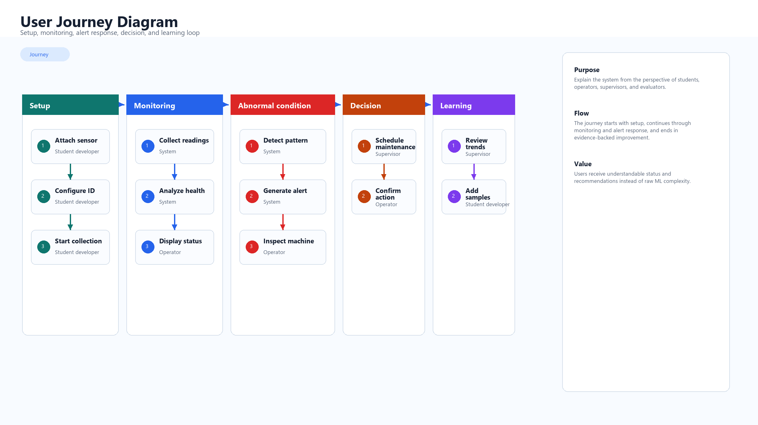

Slide 9
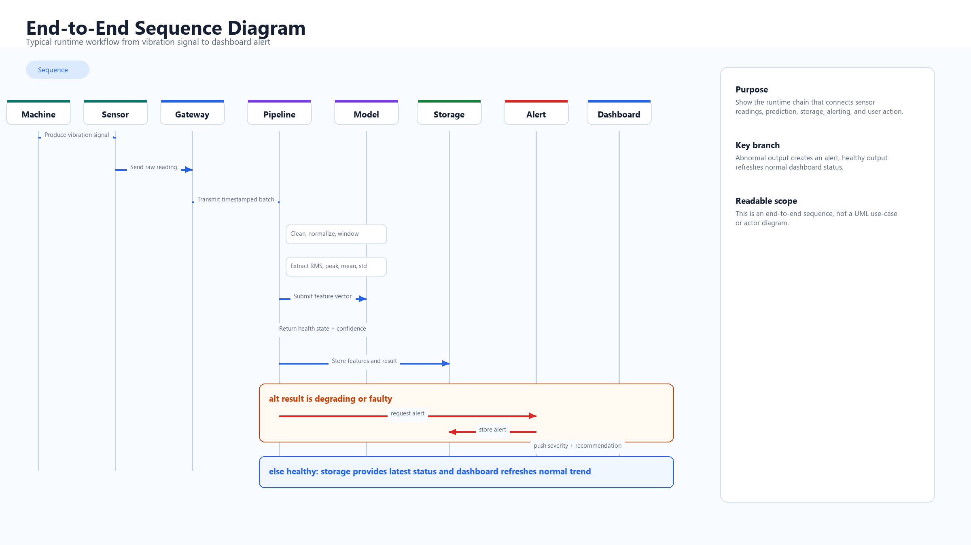

Slide 10
IMPLEMENTATION
The prototype uses accessible technologies with a clear scaling path.
Implementation choices.
Hardware
Vibration sensor, temperature sensor, Arduino, ESP32 or Raspberry Pi
Communication
Serial, Wi-Fi, MQTT, HTTP, Bluetooth, edge buffering and cloud sync
Processing
Python signal cleaning, normalization, windowing and KPI calculation
Model
ML/rule baseline for health state, risk score and probable root cause
Storage + UI
CSV, SQLite, cloud DB, alert log, maintenance history, dashboard/report
Design choice: same pipeline can run on live multi-sensor readings or stored datasets.
Smart Predictive Maintenance Decision-Support System
09
Notes:
Keep the implementation discussion concise. Mention that the exact technology can vary depending on available hardware. The important design choice is the modular pipeline, which allows the same logic to work with live sensor input or a stored dataset.

Slide 11
KPI FRAME
Evaluation covers machine condition, maintenance response, model quality, and system reliability.
How the prototype will be judged.
Machine health
Maintenance
Prediction
Health status
Vibration severity
Temperature severity
Combined risk score
Last service date
Days since service
Unresolved alerts
Machines due for inspection
Accuracy
False alarms
Missed faults
Root-cause confidence
System
Operational value
Collection rate
Transmission success
Edge buffer usage
Dashboard latency
Faults detected before failure
Planned actions improved
Emergency cases reduced
A machine with abnormal readings and a long time since last maintenance becomes the highest-priority inspection candidate.
Smart Predictive Maintenance Decision-Support System
11

Slide 12
ROADMAP
Current limitations define a credible path for future research.
Challenges and future enhancements.
Challenges and limitations
Future enhancements
- Noisy vibration/temperature readings and sensor placement affect accuracy
- Limited labeled fault and root-cause data restricts model quality
- Prototype is not a full industrial deployment
- Human verification is still required before major action
Prototype
sensor/dataset + health/risk classification
Improved model
root cause, confidence and severity tuning
Scaled system
edge-cloud monitoring + mobile alerts + KPIs
Research
remaining useful life + maintenance workflow integration
Limitation does not weaken the idea; it defines the validation path.
Smart Predictive Maintenance Decision-Support System
13
Notes:
Be realistic and credible. Acknowledge that predictive maintenance quality depends on good data and testing. Then show that the architecture already supports future growth, including better models, multiple machines, and richer alert channels.

Slide 13
CONCLUSION
The project demonstrates the full loop from multi-sensor monitoring to maintenance decision support.
Key takeaways.
Sense
Analyze
Alert
Decide
vibration + temp readings
->
features + model/rules
->
risk + probable cause
->
planned next action
Main contribution
A practical academic prototype that connects IoT sensing, signal processing, ML/rule analysis, maintenance history, KPI tracking, dashboard reporting and alerts into one predictive maintenance workflow.
real industrial problem
early warning
root-cause decision
edge-cloud scalable base
Smart Predictive Maintenance Decision-Support System
14
Notes:
Close by summarizing the contribution. The project shows how sensor data can be converted into machine health insight and actionable alerts. Reinforce that the system assists human maintenance decisions and provides a scalable base for future improvements.

