Slide 1
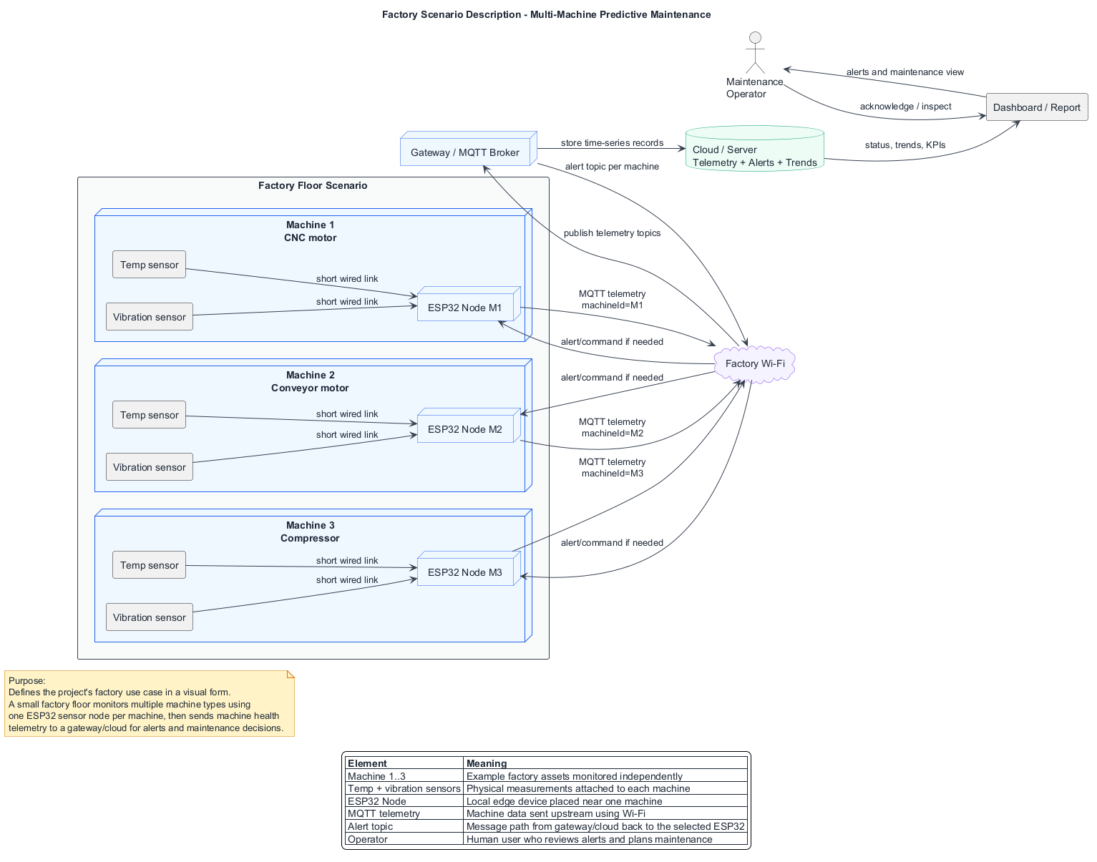
SMART PREDICTIVE MAINTENANCE
Design review with professor
Multi-sensor IoT system using vibration and temperature data to support maintenance decisions before machine failure.
Meeting goal: choose sensors, protocol, design scope, and immediate next steps.
Design review draft | Smart predictive maintenance
01

Slide 2
REVIEW FRAME
What we need help deciding
Use the diagrams as a working design, then decide what is realistic for the prototype.
01
02
03
Sensor choices
Communication path
Prototype scope
Temperature: DS18B20 vs thermocouple. Vibration: ADXL345 vs MPU6050 vs industrial piezo.
Start with MQTT over Wi-Fi, keep Serial for debugging, consider RS485/Modbus as future industrial path.
Decide whether first demo uses real hardware, stored datasets, or both with a simple dashboard/report.
Expected output of the meeting
A frozen first-build architecture, a bill of materials direction, and a one-week implementation plan for data collection plus dashboard evidence.
Design review draft | Smart predictive maintenance
02

Slide 3
SCENARIO
Factory floor concept: one node per machine
The design scales by repeating the same ESP32 sensor node for each monitored asset.
Each machine has local temperature and vibration sensing.
Each ESP32 publishes telemetry with machine identity.
Gateway/cloud stores trends and sends alert topics back.
Operator reviews alerts before planning inspection.
Design review draft | Smart predictive maintenance
03

Slide 4
ESP32 ROLE
Why ESP32 is used in the prototype
ESP32 is the edge node: it sits near the machine, reads sensors, formats records, and publishes telemetry.
Sensor bridge
Machine identity
Reads temperature and vibration sensors through simple digital buses such as 1-Wire, I2C, SPI, or UART.
Adds machineId, nodeId, sensorId, timestamp, and sequence number before data leaves the machine area.
Connectivity
Local resilience
Uses built-in Wi-Fi to publish MQTT telemetry to the broker and receive machine-specific alert topics.
Can buffer a few records during brief network loss and retry publishing when Wi-Fi/MQTT returns.
Debugging surface
USB serial logs reveal raw readings, payload formatting, Wi-Fi status, MQTT publish errors, and alert reception.
Boundary
ESP32 does not train the ML model. It mainly collects, tags, buffers, publishes, and optionally shows local alerts.
Design review draft | Smart predictive maintenance
04

Slide 5
UPSTREAM CONTRACT
Expected MQTT telemetry format from ESP32
This is the simple payload contract the backend listener should expect from factory/{machineId}/telemetry.
MQTT topic
Example JSON payload
factory/{machineId}/telemetry
{
"machineId": "M1",
"nodeId": "esp32-m1",
"timestampUtc": "2026-06-30T10:20:15Z",
"sequence": 1284,
"temperatureC": 42.3,
"vibration": {
"rmsG": 0.18,
"peakG": 0.42,
"sampleWindowMs": 1000,
"sampleCount": 200
},
"status": {
"wifiRssiDbm": -58,
"firmware": "0.1.0"
}
}
One message should represent one reading window or one compact batch. Keep the first prototype small: send features such as RMS/peak instead of large raw arrays unless we explicitly need raw waveform training data.
Backend listener should validate required fields before storage or inference.
Minimum required fields: machineId, nodeId, timestampUtc, temperatureC, vibration.rmsG, sampleWindowMs, sampleCount.
Design review draft | Smart predictive maintenance
05

Slide 6
ROW-LEVEL FLOW
How one raw reading becomes backend input
This slide follows one telemetry row until it reaches the first backend listener.
Machine
Sensors
ESP32
MQTT client
Broker
Backend listener
Physical heat and vibration signal.
Temperature and vibration readings.
Adds IDs, timestamp, sequence, and features.
Publishes JSON telemetry topic.
Receives topic and routes message.
Validates schema and stores raw row.
Example row expected by backend
Same fields can later become database columns or a normalized telemetry table.
machineId
nodeId
timestampUtc
sequence
tempC
rmsG
peakG
windowMs
sampleCount
M1
esp32-m1
2026-06-30T10:20:15Z
1284
42.3
0.18
0.42
1000
200
Backend listener first validates this row, then stores it as raw telemetry and passes it toward preprocessing/inference.
Design review draft | Smart predictive maintenance
06

Slide 7
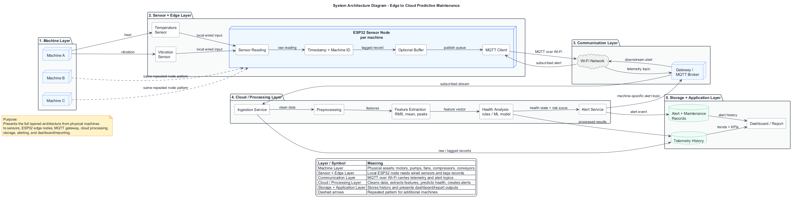
ARCHITECTURE
Edge-to-cloud system architecture
This is the end-to-end path from physical machine signals to dashboard and maintenance action.
Important design idea
Edge tags and buffers records; MQTT separates telemetry and alert topics; cloud/server handles preprocessing, features, model, storage, alerts, and dashboard evidence.
Design review draft | Smart predictive maintenance
07

Slide 8
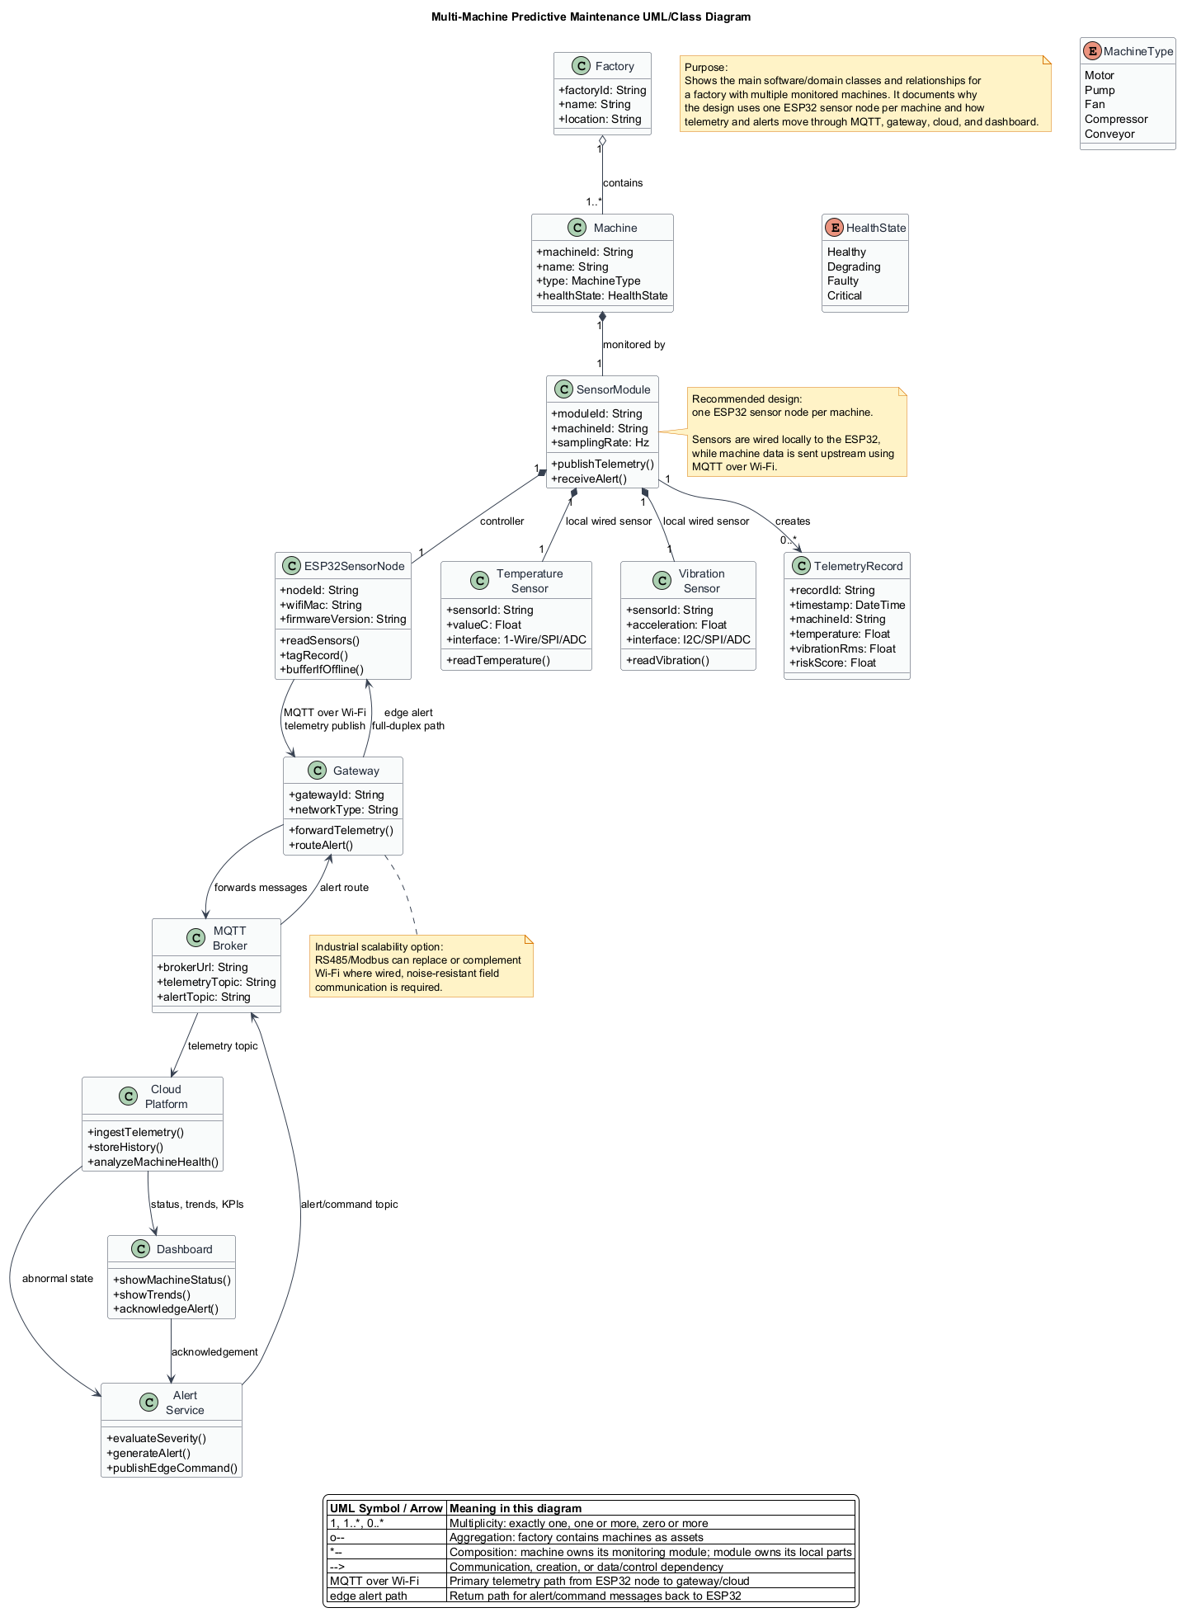
SOFTWARE MODEL
Multi-machine domain model
This class view makes the software boundaries and relationships explicit before implementation.
Why it matters
Factory contains machines; each machine owns a sensor module.
Telemetry records are created by ESP32 nodes and routed through MQTT.
Cloud platform owns analysis, alert service, dashboard, and KPIs.
Design keeps future machines and fault categories addable.
Design review draft | Smart predictive maintenance
08

Slide 9
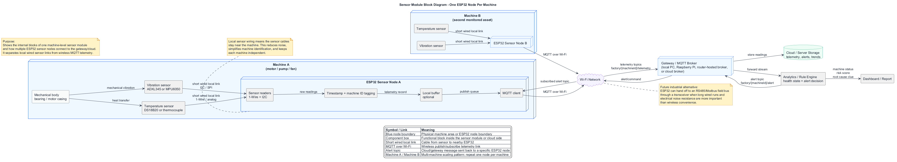
SENSOR NODE
One ESP32 module per monitored machine
Local sensor wiring keeps each machine independent and makes machine identification reliable.
Professor feedback needed
Is one ESP32 per machine acceptable for the project cost?
Should vibration sampling happen on ESP32 or mostly on server?
How much local buffering is enough for the first prototype?
Design review draft | Smart predictive maintenance
09

Slide 10
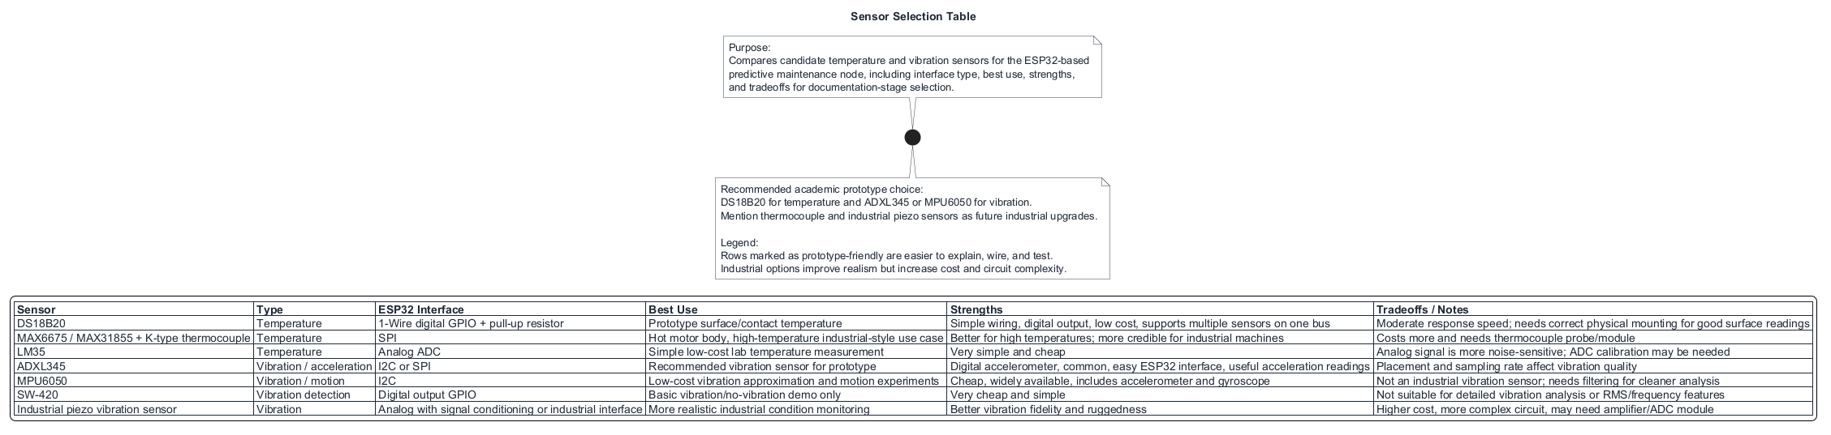
SENSORS
Candidate temperature and vibration sensors
The table compares prototype-friendly parts with more industrial upgrade options.
Current recommendation
DS18B20 for temperature
ADXL345 for vibration
Thermocouple and industrial piezo sensors stay as future upgrades.
Design review draft | Smart predictive maintenance
10

Slide 11
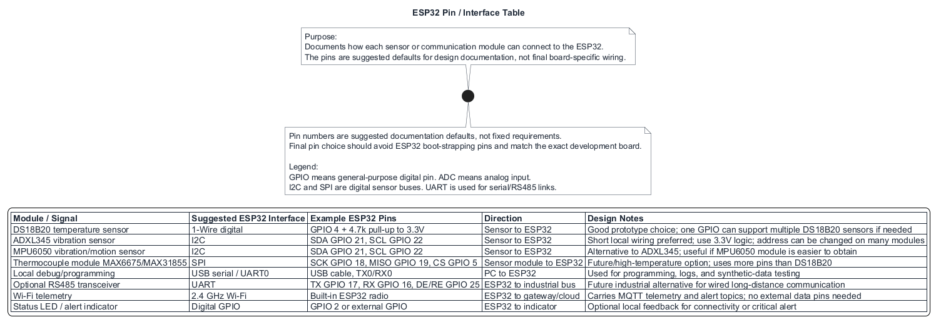
HARDWARE WIRING
ESP32 pin and interface plan
These are documentation defaults; final wiring should match the exact development board.
Review checks
Avoid ESP32 boot-strapping pins.
Keep I2C wiring short near the machine.
Use pull-up resistor for DS18B20.
Reserve UART pins if RS485 is explored later.
Design review draft | Smart predictive maintenance
11

Slide 12
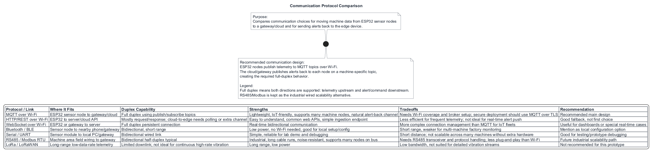
PROTOCOLS
Communication protocol comparison
MQTT gives the cleanest telemetry-up and alert-down story for multiple ESP32 nodes.
Recommended path
MQTT over Wi-Fi for the design baseline.
HTTP remains easy for APIs, Serial is useful for lab debugging, and RS485/Modbus is the industrial scalability discussion.
Design review draft | Smart predictive maintenance
12

Slide 13
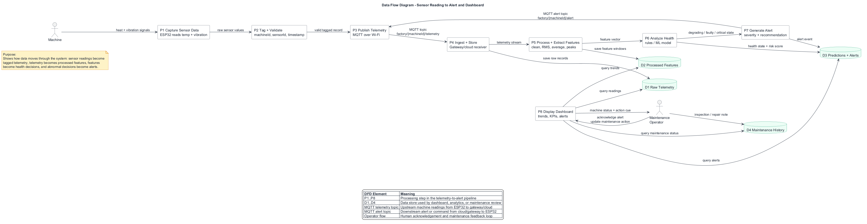
DATA FLOW
Sensor readings become decisions
The pipeline must preserve raw evidence, derived features, predictions, alerts, and maintenance history.
Key data products
Raw telemetry: machineId, sensorId, timestamp.
Feature windows: RMS, averages, peaks, temperature rate.
Predictions: health state, risk score, probable root cause.
Alerts and maintenance actions close the loop.
Design review draft | Smart predictive maintenance
13

Slide 14
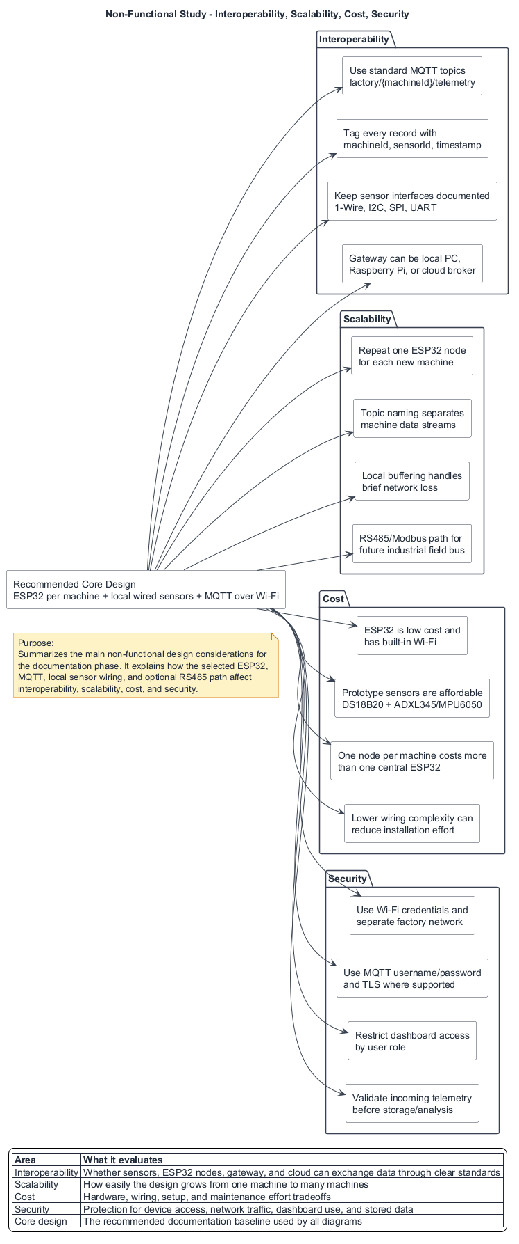
QUALITY
Non-functional choices affect feasibility
Interoperability, scalability, cost, and security should be decided before hardware purchase.
Interoperability
Scalability
MQTT topics, machineId, sensorId, timestamp, and documented interfaces.
Repeat one node per machine; keep RS485/Modbus as future field-bus path.
Cost
Security
ESP32 and prototype sensors stay low cost; one-node-per-machine costs more but simplifies wiring.
Wi-Fi isolation, MQTT credentials/TLS where possible, validation, and limited dashboard access.
Design review draft | Smart predictive maintenance
14

Slide 15
DECISION REQUEST
Proposed baseline for approval
This is the design we can freeze after professor review, unless the meeting points to a better path.
Area
Baseline choice
Reason
Machine node
One ESP32 per machine
Simpler identification, shorter sensor wiring, repeatable scaling
Temperature
DS18B20 first
Low-cost digital sensor; thermocouple kept as high-temp upgrade
Vibration
ADXL345 first
Digital I2C/SPI accelerometer; MPU6050 acceptable if easier to source
Communication
MQTT over Wi-Fi
Publish telemetry and receive machine-specific alert topics
Prototype demo
Dataset plus one hardware node
Reduces project risk while still proving the hardware path
Professor help: validate these choices or tell us what to change before implementation starts.
Design review draft | Smart predictive maintenance
15

Slide 16
NEXT STEPS
After the design review
The next sprint should produce measurable evidence, not only more documentation.
1
Finalize BOM and wiring
Buy or confirm ESP32, DS18B20, ADXL345/MPU6050, resistors, jumper wires, mounting approach.
2
Collect first data
Read temperature and vibration samples; log timestamped machine records locally and over MQTT.
3
Build analysis loop
Preprocess windows, compute RMS/mean/peak and simple risk logic before full ML.
4
Show review dashboard
Display status, trends, alerts, maintenance history, and KPIs for the professor check-in.
Success criterion: demonstrate one complete path from sensor or dataset reading to health status, alert, and maintenance recommendation.
Design review draft | Smart predictive maintenance
16

