Slide 1
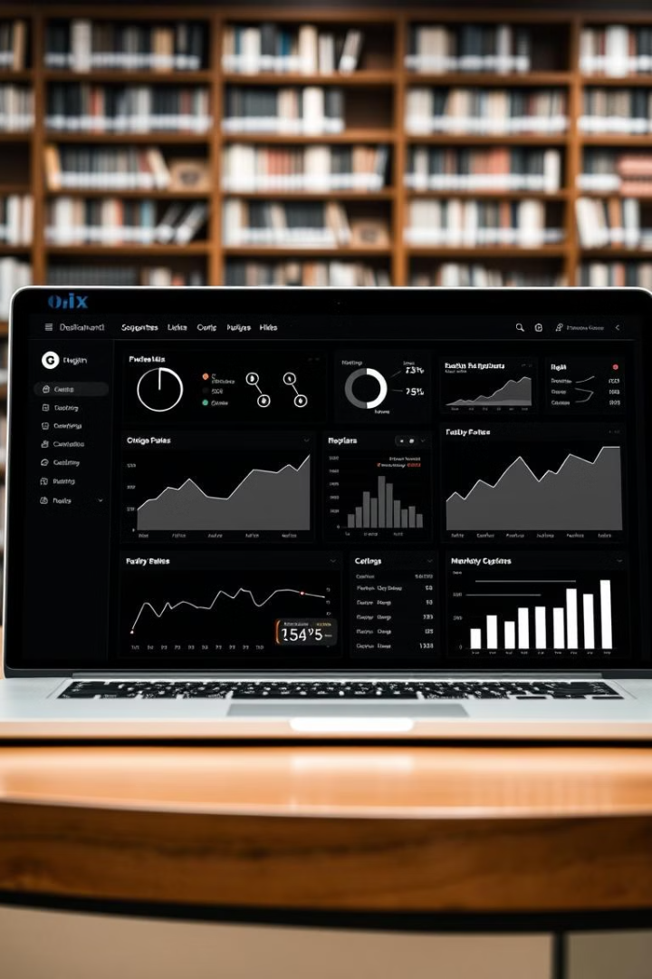

Student Dashboard: Personalized Academic Insights
This presentation outlines the concept and implementation of a personalized student dashboard designed to empower learners and enhance their academic journey.

Slide 2
Project Overview and Key Features
Personalized Progress
Course Completion
Academic Deadlines
Track academic progress in real-time, with visualized performance metrics and insights.
Monitor course completion status, deadlines, and assignments for each enrolled course.
Receive timely reminders and notifications about upcoming deadlines, exams, and events.

Slide 3

Addressing Societal Needs: Student Success
1
Empowerment
2
Transparency
Provide students with the tools and information they need to take control of their academic journey.
Increase transparency and accountability by offering clear visibility into academic progress and goals.
3
Equity
Promote equitable access to academic support resources and personalized guidance.

Slide 4



Technical Feasibility and Implementation
Data Integration
1
Integrate data from various academic systems (LMS, SIS, etc.) for a comprehensive view.
User Interface
2
Develop an intuitive and user-friendly interface for easy navigation and interaction.
Security
3
Ensure robust security measures to protect student data and privacy.

Slide 5

Data-Driven Insights and Visualizations
Performance Trends
Grade Distribution
Resource Utilization
Analyze performance trends over time to identify areas for improvement.
Visualize grade distribution across courses and assignments to understand performance patterns.
Track utilization of academic resources, such as library services and online learning tools.

Slide 6
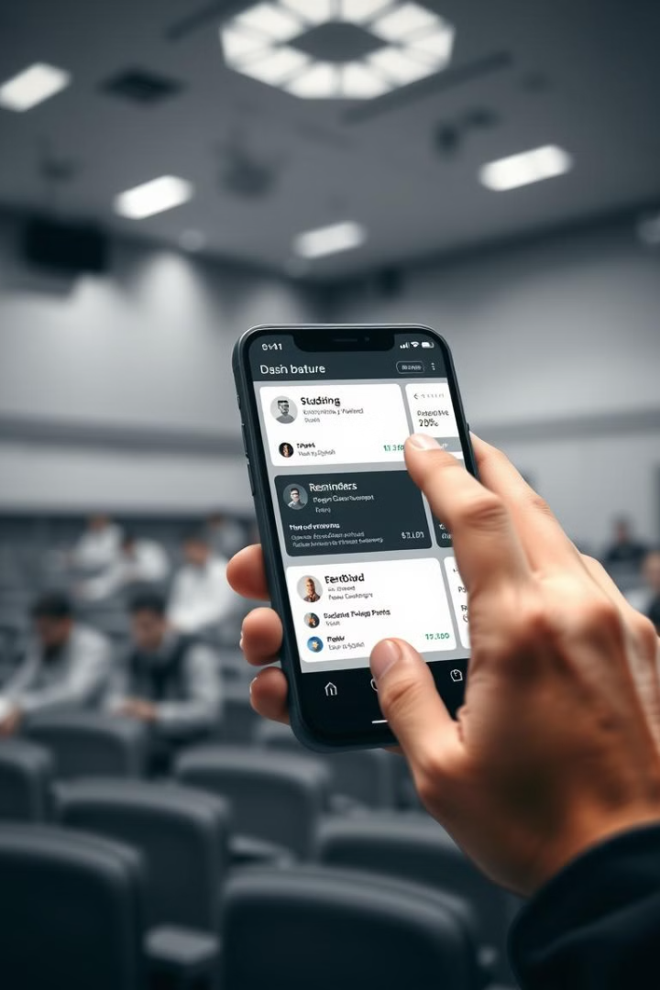
Promoting Academic Engagement and Accountability
1
Personalized Goals
Set personalized academic goals and track progress towards achieving them.
2
Deadline Reminders
Receive timely notifications and reminders about approaching deadlines and events.
3
Progress Tracking
Monitor progress towards achieving academic goals and identify areas for improvement.

Slide 7




Integrated Platform for Holistic Student Support
Academic Calendar
Messaging
Library Resources
Access an integrated academic calendar with important dates and events.
Communicate with instructors, advisors, and other academic support staff.
Explore available library resources, including books, articles, and databases.

Slide 8
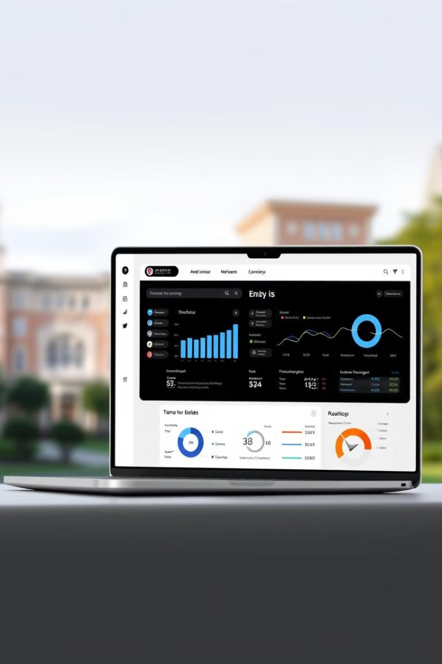
Conclusion and Future Enhancements
The student dashboard presents a powerful solution for enhancing academic engagement, empowering learners, and improving student outcomes. Future enhancements may include AI-powered personalized learning recommendations, integrated career exploration tools, and expanded support services.

