Slide 1
Penetration Testing and Vulnerability Assessment:
“The difference between theory in practice is small in theory, but great in practice.”
Ernest Lopez & Matt Linton
Ames Research Center
August 17, 2010

Slide 2
Outline
What is penetration testing?
What is the difference between Penetration Testing and Vulnerability Assessment
What is within scope of a typical Penetration Test?
Why Bother?
A high-level how-to: ARC's Pen Testing Program
Detailed how to: ARC’s testing methodology.
Outputs from Penetration Testing at ARC.
Presentation Title
—<number>—
March 5, 2010

Slide 3
What is Penetration Testing?
A penetration test is a method of evaluating the security of a computer system or network by simulating an attack from a malicious source, known as a Black Hat Hacker, or Cracker. – Wikipedia
What is the difference between a Pen Tester and a Hacker?
  Pen Tester’s have prior approval from Senior Management
  Hackers have prior approval from themselves.
  Pen Tester’s social engineering attacks are there to raise awareness
  Hackers social engineering attacks are there to trick the DMV into divulging sensitive information about the whereabouts of their estranged ex-spouse.
  Pen Tester’s war driving = geeks driving cars with really long antennas, license plate reading “r00t3d” while dying their hair green looking to discover the hidden, unapproved networks your users thought it would be OK to install for you.
  Hackers wireless war driving doesn’t happen so often because 14 year olds typically don’t have their license yet.
  Pen-testers have pink mohawks and wear trenchcoats in July.
  Hackers have pink mohawks and wear trenchcoats.... that they bought with your bank account info.
Presentation Title
—<number>—
March 5, 2010

Slide 4
Difference between Penetration Testing and Vulnerability Assessment?
Vulnerability Assessment:
  Typically is general in scope and includes a large assessment.
  Predictable. ( I know when those darn Security guys scan us.)
  Unreliable at times and high rate of false positives. (I’ve got a banner)
  Vulnerability assessment invites debate among System Admins.
  Produces a report with mitigation guidelines and action items.
Penetration Testing:
  Focused in scope and may include targeted attempts to exploit specific vectors (Both IT and Physical)
  Unpredictable by the recipient. (Don’t know the “how?” and “when?”)
  Highly accurate and reliable. (I’ve got root!)
  Penetration Testing = Proof of Concept against vulnerabilities.
  Produces a binary result: Either the team owned you, or they didn't.
Presentation Title
—2—
March 5, 2010

Slide 5
Scope of Penetration Testing
Targeted Recon.
  Targeted exploitation of vulnerable software.
Social Engineering
  Hi HelpDesk…I’m Mr. Jones…Can you tell me what my password is?
Physical facilities audit
  Hmm, I forgot my badge... but there's 200 yards of fence missing on the east side of the center
Wireless War Driving
  Detection of rogue or weakly encrypted AP’s.
Dumpster Diving
  How much fun can I have in the dumpster…whoops…I’ve found someone’s Tax forms with SSN.
Presentation Title
—<number>—
March 5, 2010

Slide 6
Why Bother?
Active pen-testing teaches you things that security planning will not
  What are the vulnerability scanners missing?
Are your users and system administrators actually following their own policies?
  host that claims one thing in security plan but it totally different in reality
  Audit Physical Security
  Just what is in that building no one ever goes in?
  The strongest network based protections are useless if there is a accessible unlocked terminal, unlocked tape vault, etc.
Raises security awareness
  I better not leave my terminal unlocked because I know that those security guys are lurking around somewhere.
Helps identify weakness that may be leveraged by insider threat or accidental exposure.
Provides Senior Management a realistic view of their security posture
Great tool to advocate for more funding to mitigate flaws discovered
If I can break into it, so could someone else!
Presentation Title
—<number>—
March 5, 2010

Slide 7
High Level Penetration Testing at Ames
Quarterly Penetration Tests performed at ARC
Rules of Engagement Document approved by CIO office (Do’s and Dont’s)
Always carry a “Get out of jail” card.
Always be humble.
Scope of ARC Testing
  Vulnerability Scanning and real world exploits (Metasploit)
  Social Engineering (Phishing, pharming, spearphishing)
  Dumpster Diving
  Physical Facilities Audit ( Unlocked terminals, unsecure buildings and labs)
  Wireless War Driving
Presentation Title
—<number>—
March 5, 2010

Slide 8
Penetration Testing at Ames
Overview
Network Vulnerability Testing
Web Vulnerability Testing
Wireless War Driving / Walking
Phone Network Testing
Social Engineering Testing
Walk-throughs and Dumpster Diving
Physical Security Auditing
Presentation Title
—<number>—
March 5, 2010

Slide 9

Vulnerability Assessment

Slide 10
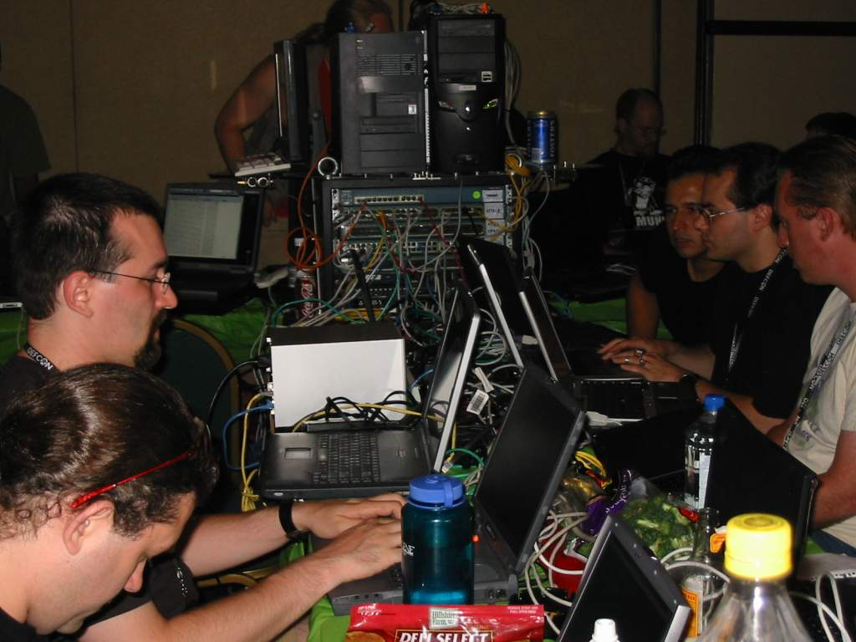
Penetration Test

Slide 11
Network Vulnerability Testing
“The only rules that really matter are these: what a man can do and what a man can't do.”
– Jack Sparrow
ABOUT ASSUMPTIONS:
  We don't want to impact operations, so no DOS, no offensive disabling of IDS/IPS/Firewalls/etc.
Above assumptions impact tests, so other assumptions made. Consider though, that if you find a vuln that'd allow you to bypass IDS/IPS, that such findings cannot be used as mitigations.
Rules of Engagement:
  Consistent with RoE document, we don't perform tests if we think they'll damage/interrupt important work.
  Example: “Damaging” tests turned off in Nessus; SQL injection of production/mission systems; etc
  Notify sysadmins/staff for critical and mission systems of pen-test window, so they can be on hand in case of crashes, etc. (Note: Decreases effectiveness but is a necessary trade-off)
Presentation Title
—<number>—
March 5, 2010

Slide 12
Network Vulnerability Testing
“If you know the enemy and know yourself you need not fear the results of a hundred battles.”
– Sun Tzu
A SUPER BASIC Rundown:
Check hacker boards, look for pre-assessed/exploted center resources
Perform full external scans on center (note whether ops blocks/calls/etc)
Note any exploitable services, etc
Confirm exploitation... by exploiting them.
  (metasploit, backtrack and other tools can be helpful here)
From each exploitable service, perform full internal scans of that network,
Run sniffers on that network to gather information/credentials/etc
Install a 'dummy' host on that nework to download/upload malware:
  Tests for IT Ops responses, exfiltration catch by IDS, reports by sysadmins, etc.
From each exploitable system found above: Lather, rinse, repeat.
Presentation Title
—<number>—
March 5, 2010

Slide 13
Web Vulnerability Testing
“Just cause you got the monkey off your back doesn't mean the circus has left town.”
– George Carlin
During network testing, check out some of the websites your developers have put together. If possible (in scope), get permission to test sites that contractors run on behalf of NASA.
Remember, many systems now considered 'critical' are web systems throughout. An agency can be 'owned' without touching a router or system, if you nail IFMP (for example)
Seen on one contractor system (the login page):
<!-- 0) SQL2K=true CONN=Provider=SQLOLEDB;server=XXX;database=YYY;uid=ZZZ;pwd=ZZZ;SQL=undefined --->
Fuzzers, webapp tests, OWASP. Other testing frameworks are useful here
Consider metasploit ;)
Presentation Title
—<number>—
March 5, 2010

Slide 14
Wireless War Driving / Walking
“I have no special talent. I am only passionately curious.” – Albert Einstein
Is your campus wireless accessible from outside the campus? Have you checked? Can it be cracked?
Drive the campus w/ Laptops equipped with 802.11, antennas if possible.
Record any wireless network NOT authorized by the center.
Shut down if possible!
Bluetooth? Do the same! See what wireless shares are being broadcast (short-range) from inside locked buildings to the outsides of the building, lab, etc.
Look for “hpsetup”, “Free Public Wifi” (a worm), “linksys” and others.
In the future, “MiFi” mobile hotspots in employees' possession are going to become numerous accidental wifi connection points.
TIP: Use a cell w/ GPS enabled to record GPS location of hotspots found.
Presentation Title
—<number>—
March 5, 2010

Slide 15
Phone Network Tests
“I don't answer the phone. I get the feeling whenever I do that there will be someone on the other end.” --Fred Couples
Phones? Yep, we still use 'em.
War-dialing: Using a modem to call every number in your block looking for modems/backdoors
  Best done at night, or employees may get upset
Don't forget VOIP services, Skype IDs, etc
Use CallerID spoofing(Check with legal office) and redirection services (google voice, etc) to try to fool helpdesk staff into revealing information/passwords/etc – or to impersonate helpdesk for others
Presentation Title
—<number>—
March 5, 2010

Slide 16
Social Engineering / Phishing Tests
“"Foolproof systems don't take into account the ingenuity of fools." — Gene Brown.”
Your users are being socially engineered and phished every day!
They are falling for it, pretty regularly.
Send your users a phishing email w/ Remote IP that you monitor
Check which users download the file
Go further! Send them a script to run; the script pings a webserver whose logs you monitor.
Again, see who executes the file.
Place this file on a USB thumb drive named 'Financials', drop the drive in the cafeteria
Start a Facebook group... find people on LinkedIn... etc.
Remedial training needed for employees who respond to phsihing!
TIP: Don't make your phishing email TOO good. Make it semi-obvious, or you'll get into tension with what you're trying to accomplish. Remember, it's not a 'gotcha!' game, it's “This is what to look for our adversaries doing...”
Presentation Title
—<number>—
March 5, 2010

Slide 17
Walk-throughs and Dumpster Diving
“Lack a witty quote here and see if people notice” – Just checking
Goal: See what kind of sensitive information your employees are leaving in:
  recycling/trash
  Printer and copy rooms
  Unlocked file cabinets
  Unattended “archival” areas
Check for unlocked terminals. Check for unlocked but unattended offices w/ sensitive information in them
Look for macguyvered IT setups in labs, offices, etc
Use a cell phone w/ GPS tags in camera (iphone style), or GPS camera to take photos of findings. Will help with mapping problem areas, providing feedback to users.
TIP: If you're stopped and questioned by any employees, take their names (after explaining the situation) and be sure to send positive feedback to their supervisors!
Presentation Title
—<number>—
March 5, 2010

Slide 18

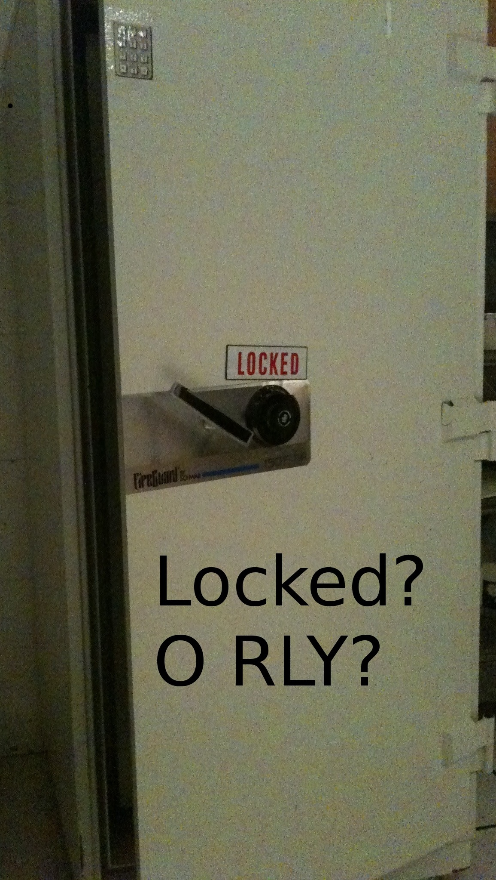
Walk-throughs and Dumpster Diving
Presentation Title
—<number>—
March 5, 2010

Slide 19
Physical security auditing
“Knowledge becomes evil only if the aim be not virtuous. “ -- Plato
Test the efficacy of your physical security controls. These are the controls we take for granted!
Common things to look for:
  Double doors unpinned (pull n' open)
  Door locks w/ no front plate
  Poorly installed door locks
  Digital door locks with default passcodes, or malfunctioning latch
  Removable floors which extend beyond gateway doors
  Ceilings which don't run “all the way”
  Are your badge reader door locks fail-safe... or fail-open?
  Circuit breakers outside sensitive areas?
Remember, the majority of successful security compromises are insiders to the organization!
  “TJX, a retail conglomerate, had 94 million credit card numbers stolen by former employees already familiar with security procedures at the company.
Ensure your team has proper safety training for physical walkthroughs.
Presentation Title
—<number>—
March 5, 2010

Slide 20
Physical Sec: Safety Considerations
“A word to the wise ain't necessary. It's the dumb ones who need the advice!”
    – Bill Cosby
Safety precautions for pen-test team:
Buddy system (minimum of 2 testers)
Have a management “Bosley” for people to contact, and to run confirmation w/ police
Have cell phone or radio contact with team members at all times
Pre-train for safety:
ARC's TEAM: Training required per-position
Pen-test lead: Hazardous Materials, Confined Space, First Aid & CPR
Pen-tester 1: Hazardous Materials
Pen-tester 2: Hazardous Materials
Presentation Title
—<number>—
March 5, 2010

Slide 21
High Level Outputs
Training and awareness
  Birds of a Feather
  Division and Directorate training
Management awareness
  Reports sent to Senior Management and anyone with a need to know.
  Security Posture reports. What is the centers risk posture?
Trends for ARC since inception of program:
  Significant decrease in unlocked terminals
  Increase in reports of Spam & Phishing to Security Office.
  Significant decrease in the amount of Sensitive information being discovered during tests.
  More requests for All-Hands training by the Security Office.
  Significant increase in overall Security Awareness
Presentation Title
—<number>—
March 5, 2010

