Slide 1
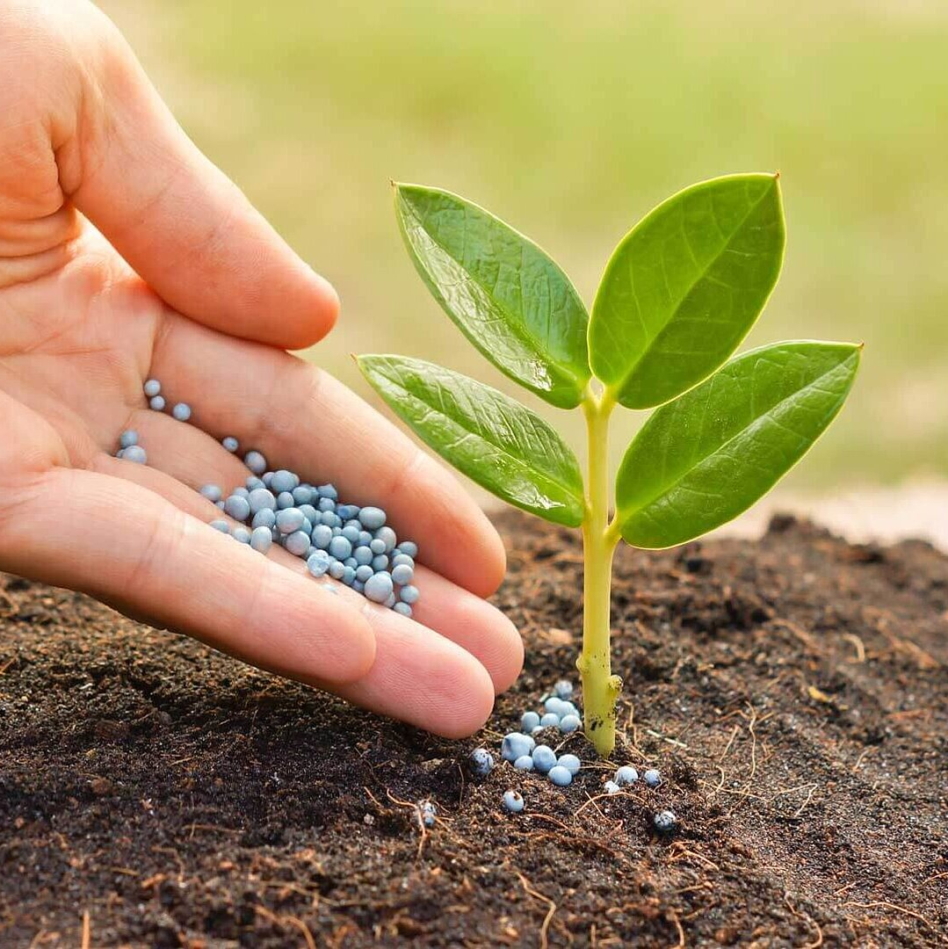
AgriAdvisor
Apoorva Gonegari
Chandana Kolluru
Dheeraj Chetti

Slide 2
Introducing a Greener Tomorrow: Empowering Agriculture with AI
The global population is projected to reach 9.7 billion by 2050, leading to an unprecedented demand for food production.
In today's fast-paced world, agriculture faces an incredible challenge: how to feed a growing global population while conserving resources and minimizing environmental impact.
Imagine a world where every farmer, regardless of their experience, can make informed decisions that boost crop yields, reduce waste, and ensure healthier plants.
Traditional farming methods can be resource-intensive and often lead to unpredictable outcomes. This is where our project steps in.
Welcome to the future of agriculture, where data science and AI are revolutionizing farming practices.

Slide 3
Harnessing the Power of Data
We've scoured vast datasets from United States Department of Agriculture .
We've also tapped into the rich and diverse New Plant Dataset to gather insights into crop health. Diseases
Weather is a critical factor in agriculture. We obtained historical and real-time weather data from meteorological agencies to analyze its impact on crop performance.
Our approach is holistic. It's not just about identifying diseases and suggesting treatments. It's about recognizing the entire ecosystem of farming, where art and science come together to nurture crops, ensure food security, and sustain livelihoods.

Slide 4
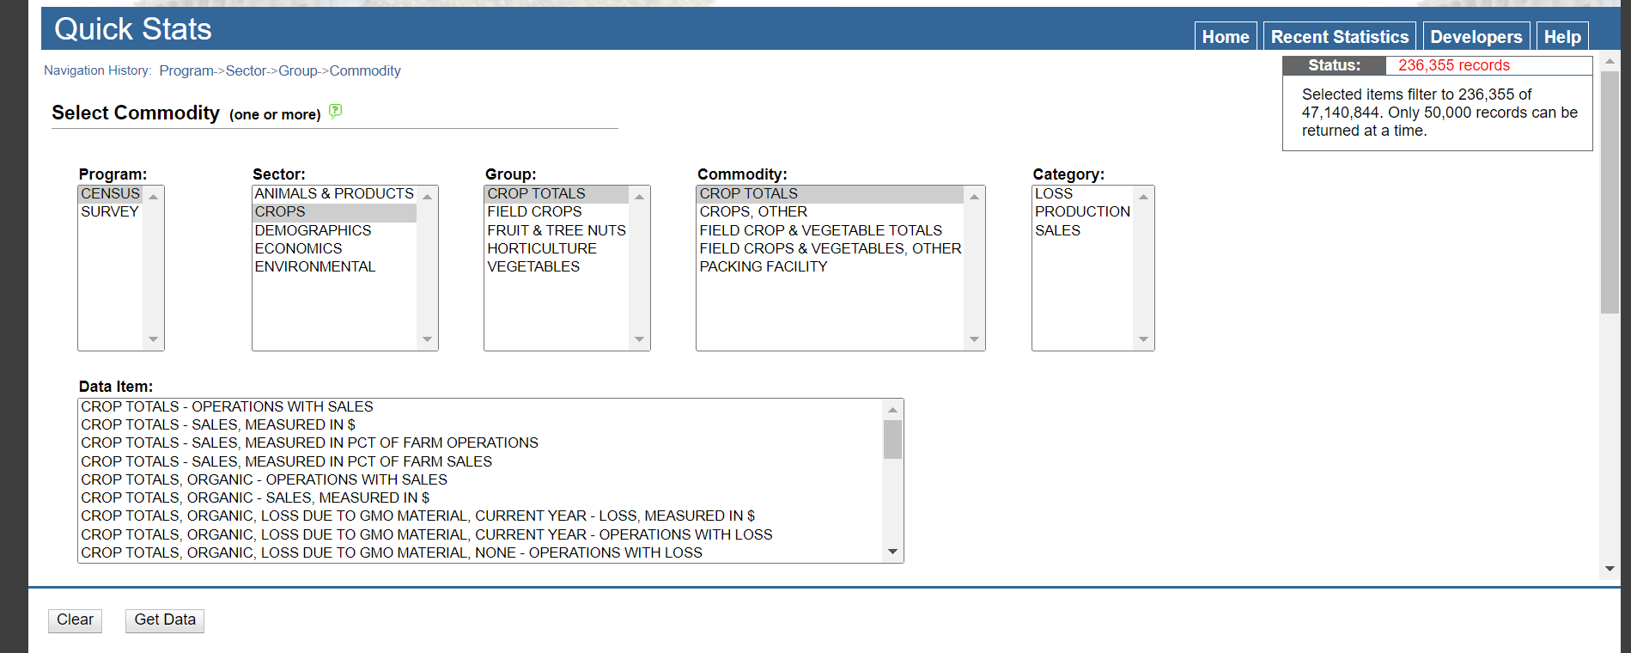
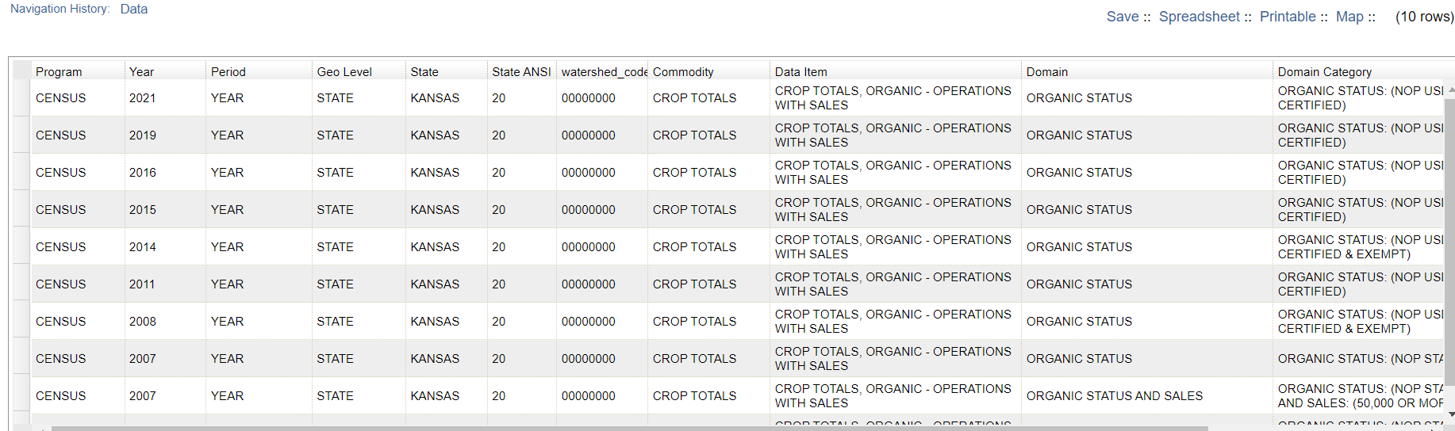

Slide 5
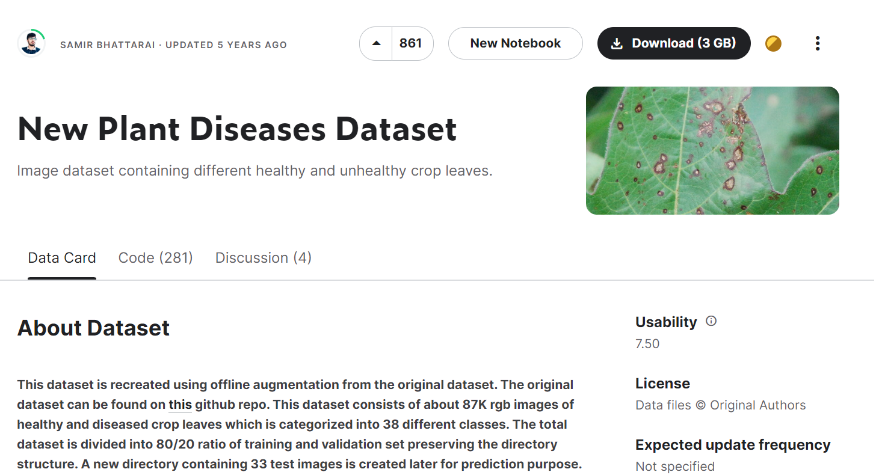

Slide 6
Methodologies
Seamlessly combining agricultural expertise with the precision of data science and AI.
Our approach is a harmonious blend of art and science. On one hand, we harness the power of state-of-the-art technologies like ResNet-9, Support Vector Machines to predict and recommend the crops and fertilizers ,XGBoost to decode plant diseases from images. These cutting-edge techniques allow us to provide accurate and data-driven insights.
Through our advanced algorithms, we extract valuable insights from images of plant leaves. We can identify diseases, assess their severity, and recommend suitable treatments.
These insights are based on rigorous data analysis, ensuring precision and reliability.

Slide 7
ML models
ResNet (Residual Networks):
ResNet is a deep learning architecture that was introduced to address the vanishing gradient problem in very deep neural networks.
It employs a residual learning framework, where instead of learning the desired underlying mapping, it learns the residual mapping.
ResNet is known for its ability to train very deep neural networks effectively, enabling the development of deeper models without the risk of degradation in performance.
Support Vector Machines (SVM):
SVM is a supervised machine learning algorithm used for classification and regression tasks.
It works by finding the hyperplane that best separates the data into different classes in a high-dimensional space.
SVM aims to maximize the margin between different classes, making it a powerful algorithm for handling both linear and non-linear relationships in data.

Slide 8
XGBoost
XGBoost (Extreme Gradient Boosting):
XGBoost is a gradient boosting algorithm that has gained popularity for its high performance and efficiency in various machine learning competitions.
It is an ensemble learning method that combines the predictions from multiple weak learners (typically decision trees) to create a strong predictive model.
XGBoost is known for its regularization techniques, handling missing data, and being able to capture complex relationships in the data.

Slide 9
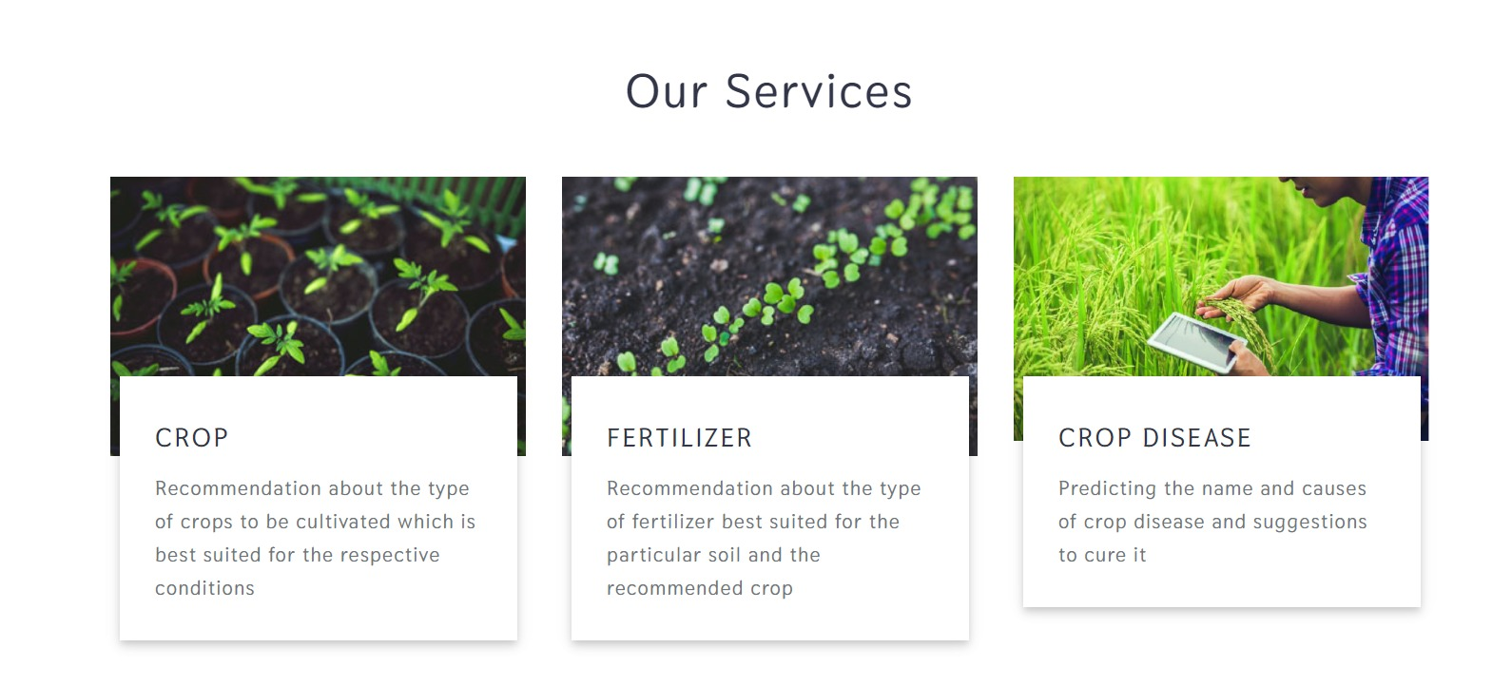
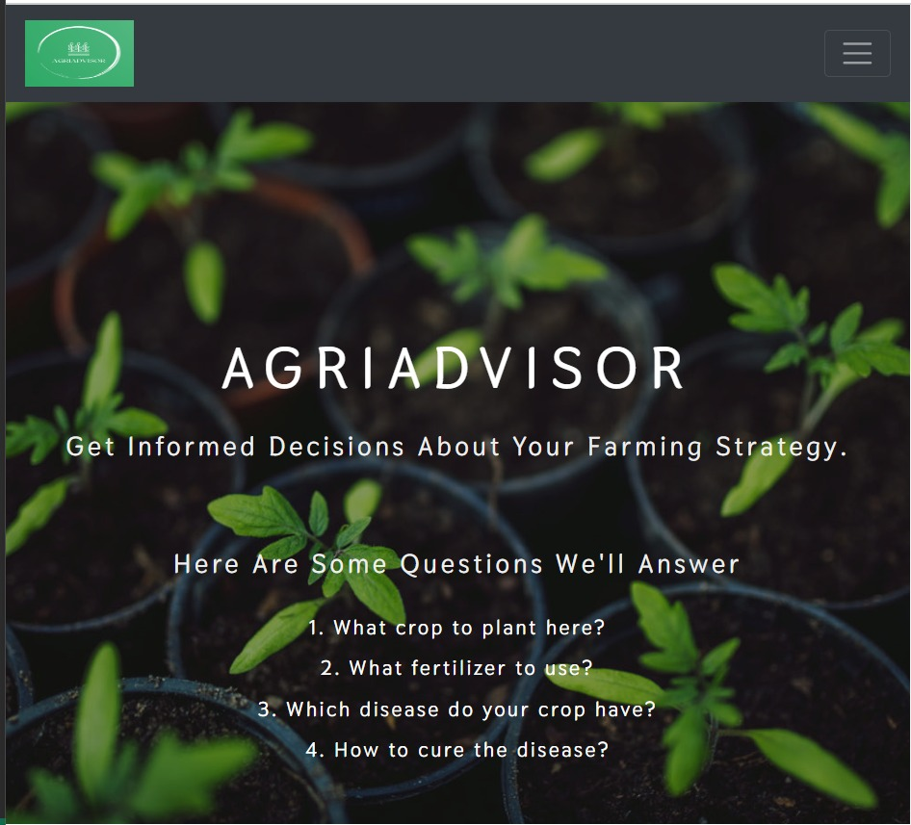
Results

Slide 10
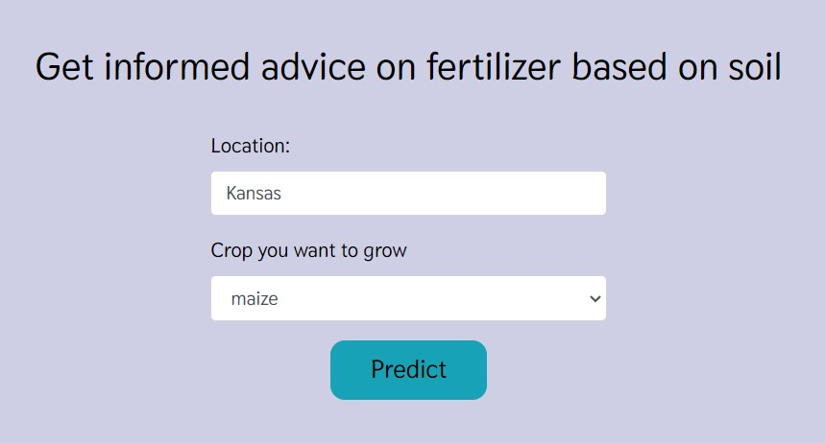
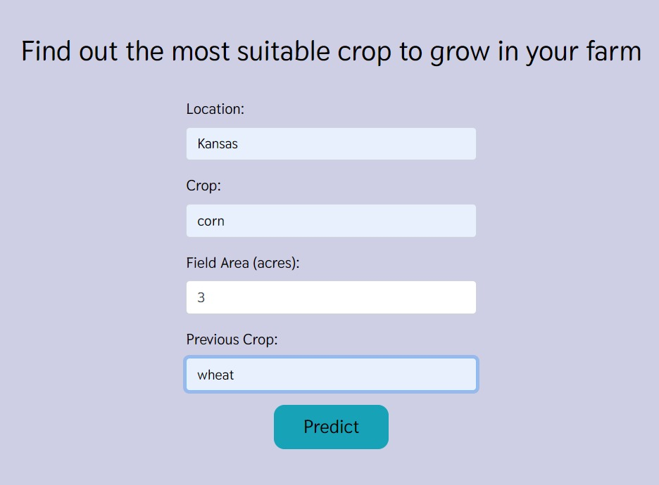
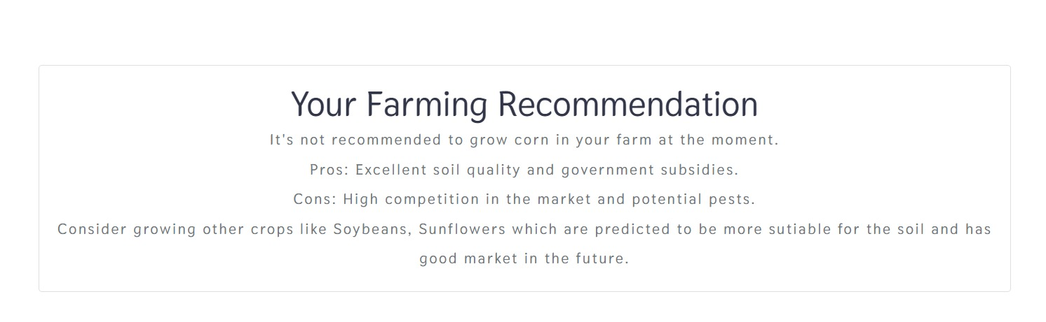
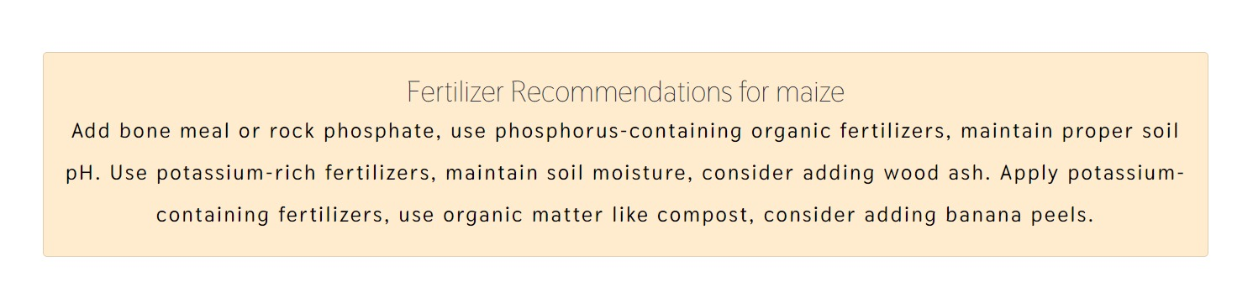

Slide 11
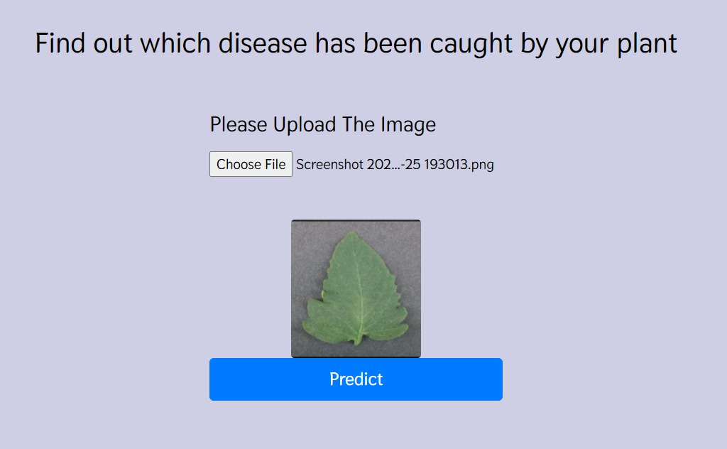
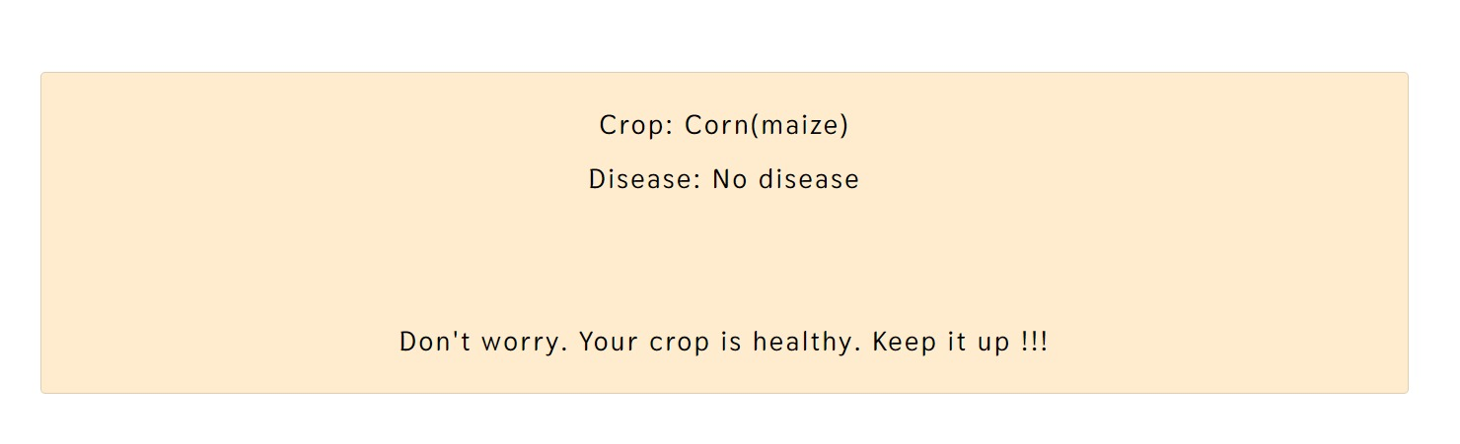
Crop disease prediction and results

Slide 12
What to Expect
Picture this: a farmer inputs their soil data into our system. In seconds, it recommends the best crop for their land. No more guesswork, just science-backed decisions that optimize yield.
Moving on to fertilizer recommendations, our AI considers the crop type and soil conditions. It pinpoints deficiencies or excesses, offering precise suggestions for improvement.
And for the final act, the plant disease prediction application. Farmers upload an image of a diseased plant leaf, and our AI springs into action. It identifies the disease, provides background information, and suggests remedies. It's like having a plant doctor at your fingertips.
Join us on this journey to empower agriculture with AI. Together, we can cultivate a greener, more sustainable future for generations to come. The seeds of change have been sown, and we invite you to be a part of the harvest.

Slide 13
Future Works
Currently, we focus on plant disease prediction and remedies. Our future vision includes proactive disease prediction from plant leaf images.
We plan to expand services to include yield prediction, aiding farmers in making informed decisions about planting and harvesting.
We aim to address waste management, predicting waste quantities and providing sustainable disposal guidance for farming.

Slide 14
Thank you !

