Slide 1
Project NAME Bankruptcy PREVENTION
Project Group 03
Dheeraj Kumar Meesala
Rohit Bharat Gaikwad
Imran Ayyub Khan
Ganesh Deepak Kalambe
Mohan Samdhan Patil
Ganesh Deepak Kalambe
Github Link : Bankruptcy_Prevention

Slide 2
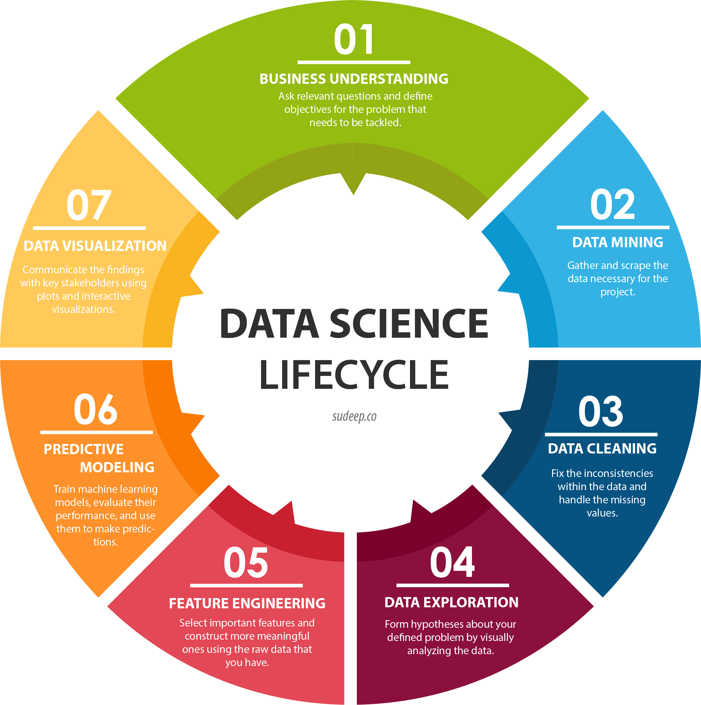
Flow of the project
Import the libraries
Load the dataset
Data Exploration
Descriptive Statistics
Feature Engineering
Explorative Data Analysis
Model Building
Hyperparameter Tuning
Model Validation
Model Deployment
Production

Slide 3
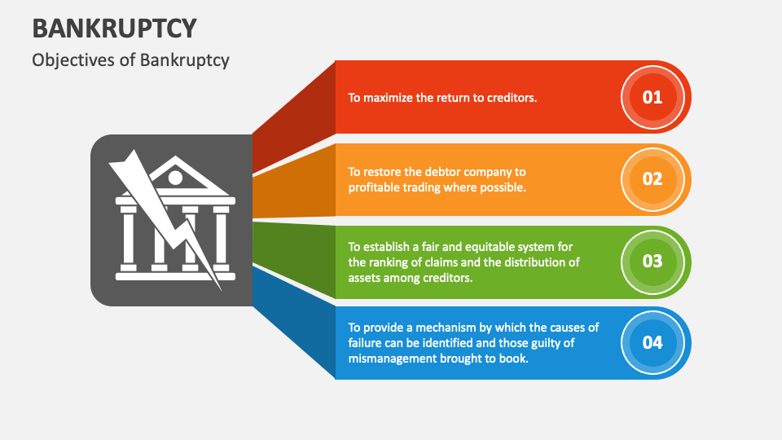
Introduction
Bankruptcy is a legal process through which people or other entities who cannot repay debts to creditors may seek relief from some or all of their debts. In most jurisdictions, bankruptcy is imposed by a court order, often initiated by the debtor.

Slide 4
Business Problem
This is a classification project, since the variable to predict is binary (bankruptcy or non-bankruptcy).
The goal here is to model the probability that a business goes bankrupt from different features
Bankruptcy prediction is the problem of detecting financial distress in businesses which will lead to eventual bankruptcy. Bankruptcy prediction has been studied since at least 1930s. The early models of bankruptcy prediction employed univariate statistical models over financial ratios.

Slide 5
ABOUT DATASET
The data file contains 7 features about 250 companies
Input Variables:
Industrial Risk: 0=low risk, 0.5=medium risk, 1=high risk.
Management Risk: 0=low risk, 0.5=medium risk, 1=high risk.
Financial Flexibility: 0=low flexibility, 0.5=medium flexibility, 1=high flexibility.
Credibility: 0=low credibility, 0.5=medium credibility, 1=high credibility.
Competitiveness: 0=low competitiveness, 0.5=medium competitiveness, 1=high competitiveness.
Operating Risk: 0=low risk, 0.5=medium risk, 1=high risk.
Target Variable:
Class: bankruptcy, non-bankruptcy (target variable).

Slide 6
INSIGHTS:
The data file contains 7 features about 250 companies.
All columns are of numerical datatype.
There are no missing values in the dataset.
There are no null values in the dataset.
There are no duplicates in the given dataset.
Since, there are no categorical features, no transformation techniques are used.
No categorical variables, so there is no point of handling rare categorical variables.
Since there are no continuous variables, outliers will not be present.

Slide 7
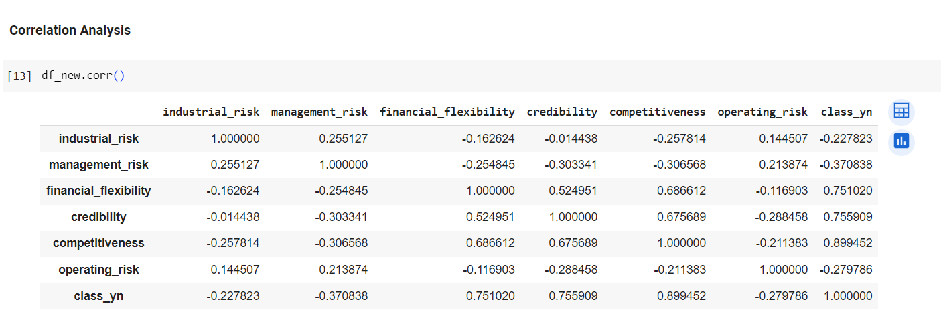
CORRELATION BETWEEN VARIABLES:
We can see that the variables that correlate the most with the target variable negatively correlate. Competitiveness is the variable with the highest correlation
financial_flexibility is highly overall correlated with class_yn.
credibility is highly overall correlated with class_yn.
competitiveness is highly overall correlated with class_yn.

Slide 8
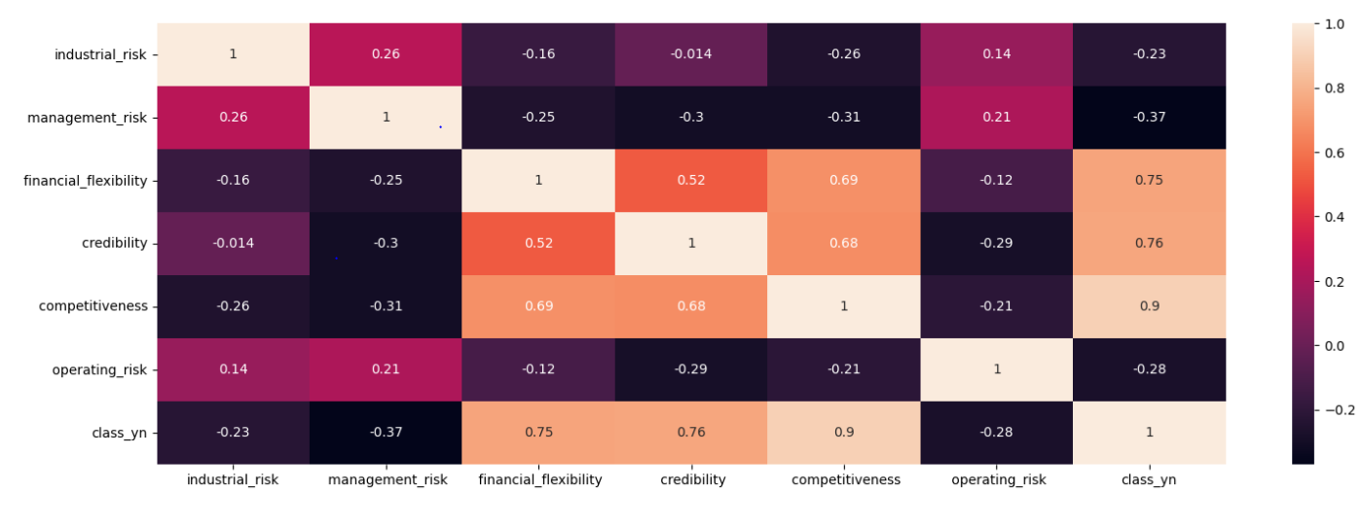
Heatmap below says:
A bank with high credibility may also be highly competitive in the market. This is because a good reputation and trustworthiness con attract customers and investors, enhancing the bank market position.
High credibility often leads to customer trust and loyalty. When customers trust a bank, they are more likely to doing business with it, and this can contribute to the bank's competitiveness.
A credible bank is likely to be financially stable. Financial stability is a key factor in competitiveness as it allows the bank to offer reliable and secure services
A bank with high credibility is more likely to comply with industry regulations and standards. This can enhance its competitiveness, as it is less likely to face legal or regulatory issues.
A company facing high industrial risk may need to implement more sophisticated risk management strategies. This could result in a positive correlation between industrial and management risk

Slide 9
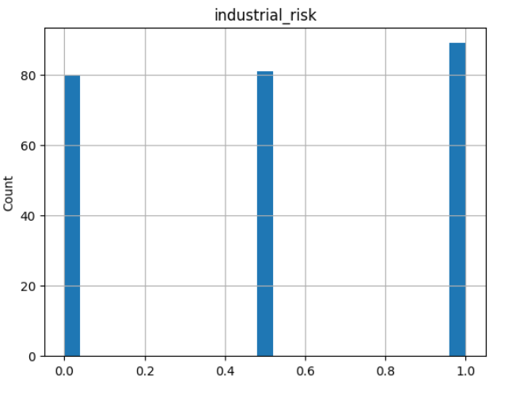
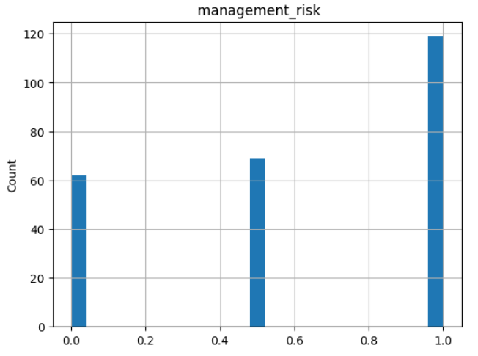
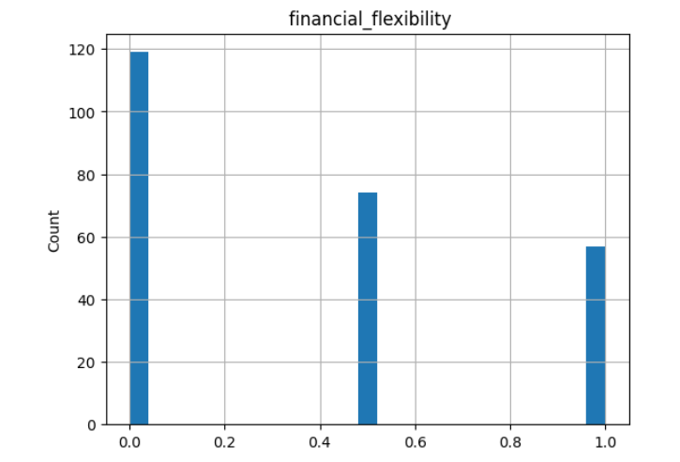
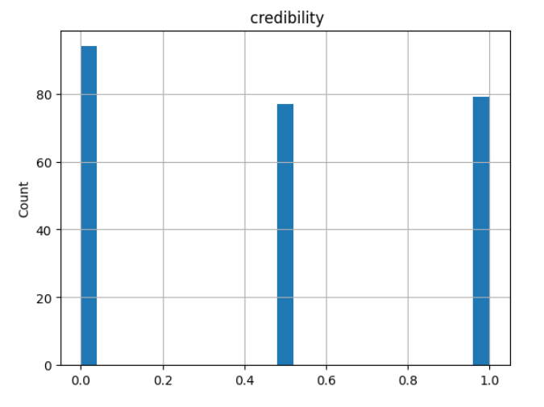
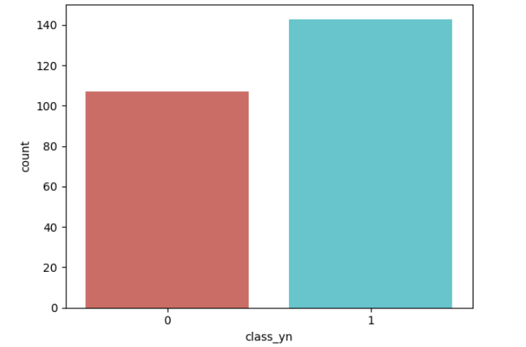
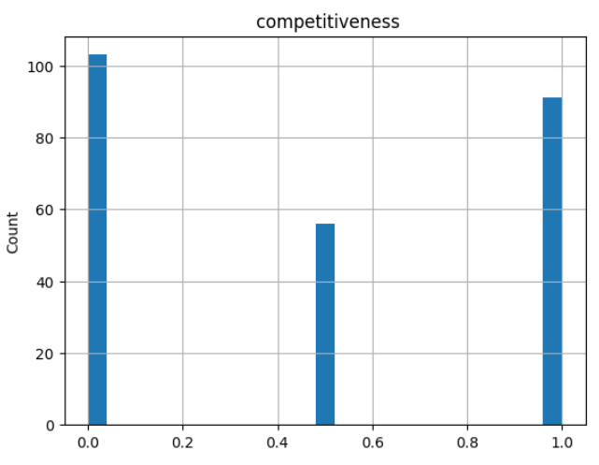
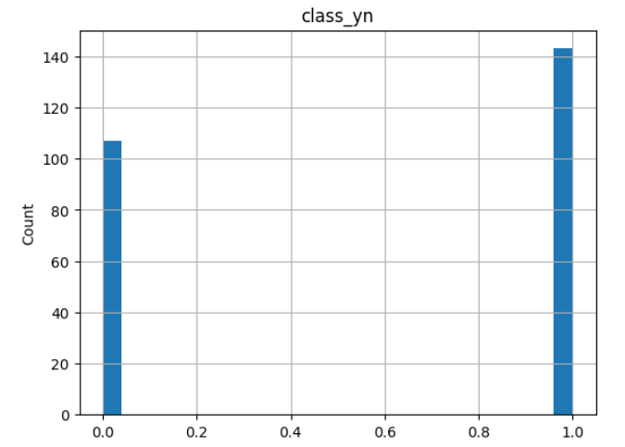
GRAPHICAL REPRESENTATIONS
Distribution of the target variable (class_yn) is done to see if there's an imbalance between classes. This helps in understanding if there are more instances of one class compared to the other.

Slide 10
FEATURE ENGINEERING
Handling Missing Values
Handling Rare Categorical Variables
Feature Transformation:
Standardization
Scaling/ Normalization
Encoding (To convert categorical variables into numerical, if any)
log, sqrt transformations of cont. variables if they are skewed
Handling outliers in continuous variables.
Since we don't have any missing values, categorical variables or continuous numerical data in the given data, feature engineering can be skipped.

Slide 11
MODEL BUILDING
Before, proceeding with model building we should handle the imbalances in our data set, As we saw in EDA part there is clear imbalance in our dataset.
LETS BALANCE OUR DATA SET using one of the following techniques
We can handle imbalanced classes by balancing the classes by increasing minority or decreasing majority.
We can do that by following few techniques:
Random Under-Sampling
Random Over-Sampling
SMOTE - Synthetic Minority Oversampling Technique
ADASYN - Adaptive Synthetic Sampling Method
SMOTETomek - Over-sampling followed by under-sampling
Under sampling tends to loss of data so we will not use that. We will go with one of Random Over-Sampling, SMOTE - Synthetic Minority Oversampling Technique, ADASYN - Adaptive Synthetic Sampling Method and see which technique works better.

Slide 12
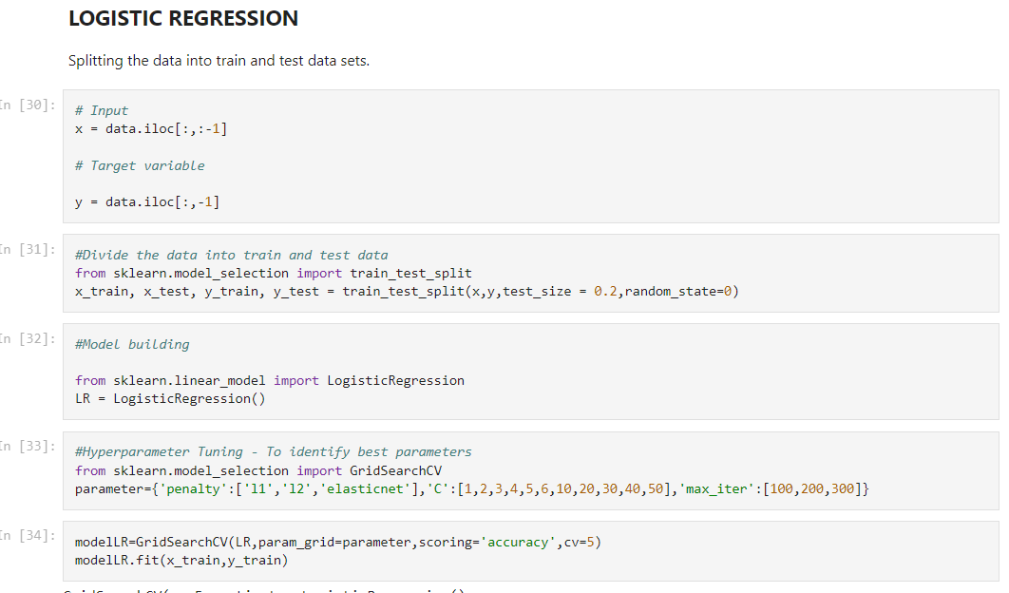
MODELS USED
Since this is a classification project we used 5 different classifiers to build different models:
Logistic Classifier
KNN Classifier
Decision Tree Classifier
Random Forest Classifier
Support Vector Machines
Codes of Different Classifiers:
Logistic Classifier:

Slide 13
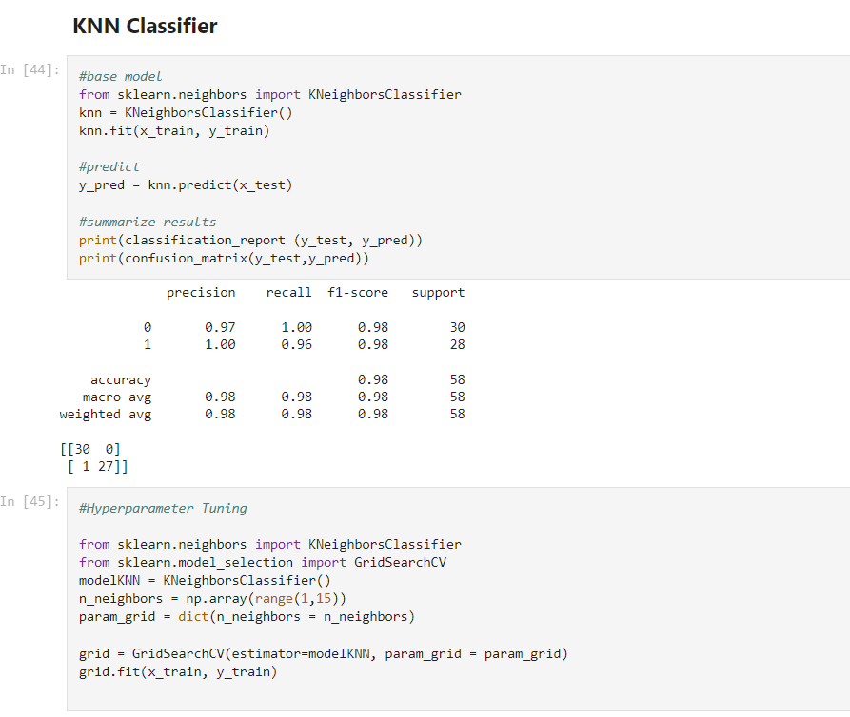
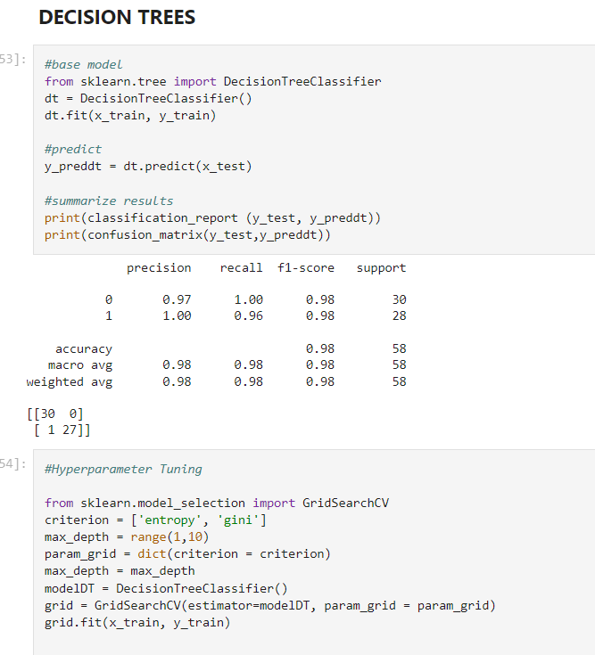
KNN Classifier
Decision Trees

Slide 14
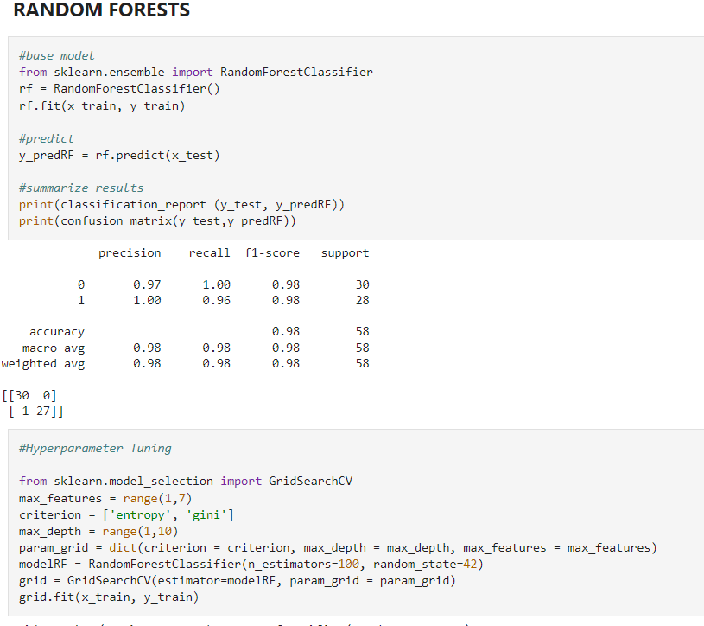
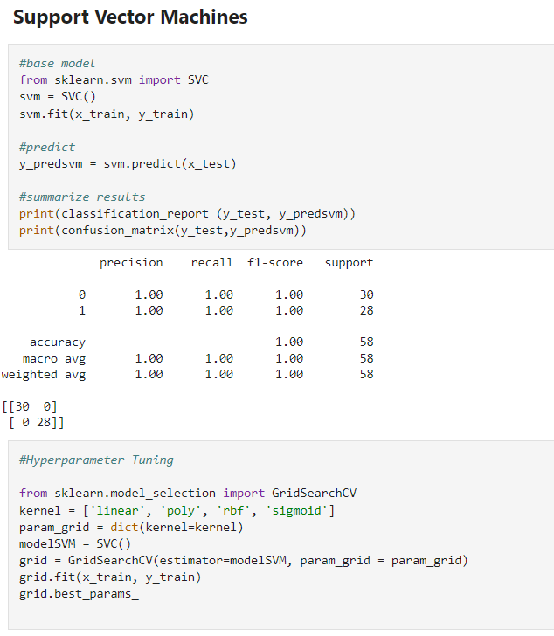
Random Forest Classifier:
Support Vector Machines

Slide 15
MODEL VALIDATION
MODEL EVALUATION:
Cross-validation is a statistical method used to estimate the skill of machine learning models.
It is commonly used in applied machine learning to compare and select a model for a given predictive modeling problem because it is easy to understand, easy to implement, and results in skill estimates that generally have a lower bias than other methods.
K Fold Cross Validation:
K-fold cross-validation is to evaluate the model design, not a particular training. Because you re-trained the model of the same design with different training sets.
The general procedure is as follows:
Shuffle the dataset randomly.
Split the dataset into k groups
For each unique group:
Take the group as a hold out or test data set
Take the remaining groups as a training data set
Fit a model on the training set and evaluate it on the test set
Retrain the evaluation score and discard the model
Summarize the skill of the model using the sample of model evaluation scores.

Slide 16
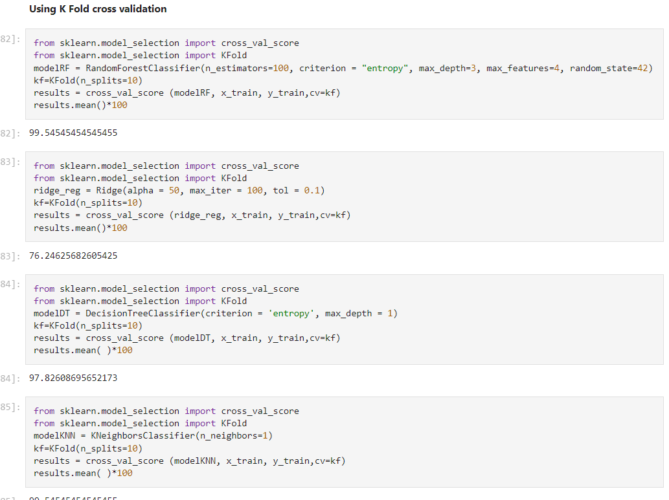
CODE USED FOR K FOLD CROSS VALIDATION

Slide 17
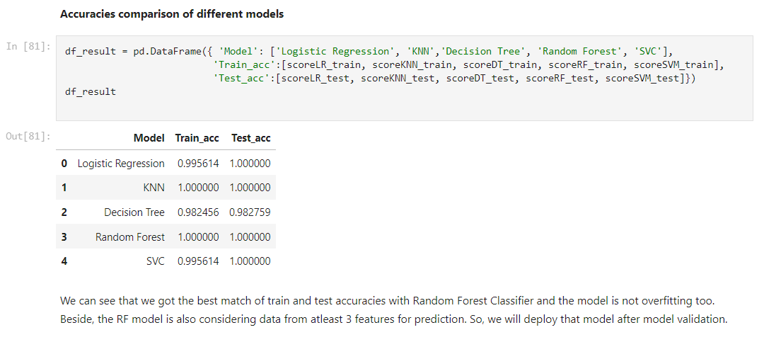
ACCURACIES OF DIFFERENT MODELS
We can see that we got the best match of train and test accuracies with Random Forest Classifier and the model is not overfitting too.
Besides, the RF model is also considering data from at least 3 features for prediction. So, we will deploy the Random Forest Classifier model after model validation.

Slide 18
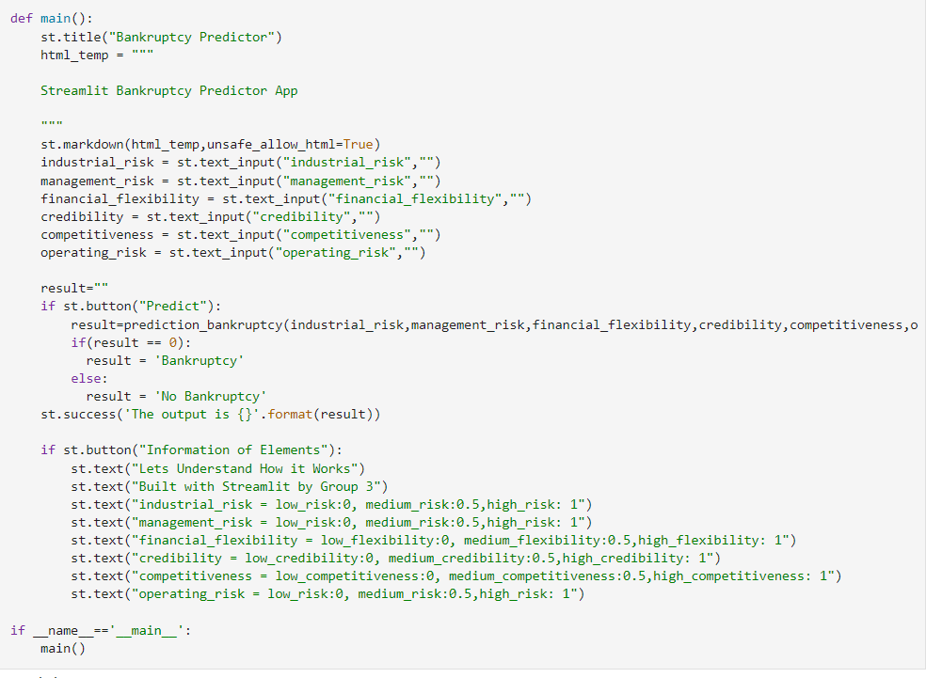
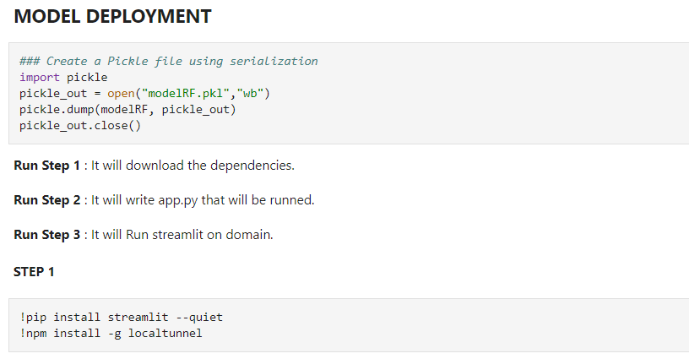
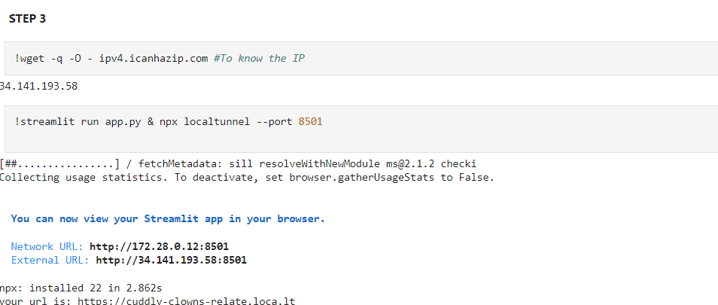
MODEL DEPLOYMENT
Create a Pickle file using serialization to store the model
Install Streamlit framework and local tunnel in google colab.
Write an app development code using Python and HTML.
Run the app and you will get an URL to your streamlit app
where the model is deployed and ready for production.
The code is written as follows:

Slide 19
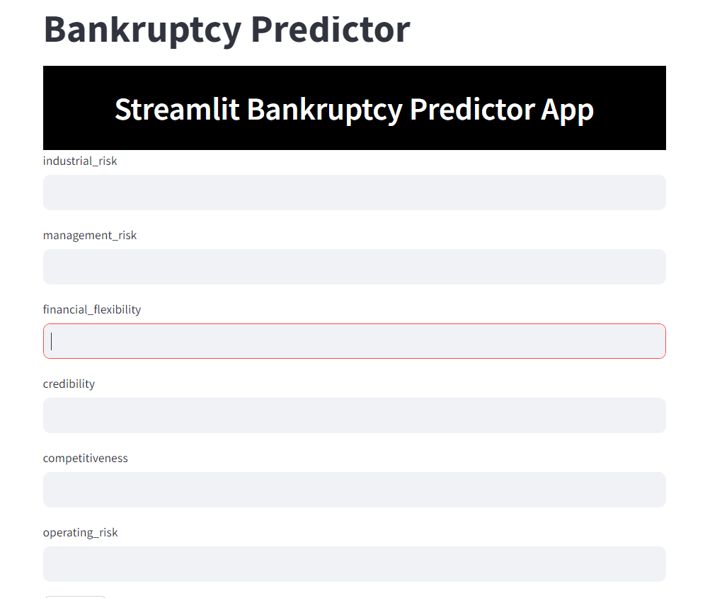
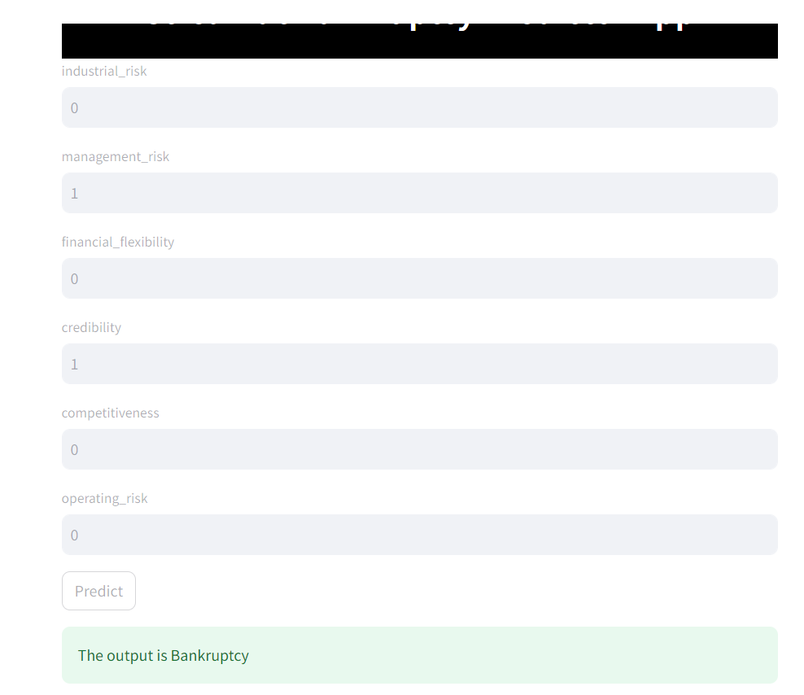

Slide 20
Real Life applications:
Bankruptcy predictions are classification problems that entail the prediction of the likelihood of failure of a company, given a number of financial ratio shaping to its status.
In number of such studies, neural networks have been used and tested against traditional classification methods such as discriminant analysis, logistic regression, probit analysis, decision trees, k-nearest neighbour and case based reasoning.
Bankruptcy prediction model detects financial distress in businesses which will lead to eventual bankruptcy which will allow the officials to work on factors causing bankruptcy.
First, companies using bankruptcy prediction models need to take these financial and other aspects into account when building and applying prediction models to minimize the misclassification costs and maximize the saved costs.
Second, when the number of employees is used as an additional evaluation criterion, ML models could provide a specific focus on large companies whose bankruptcies could have serious (socio-economic) consequences due to company size, number of employees, or related measures of company relevance from an economic perspective.

Slide 21


