Slide 1
INTERNSHIP PROJECT | AEROLOGISTICS
Project Overheat: Predictive Maintenance AI
Predicting motor failures 24 hours before they happen
Dheeraj | Data Science Division | Oct 2026

Slide 2
1. Project problem statement
AeroLogistics sorting robots depend on drive motors that overheat and fail without warning. Each failure stops the warehouse and costs $50,000 per minute.
Task: use IoT sensor data to predict a motor failure at least 24 hours in advance, so maintenance can move from reactive to proactive.
$50,000
lost per minute of downtime
10,000
hours of sensor logs
15
motor failures in the data
Notes:
The problem: unplanned motor failures. The goal: a 24 hour early warning.

Slide 3



The data: three sensors, hourly
Temperature
Sensor_Temp_C
Normal around 65 °C; climbs past 100 °C before failure
Vibration
Sensor_Vibration_mm
Normal around 1.2 mm; rises to 8+ mm before failure
Voltage
Sensor_Voltage_V
Stays near 220 V with minor dips
Plus Catastrophic_Failure flag (1 = motor failed that hour). Only 0.15% of rows are failures.

Slide 4
2. Project solution: five steps
1
2
3
4
5
Rolling windows
Shift target
Chronological split
Balanced forest
Explain
12h mean of temp, 12h std of vibration
Move label back 24 rows
First 80% train, last 20% test
Random Forest, class_weight balanced
Feature importances for mechanics
Shuffling rows would let the model learn from the future, so the split is strictly by time.

Slide 5
Tools and methods used
Python
Pandas
NumPy
scikit-learn
Matplotlib
Seaborn
Jupyter / Colab
Rolling mean and rolling standard deviation (12-hour windows) to capture sustained heat and shaking
Target shifting with .shift(-24) so each row predicts the future
Chronological 80/20 split with .iloc, no random shuffling
Random Forest with class_weight='balanced' for rare failures
Feature importance for explainable results

Slide 6
Sensors ramp up before a failure
+50 °C
above the 65 °C norm in the last day
7x
vibration vs the 1.2 mm norm

Slide 7
One tweak made the target learnable
Exact 24h shift
One positive hour per failure. Only 3 in the test set, recall 67%.
24h warning window
Positive if a failure happens in the next 24 hours. 72 test positives, recall 100%.

Slide 8
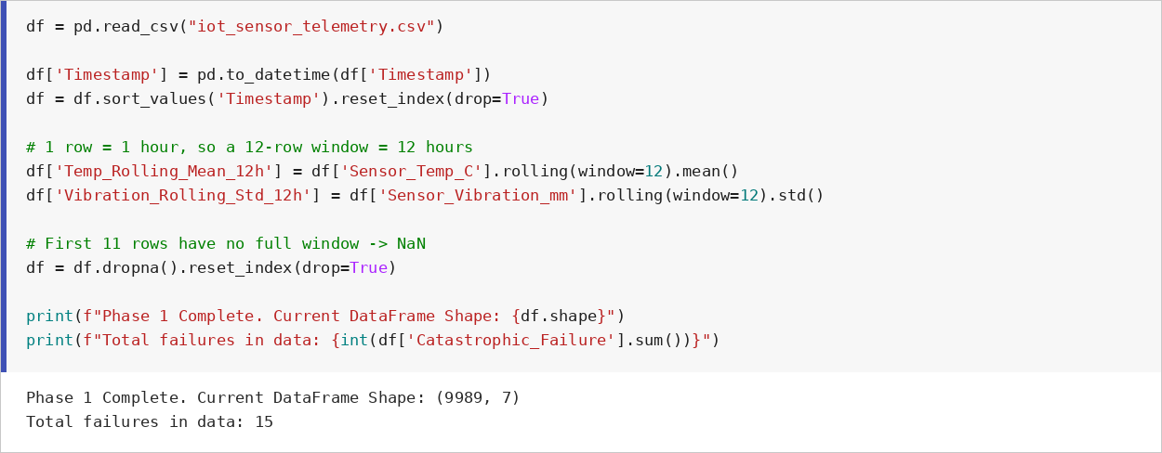
3. Screenshots: feature engineering
Rolling 12-hour mean (temperature) and standard deviation (vibration); NaN rows dropped. Output: 9,989 rows, 15 failures.

Slide 9
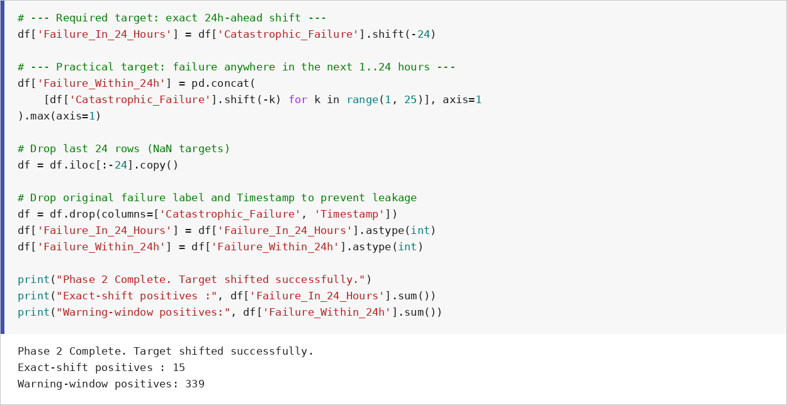
Screenshots: target shifting
Label shifted 24 hours back, last 24 rows dropped, failure and timestamp columns removed to prevent leakage.

Slide 10
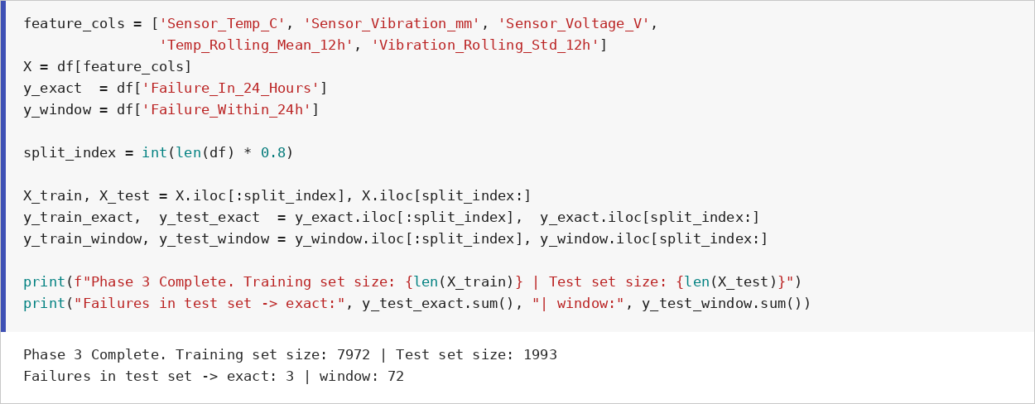
Screenshots: chronological split
First 80% of the timeline trains (7,972 rows), last 20% tests (1,993 rows). No shuffling.

Slide 11
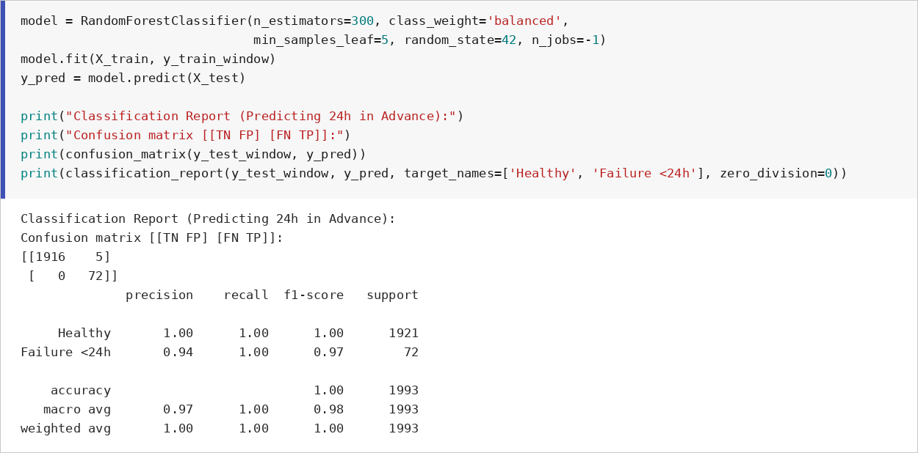
Screenshots: model and output
Random Forest with balanced class weights. Recall 1.00 and precision 0.94 for failures within 24 hours.

Slide 12
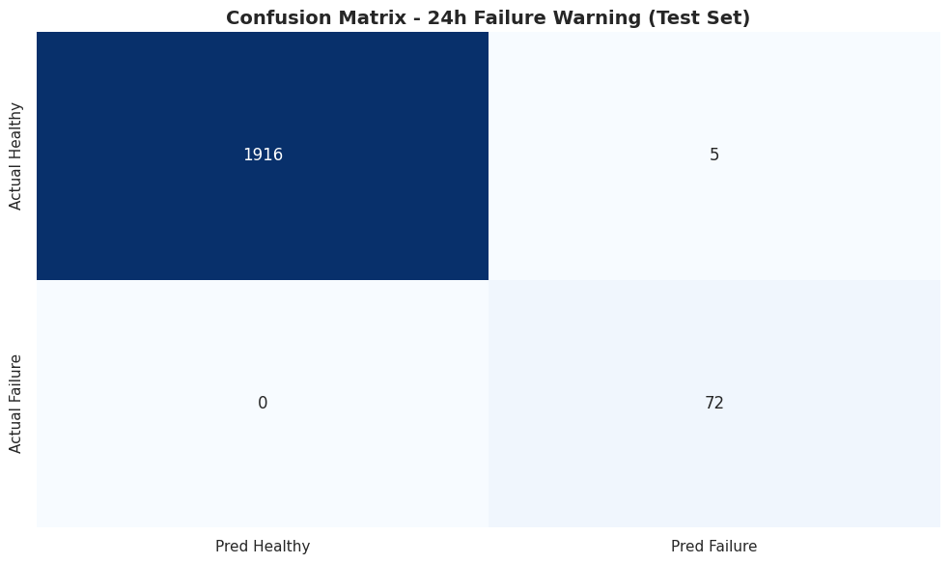
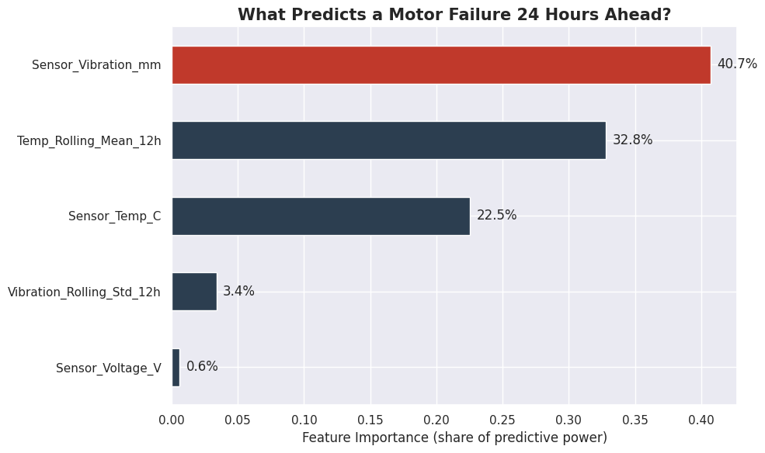
Screenshots: final output charts
Confusion matrix: 72 of 72 failures caught, 5 false alarms.
Feature importance: vibration (41%) and 12h average temperature (33%) lead; voltage is 0.6%.

Slide 13
4. Project report
Problem
Motor failures cost $50,000 per minute and happen without warning.
Solution
Rolling-window features, a 24-hour shifted target, a chronological split and a balanced Random Forest.
Result
On the held-out final 20%: recall 100%, precision 94%, 0 missed failures, 5 false alarms.
Insight
Vibration and 12-hour average temperature are the leading indicators; voltage is not.
Limit
Only 15 failures in the data, so the model should be re-validated as more data arrives.

Slide 14
Recommendation
1
Deploy as a pilot
Raise a maintenance ticket whenever a motor is flagged.
2
Schedule smart
Repair in the next off-peak window, before the 24h horizon ends.
3
Monitor vibration + temperature
They carry nearly all of the predictive signal.
4
Re-validate with more data
Only 15 failures so far; retrain as more are logged.

