Slide 1


FOOTBALL MATCH RESULTS PREDICTOR
AMD
Dheeraj Parkash
Muhammad Ahmed
Alireza Foroutan

Slide 2
Introduction
Data-driven prediction of football match outcomes and championship results using machine learning.
Meticulous handling of data, cleaning inconsistencies, and merging datasets into a unified "rera" dataset.
Regression models are fine-tuned and evaluated using confusion matrices.
championship cup simulations, covering both group and knockout stages, with detailed understanding of tournament structure, point systems and match outcomes.

Slide 3
Data Preparation
Dataset Exploration
FIFA Rankings (1992-2023) and International Football Results (1872-2023) provide a global football overview, facilitating a detailed analysis of international competitiveness with key attributes in the ranking dataset and historical perspectives from 45,315 matches in the results dataset.

Slide 4
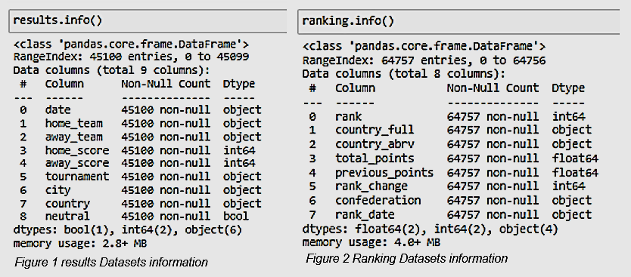
Data Preparation
Dataset Exploration

Slide 5
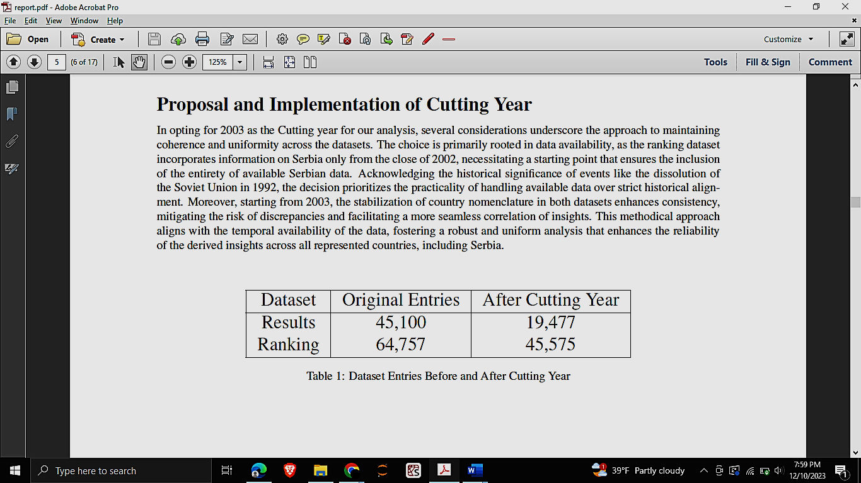
Cutting Year Selection
Uniformity in datasets was achieved by adopting 2003 as the cutoff year. Emphasis on practicality and consistency in country nomenclature from 2003, while acknowledging historical events.

Slide 6
Country Name Standardization
Addressed dataset inconsistencies through mapping, rectifying duplications for consistent country name representation. Following standardization, additional filtering of 'FIFA World Cup' matches in the 'results' dataset resulted in hundreds of entries, showcasing a commitment to data integrity and ensuring robust analyses with uniform datasets.

Slide 7
Data Resampling
To integrate ranking data seamlessly into the results database, the process involved resampling the ranking dataset daily to address asynchronous data collection. Employing Pandas' capabilities, the upsampled ranking data was strategically filled using the 'ffill' method, ensuring continuity in the time series. The filtered data included only countries present in both datasets with 500k entries, ensuring coherence and completeness for subsequent analyses.

Slide 8
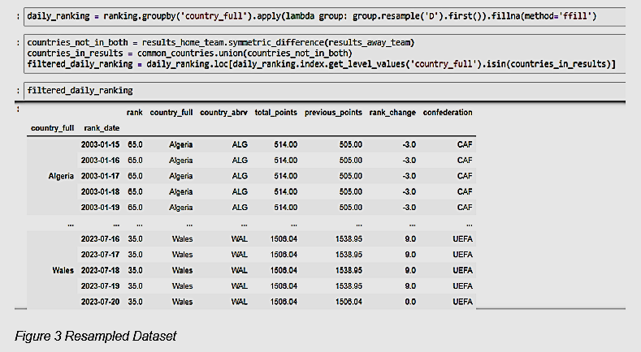
Data Resampling

Slide 9
Merging
Integrated ranking data into the results dataset to form the 'rera' DataFrame, associating each result row with corresponding ranking data columns. The resulting DataFrame, comprising 17 columns, serves as a consolidated foundation for subsequent analyses and model training.

Slide 10
Feature Enhancement
Proposed Features
Goals in Last 5 Matches: Computes a team's average goals in their last five matches, offering insights into offensive performance.
Avg. Points in Last 5 Matches: Calculates a team's recent overall performance through the average points in the last five matches.
Rank Increase Last 5 Matches: Calculates each team's FIFA ranking changes over their last five matches, providing insights into recent competitiveness and ranking dynamics.
Avg. Points in Last 5 Direct Matches: Assesses a team's average points in their last five direct matches with a specific opponent, providing insights into historical performance.

Slide 11
Correlation Analysis
Correlation analysis reveals strong positive correlations (e.g., 'total points home' and previous points home) and robust negative correlations (e.g., rank home with total and previous points home). To address multicollinearity, only one feature from each negatively correlated pair is retained. Intriguing correlations warrant further exploration, though relationships with target variables (home score and away score) are relatively weak, indicating limited linear relationships.

Slide 12
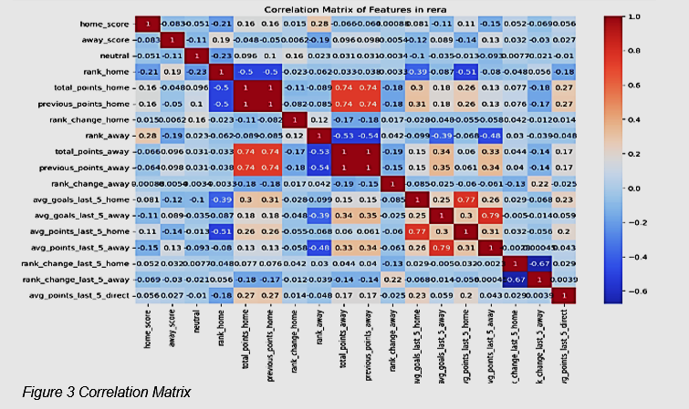
Correlation Analysis

Slide 13
Predictor
Data preparation for model training: Handling missing using data SimpleImputer and scaling features.
Model construction, training, hyperparameter tuning and analysis.
Logistic Regression
Random Forest Classifier
Neural Network (MLP)
Championship

Slide 14
Model Building
Import the refined data from the rera file
Strategically eliminate irrelevant columns like 'Unnamed: 0,' 'date,' 'home_team,' and 'away_team'
Tailor the dataset to meet specific analysis requirements for improved operational efficiency
Use scikit-learn's SimpleImputer to systematically fill missing values in numerical columns with their means during model training.
This technique imputes missing values to maintain overall dataset consistency, ensuring accurate model training and evaluation

Slide 15
Model Building - Logistic Regression
Used the preprocessed data of rera file for model training and testing.
Chose logistic regression for its effectiveness in classification
Implemented logistic regression using scikit-learn's Logistic Regression class
Specified parameters:multi_class='multinomial', solver='lbfgs', random_state=42
used SimpleImputer to handle missing values
Utilized StandardScaler to standardize features
Logistic regression gives 85% accuracy
Evaluated model accuracy using accuracy_score function from scikit-learn
By Comparing predicted values against actual target values in the test set

Slide 16
Machine Learning Pipeline, GridSearchCV and Serialization
Implemented Pipelines for seamless data preprocessing, model training, and evaluation
Pipelines accommodate both classification and regression tasks, showcasing versatility
Used GridSearchCV to optimize model configurations by systematically exploring hyperparameter combinations.
To improve the scalability and reproducibility of machine learning projects, models are serialized using joblib, facilitating efficient storage and retrieval.

Slide 17
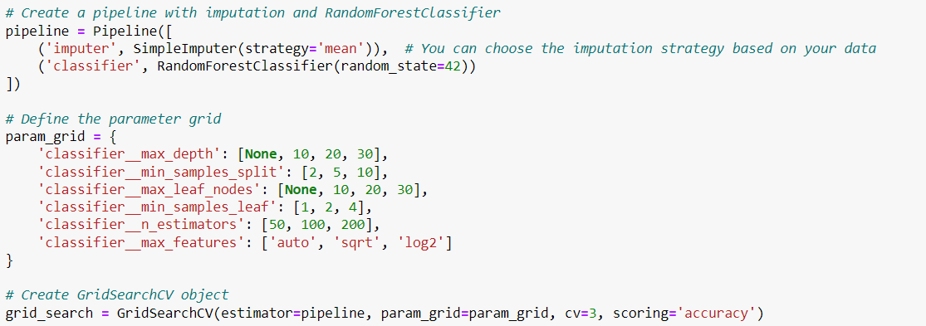
Machine Learning Pipeline and GridSearchCV

Slide 18
Random Forest Classifier
Implemented RandomForestClassifier with random hyperparameters (e.g., n_estimators, max_depth, min_samples_split)
Obtained 89% accuracy on the data
Noted good precision and recall for classes 1 and 2
Observed lower f1 score for class 0
Results indicate promising outcomes with random parameter configurations

Slide 19
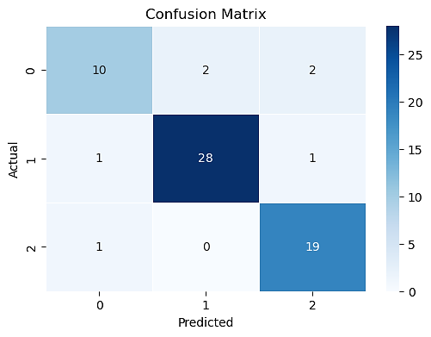

Slide 20
Hyperparameter Tuning
Conducted Hyperparameter Tuning for the RandomForestClassifier using GridSearchCV
Constructed a pipeline with critical preprocessing steps, including imputation and scaling
Defined a parameter grid for systematic exploration of hyperparameter combinations
Fitted the GridSearchCV to the training data to identify the set of hyperparameters maximizing accuracy
Extracted the best hyperparameters and Trained the model.
Made predictions on the test set using the optimized model
Best Hyperparameters:
'max_depth': None, 'max_features': 'sqrt','max_leaf_nodes': 30
'min_samples_leaf': 1, 'min_samples_split': 5, 'n_estimators': 100

Slide 21
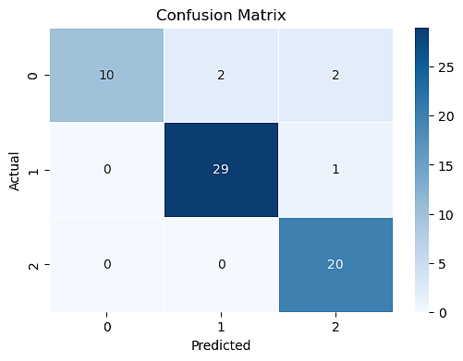
Achieved model accuracy of 92.2% with best-tuned parameters from GridSearchCV
Precision, recall, and F1-score metrics indicate excellent performance across all

Slide 22
Neural Network Regressor (MLP)
Created pipeline to train MLPRegressor using a GridSearchCV for hyperparameter tuning
Pipeline includes StandardScaler for feature scaling, SimpleImputer for handling missing values, and MLPRegressor for regression tasks
The best model, identified with ‘tanh’ activation, alpha of ‘0.01’, and a hidden layer size of ‘(50,)’, achieved an accuracy of approximately 41.98%.
Classification report and confusion matrix reveal challenges in predicting class labels, especially for classes 0 and 2
Model shows low precision, recall, and F1-score for each class, indicating difficulty in distinguishing between different outcomes

Slide 23
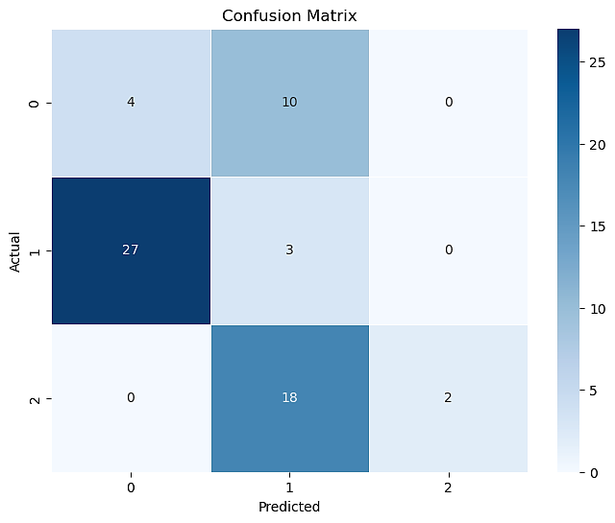

Slide 24
Methodology
In our project, we start with the initial loading and examination of the two datasets. The analysis includes addressing issues with country names and implementing essential data preprocessing steps, such as feature removal, imputation, and scaling. Subsequently, we train Logistic Regression, Random Forest Classifier, and MLP Regressor models.
The promising results obtained from hyperparameter tuning using GridSearchCV contribute to the effectiveness of our models.

Slide 25
Championship
The "Run Championship" code is like a well-organized toolbox where each function does a specific job, making it easy to understand. It also saves important data for later use. The main function, runChampionship, smoothly manages the entire championship tournament.
First, it sets up everything needed for the tournament, like creating files and folders for group stage matches.
Then, as the tournament goes on, the function handles group stage matches and keeps track of points. Later, it goes through a loop four times to simulate knockout rounds. In each loop, it creates folders and files for knockouts, schedules matches, plays them, and updates the points table for that stage.
The code finishes by figuring out which team wins the tournament. This way of organizing the code makes it easy to read but also allows for simple maintenance and customization.

Slide 26
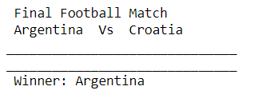

Slide 27
Results and Discussion
Moving on to the results and discussion, we highlight the impressive performance of our models. Logistic regression achieves 85% accuracy, Random Forest reaches 92% after hyper-parameter tuning, and the Neural Network has 41%, despite challenges, it demonstrates predictive capabilities. We picked up the randomForest Classifier to run the championship. In the End Model serialization makes it easy to deploy and running championships.

Slide 28
Thank you😊
Q&A?

