Slide 1
A hybrid unsupervised GenCompareSum
summarization method
Dheeraj Parmar | 20190802113

Slide 2
Introduction
Limitations for transformers are restricted number of tokens & the computational cost of fine tuning the mechanism in transformers.

Slide 3
Working & Methods
Hybrid abstractive-extractive model, which makes use of transformer-based architectures but is extendable to any document length.

Slide 4
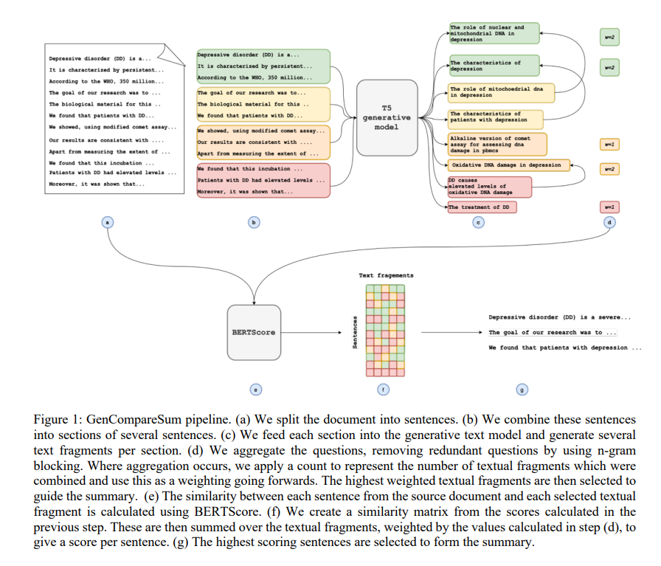

Slide 5
Working in Detail
Text Splitting
T5 sequence-to-sequence model uses enc-dec arch.
Textual Fragment Gen
Worked on docTTTTTquery and t5-s2orc-title.
N-Gram Blocking
Reduce redundancy and improve coverage.

Slide 6
Experiments
PubMed
CORD-19
S2ORC
ArXiv
We Implement GenCompareSum and compare the performance between using different generative text models: docTTTTTquery, t5-med-query, and t5-s2orc-title.

Slide 7
Experimental Results
Varies for short and long documents & best fit is t5-s2orc-title but LexRank also gave competitive performance.

Slide 8
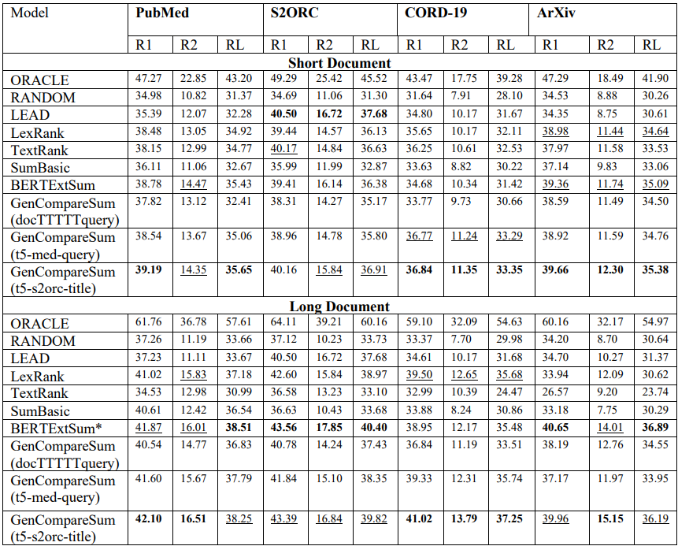

Slide 9
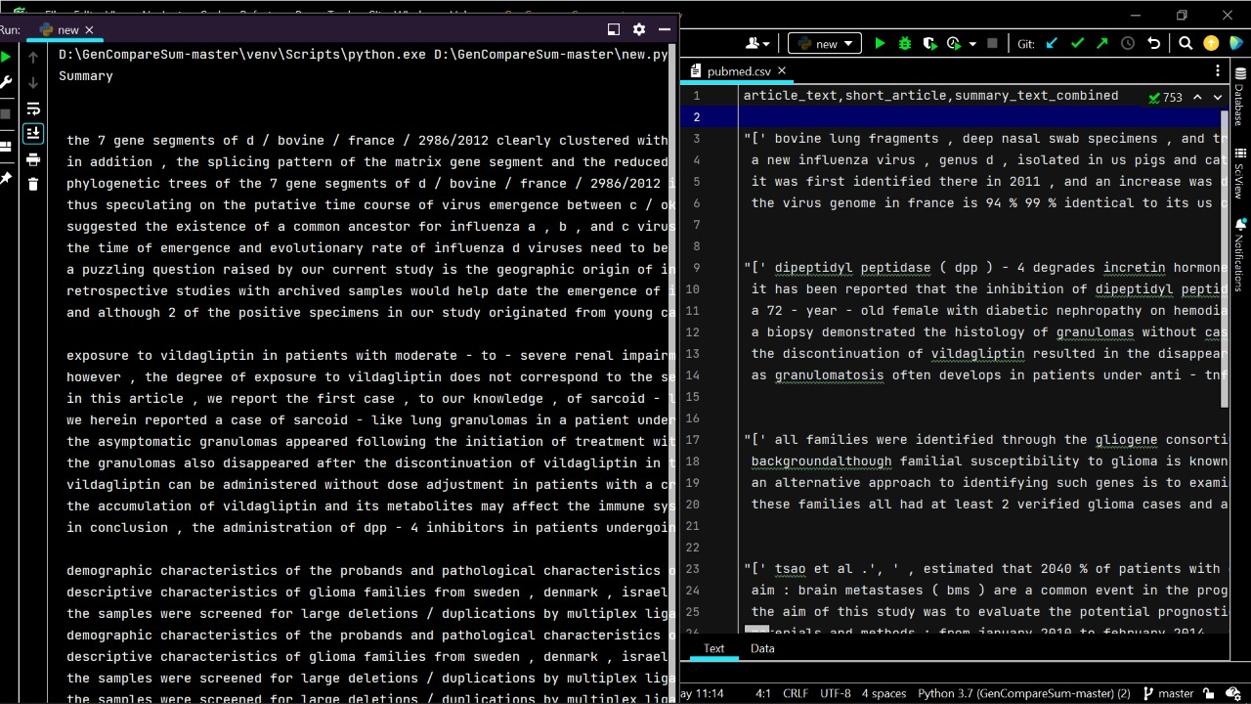
Summary
Text

Slide 10
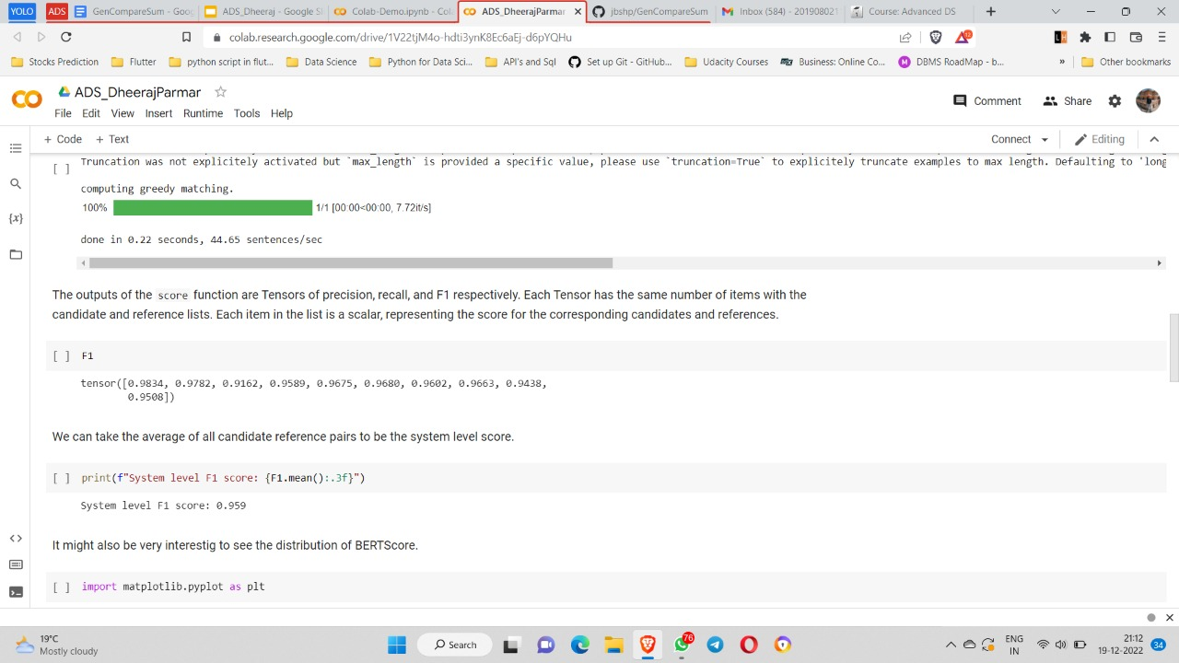
Here, we get the Precision, Recall and the F1 Score by using BertScore

Slide 11
Conclusion
We propose a hybrid, unsupervised, abstractive-extractive approach & compare the performance between long and short documents using different generative text models. We showed that our hybrid approach outperforms existing unsupervised methods, as well as state-of-the-art supervised methods, despite not needing a vast amount of labeled training data.

Slide 12
Thank You

Slide 13
Any Questions?

