Slide 1
19ECE498- PROJECT PHASE I
RTL Design and ASIC Synthesis of a 4-Channel Digital Beamforming Processor in 45nm CMOS
TEAM MEMBERS: B018
REG. NO. NAME
BL.EN.U4ECE23101 A ADHARSH
BL.EN.U4ECE23147 SURYA NARAYANAN RAMAKRISHNAN
BL.EN.U4ECE23240 RISHABH S BHAT
Name of the Guide: Mr. Vignesh
Evaluators:
Dr. Ashish Goswami
Mr. Swaminathan R

Slide 2
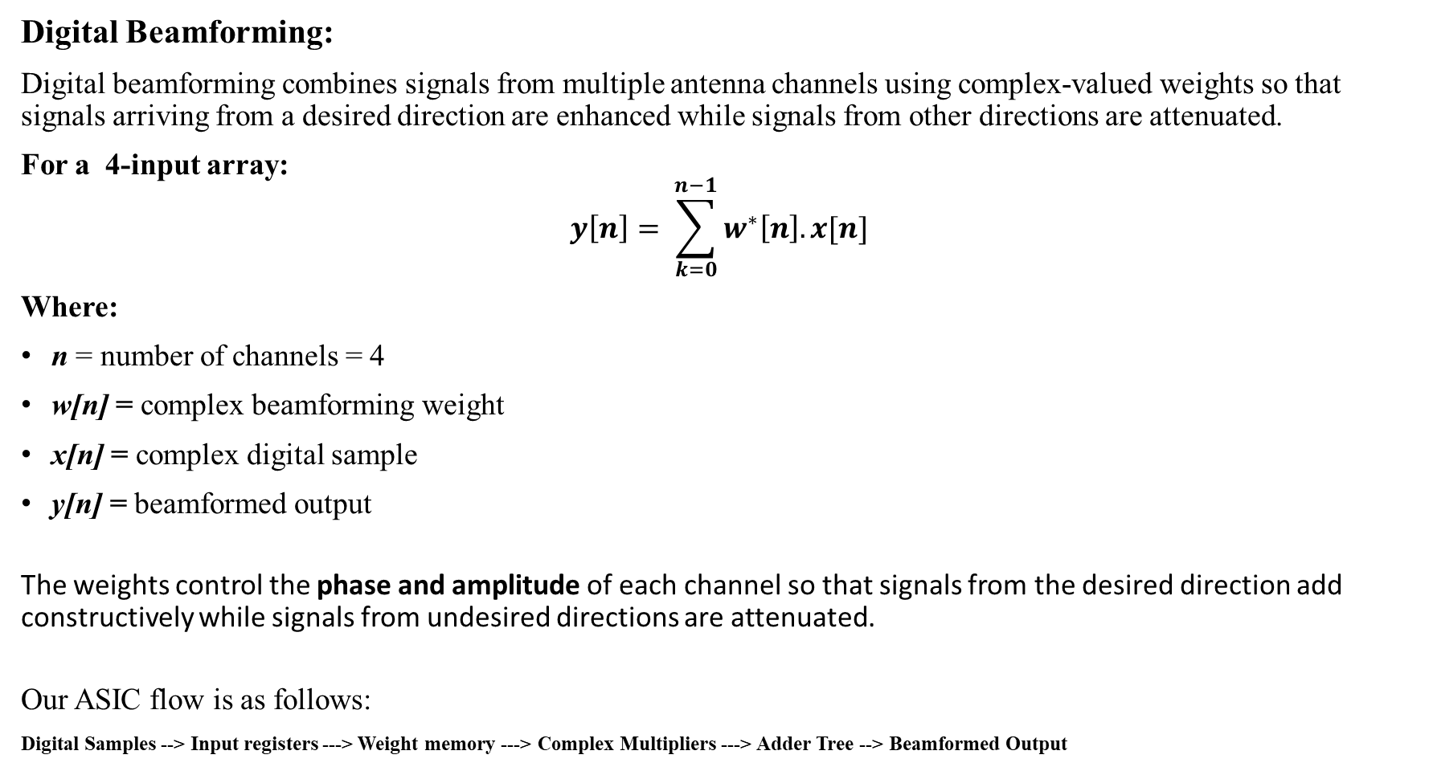
Introduction
Digital Beamforming:
Digital beamforming combines signals from multiple antenna channels using complex-valued weights so that signals arriving from a desired direction are enhanced while signals from other directions are attenuated.
For a 4-input array:
$$y\left[n\right]= \sum_{k=0}^{n−1}{w^{∗}\left[n\right].x[n]}$$
Where:
n = number of channels = 4
w[n] = complex beamforming weight
x[n] = complex digital sample
y[n] = beamformed output
The weights control the phase and amplitude of each channel so that signals from the desired direction add constructively while signals from undesired directions are attenuated.
Our ASIC flow is as follows:
Digital Samples --> Input registers ---> Weight memory ---> Complex Multipliers ---> Adder Tree --> Beamformed Output

Slide 3
Motivation
Analog Beamforming processors require dedicated analog phase/ amplitude control for analog channels. On the contrary Digital Beamforming processors provide.
Programmable beam steering
Flexible beam patterns
Digital control of Amplitude and Phase
Possibility of Adaptive weight calculation
Why ASIC?
1. ASIC based implementation and the ASIC design flow help to evaluate functionality such as Area, Timing, Maximum Operating Frequency and Power.
2. ASIC implementation enables accurate and efficient hardware realization of the beamforming algorithm

Slide 4
Objective
To design, functionally verify, and synthesize the RTL implementation of a 4-channel digital beamforming processor targeting the GPDK45 45-nm technology library. The design will perform channel-wise weighting and signal combination using fixed-point arithmetic to achieve beam steering, with functional correctness validated against a MATLAB reference model. Post-synthesis, the design will be evaluated in terms of area, timing, and power.
Sub-Objectives:
Define the beamforming architecture and fixed-point representation for the input I/Q samples, complex beamforming weights, channel count, and programmable steering directions.
Develop the synthesizable RTL for the key processing blocks, including the per-channel complex multiplier, weight LUT/memory, control unit, adder tree, and top-level integration.
Develop a MATLAB/Python reference model to generate multi-channel test signals and beamforming weights using conventional Delay-and-Sum beamforming and selected adaptive algorithms such as LMS/MVDR. Use the model to generate reference data and quantized weights for RTL verification.
Functionally verify the RTL using Cadence Xcelium by comparing RTL outputs with the MATLAB/Python reference model across multiple predefined steering directions and test conditions.
Synthesize the verified RTL using Cadence Genus targeting the GPDK45 standard-cell library, and evaluate the implementation in terms of area, timing, maximum operating frequency, and power consumption.

Slide 5
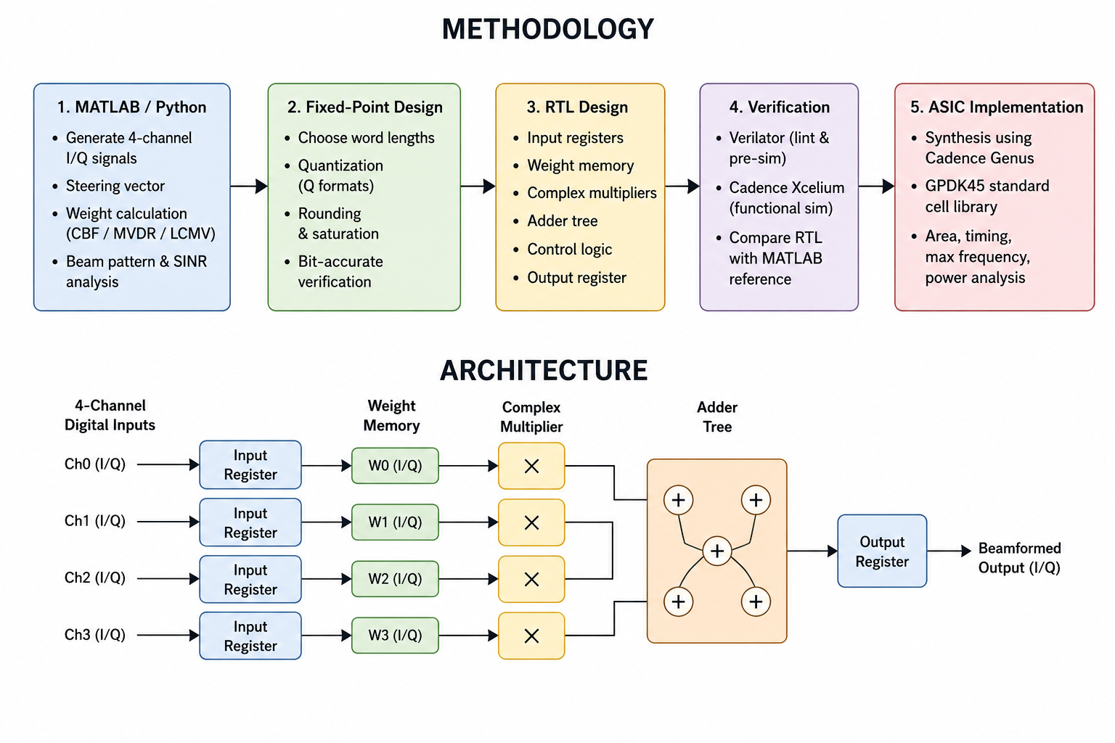
Conceptual Architecture/Block Diagram and Methodology
Fig. Proposed Methodology and Architecture

Slide 6
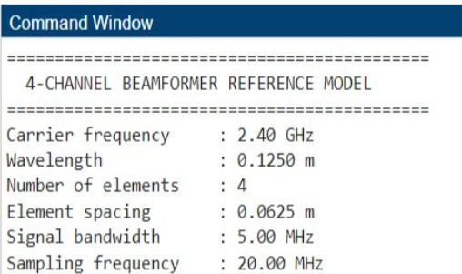
Partial Results and Analysis – Reference model
Reference model specifications:
Carrier Frequency: 2.40 GHz
Wavelength: 0.1250 m
Number of Elements: 4
Element Spacing: 0.0625 m
Signal Bandwidth: 5.00 MHz
Sampling Frequency: 20.00 MHz
Desired Beam Angle: 30°
24/09/2026
15

Slide 7
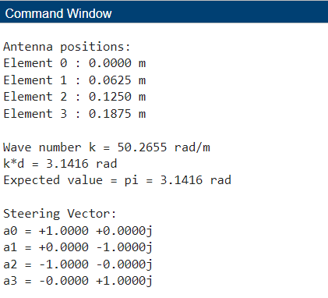
Partial Results and Analysis – Reference model
Antenna Element Positions:
  Element 0: 0.0000 m
  Element 1: 0.0625 m
  Element 2: 0.1250 m
  Element 3: 0.1875 m
Wave Number: k = 50.2655 rad/m
Phase Difference per Element: k*d = 3.1416 rad
Expected Phase Difference: pi = 3.1416 rad
Steering Vector:
a0 = +1.0000 +0.0000j
a1 = +0.0000 -1.0000j
a2 = -1.0000 -0.0000j
a3 = -0.0000 +1.0000j
24/09/2026
15

Slide 8
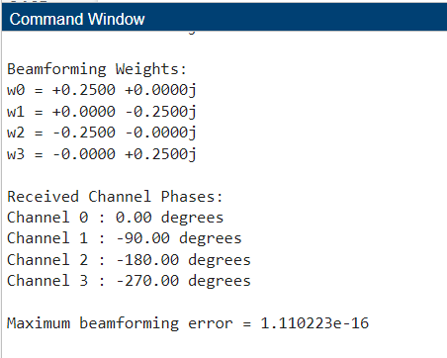
Partial Results and Analysis – Reference model
Beamforming Weights:
w0 = +0.2500 +0.0000j
w1 = +0.0000 -0.2500j
w2 = -0.2500 -0.0000j
w3 = -0.0000 +0.2500j
Received Channel Phases:
Channel 0 : 0.00 degrees
Channel 1 : -90.00 degrees
Channel 2 : -180.00 degrees
Channel 3 : -270.00 degrees
Maximum beamforming error = 1.110223e-16
24/09/2026
15

Slide 9
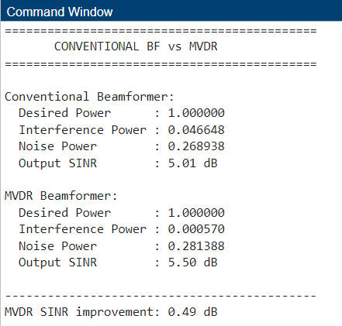
Partial Results and Analysis – Reference model
CONVENTIONAL BF vs MVDR
Conventional Beamformer:
Desired Power : 1.000000
Interference Power : 0.046648
Noise Power : 0.26893
Output SINR : 5.01 dB
MVDR Beamformer:
Desired Power : 1.000000
Interference Power : 0.000570
Noise Power : 0.281388
Output SINR : 5.50 dB
MVDR SINR improvement: 0.49 dB
24/09/2026
15

Slide 10
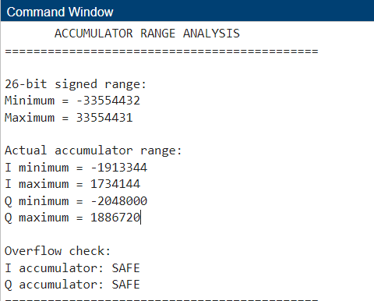
Partial Results and Analysis – Reference model
ACCUMULATOR RANGE ANALYSIS
26-bit signed range:
Minimum = -33554432
Maximum = 33554431
Actual accumulator range:
I minimum = -1913344
I maximum = 1734144
Q minimum = -2048000
Q maximum = 1886720
Overflow check:
I accumulator: SAFE
Q accumulator: SAFE
24/09/2026
15

Slide 11
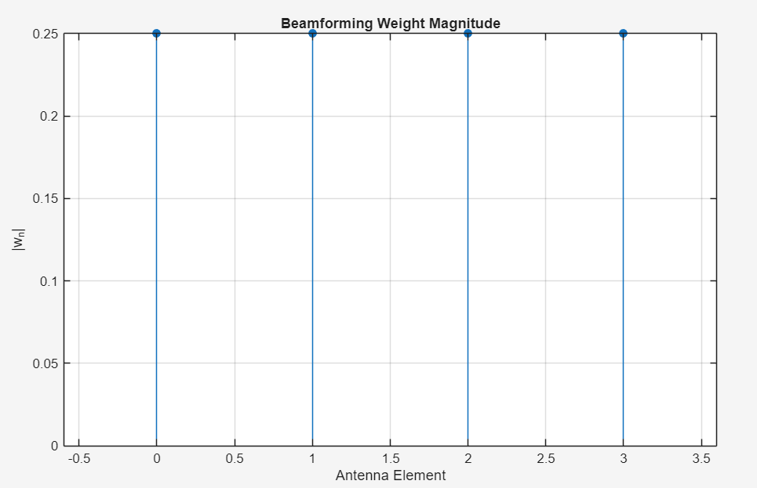
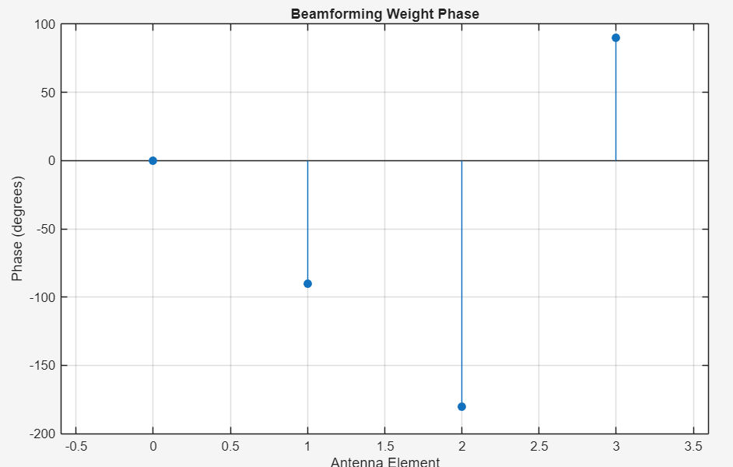
Partial Results and Analysis – Beamforming Response
Beamforming weights for 30 degree desired signal
Weight Phase
24/09/2026
15

Slide 12
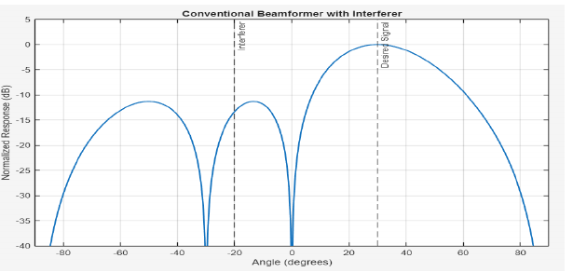
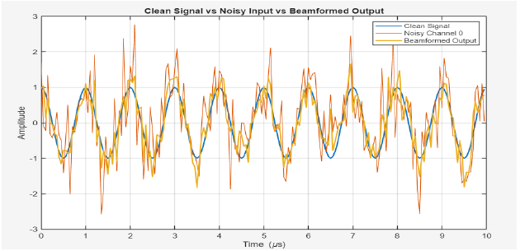
Partial Results and Analysis – Beamforming Response
Conventional Beamformer with Desired Signal at +30° and Interferer at −20°
Clean Signal vs Noisy Input vs Beamformed Output
Analysis
The conventional beamformer preserves the main beam toward the desired +30° direction.
The −20° interferer is not explicitly nulled by CBF, motivating adaptive/constrained beamforming.
The beamformed waveform follows the clean signal more closely than the raw noisy channel, confirming signal recovery.
24/09/2026
15

Slide 13
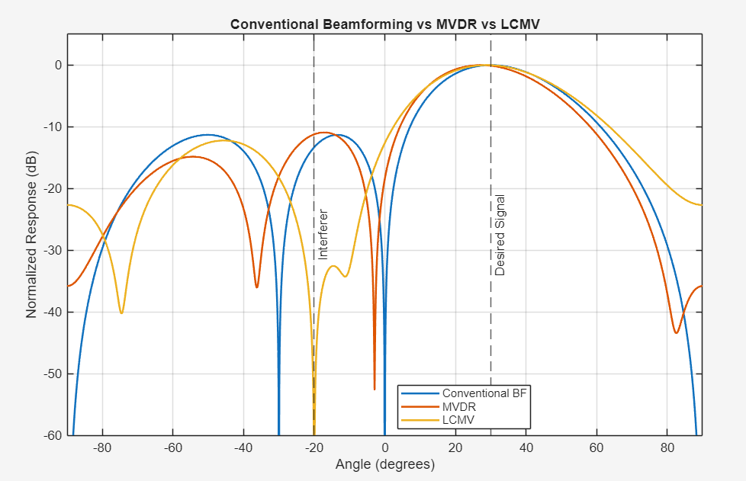
Partial Results and Analysis – CBF, MVDR and LCMV
Algorithm | Output SINR | vs CBF
CBF | 5.42 dB | Baseline
MVDR | 5.44 dB | +0.02 dB
LCMV | 6.09 dB | +0.67 dB
Key Result
All three algorithms preserve the desired +30° response.
LCMV gives the strongest explicit suppression around the known −20° interferer.
For the tested case, LCMV improves SINR by 0.67 dB over CBF; MVDR improves it by 0.02 dB.
CBF remains the simpler, first RTL datapath; adaptive methods are used as algorithmic references.
24/09/2026
16

Slide 14
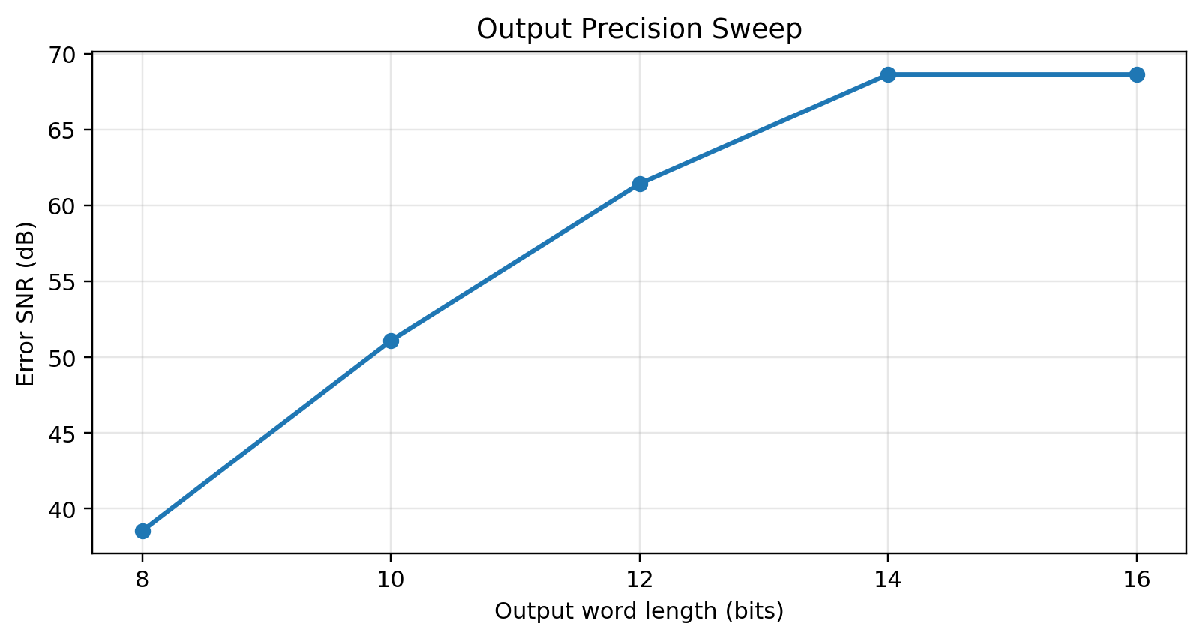
Partial Results and Analysis – Fixed-Point Verification
Bit-Accurate Verification
RMS error = 3.841 × 10⁻⁴
Error SNR = 69.46 dB
Rounding vs Truncation
Rounding: 61.45 dB
Truncation: 58.15 dB → +3.30 dB
Selected RTL Specifications:
Input: 12-bit Q3.9 |
Weights: 12-bit Q1.11 |
Product: 24-bit Q4.20
Accumulator: 26-bit Q6.20 |
Output: 12-bit Q3.9 |
Rounding + Saturation
Overflow Handling
Saturation RMS error = 0.2815
Wrap-around RMS error = 2.9932
24/09/2026
17

Slide 15
Architectural Specifications
Parameter | Specification
System | Digital Beamforming Processor
Architecture | 4-Channel Uniform Linear Array (ULA)
Input | Digital I/Q Samples from 4 Channels
Beamforming | Complex-Weighted Signal Combination
Weight Storage | Programmable Weight LUT / Memory
Core Processing | Per-Channel Complex Multipliers + Adder Tree
Control | Dedicated Control Unit
Output | Beamformed Digital I/Q Signal

Slide 16
Timeline
Month | Work to be implemented
July 2026 | • Literature survey on digital beamforming processor architectures, low-power ASIC design and Cadence-based RTL to GDSII flows • Finalization of architecture specification (channel count, bit-widths, weight LUT based steering)
August 2026 | • RTL development of channel input interface and per channel complex multiplier module, including the development of weight LUT and the main control unit. • Development of reference model on MATLAB for verification of weights using adaptive algorithms, hardcoded into RTL memory
September 2026 | • RTL development of adder tree and top-level integration module • Testbench development for functional simulation • Preliminary RTL simulation using Verilator for lint and sanity checks
October 2026 | • Functional verification of complete RTL using Cadence Xcelium against the model • RTL debugging and simulation coverage closure
November 2026 | • Logic synthesis of verified RTL using Cadence Genus targeting the GPDK45 library • Formal equivalence checking of synthesized netlist against RTL using Conformal

Slide 17
References:
[1] E. Ortega, A. Martínez, A. Oliva, F. Sanz, Ó. Rodríguez, M. Prieto, P. Parra, A. da Silva, and S. Sánchez, “A Digital Beamforming Receiver Architecture Implemented on a FPGA for Space Applications,” Microprocessors and Microsystems, vol. 121, Art. no. 105243, Mar. 2026.
[2] B. D. Van Veen and K. M. Buckley, "Beamforming: A Versatile Approach to Spatial Filtering," IEEE ASSP Magazine, vol. 5, no. 2, pp. 4–24, Apr. 1988.’
[3] Y. M. Shi, L. Huang, C. Qian, and H. C. So, "Shrinkage Linear and Widely Linear Complex-Valued Least Mean Squares Algorithms for Adaptive Beamforming," IEEE Transactions on Signal Processing, vol. 63, no. 1, pp. 176–187, Jan. 2015.
[4] L. Zhang, W. Liu, and R. J. Langley, "A Class of Constrained Adaptive Beamforming Algorithms Based on Uniform Linear Arrays," IEEE Transactions on Signal Processing, vol. 58, no. 7, pp. 3918– 3930, Jul. 2010.
[5] P. Hager, G. Matrone, F. Svelto, et al., "Assessing the Area/Power/Performance Trade-Offs for an Integrated Fully-Digital Large-Scale 3-D Ultrasound Beamformer," in Proc. IEEE Biomedical Circuits and Systems Conference (BioCAS), 2014, pp. 448–451.
[6] S. M. Jang, A CMOS Digital Beamforming Receiver, Ph.D. dissertation, Department of Electrical Engineering and Computer Science, University of Michigan, Ann Arbor, MI, USA, 2018.

