Slide 1

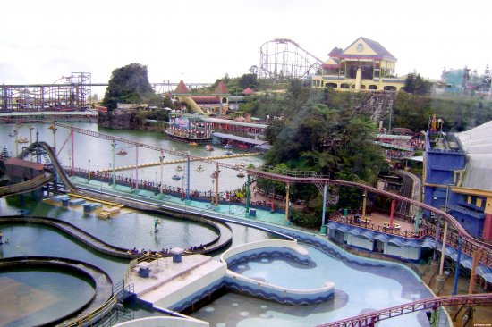

THBS PARK
By Team:
BATCH – 98
DHEERAJ SHETTY (EMP ID : 6606)
RUTHU (EMP ID: 6613)
VIKRAM RAJ (EMP ID : 6649)
PUNIT MISHRA (EMP ID : 6609)
VIJAY KUMAR (EMP ID : 6614)

Slide 2
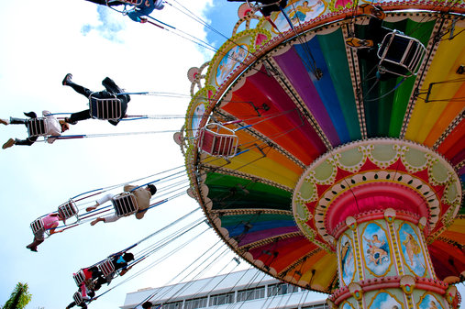
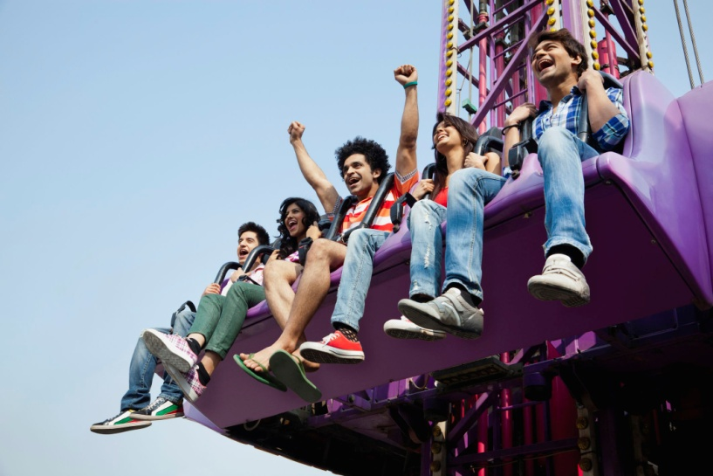
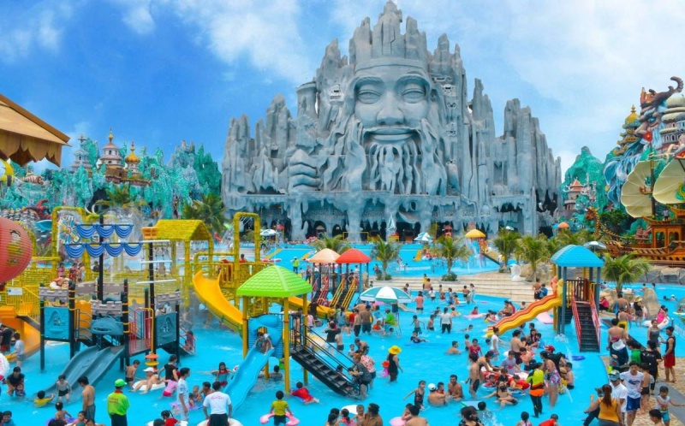

Slide 3
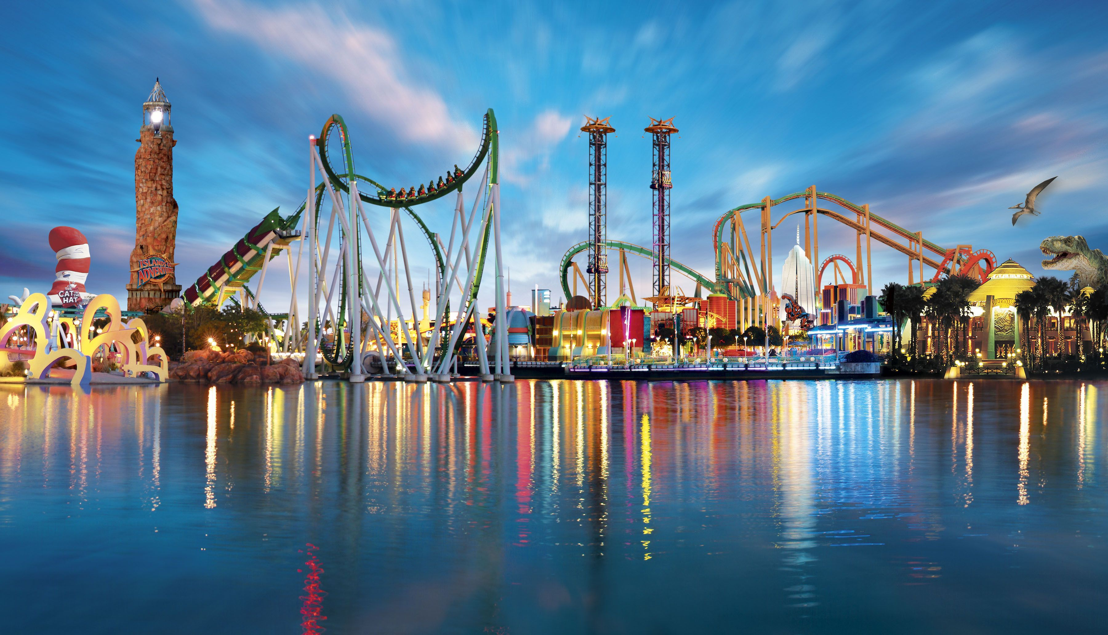
CONTENTS
Introduction
Problem Statement
System design
Technology
Result and Conclusion

Slide 4
INTRODUCTION
An Amusement park is a place with attractions made up of rides, such as roller coasters and water rides.
They usually contain a selection of different types of rides, along with shops, restaurants and other entertainment outlets. Theme parks can be enjoyed by adults, teenagers and children.

Slide 5
Problem Statement
A Process To buy Ticket is slowly that make our customer waste of their time , so we open the system to buy ticket online.
One of the most important thing is each ride information and we should show the summary report for customers to inform the information and details and so on.

Slide 6
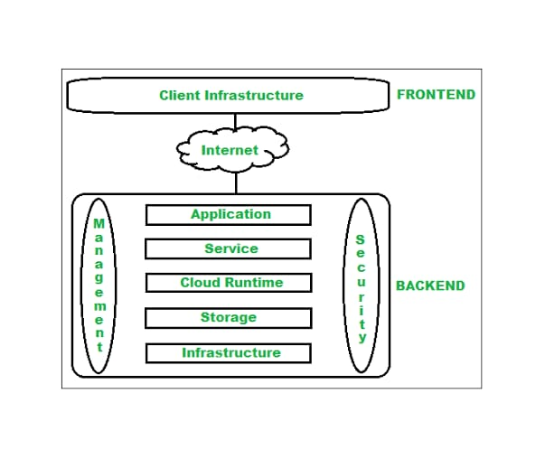
System Design

Slide 7
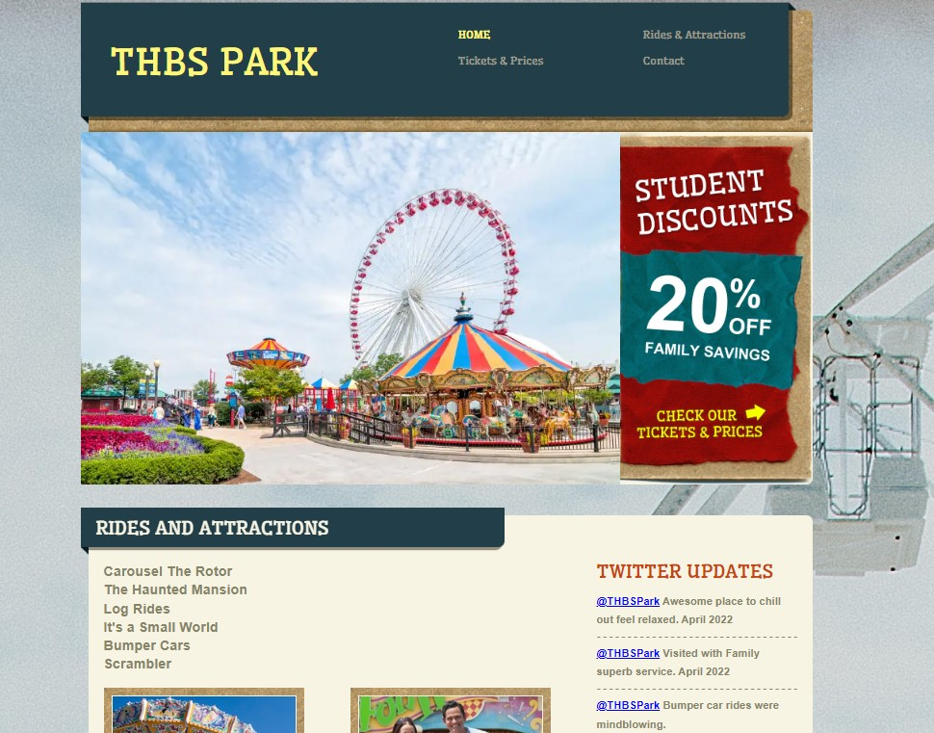
THBS THEME PARK

Slide 8
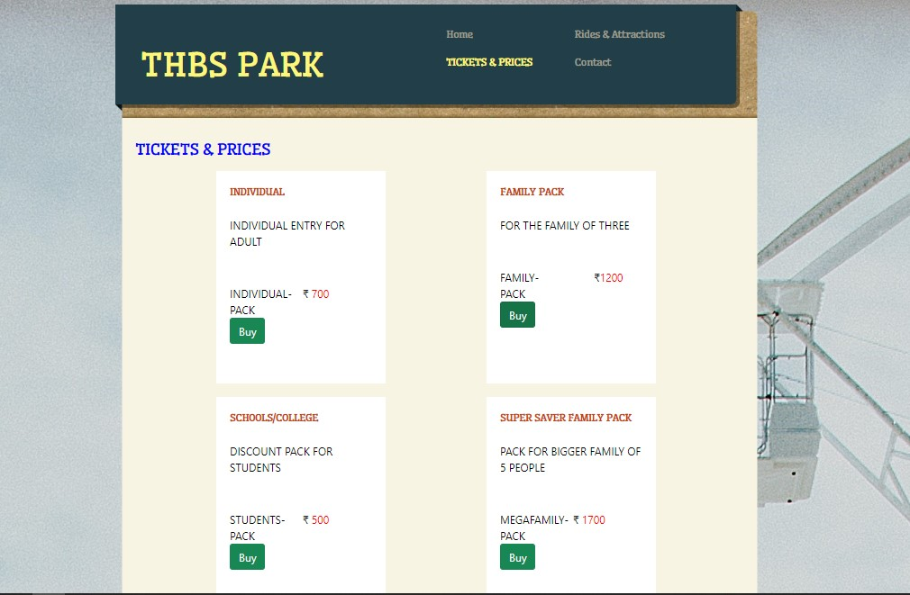
Tickets and Prices

Slide 9
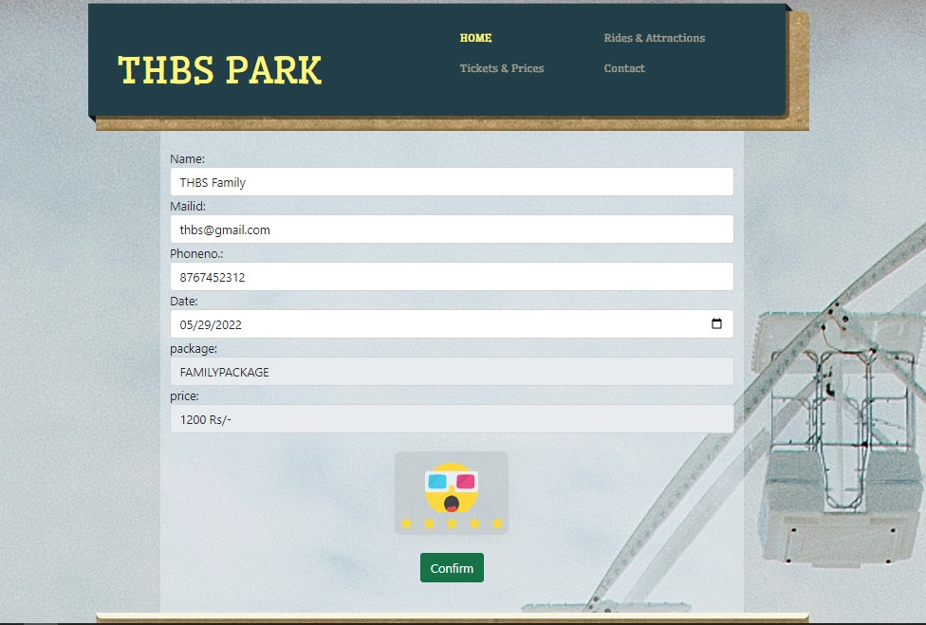
User Info

Slide 10
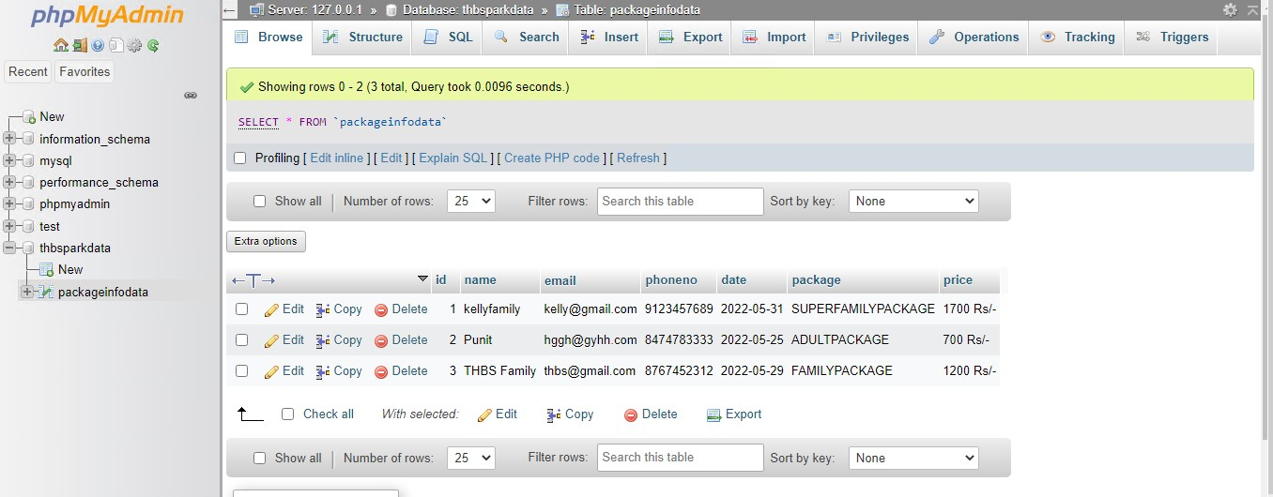
Database

Slide 11
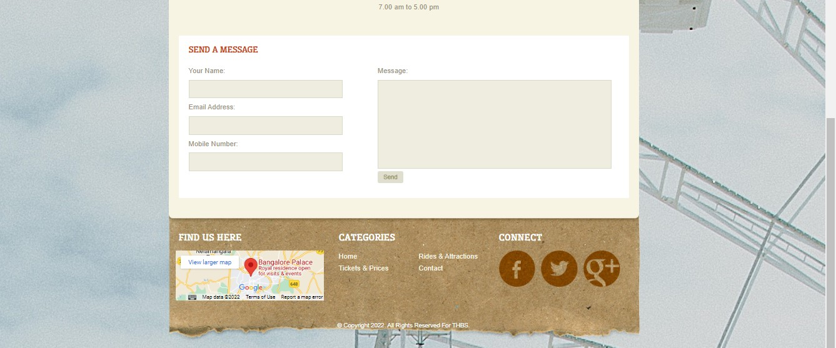
Feedback

Slide 12
All the user information with the package data were been stored in database successfully. The website hosting via Apache Server by means of xaamp works 24/7. The THBS theme park is successfully hosted in AWS. Link:http://35.174.6.171/dashboard/index.php
Result and Conclusion

Slide 13


