Slide 1

What is confidence?

Slide 2
Definition
confidence is a state of mind. Positive thinking, practice, training, knowledge and talking to other people are all useful ways to help improve or boost your confidence levels.
Confidence comes from feelings of well-being, acceptance of your body and mind (your self-esteem) and belief in your own ability, skills and experience.

Slide 3
Self- esteem
Self-esteem is your opinion of yourself.
Rumination is the habit of hanging on to the negative things that happened in the past and retelling the story to yourself again and again.
Low self- esteem brings:
negative feeling
Relationship problems
Fear of trying
Perfectionism
Fear of judgment
Lack of self-care

Slide 4
Low Confidence
Low self-confidence can result in:
Shyness
Communication difficulties
Social anxiety
Lack of assertiveness.

Slide 5
Interpersonal Communication
Interpersonal communication is the communication where exchange of ideas and information happens between two or more people by way of any channel. This can be face to face, online, over the phone, or in written forms as well.
There are four types of Interpersonal communication.

Slide 6
Inescapable: Even when we hold some thought inside us and do not let it out verbally, it will take its form in other nonverbal aspects of communication such as mood, attitude, or body language.
Irreversible: Once something is written, said, or submitted, it cannot be taken back. It is forever in the minds of others.
Complex: There is a high chance of miscommunication between sender and receiver, therefore interpersonal communication is complex.
Contextual: Context is an integral part of this type of communication, and the context can be situational, environmental, and relational.

Slide 7
Intrapersonal Communication
Intrapersonal communication is the communication done with oneself. Included are the thoughts, assessments, contemplations, and feelings that are associated with one’s inner communication.
Here are some things that are uniquely intrapersonal:
Self-Concept: One’s own self concept is at the center of intrapersonal communication. It includes an evaluation of one’s own beliefs, values and attitudes, and how that evaluation plays into what occurs in the outer world.

Slide 8
Intrapersonal Communication
Perception: Perception is how people interpret what is going on around them. Perception can influence intrapersonal communication.
Expectation: Expectations are based upon intrapersonal communication with one’s own self, and are predictions of what will happen based on perceptions of what has happened.

Slide 9
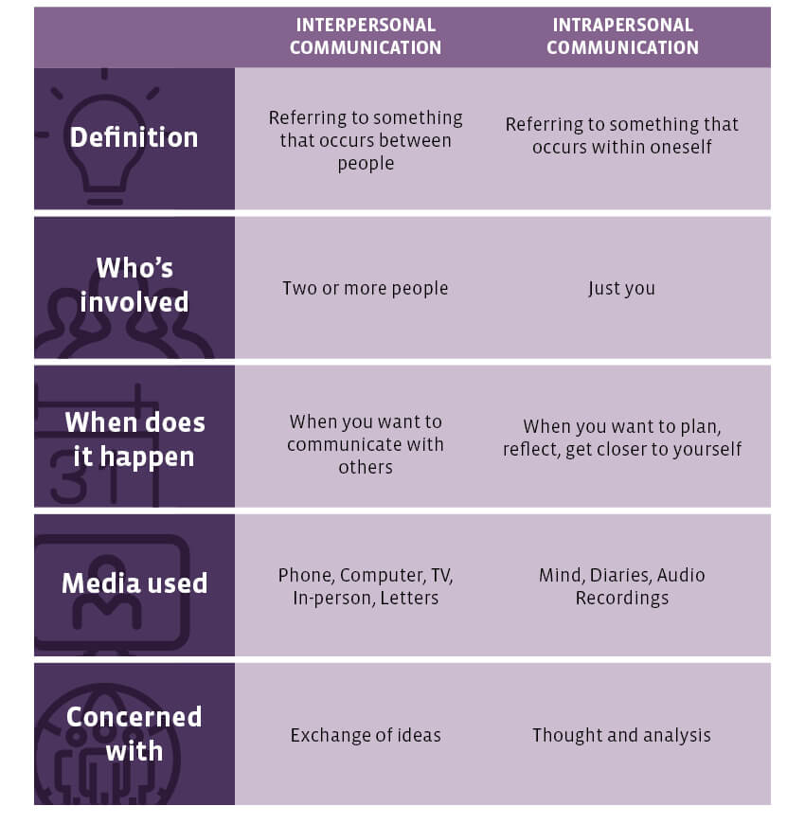

Slide 10
Why confidence is needed in communication
You’ll communicate more effectively:
Confidence allows you to speak concisely and with clarity. Professionals who communicate with confidence can convey what they want to their clients and co-workers in a clear and efficient manner. Effective communication is critically important for career advancement.

Slide 11
How to communicate with confidence
Communicate clearly
Maintain eye contact and smile while you’re speaking.
Don’t use ‘maybe’ words like ‘just’, ‘perhaps’ or ‘like’ as it can undersell what you’re trying to say.
Provoke Questioning
Self- esteem is key
Be prepared
Focus on your message that you want to share

Slide 12
How to communicate with confidence
Body language
Think about your posture, make eye contact with others, smile, and take the time to pause before you speak.
Keep your mentor in mind
Think about someone you admire at work – perhaps a mentor or manager. How do they hold people’s attention when they communicate? Pay attention to the ways they present information, ask questions, or summarise actions in a meeting.

