Slide 1
Data structures & Algorithm
A data structure is a specialized format for organizing, processing, retrieving and storing data. There are several basic and advanced types of data structures, all designed to arrange data to suit a specific purpose. Data structures make it easy for users to access and work with the data they need in appropriate ways. Most importantly, data structures frame the organization of information so that machines and humans can better understand it.
The following algorithm is given below.
Explanation:
Step 1: Place the fresh water in a saucepan or a kettle.
Step 2: Boil the water to match your style of tea.
Step 3: Put the black tea leaves in that pot
Step 4: After that add some milk into that pot.
Step 5: Add some sugar.
Step 6: Boil for some time.
And it is ready to serve.

Slide 2
Data structures

Slide 3
Linear and Nonlinear
Linear structures arrange data in a linear sequence, such as found in an array, list, or queue.
In nonlinear structures, the data doesn’t form a sequence but instead connects to two or more information items, like in a tree or graph.
Dynamic data structures are designed to facilitate change of data structures in the run time. Static data structures, such as arrays, have a fixed size and are allocated at compile-time

Slide 4
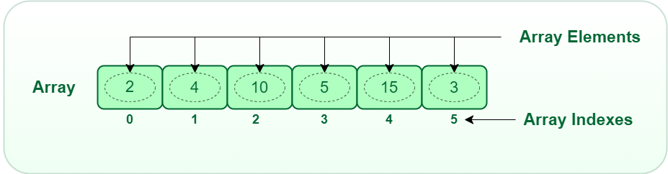
Linear Data Structure:
Data structure where data elements are arranged sequentially or linearly where each and every element is attached to its previous and next adjacent is called a linear data structure. In linear data structure, single level is involved. Therefore, we can traverse all the elements in single run only. Linear data structures are easy to implement because computer memory is arranged in a linear way. Its examples are array, stack, queue, linked list, etc
1. Array
The array is a type of data structure that stores elements of the same type. These are the most basic and fundamental data structures. Data stored in each position of an array is given a positive value called the index of the element. The index helps in identifying the location of the elements in an array.

Slide 5
2. Stack
The data structure follows the rule of LIFO (Last In-First Out) where the data last added element is removed first. Push operation is used for adding an element of data on a stack and the pop operation is used for deleting the data from the stack. This can be explained by the example of books stacked together. In order to access the last book, all the books placed on top of the last book have to be safely removed.
3. Queue
This structure is almost similar to the stack as the data is stored sequentially. The difference is that the queue data structure follows FIFO which is the rule of First In-First Out where the first added element is to exit the queue first. Front and rear are the two terms to be used in a queue.
Enqueue is the insertion operation and dequeue is the deletion operation. The former is performed at the end of the queue and the latter is performed at the start end. The data structure might be explained with the example of people queuing up to ride a bus. The first person in the line will get the chance to exit the queue while the last person will be the last to exit.

Slide 6
4. Linked List
Linked lists are the types where the data is stored in the form of nodes which consist of an element of data and a pointer. The use of the pointer is that it points or directs to the node which is next to the element in the sequence. The data stored in a linked list might be of any form, strings, numbers, or characters. Both sorted and unsorted data can be stored in a linked list along with unique or duplicate elements.
5. Hash Tables
These types can be implemented as linear or non-linear data structures. The data structures consist of key-value pairs.

Slide 7
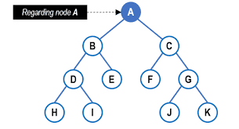
Non-linear Data Structure:
Data structures where data elements are not arranged sequentially or linearly are called non-linear data structures. In a non-linear data structure, single level is not involved. Therefore, we can’t traverse all the elements in single run only. Non-linear data structures are not easy to implement in comparison to linear data structure. It utilizes computer memory efficiently in comparison to a linear data structure. Its examples are trees and graphs.
1. Trees
A tree data structure consists of various nodes linked together. The structure of a tree is hierarchical that forms a relationship like that of the parent and a child. The structure of the tree is formed in a way that there is one connection for every parent-child node relationship. Only one path should exist between the root to a node in the tree. Various types of trees are present based on their structures like AVL tree, binary tree, binary search tree, etc.

Slide 8
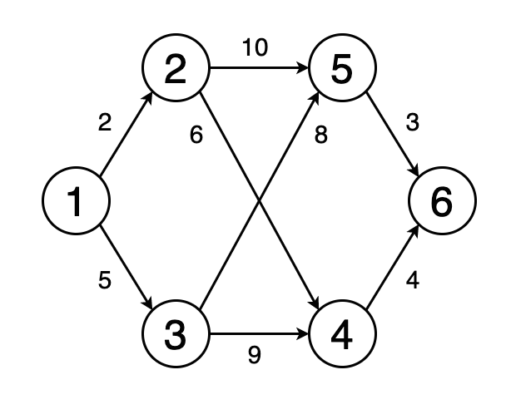
2. Graph
Graphs are those types of non-linear data structures which consist of a definite quantity of vertices and edges. The vertices or the nodes are involved in storing data and the edges show the vertices relationship. The difference between a graph to a tree is that in a graph there are no specific rules for the connection of nodes. Real-life problems like social networks, telephone networks, etc. can be represented through the graphs.

Slide 9
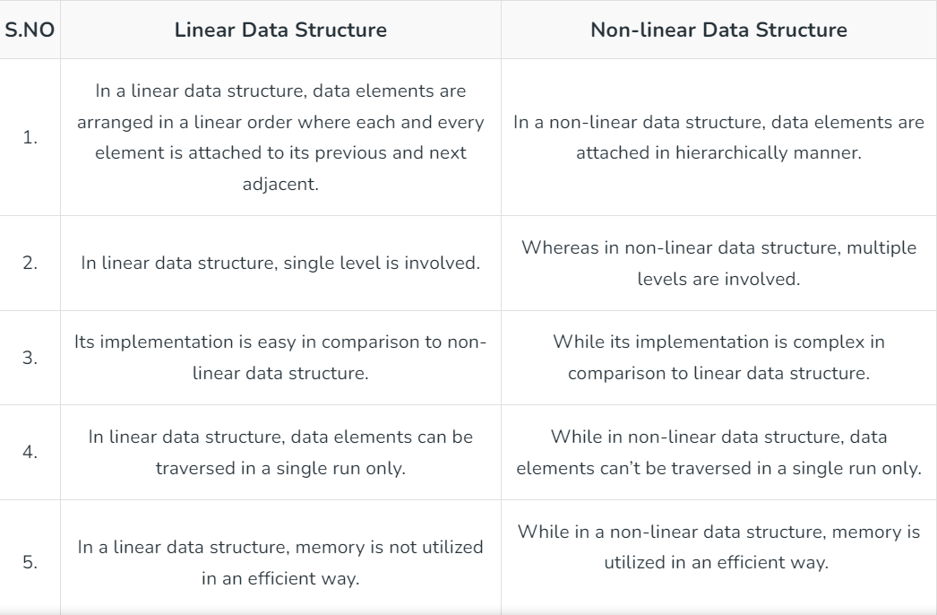
Difference between Linear and Non-linear Data Structures:

Slide 10
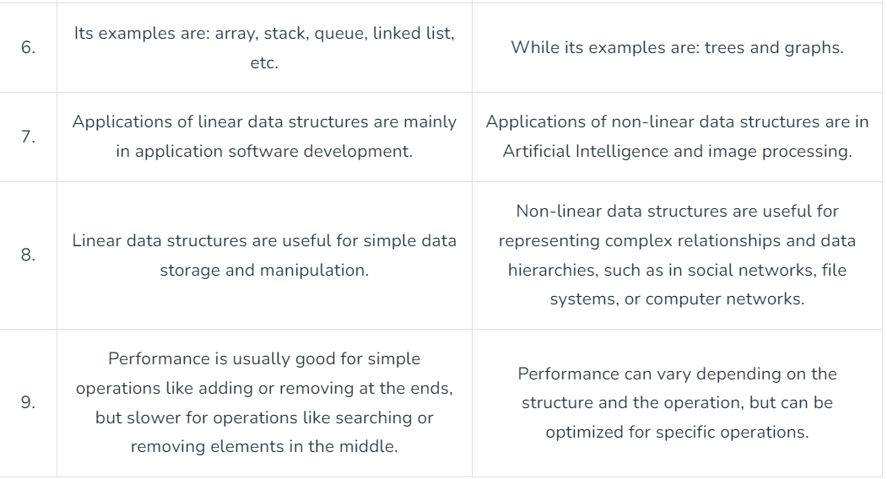
Difference between Linear and Non-linear Data Structures:

Slide 11
Algorithms Explained
Algorithms are structured sets of instructions designed to solve specific problems or perform particular tasks. They function through a series of well-defined steps, each contributing to the ultimate goal. Here, we break down the typical stages involved in the functioning of an algorithm:
Input. The first step involves defining the inputs that the algorithm will use. Inputs are the data on which the algorithm will operate. It could be anything from a single value to a complex data structure.
Processing. This is the core phase where the algorithm performs operations on the inputs using a series of computational steps. This phase is guided by logical and arithmetic calculations to process the data effectively. Within the processing phase, there are often crucial substeps:
Decision making. At various points during processing, decisions need to be made based on certain conditions. This substep involves directing the flow of the algorithm based on conditional statements, leading to different paths in the algorithm.
Looping. For many algorithms, certain steps need to be repeated multiple times until a specific condition is met. Looping allows the algorithm to execute the same steps repeatedly, optimizing the process and saving time.
Output. After processing the inputs through various computational and conditional steps, the algorithm produces an output. This output is the result of the algorithm’s operations and is used to solve the problem or perform the task at hand.
Termination. An algorithm must have a defined stopping point to ensure it doesn’t run indefinitely. Once all the steps are executed successfully, and the output is produced, the algorithm reaches its termination point.

Slide 12
Types of Algorithms
Understanding the different types of algorithms can help in selecting the most appropriate one for solving a specific problem. Broadly, we can categorize algorithms based on their use cases and their structural or problem-solving strategies:
Algorithm Use Cases
Search algorithms. Designed to retrieve information stored within some data structure, e.g., binary search algorithm used to find a particular item in a sorted list.
Sorting algorithms. They rearrange the elements of a dataset in a specified order, like quicksort and mergesort, which are efficient for sorting large datasets.
Graph algorithms. These deal with graphs, which are mathematical structures used to represent pairwise relations between objects, e.g. Dijkstra's algorithm finds the shortest path between nodes in a graph.

Slide 13
Structural or Problem-solving Strategies
Dynamic programming algorithms.
Implemented to solve problems by breaking them down into smaller subproblems, dynamic processing algorithms avoid redundant work by remembering past results, which is a technique called memoization.
Brute force algorithms. By trying all possible solutions until the correct one is found, brute force algorithms can be effective, but time-consuming for complex problems.
Recursive algorithms. These algorithms call themselves with smaller input values and use the results of these calls to solve the current problem. A classic example is the factorial function, where the factorial of a number n is calculated as n multiplied by the factorial of (n-1).
Greedy Algorithms. Greedy algorithms make locally optimal choices at each step with the hope of finding the global optimum. One example is the Huffman coding algorithm, used for lossless data compression.
Divide and conquer algorithms. These algorithms divide the problem into smaller subproblems, solve them independently, and then combine their solutions to solve the original problem. The mergesort algorithm is a classic example of a divide and conquer strategy.

Slide 14
Structural or Problem-solving Strategies ..
Backtracking algorithms. They work by trying different solutions and backtracking to find the correct solution when a dead end is reached. Sudoku solvers often use backtracking algorithms.
Randomized algorithms. Randomized algorithms use random numbers to make decisions during the execution, which means they can give different outputs on different runs. QuickSort is an example where randomization can be used to improve performance on average.

Slide 15
What Makes a Good Algorithm?
In the world of computing and data science, creating a good algorithm is a fundamental goal. A well-crafted algorithm can significantly enhance the efficiency and effectiveness of a system. There are several principles that underpin whether an algorithm is effective and fit for use:
Correctness. Foremost, a good algorithm must be correct, meaning it should always produce the right output for any given input. It should be free of errors and bugs to ensure reliable performance.
Efficiency. Efficiency is a critical aspect of a good algorithm. It refers to the optimal use of computational resources, including time and memory. An efficient algorithm performs tasks swiftly, saving both time and energy.
Simplicity. A good algorithm should be simple and straightforward, avoiding unnecessary complexity. Simplicity facilitates easier understanding, implementation, and maintenance, making the algorithm more user-friendly.
Flexibility. Flexibility is the ability of an algorithm to adapt to changes and varying conditions. A flexible algorithm can accommodate different inputs and adjust to modifications without compromising its performance.

Slide 16
Robustness. Robustness refers to the algorithm's ability to handle errors gracefully. A robust algorithm can manage unexpected inputs or conditions without crashing, providing stable and reliable performance.
Stability. Stability is crucial; it ensures that the algorithm performs reliably and consistently under various conditions, maintaining its accuracy and reliability over time, even with varied inputs.
Maintainability. Maintainability is about how easily an algorithm can be updated or modified. A maintainable algorithm allows for smooth updates and alterations, ensuring it remains up-to-date and functional over time.
Documentation. Good algorithms come with comprehensive documentation that outlines how the algorithm works, its limitations, and how to use it effectively. Well-documented algorithms are easier to use and integrate into different systems.
Security. In the current digital age, security is a paramount concern. A good algorithm should be designed with security in mind, ensuring that it protects sensitive data and resists attacks from malicious entities.

Slide 17
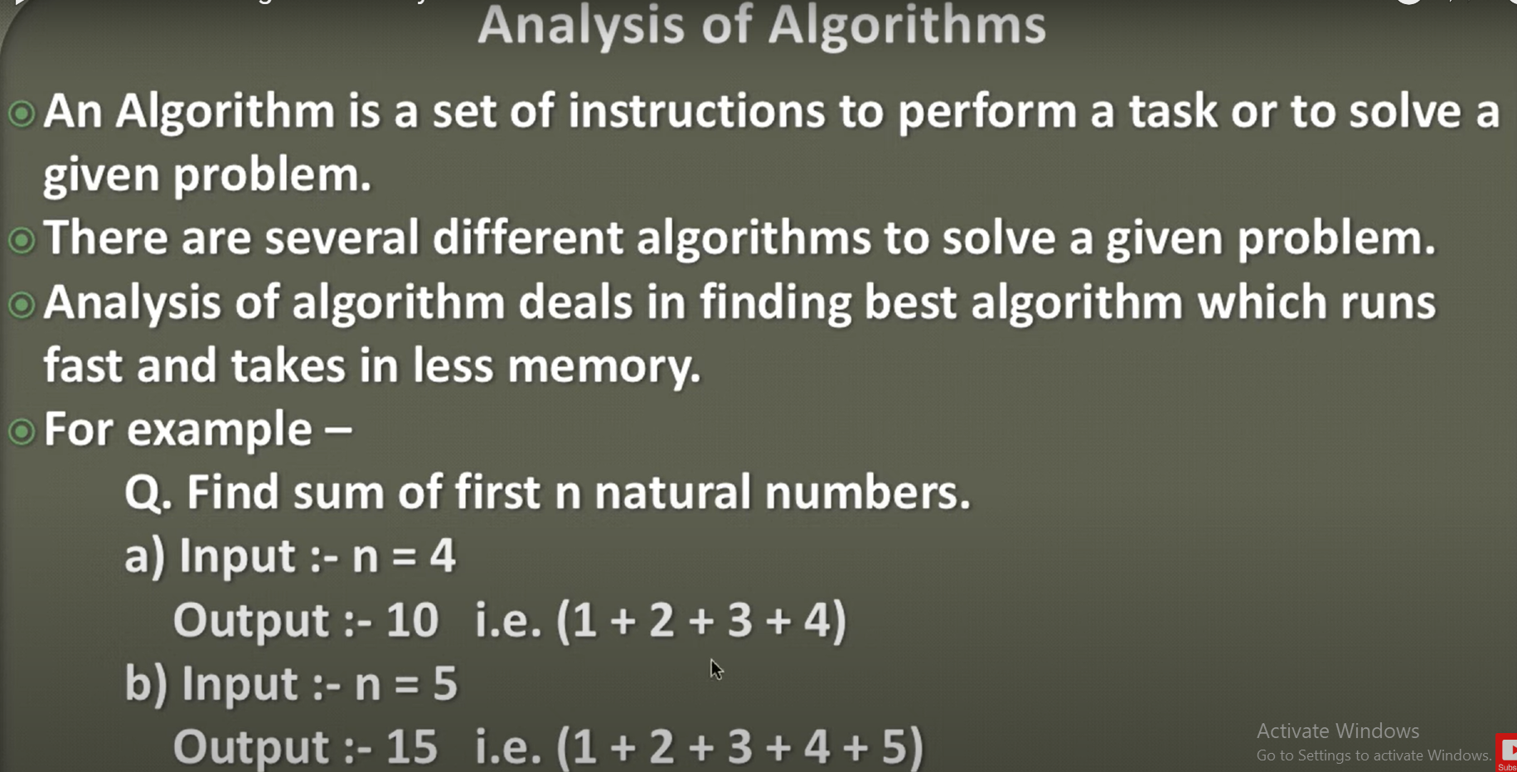

Slide 18
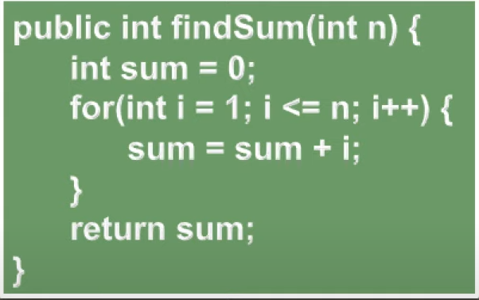
Analysis Of Algorithm

Slide 19
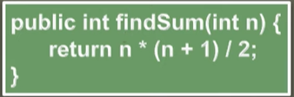
Analysis Of Algorithm

