Slide 1
Introduction to Data structures and Algorithms
Lecture 1

Slide 2

Data structures
It is Way To Organize Data.
After Organize data it becomes easy to process it.

Slide 3
Data Structures
A data structure is a way of organizing and storing data so that it can be accessed and used efficiently. Different data structures are designed to organize data to suit different purposes, whether it's for fast insertion and retrieval, efficient searching, or sorting. Some common data structures include:

Slide 4
Arrays: A collection of elements, each identified by an index or key.
Linked Lists: A collection of nodes where each node contains data and a reference (or pointer) to the next node in the sequence.
Stacks: A collection of elements with two main operations: push (adds an element to the top) and pop (removes the most recently added element).
Queues: Similar to stacks but with a first-in, first-out (FIFO) order. Elements are added to the rear and removed from the front.
Trees: Hierarchical structures with a root node and child nodes, like binary trees, binary search trees, AVL trees, etc.
Graphs: Representations of networks consisting of nodes (vertices) and edges (connections between nodes).

Slide 5
Algorithms
Algorithms are step-by-step procedures or formulas for solving problems. They describe how to perform a specific task or solve a particular problem.
Algorithms can range from simple to highly complex, and their efficiency can significantly impact the performance of software applications. Some common algorithms include:

Slide 6
Importance
Understanding data structures and algorithms is crucial for several reasons:
Efficiency: The choice of data structure and algorithm affects how fast and how well a program performs.
Problem Solving: Many programming interview questions and real-world problems require knowledge of these concepts.
Resource Management: Proper data structures and algorithms can save memory and improve the use of system resources.
Software Design: They are fundamental tools for designing software systems and architectures.
In essence, data structures and algorithms are the building blocks of efficient and scalable software solutions, providing the foundation for problem-solving and computational thinking in computer science.

Slide 7
Why Study Data Structures?
Data structures organize Data
Good choice → better program (more efficient program)
Bad choice → poor program performance
Changes over time
More powerful computers
More complex applications
More complex tasks

Slide 8
Why Study Data Structures?
Characteristics of problem’s solution
Efficiency: a solution is efficient if it solves problem within resource constraints
Time
Space
Cost: the amount of resources a solution will consume

Slide 9
Why study Algorithms
Algorithms solve problems
Good choice → more efficient program
Bad choice → poor program performance
Impact
Different algorithms perform better on different inputs
Input size can affect the performance

Slide 10
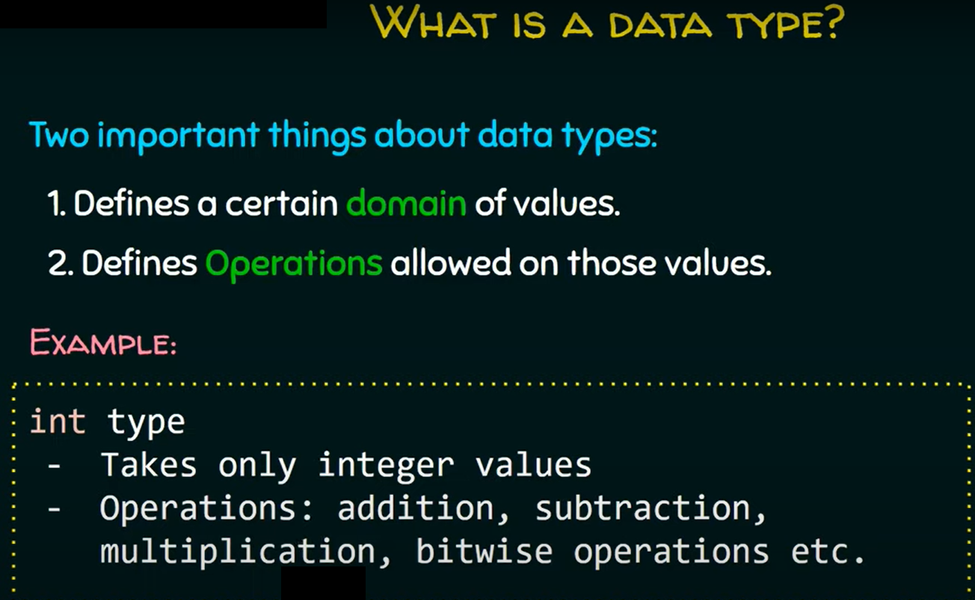

Slide 11
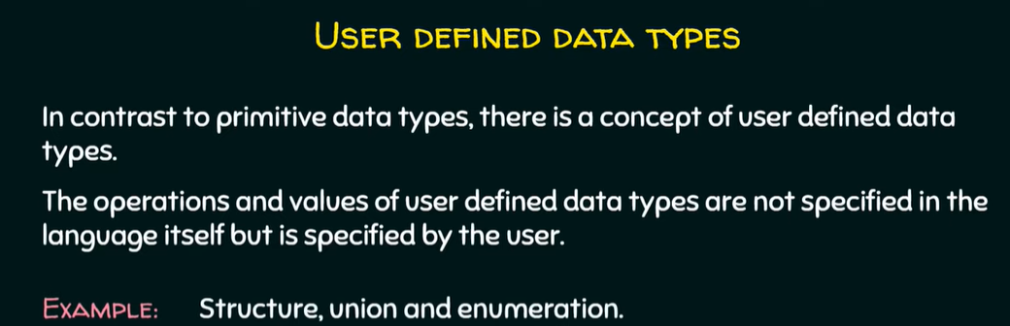
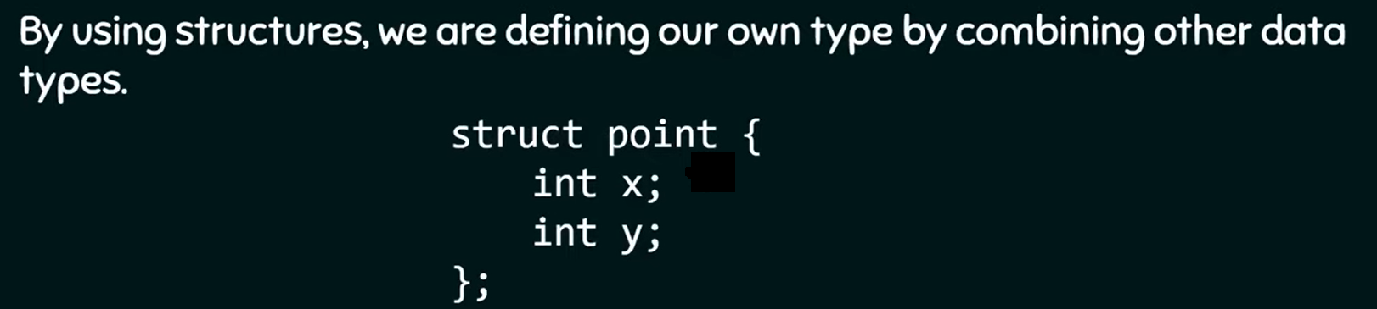

Slide 12
Abstract Data Types ADT
ADTs are like user defined data types which defines operations on values using functions without specifying what is there inside the functions and how the operations are performed .
Example Stack ADT
A stack consists of element of same type arranged in a sequential order.

Slide 13
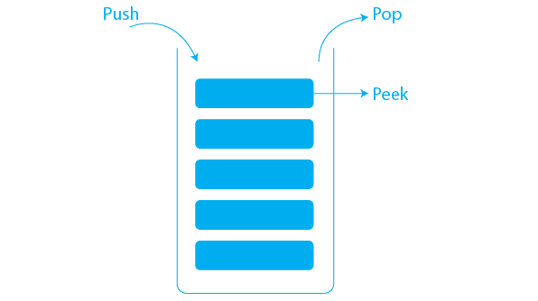
Stack ADT
A stack is a linear data structure that only allows data to be accessed from the top. It simply has two operations: push (to insert data to the top of the stack) and pop (to remove data from the stack). (used to remove data from the stack top).
Some of the most essential operations defined in Stack ADT are listed below.
top(): returns the value of the node present at the top of the stack.
push(int val): creates a node with value = val and puts it at the stack top.
pop(): removes the node from the top of the stack.
empty(): returns true if the stack is empty, otherwise returns false.
size(): returns the number of nodes that are present in the stack.

Slide 14
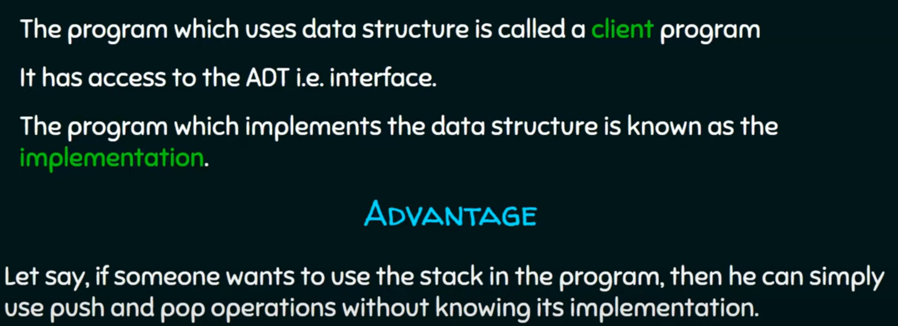
Why ADT

Slide 15
Abstract Data Types ADT
Basic definitions
Type: a set of objects
Data item or element: a piece of information or record
Member: a data item is said to be a member of a data type
Simple data item: a data item containing no subparts
Aggregate data item: a data item that may contain several pieces of information
Abstract data type: a type and a collection of operations to manipulate that type
ADT are mathematical abstractions, an ADT only mentions what is to be done, not how.

Slide 16
Data Structure
A data Structure is a physical implementation of an ADT
Each ADT operation is implemented by one or more subroutines
Data structures are organizations for data in the main memory

Slide 17
Selecting a Data Structure
Analyze problem
Determine basic operations
Select a data structure
Questions
At what times(s) in the program run do inserts occur
Are deletes allowed?
Is there any Order to data processing?

Slide 18
Algorithm/ Data Structure
Each data structure requires:
Space to store each item, including overhead
Time to perform basic operations
Programming effort
Algorithms are closely related:
Poor data structure choice →higher complexity algorithms
Good data structure choice → algorithm trivial

Slide 19
Algorithms and Programs
Problem: task to be performed
Algorithms: a method or process to solve a problem
Algorithm transforms the input of a problem to its outputs
Algorithm proprieties
Must be correct
It must be composed of a series of correct steps
There can be no ambiguity about which step is next
It must be finite in length
It must terminate
Program: an instance of an algorithm, written in some programming language.

Slide 20
Collections
A collection is a structured data type that stores data and provides operations to manipulate this data (add, remove, and update)
Collection types:
Linear: List of elements where elements follow each other in a linear order (ordered by position first, second, …, etc ).
E.g. Grocery list, array
Nonlinear: List of elements which don’t have positional order
E.g. Organization chart, trees and graphs
Collection property such as
Count: number of items in the collection

Slide 21
Collection operations
Add: Add a new element to the collection
Insert: Add a new element to the collection at a specific location
Remove: Remove a specific element from the collection
Clear: Remove all element from the collection
Contains: Determine if a specific element is a member of a collection
IndexOf: Determine the index of a specific element in a collection

Slide 22
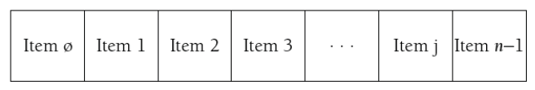
Direct Access Collections
Array: a collection of elements with the same data type that are directly accessed via an integer index
String: a collection of characters that can be directly accessed via an index
Struct (Structure or record): a composite data type that holds data that may consist of many different data types
E.g.: Student record (num: int, name: string, avg: float)

Slide 23
Sequential Access Collections
Is a list that stores its elements in a sequential order (i.e., linear list)
Linear list are not limited by size
Items in linear list are referenced (i.e., can only be accessed by their positions)
Examples: Stacks and Queues

Slide 24
Stack

Slide 25
Queue

Slide 26
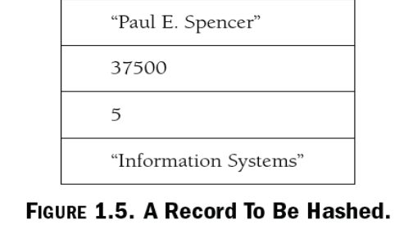
Hash Table
Define Keys Examples
Name
Salary
Rank
Depart
Hash Table
Hashing in the data structure is a technique of mapping a large chunk of data into small tables using a hashing function. It is also known as the message digest function. It is a technique that uniquely identifies a specific item from a collection of similar items

Slide 27
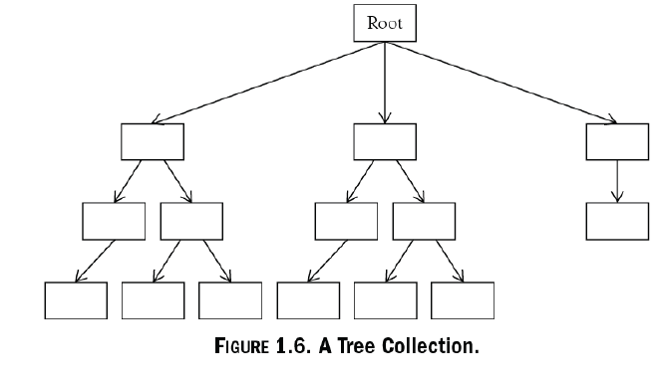
Hierarchical Collections

Slide 28
Group Collections
A nonlinear collection of items that are UNORDERED.
Examples:
sets,
graphs,
networks

Slide 29
Sets

Slide 30
Graphs

Slide 31
Networks

